Slide 1
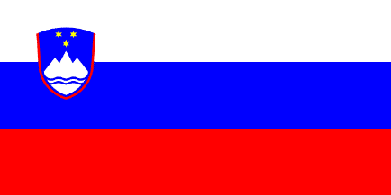
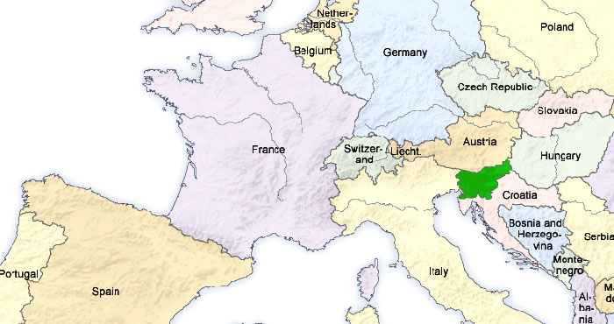
SLOVENIA
Slovenia is situated in Central and Southeastern Europe touching the Alps and bordering the Mediterranean. This small green country measures 20,273 km2 in area and it has a population of two million. The majority of people live in towns and cities, but a significant number live in the countryside. The capital of Slovenia is Ljubljana. Slovenia is bordered by Italy to the west, Austria to the north, Hungary to the northeast, Croatia to the south and southeast, and the Adriatic Sea to the southwest. Green is the country’s dominant colour, thanks to its extensive forests and other areas of greenery. Centuries ago more than 90% of Slovenia was covered by forest. Slovenia’s trees are still its lungs, absorbing greenhouse gas emissions. But alone they are not enough. Alongside environmental conservation and energy efficiency, Slovenia is also promoting green tourism to minimize the impact on the environment.

Slide 2
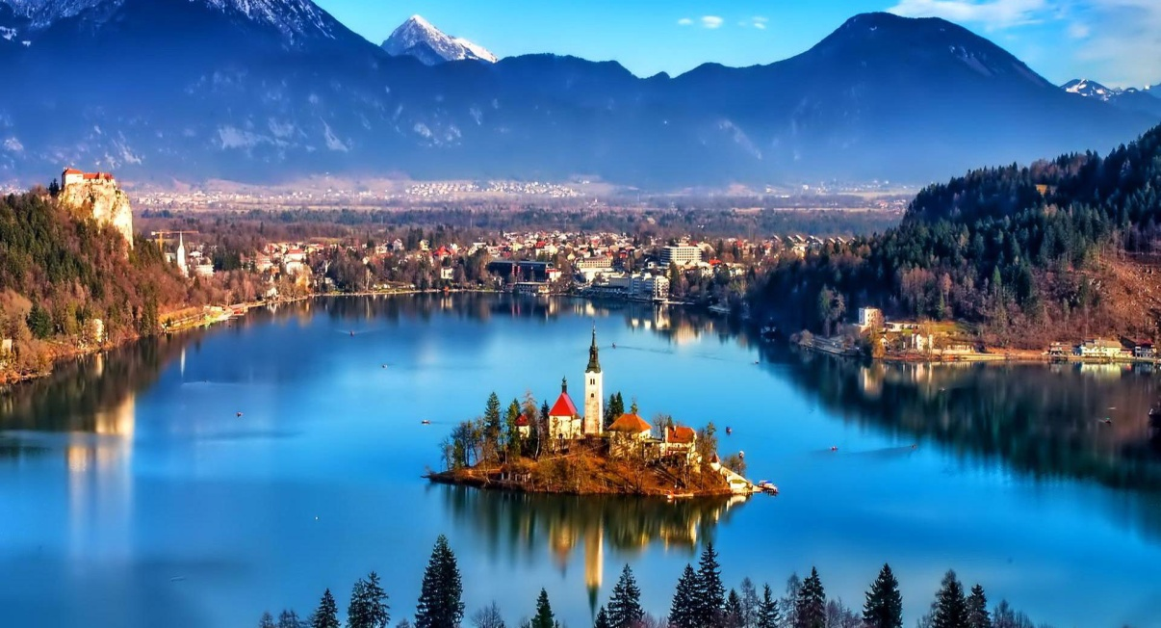
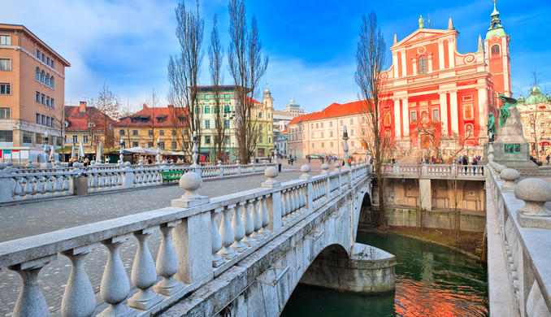
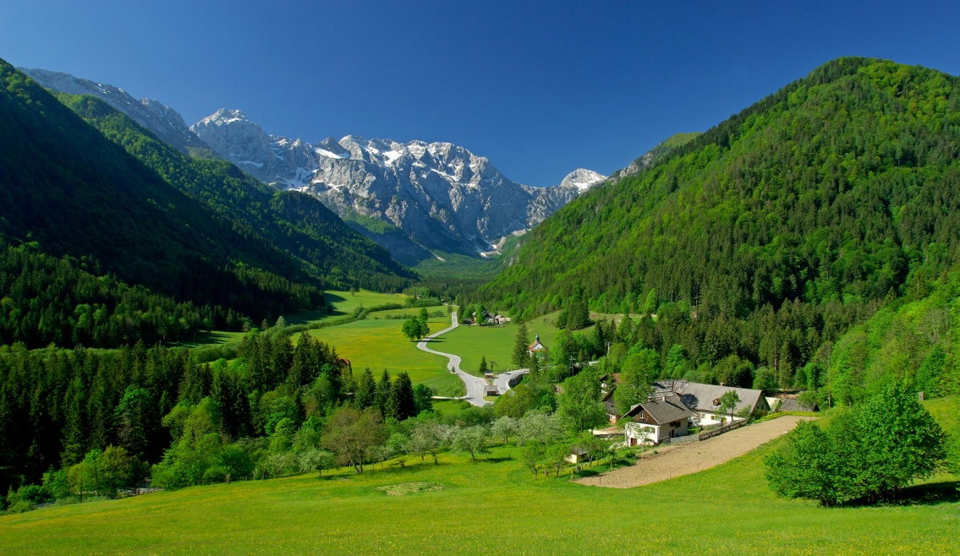
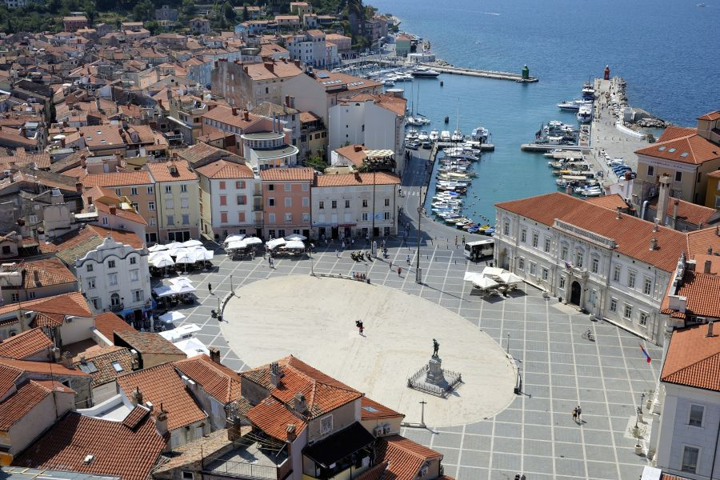
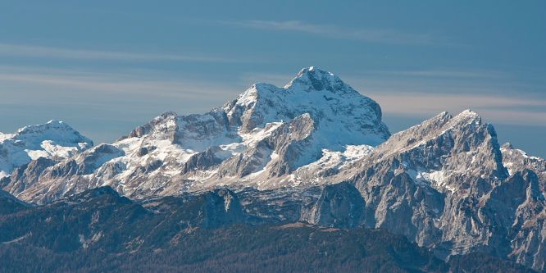
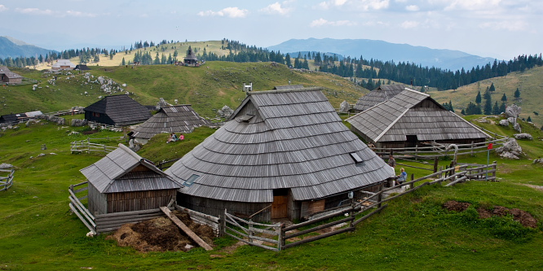

Slide 3
Ljubljana, with approx. 280.000 inhabitants, is the capital of Slovenia.

Slide 4
The Soča (pronounced [ˈsoːtʃa] in Slovene) or Isonzo (pronounced [iˈzontso] in Italian) is a 138-kilometre long river that flows through western Slovenia (96 kilometres or 60 miles) and northeastern Italy (43 kilometres or 27 miles).
Due to its emerald-green water, the river is marketed as "The Emerald Beauty." It is said to be one of the rare rivers in the world that retain such a colour throughout their length.

Slide 5
Peca
Peca (pronounced: Petza) is the last high mountain in the Karavanke/Karawanken range, going towards the East. Actually, if the whole long arc of European Alps would not have a strange tail towards NE, towards Vienna, the whole Alps would end here, where high mountains blend into forehills and finally lower down on the Panonia plane. To a certain degree, Peca is also a cult mountain, at least for Slovenian people.

Slide 6
Pohorje
Pohorje (pronounced [ˈpoːxɔɾjɛ]), also known as the Pohorje Massif or the Pohorje Mountains (German: Bachergebirge, Bacherngebirge or often simply Bachern), is a mostly wooded, medium-high mountain range south of the Drava River in northeastern Slovenia. Pohorje is sparsely populated with dispersed villages. There are also some ski resorts.

Slide 7
Uršlja gora
Mount St. Ursula (Slovene: Uršlja gora) or Plešivec (1,699 metres or 5,574 feet) is the easternmost peak of the Karawanks. It lies between the towns of Slovenj Gradec and Črna na Koroškem. The mountain offers a panoramic view towards all of Carinthia, the Kozjak Mountains, and the Kamnik–Savinja Alps. Below the peak of Mount St. Ursula stands the Gothic St. Ursula's Church (which gives the mountain its name and is the highest-standing church in Slovenia).

Slide 8
The Mislinja valley
The Mislinja Valley, as part of the Koroška (Carinthia) landscape, is a land of hills, mountains and valleys. Here live people of melancholic souls, as well as soft and joyful hearts.

Slide 9
The Drava valley
The Drava valley was the chief passage through which invaders from the east, such as the Huns and Slavs, penetrated the Alpine countries. The main towns of the Drava and its affluents are Klagenfurt and Graz in Austria, Maribor and Ptuj in Slovenia, and Varaždin and Osijek in Croatia.

Slide 10
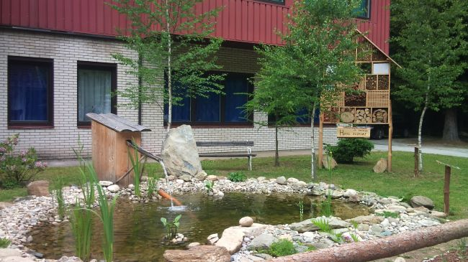
SREDNJA ŠOLA SLOVENJ GRADEC IN MUTA

Slide 11
ABOUT OUR SCHOOL
Our school is in the northern part of Slovenia and is split up in two locations – Slovenj Gradc and Muta. We educate in seven programmes:
sales assistant, tourism, economy, preschool education, environmental education, gastronomy, and woodworking. Besides four year vocational programmes we offer three year programmes with a two year upgrade as well as technical education programmes. After three, four or five years students need to pass the matura exam so they can go to university or directly to the labour market. Our students are very active, taking part in different competitions and winning the highest awards (in the fields of cooking, serving, tourism, economy, environmental protection, woodworking, selling, etc.) Our students take part in Erasmus+ KA1. We also take part in three Erasmus + school partnership projects this year and in many other projects.

Slide 12
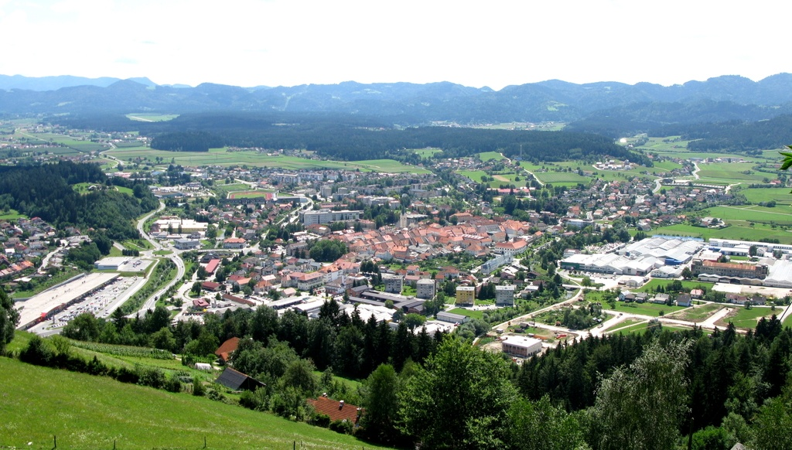
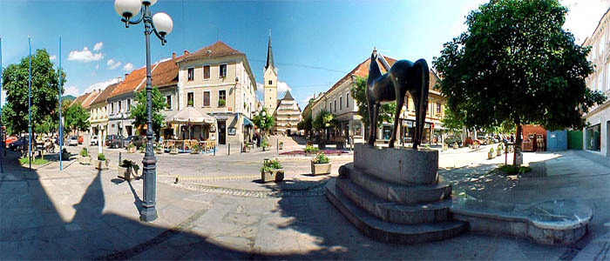
Slovenj Gradec – one of the two locations of our school
The town Slovenj Gradec lies between Mount St. Ursula (Uršlja gora) and the western Pohorje hills. It is a typical medieval town with a high street (Glavni trg), the main square (Trg svobode) and the side narrow street (Meško's street). The town was founded by the Counts of Andechs and then experienced turbulent centuries passing from one owner to another while its crafts and commerce flourished. The current Slovenj Gradec continues the tradition of the past; numerous exhibitions and events have brought international fame, and in 1989 the town was given the honorary title of Peace Messenger City. Population today is about 7500.

Slide 13
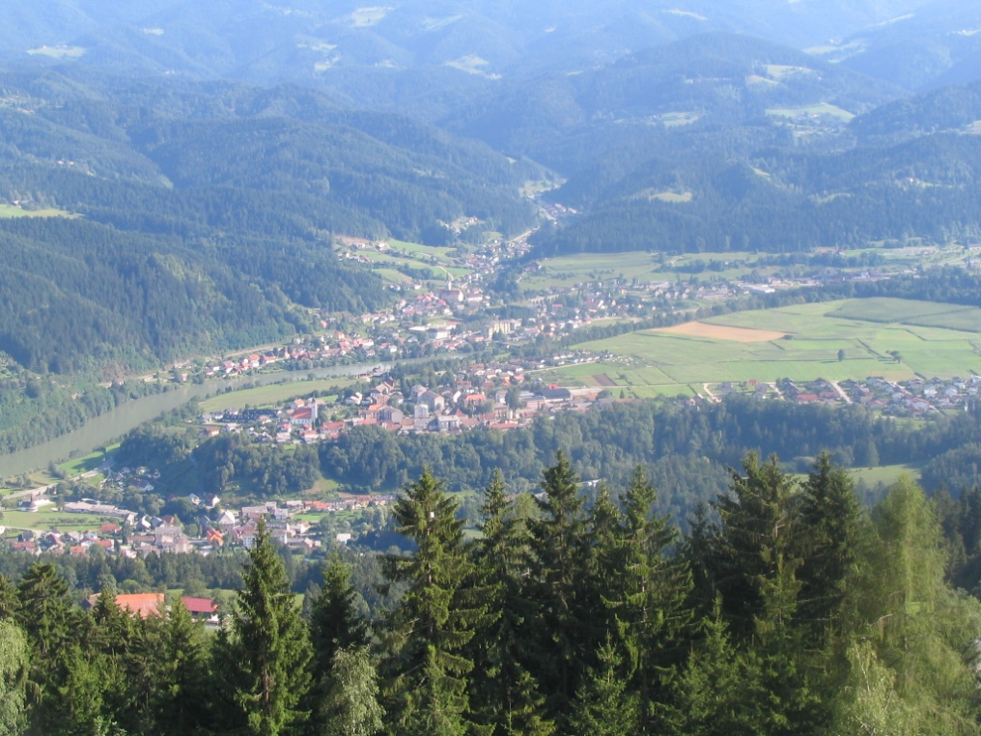
Muta – one of the two locations of our school
Muta lies in the central Drava valley on the northeastern part of Slovenia and it is between the river Drava on south and Slovene-Austrian border on north. The center of Muta is the square named Upper Muta. Here is also an administrative center, local office, school, a library, a bank, a post office, health centre, shops and other institutions.

Slide 14
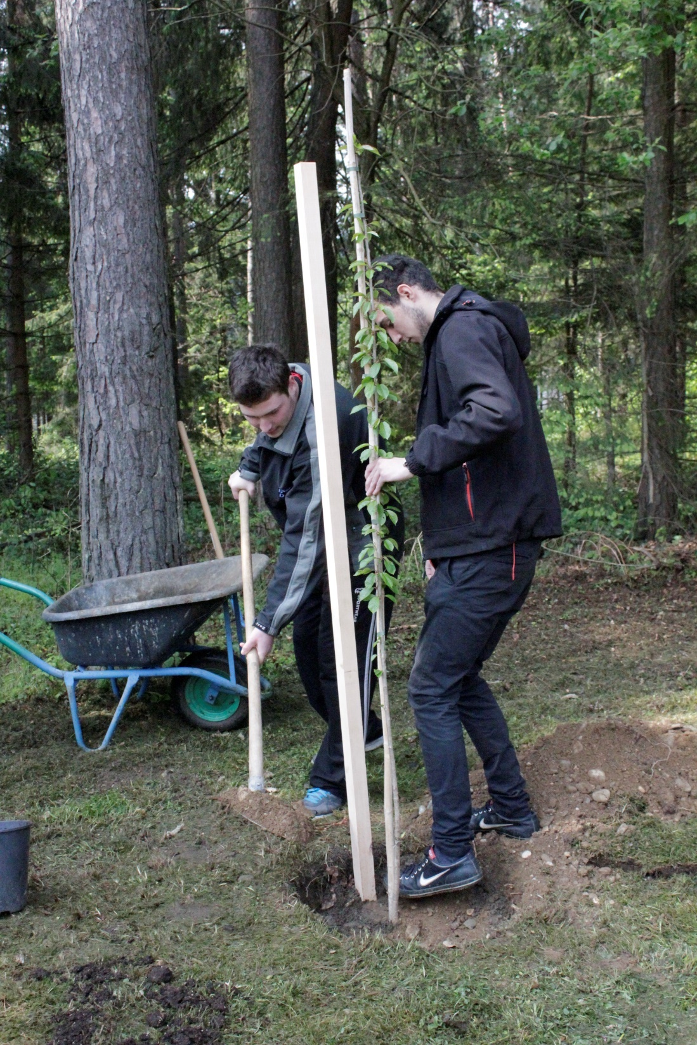
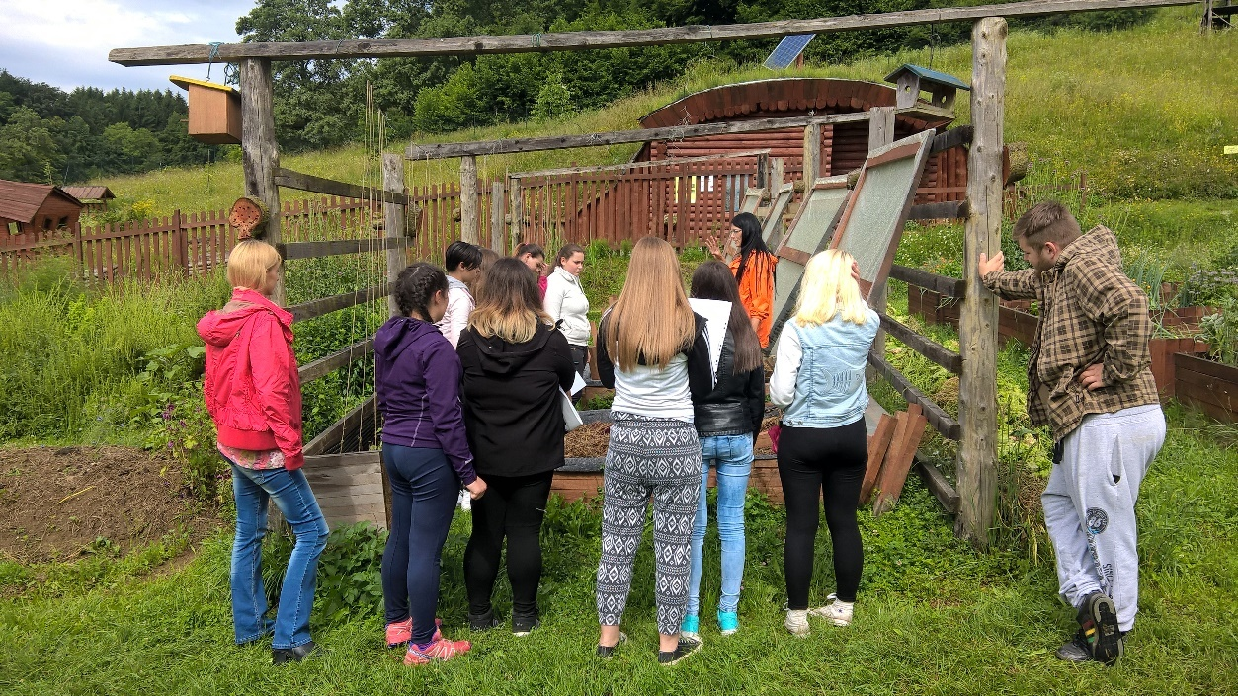
Activities our students take part in … planting a new tree at the school every year …

Slide 15
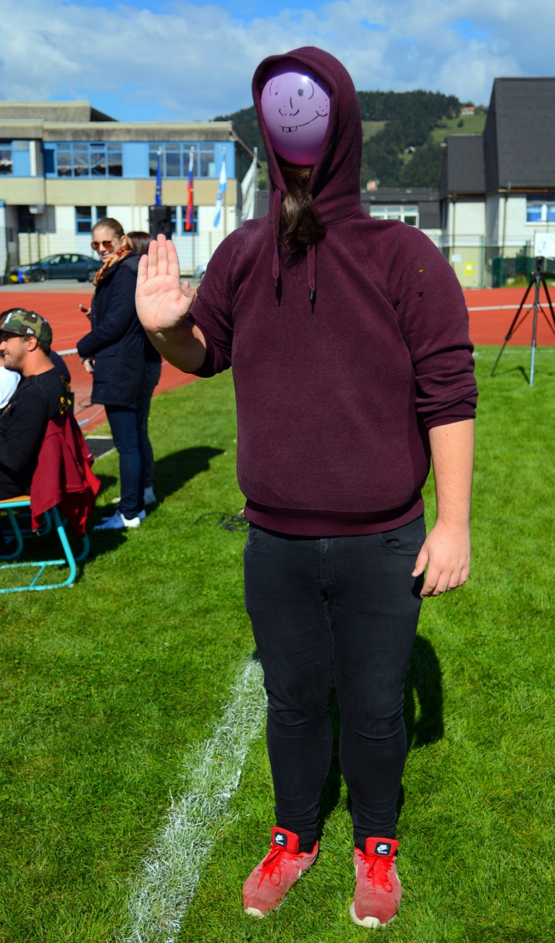
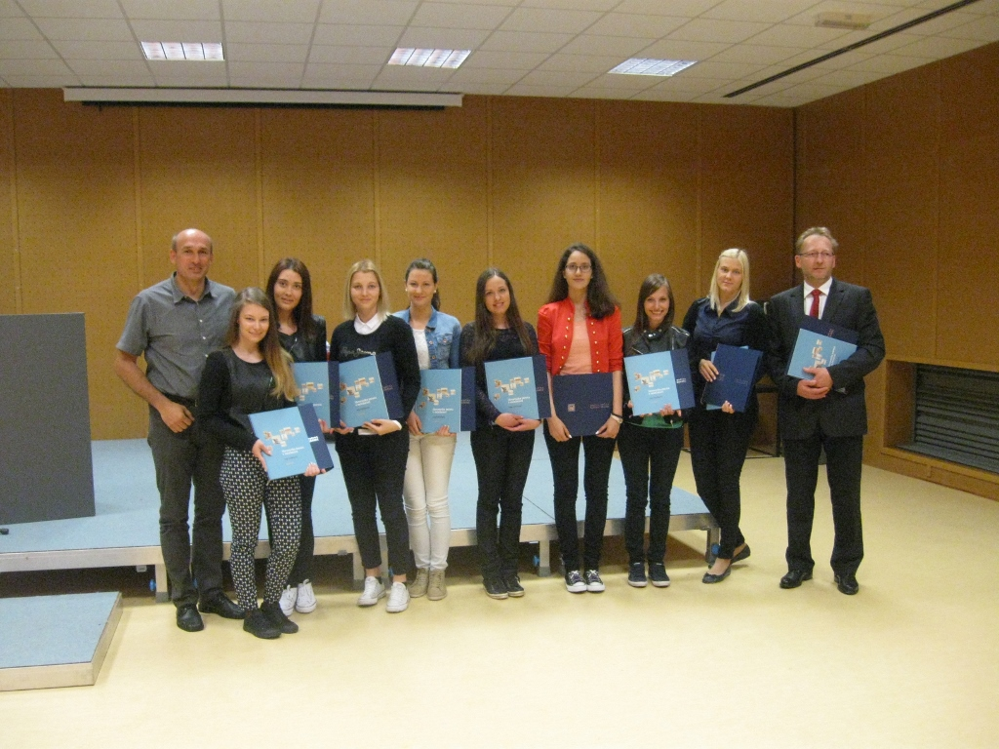
Snapshots taken during different activities …

Slide 16
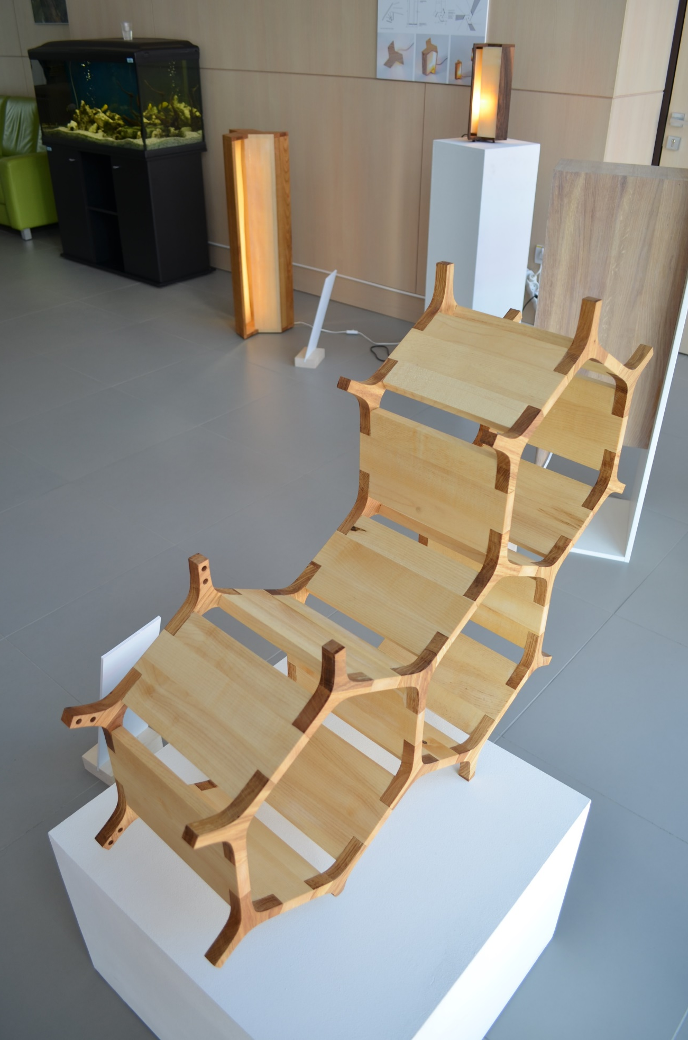
Future tourist workers‘ animations
Future woodworkers‘ products exhibition

Slide 17
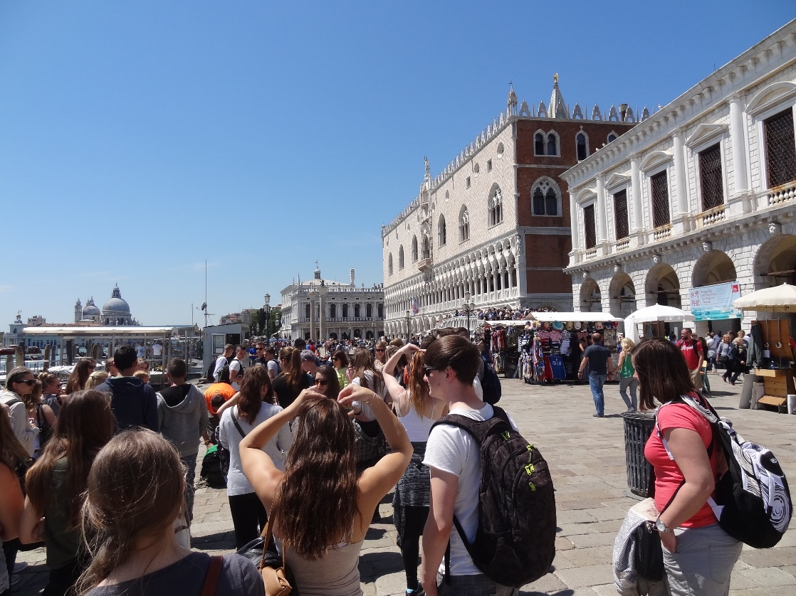
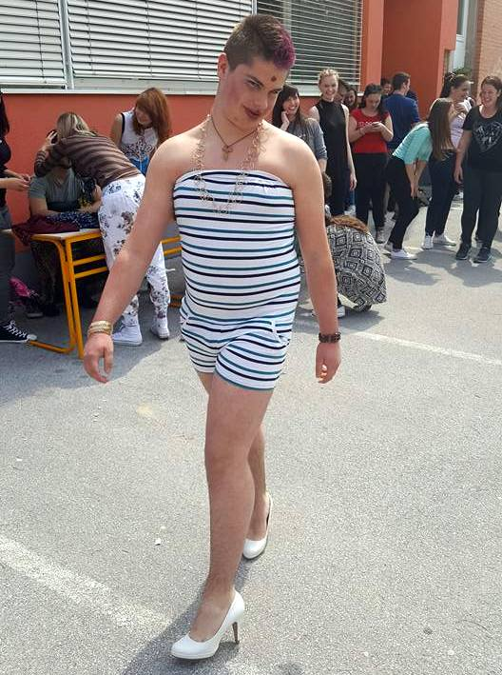
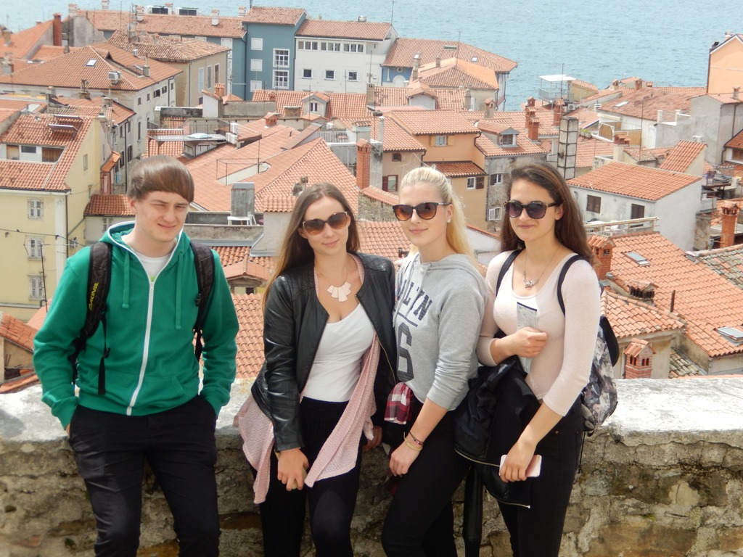
Future tourist workers take several field trips …

