Slide 1
What makes Me Happy… Italian Style!

Slide 2
Being with others
Being with others
The Italian word «compagnia», that indicates staying with other people, comes from the Latin expression ‘cum panis’ ( with the same bread ). That means that Italians as they do for food, like to share every experience they have with their friends or relatives
We like sharing our meal, living the better experiences and laughing with our friends. Because the best part of everything is the possibility to live the same experience twice, when we recall the happy memories together.
Whatever you do in this life it's not legendary unless your friends are there to see it.
Barney Stinson

Slide 3
.
Sharing experience
Italians are often divided and sometimes they don't feel proud of their country. But everything changes for food and football when they discover their sense of belonging
For us, it’s so important to share experiences that we aim to involve whoever around, in the stories we are talking about. In fact we are so used to talk loudly that we do even if our friends are really close to us
At first glance we might seem noisy, but don't worry, we're just a little too chattie ☺
As you probably know, we use also our hands to communicate and to express our emotions

Slide 4
Love in Italy
Italians by far are the more romantic lovers. In Italy there are many features that remind to love. For example we have «peruginian kisses»: a type of chocolatine that has a romantic quote inside it.
Italians are known as a passionate race—they live and laugh and love in a big way, and they enjoy the finest things in life, from sumptuous food to gorgeous women and men.
Italy is famous for spawning many a Latin lover, a man who is zealous about love and sex and that can make any woman on Earth feel beautiful and blissful due to his passionate and romantic nature.
In books and movies, Latin lovers are often depicted as tall, dark and handsome with golden skin and molten dark eyes. Increasingly, many men pretend to be a Latin lover, but lack the innate charm and personality it takes to be one.

Slide 5
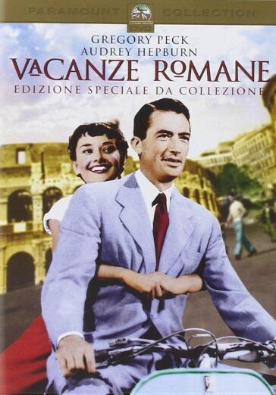
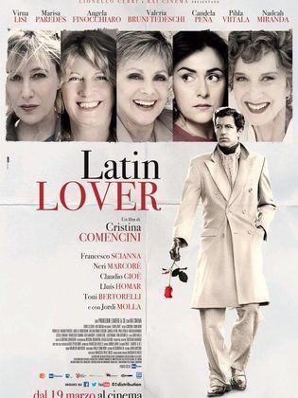

Slide 6
Love throughout the history
Italians poets have always been recognized by everyone for their romanic poetry. I think that every women dream to be a muse for the drafting of a love poetry.
For example during the 1400 in Italy there were great poet such as Dante and Petrarch that dedicates their verses to Beatrix and Laura
But all of this is not just about the past, in a sense we have inherited all of this charms. In fact, there are also more recent composers who have gone down in history as Latin lovers such as Rodolfo Valentino and Casanova
So even now with songs or words, Italians still have an edge when it comes to love

Slide 7
FOOD

Slide 8
Why is food so important for Italians?
Italian people dedicate about 28% of their time to food activities: cooking, searching restaurants, organising meals
Food is a vehicle of social relations and conviviality: during a meals you chat about every matter with others
Compagnia (= company) comes from latin «cum panis», which means «share the same food»

Slide 9
It is a moment where the whole family gathers
During traditional festival food remind the origins of the place

Slide 10
Numerous nutritionists verified it is the most complete diet for the human body.
It is based on mediterrean products and the large use of cereals and derivates (pasta, bread), oil, fruit and vegetables, legumes
Instead there are moderate quantities of fish, meat, milk derivates

Slide 11
It is certaily the most iconic italian food duplicated all over the world
It is made by simple ingredients such flour dough, tomatoes and mozzarella, but you may also add more ingredients to create new tastes
Its great success has been due to the fact it is a complete food (carbohydrate, lipid, protein) and has a delicious savour

Slide 12
LANDSCAPE
Another thing that makes Italians happy is undoubtedly landscapes. A beautiful valley seen from high, a sunset by the seashore, a vast city: all of these induce happiness in the heart of Italians.

Slide 13
Santa Cristina Valgardena

Slide 14
Ostia Seashore (Rome)

Slide 15
Ischia Island

Slide 16
Rome

Slide 17
SOCCER
Being an Italian partly means to be invested in soccer: having a favourite team, watching the matches, championships, playing yourself the sport. The happiness conveyed in the many activities revolving around soccer is something deeply rooted in Italians' hearts.

Slide 18
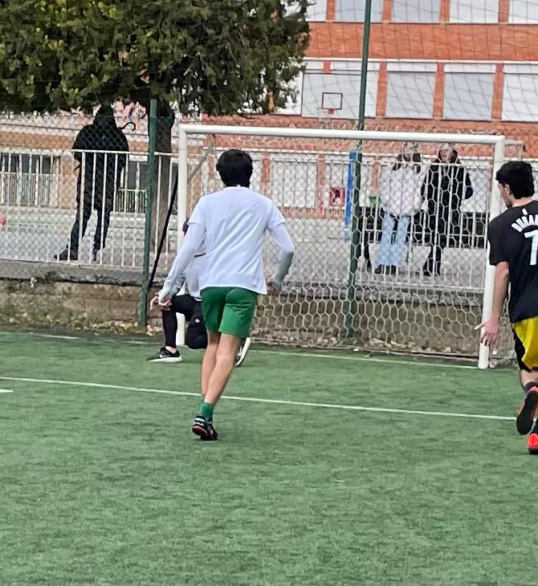
A feeling of belonging
Being collectively involved
An everlasting source of joy

