Slide 1
Palm Sunday
Palm Sunday commemorates Jesus Christ’s triumphal entry into Jerusalem, according to Christian belief. It marks the beginning of Holy Week and always falls on the Sunday before Easter Sunday.

Slide 2
Processions in Spain
Processions take place in Spain, during Holy Week and start on Palm Sunday.
These processions portray the Passion of Jesus Christ, which refers to Jesus’ suffering prior to his trial and execution

Slide 3
The palm branch
The Palm Sunday Procession is held on the Sunday before Easter week, hundreds of people take part, carrying palm branches.
The palm branch is traditionally a symbol of joy and victory.

Slide 4
Elche is famous for its palm trees
Elche, a town near Alicante, is famous for it's palm trees which provide a large percentage of the white palms that are used throughout the world on Palm Sunday.
Elche is the only place in the world where the tradition of crafting white palm fronds lives on
This town has been exporting palm frond creations to other countries for centuries

Slide 5
How to make white palm fronds
In many palm groves in and around Elche, the palm leaves spend most of the year wrapped in black plastic to starve them of sunlight and turn them from green to golden colour

Slide 6
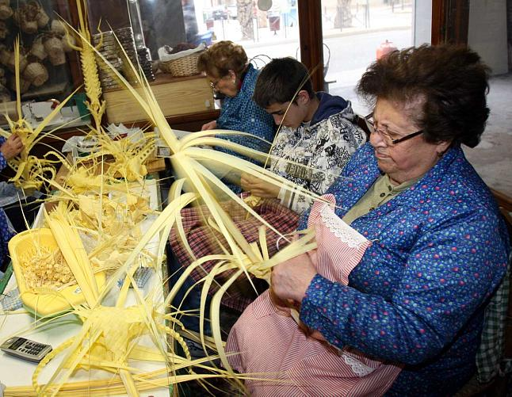
Palm branches, after being treated, are plaited into beautiful, creative forms and figures.

Slide 7
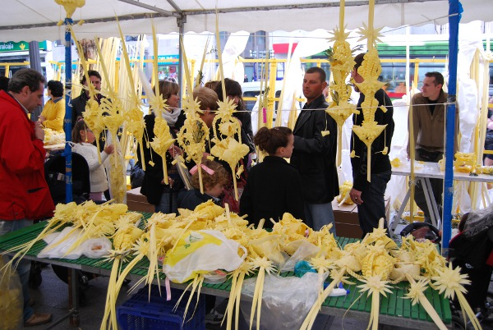
Elche White Palm Market
The tradicional Elche White Palm Market will take place two days before Palm Sunday

Slide 8
Hundreds of people take part in The Palm Sunday Procession carrying figures hand-crafted in the town from palm branches, a beautiful spectacle

