Slide 1
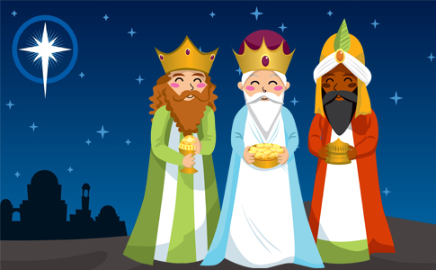
THE THREE WISE MEN
Javier Martinez
Javier villanueva

Slide 2
WHO ARE THEM?
They’re three priests who come from the middle East to give some presents to the newborn Christ.
In Spain, they decided to crate a tradition with this three men for the children, giving them presents. Just like Santa Claus does.
This tradition has been celebrated since 1866, when the first cavalcade took place in Alcoy, a city in Alicante, Spain.
They are recognized as characters mostly belonging to Catholic and Christian religions, called magicians because it was said that their wisdom was too much and that there must be some spell that was on them, in this way all the scholars with great intellectual abilities were called magicians in the Ancient East.

Slide 3
MELCHOR
According to tradition, King Melchor comes from Europe. He is represented as a man with a clear skin and a long gray beard of white or ash blond color, thus giving the perspective of an older adult. The roots of its name come from the Hebrew, and the translation of both words that complement the name malkî and ôr, is "My king is light" or "King of light".
In this case Melchor brought the Gold, the most precious of the metals.

Slide 4
GASPAR
King Gaspar discriminates himself as the youngest of the three magicians, for his part, Gaspar has a peculiar Asian origin, he does not have a beard, he is always shaved. It is said that the magician king Gaspar lived around 109 years, and that after this he died along with his eternal companions, Melchior and Balthazar, his name comes from the Persian kansbar meaning valuable treasurer, is usually represented with the beard and the brown hair.
This king is in charge of offering the Lord Jesus incense, this being the representation of the spirit in each of the people, the living manifestation of faith and hope.

Slide 5
BALTASAR
The bible simply places him as one of the wise men from the east who were going to bring gifts to the son of God. The term Bel-Sar-Utsor comes from Babylon which translates as "God protects the king“
The specific gift of the magician king Baltasar is the myrrh, it is being a reddish and aromatic substance that for the time was common in East and Somalia, with this one perfumes of very high value were elaborated, and this it gave as a gift to the Messiah, meaning this all the injustices and banal desires of humanity.

