Slide 1
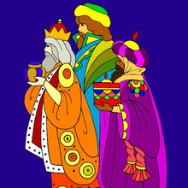
6th January. The kings’Day
On the 6th of January there is a festival that is celebrated in Spain. It is called Epiphany or The Kings’Day. Epiphany celebrates when the Kings or Wise men brought gifts to the baby Jesus.

Slide 2

The Three Kings
In Spain The Three Kings are the ones who bring children their presents on the morning of the 6th January.
Parents encourage their children to write to the Three kings to ask for their presents.
Spanish children leave straw and carrots out for the kings’ camels and food and drinks for the kings.
If the children have been bad, the Kings might leave pieces of coal made out of sugar in the presents!

Slide 3
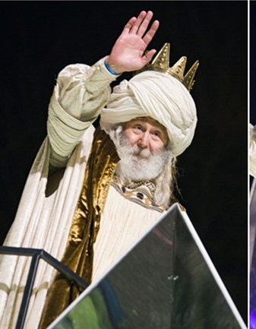
The king Melchior
Melchior has long white hair and a white beard and wears a gold cloak. He is the King of Arabia. Melchior represents the Gold brought to Jesus. Gold is associated with Kings and Christians believe that Jesus is the King of Kings.

Slide 4
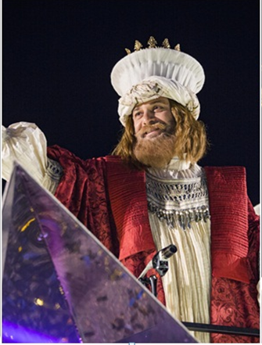
The King Gaspar
Gaspar has brown hair and a brown beard and wears a gold crown with green jewels on it. He is the King of Sheba. Gaspar represents the Frankincense brought to Jesus. Frankincense is sometimes used in worship in Churches and showed that people worship Jesus.

Slide 5
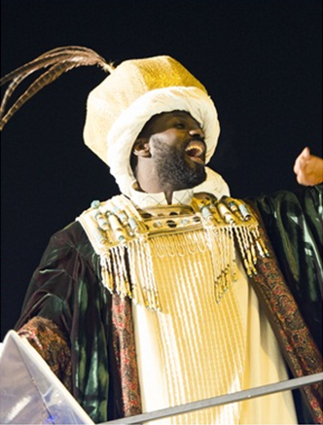
The king Balthazar
Balthazar has black skin and a black beard (or no beard!) and wears a purple cloak. He is the King of Tarse and Egypt. Balthazar represents the gift of Myrrh that was brought to Jesus. Myrrh is a perfume that is put on dead bodies to make them smell nice and showed that Jesus would suffer and die.

Slide 6
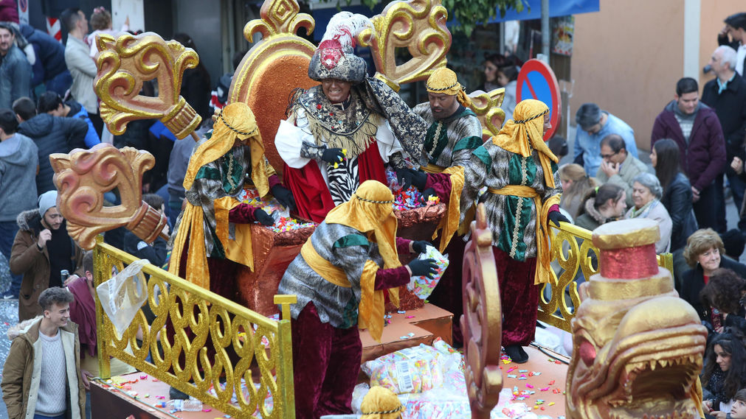
The parade of The Three kings
Parades with large floats are celebrated to welcome The Three Kings in every town in Spain on evening of the 5th January.
At the end of the procession The Three Kings come, each one in his own carriage.
People on the floats throw sweets and toys to the children.

