Slide 1
Spanish Turrón
Made by Vicent Baeza

Slide 2
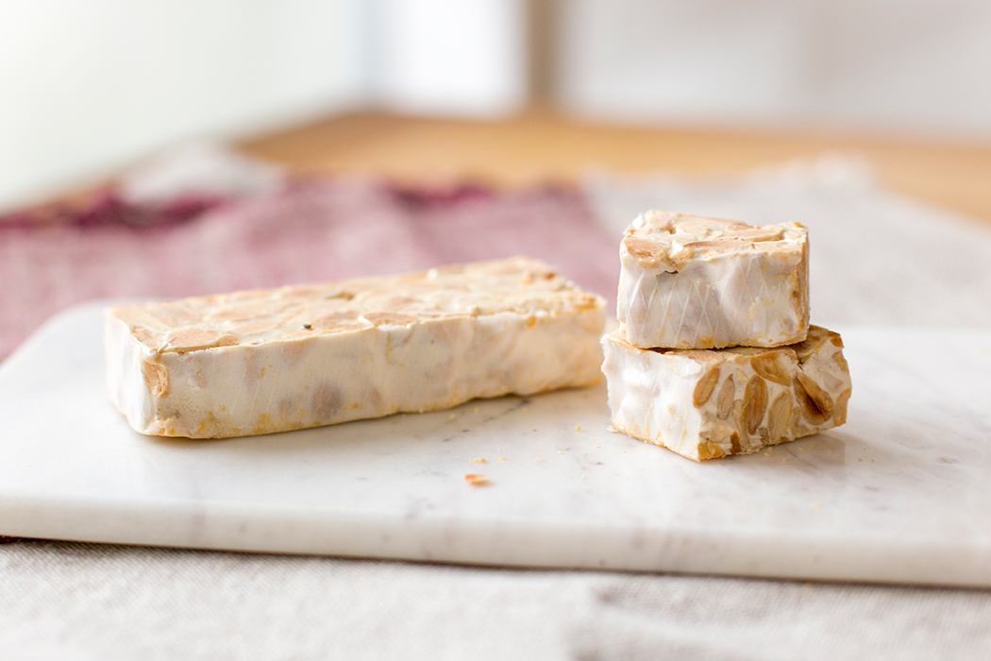
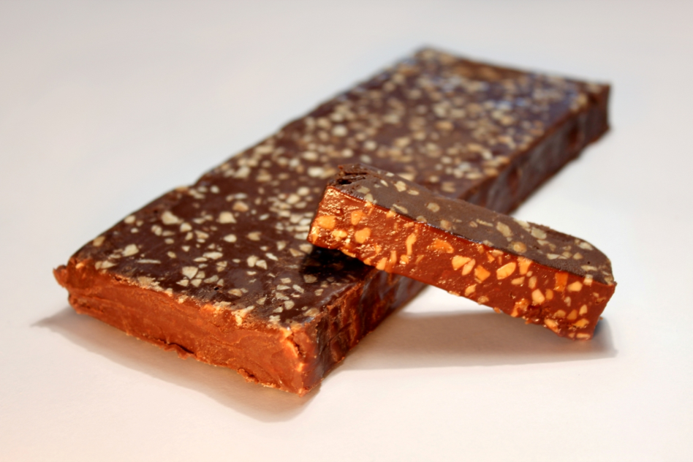
What is Turrón?
Turrón is a southern European dessert, traditionally made of honey, sugar and egg white, often made with toasted almonds or other nuts. It is usually shaped into a rectangular tablet. It is frequently consumed as a traditional Christmas dessert in Spain, Italy and some countries in Latin America.

Slide 3
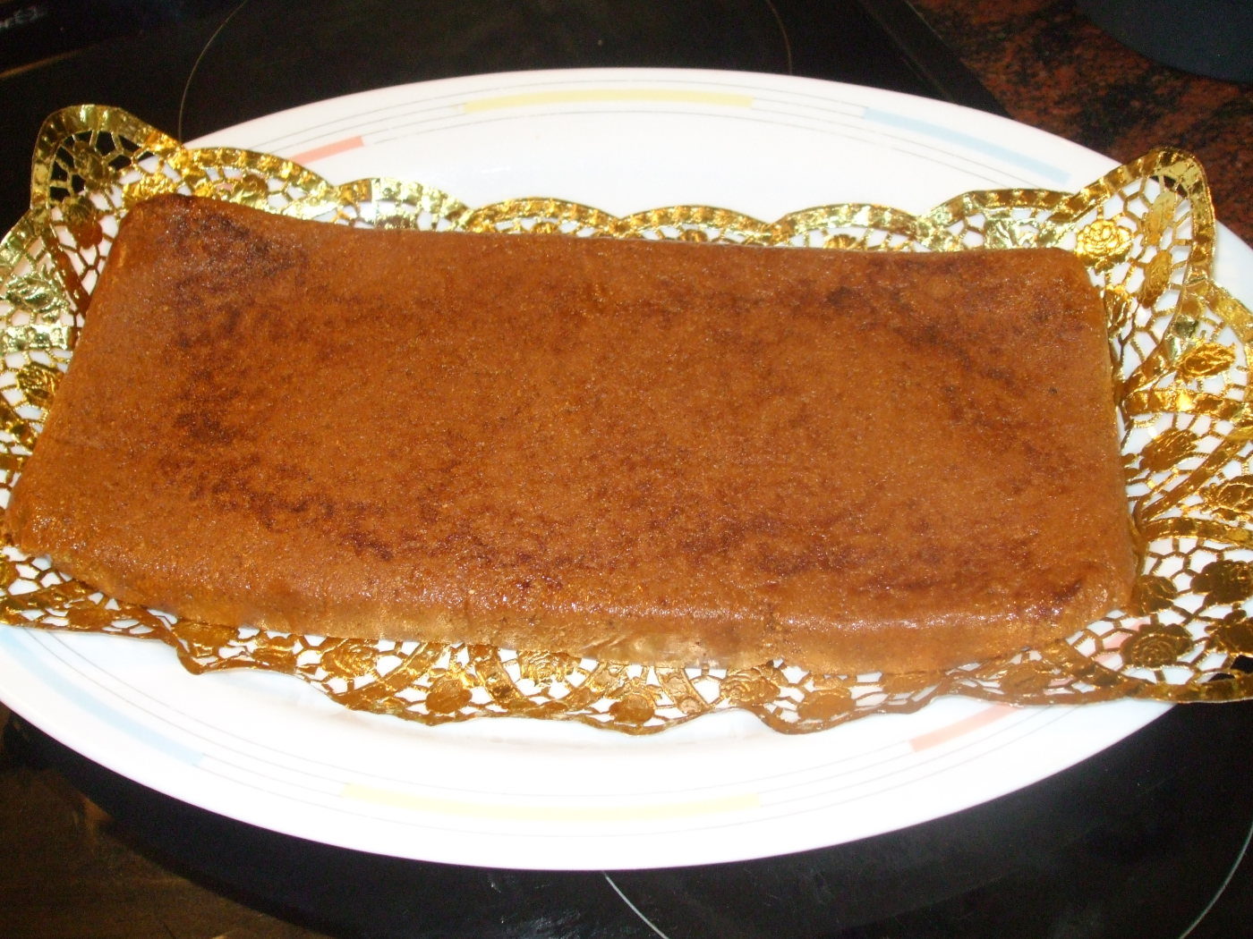
A typical, rectangular tablet of traditional soft Spanish turrón

Slide 4
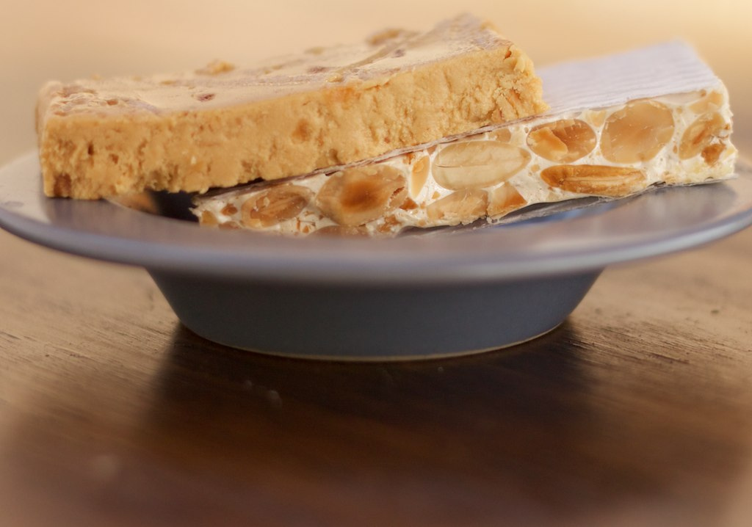
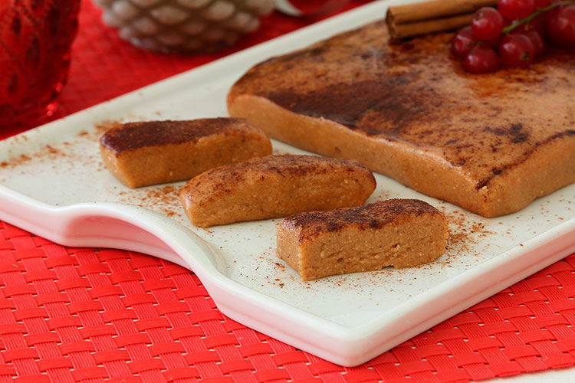
Origins
The 16th-century ‘Manual de Mujeres’, a handbook with recipes for foodstuffs, has the oldest known Spanish turrón recipe. It consists of adding egg whites and honey, cooked until the honey is caramelized. The recipe then suggests adding almonds or hazelnuts, peeled and cooked. The mix then is cooked a bit more, and then is removed and cut into slices.

Slide 5
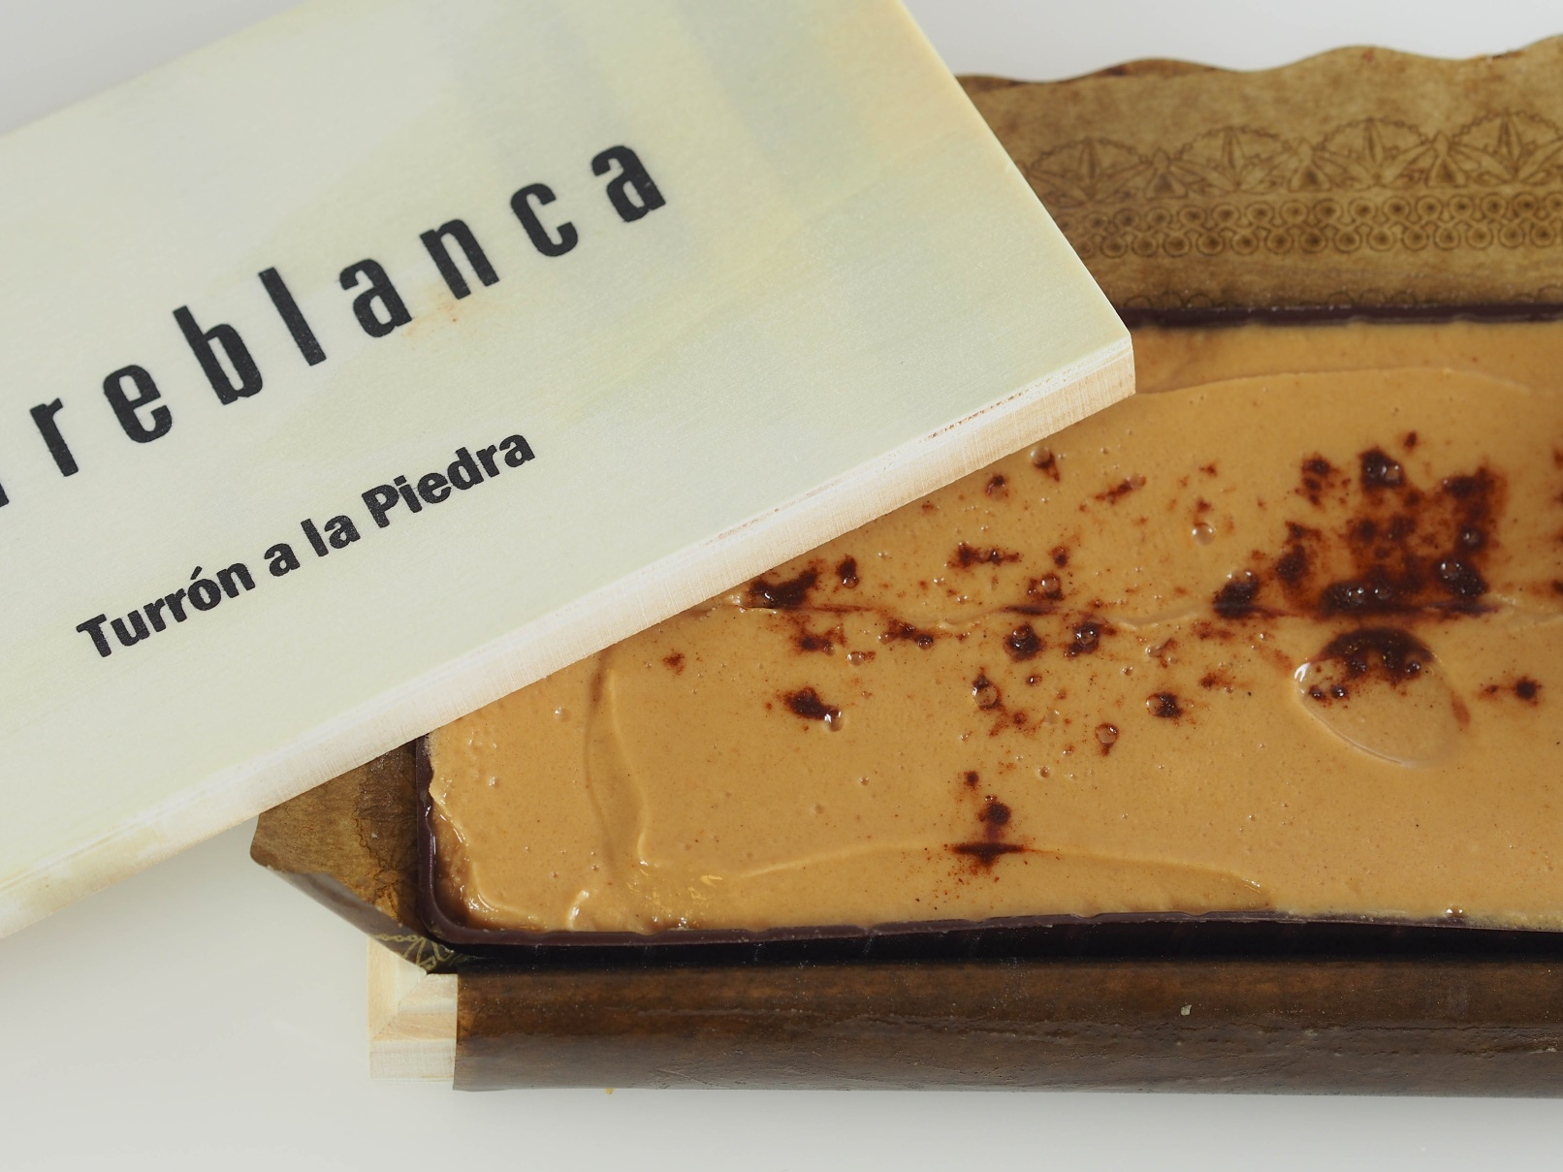
Another soft turrón tablet, made at Torreblanca, Spain

Slide 6
Variations
Variations of this recipe are found throughout the northern Mediterranean. Traditionally, there were two main types. There is Hard turrón and Soft turrón. The main difference was in the nuts. While in the ‘Hard’ one they were solid nuts, in the ‘Soft’ they were reduced to a paste and mixed with oil. The addition of oil made the ‘Soft’ one more chewy and sticky, hence its name.

Slide 7
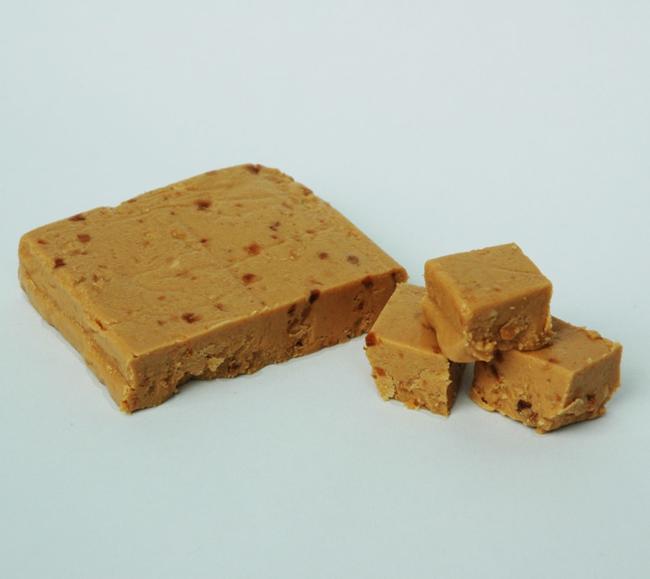
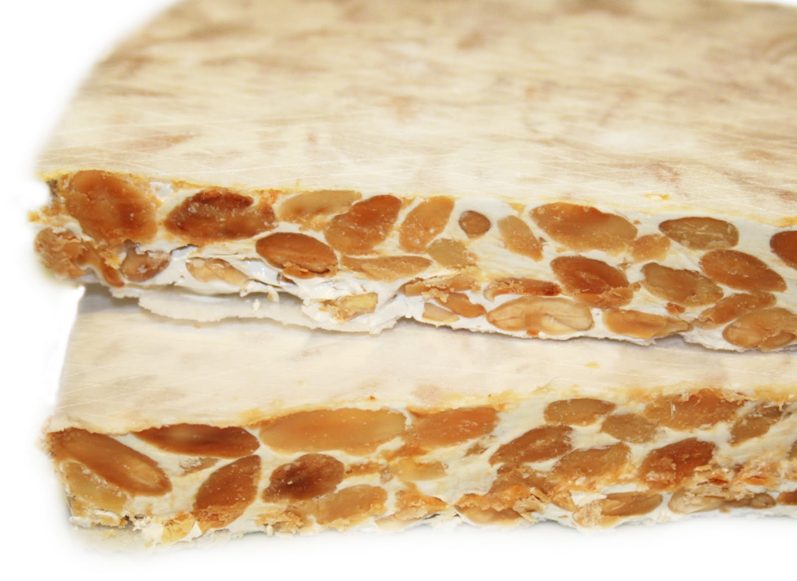
Soft turrón
Hard turrón

Slide 8
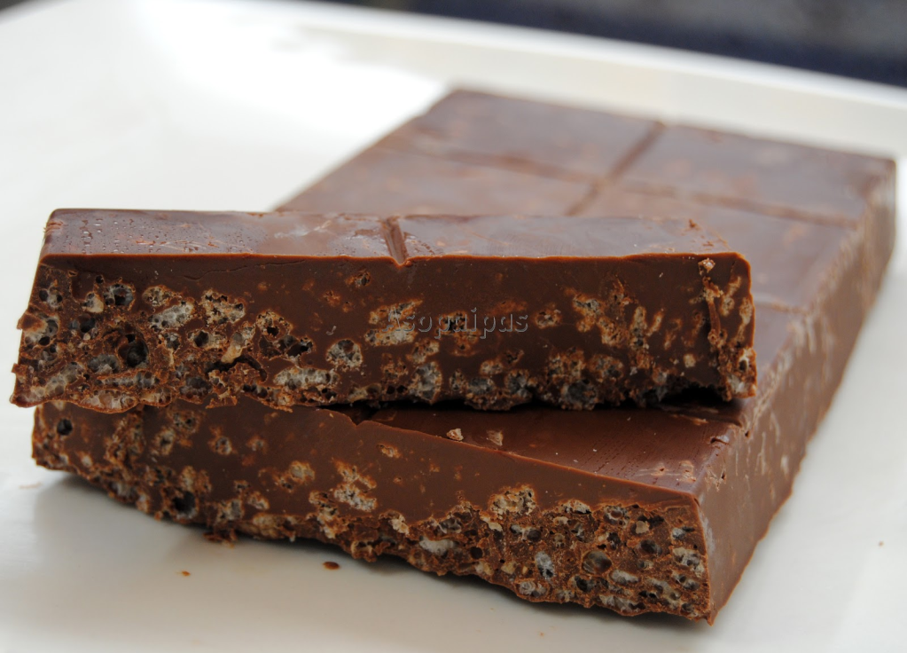
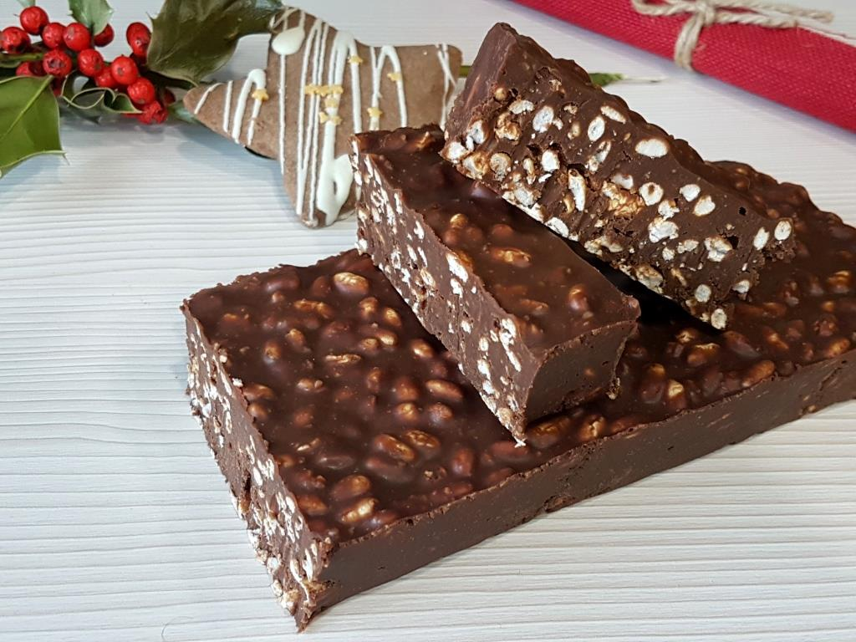
Nowadays though, there are countless variations of this sweet dessert being sold. One of the most popular variations replaces the honey with chocolate and the almonds with rice

Slide 9
Thanks for watching!
And Merry Christmas!

