Slide 1
The three wise men
By: Noelia martinez and lucia ruzafa

Slide 2
When is celebrated?
The Three Kings ‘Day is celebrated on January 6th every year. It is a long awaited day and loved by the youngest of the house, as on this day their Majesties the Magi give children gifts in Spain.

Slide 3
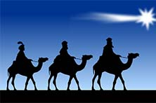
History
The Day of Kings celebrates the commemoration of the arrival of visitors with gifts to the newborn baby Jesus. They follow the stars until they reach the portal of birth. According to the Gospel, the people who brought the gifts were kings.
The three wise men together with their gifts are: Melchor (gold), Gaspar (incense) and Baltasar (myrrh).

Slide 4
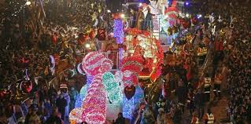
What is done?
before the Day of Kings children write a letter of gifts and toys that they would like to get from the Magi.
The Three Wise Men's Parade takes place on the Three Kings’Eve . This is a parade of floats and the Three Wise Men who run through the cities waving and handing out sweets to all the children.

Slide 5
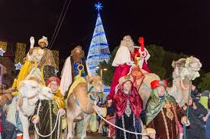
The presents
That night the children should leave their shoes clean so that the Magi can leave their gifts. There is a pair of shoes for each person, since the adults also receive some gifts. In some homes they also leave a piece of nougat and some drinks.
On the morning of the Three Kings Day the children open the gifts and discover the toys that the Magi have left for them. On the same morning or afternoon, children usually visit various relatives such as their grandparents because it is also possible that the Magi have left gifts in their houses.

Slide 6
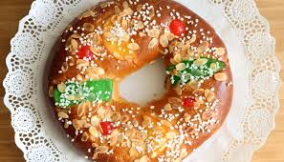
The roscón
The Roscón de Reyes or Rosca de Reyes is the typical Three Kings' day bun, made with a sweet dough and garnished with beautiful and striking crystallized fruits. There are varieties of Roscón de Reyes such as chocolate or moka, or those filled with cream.
Inside the Roscón de Reyes there is a surprise, which will be discovered by the person who eats this piece of roscón. It can be a figurine or a bean . The person who finds the bean should buy the bun the following year. The person who finds the figurine will be crowned with a paper crown.
The Roscón de Reyes is a typical snack or dinner after the Three Kings 'parade, or at the breakfast of the Three Kings' Day, accompanied by a hot chocolate cup.

