Slide 1
MY CHRISTMAS
ARIADNA LLOBREGAT ROJAS

Slide 2
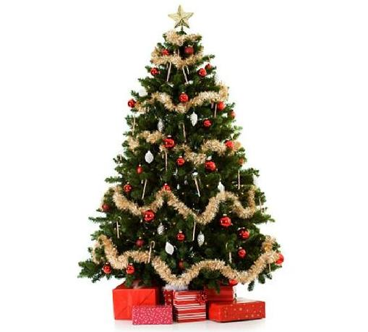
MY FAVOURITE DAY
My favorite day of Christmas holidays is Christmas eve.
So I will talk about how I lived this day with illusion, till I knew that Santa Claus doesn’t exist.
I remember, that my brother and I decorated our home, with our parents help, specially the garden, we used to put Christmas lights on our palm trees and at the balconies and a Santa Claus climbing the wall, a nativity scene with a fountain for the animals to drink and a big inflatable Santa.
That night all my family came to have dinner at my home, I like that we were all together.
Noise was beginning to be heard in the street and someone knocked on the door. My father opened and… SURPRISE! Santa was there with a big sack of gifts. We went running to receive him and Santa spoke to us and my brother said me that that man wasn’t Santa, that he was our grandpa with a costume, but I didn’t care, I wanted my gifts. That night we put for Santa a cookie and a glass of milk, and at the morning it was empty.
I always liked more Santa Claus because I had more days to play, but y also liked the Three Kings, my favorite one is Baltasar.

Slide 3
MY 2nd FAVOURITE DAY
My second favorite day of Christmas holidays was New year’s eve because there was a party and when my family ate the twelve grapes while the chimes sounded I ate Lacasitos because I hate grapes.

