Slide 1
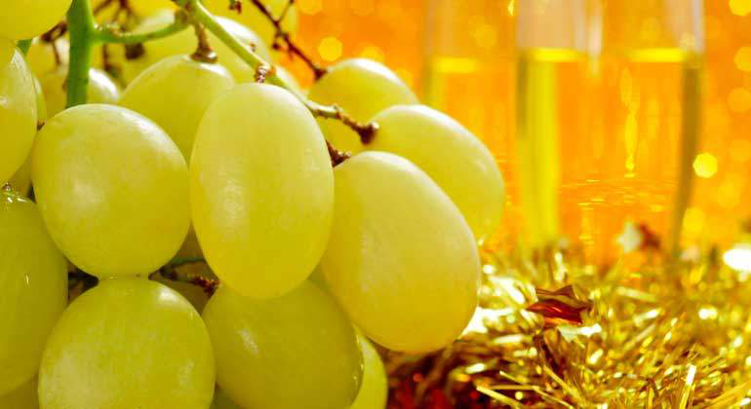
New Year's Eve
31st December
On NewYear’s Eve it is tradition to participate in a celebration called the “lucky grapes”. On each stroke of midnight you take a grape and make a wish for the New Year ahead. Other superstitions include wearing red underwear and putting gold in the champagne for good luck.

Slide 2
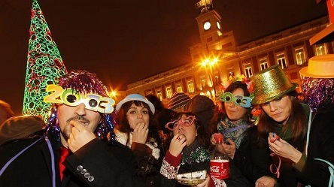
Origin of this grape-eating tradition
The most popular theory which explains this tradition dates back to 1909, a year in which wine producers had so much surplus grapes that they decided to give them away to citizens. They claimed that eating grapes on New Year’s Eve would bring them good luck, and so, over a hundred years later, this custom is still followed by all Spanish people

Slide 3
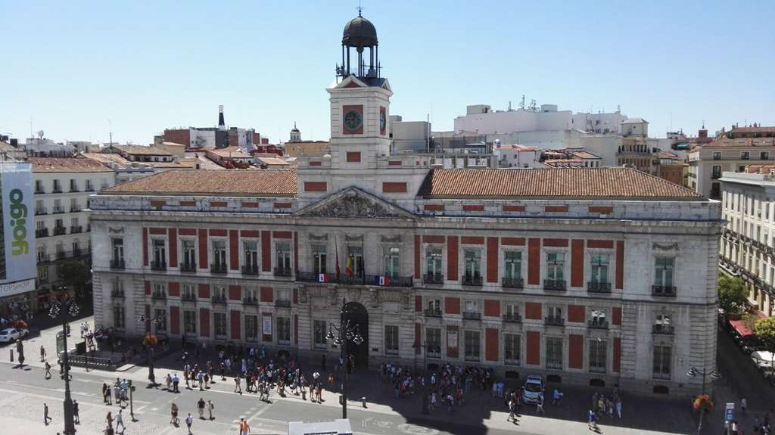
The Puerta del Sol in Madrid
On the evening of the 31st of December, all televisions in Spain light up with the image of the Puerta del Sol. Thousands of people flock to the square to eat 12 lucky grapes to the twelve chimes of the Real Casa de Correos clock.

Slide 4
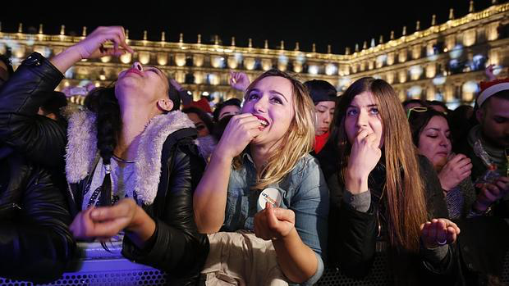
Explanation of how you have to eat the grapes
Just a few seconds before midnight, the ball, located in the upper part of the tower, is lowered to the sound of the carillon. This is followed by the four quarters (4 warning tolls that give you time to grab that grape that’s rolled under the table) and then, finally, the 12 chimes for your 12 grapes.
And once you’ve managed to swallow them all, have a glass of champagne, kiss and hug everyone and then it’s time to get ready to party.
The night and the new year have only just begun!

