Slide 1
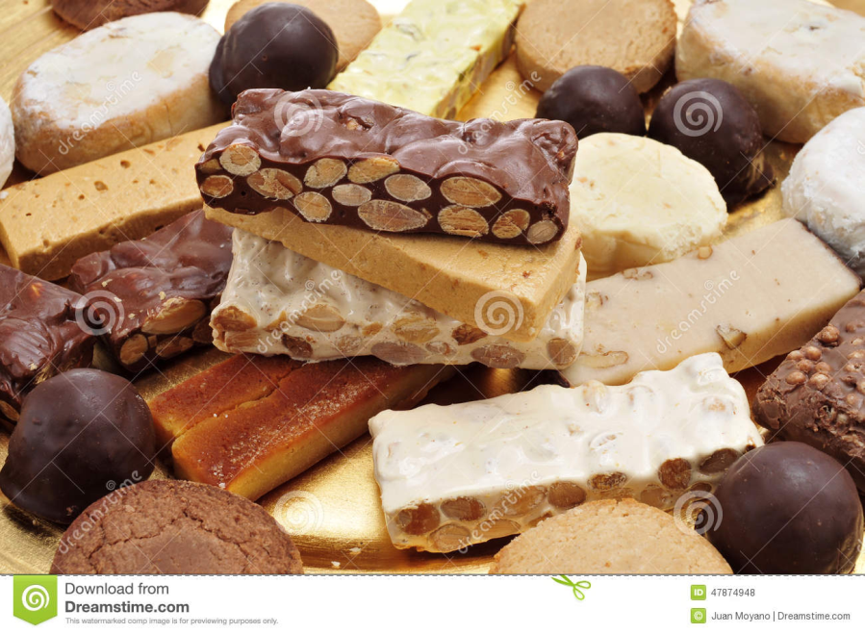
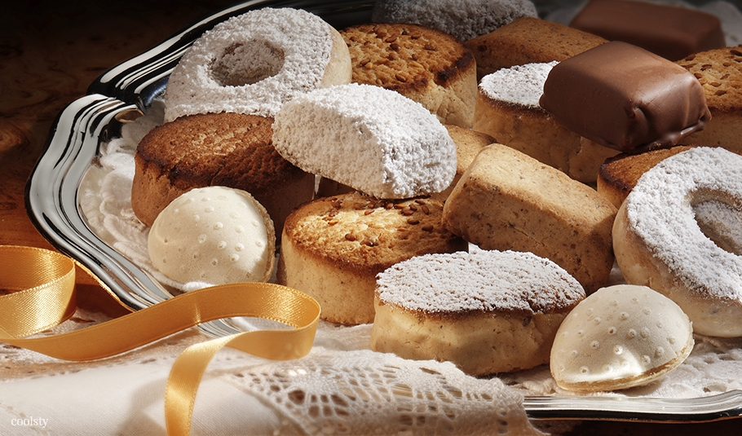
TYPICAL CHRISTMAS SWEETS IN SPAIN

Slide 2
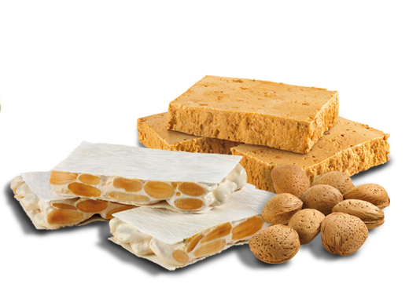
TURRÓN
The typical Christmas sweet is made with honey, sugar, almonds and egg white. The most popular turrón is soft and hard and its geographical origen is in Jijona and Alicante.
It’s typical to eat with
polvorones or peladillas
or another sweets.

Slide 3
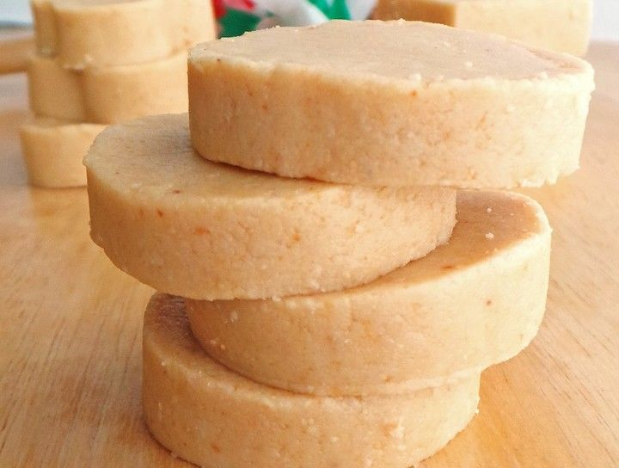
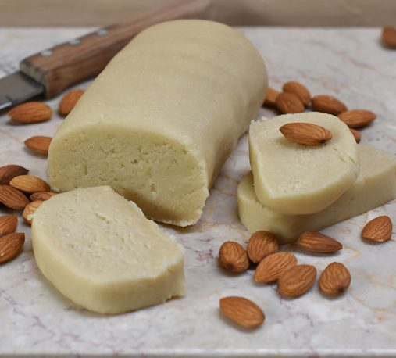
Mazapán
Is consumed in Toledo throughout the year, but especially in the Christmas season.
It’s made with almonds and sugar crushed with a mace.

Slide 4
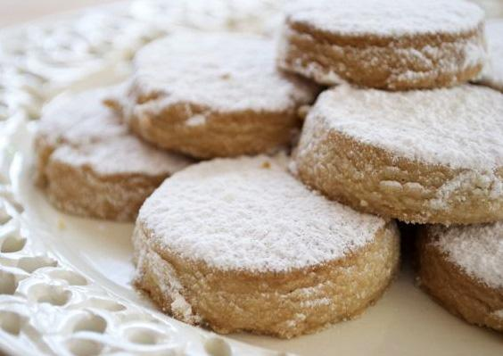
polvorones
Small cake made of lard, flour, ground almonds and sugar, it’s typical in Spain but especially in Andalucia.
It is called polvorón because when you put flour that decorate this typical Spanish sweet it seems that there is powder.
It is usuallty eaten with
some mantecados or
turrón.

Slide 5
Roscón de reyes
This sweet dough bun decorated with slices of candied fruit is one of the most requested Christmas sweets.
It’s dificult to find a house of Spain where they don’t eat that sweet for breakfast on The Day of the Kings.
It is usually filled with whipped cream or cream and sometimes with chocolate, truffle or mocha. In its interior it always hides a small surprise as a figure, a chocolate coin , banknotes or the traditional bean. Whoever finds the bean will have to pay the roscón.

Slide 6
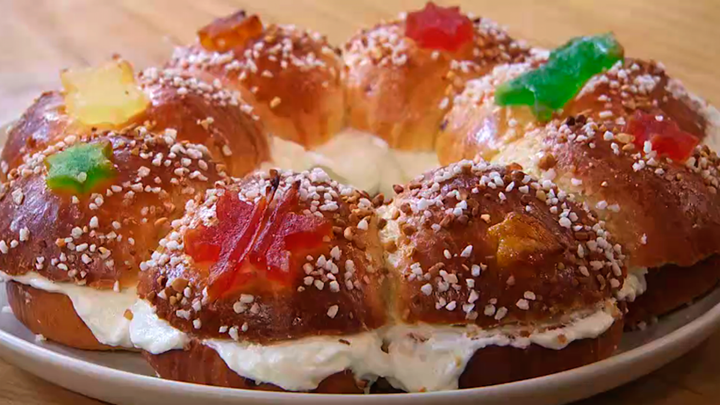
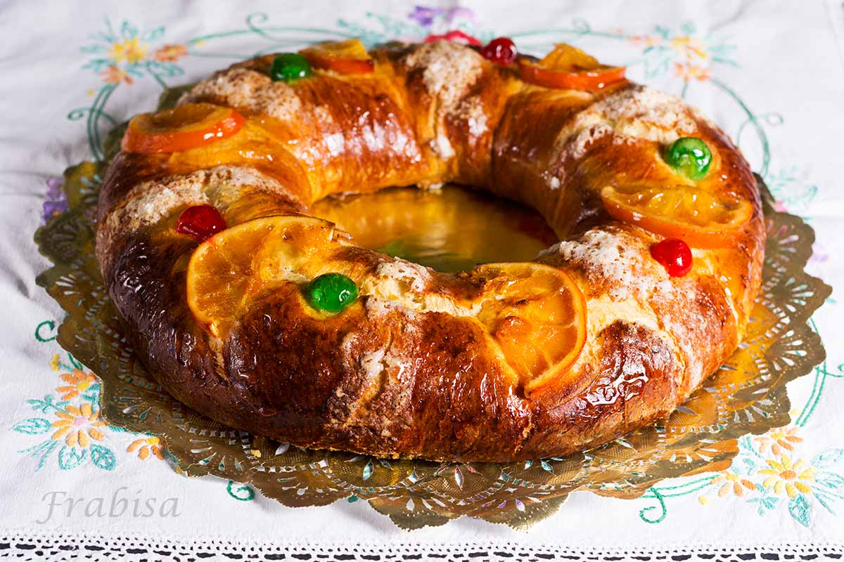
ROSCÓN:

Slide 7
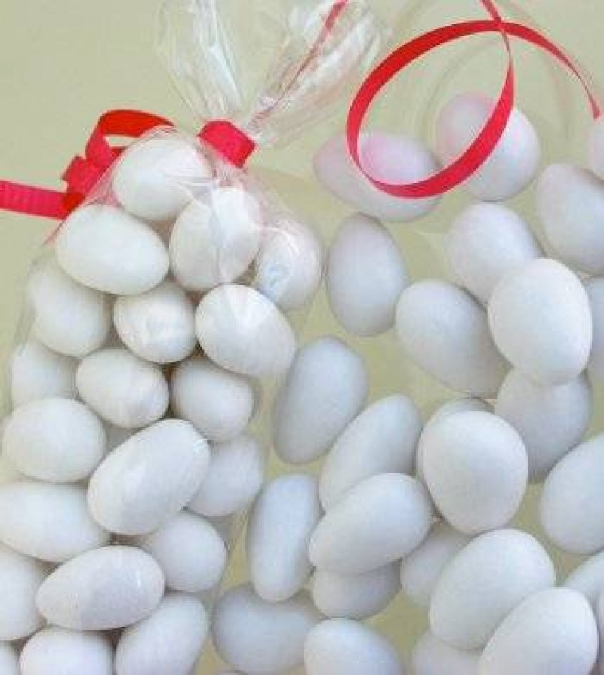
peladilla
This candied almond is typical from de Valencian Community and is a Christmas sweet.
Alcoy and Casinos are the main producers of peladillas in Spain.
New varieties have been
added with some types of
chocolate.

Slide 8
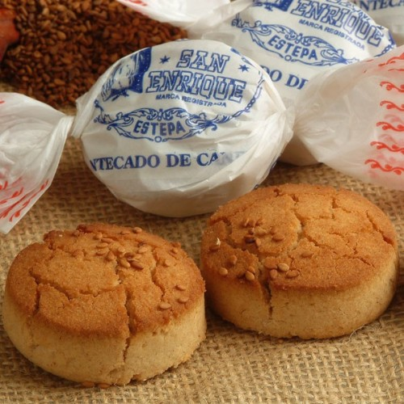
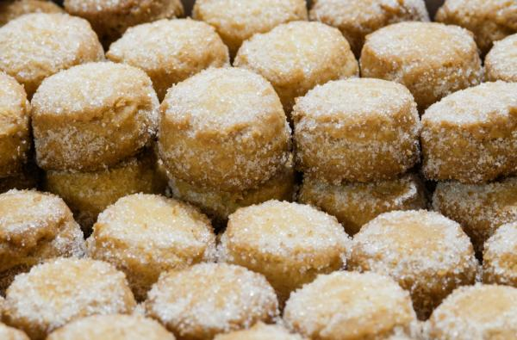
mantecados
Although they are sold throughout the
year in Spain sales go up at Christmas.
Mantecados are from Andalucia, and are made with lard and cereals.
The most tradicional
ones are“ of crafts”
modeled by hand,
with double of cinnamon,
with almond,
chocolate or lemon.

