Slide 1
What is turrón?
Turrón is a sweet treat made from a mixture of honey, eggs, sugar and, perhaps most importantly of all, toasted nuts. The most common type of nut to be used in the elaboration of turrón is almonds, although other nuts such as pistachios can sometimes be used instead.

Slide 2
How is turrón made?
To make turrón, the artisan-maker first starts by heating the honey until it begins to caramelize, before then adding sugar and egg whites to the preparation. The next step is to add the toasted nuts to the mixture and blend it all together before leaving it to rest and set. Once the turrón is set it can be kept for up to a year.

Slide 3
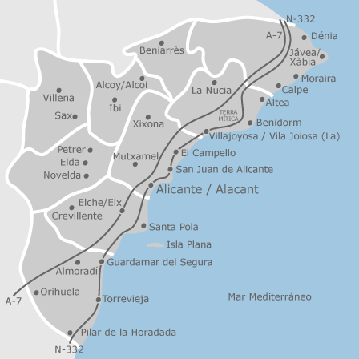
Different types and flavours
The most important distinction between types of turrón is whether it is hard and easily broken, or soft and chewy.
The harder variety is known as turrón duro or turrón de Alicante, whereas the softer kind is known as turrón blando or turrón de Jijona, in reference to the two towns in which each kind became most famous.

Slide 4
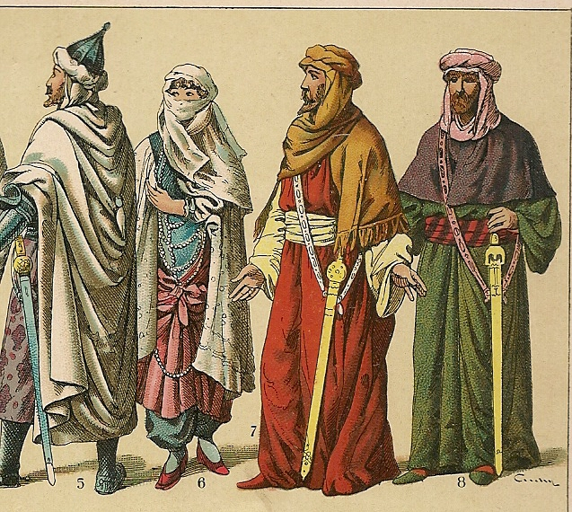
Origins of turrón
Its origins can actually be traced back to the Moors who invaded the country in the early Middle Ages. The Moors brought with them a rich culinary heritage.
By the 15th century, turrón was a popular sweet in Spain and there were some artisan-makers who made turrón especially around the town of Alicante.
While honey was used in the preparation from the beginning, it would seem that sugar was only added to the list of ingredients when the first sugar plantations were discovered in South America and sugar became a more common ingredient in Spanish cuisine.

Slide 5
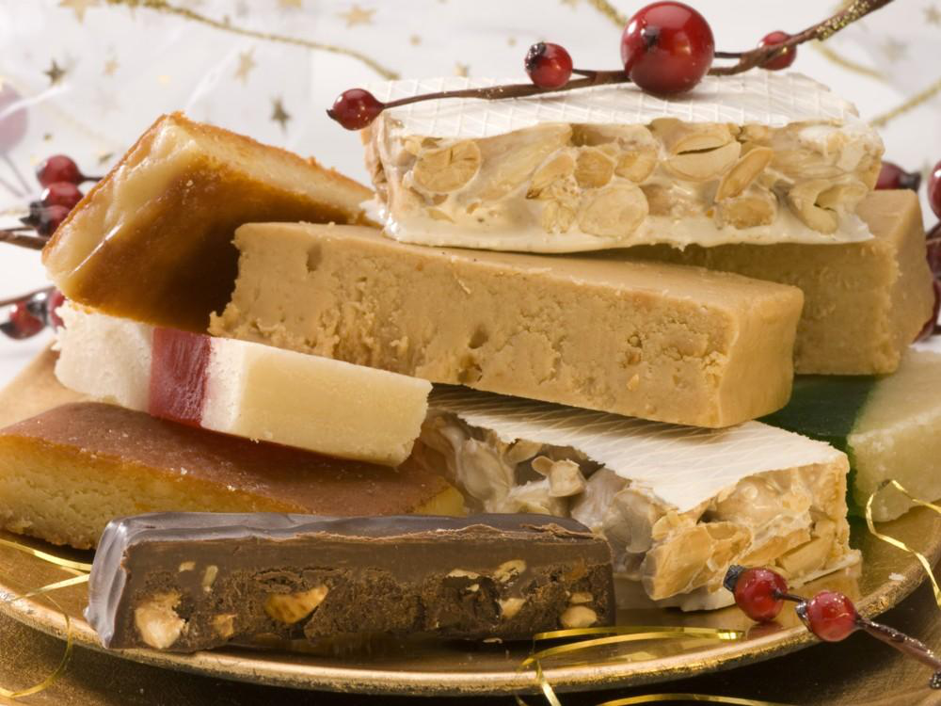
Turrón in Spain today
Nowadays turrón remains one of the most common treats to be offered around the time of the Christmas holidays.
In 2017, the province of Alicante produced over 35 million kilograms of turrón, 95 per cent of which is sold around Christmas time.
23 companies make turrón and 1800 people work in these companies.
The turrón business had an annual turnover of 210 million euros last year.
The country is the biggest exporter of turrón in the world, primarily to South America but also Japan and the Middle East, as well as neighboring countries such as Germany and Italy.

Slide 6
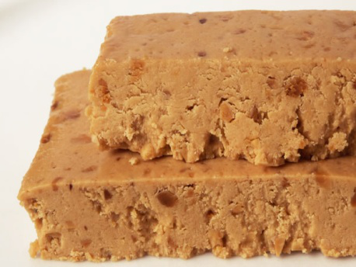
Jijona Turrón
Made for centuries in the Alicante town of the same name, Jijona turrón, with is characteristic golden colour and soft texture, has become one of the most typical Christmas desserts.
Turron is a nougat obtained by cooking honey and adding toasted almonds (usually peeled) and egg whites and then kneading it to form a rectangular or round tablet.
During its manufacture, Jijona turrón undergoes a chopping process that makes the almond lose part of its oil before going through a softening process in which the mixture is evened out until it achieves the typical golden colour and soft texture that characterise it.
Jijona turrón is a food with great energy value, rich in carbohydrates, vegetable fat and protein

Slide 7
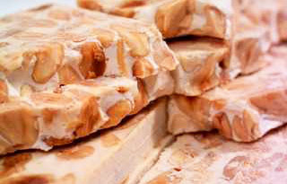
Turrón from Alicante
Of Arabic origins, this sweet, made essentially with an almond base and honey, is indisputably and important item on any Christmas table.
Turron is a nougat obtained by cooking honey and adding toasted almonds (usually peeled) and egg whites and kneading it to form a rectangular or round tablet.
It is characteristically hard and it is known especially for the presence of whole or nearly whole peeled almonds.
Despite the obvious industrialisation of its production, the process is still basically the same as it traditionally has been for centuries.

