Slide 1
December 28th is 'Día de los santos inocentes' or 'Day of the Innocent Saints'
The equivalent of April Fools ‘Day in the UK and USA.
December 28 is the day when everyone is allowed to play practical jokes.
Newspapers and TV stations also run silly stories.
If you trick someone, you can call them 'Inocente, inocente' which means 'innocent, innocent'.

Slide 2
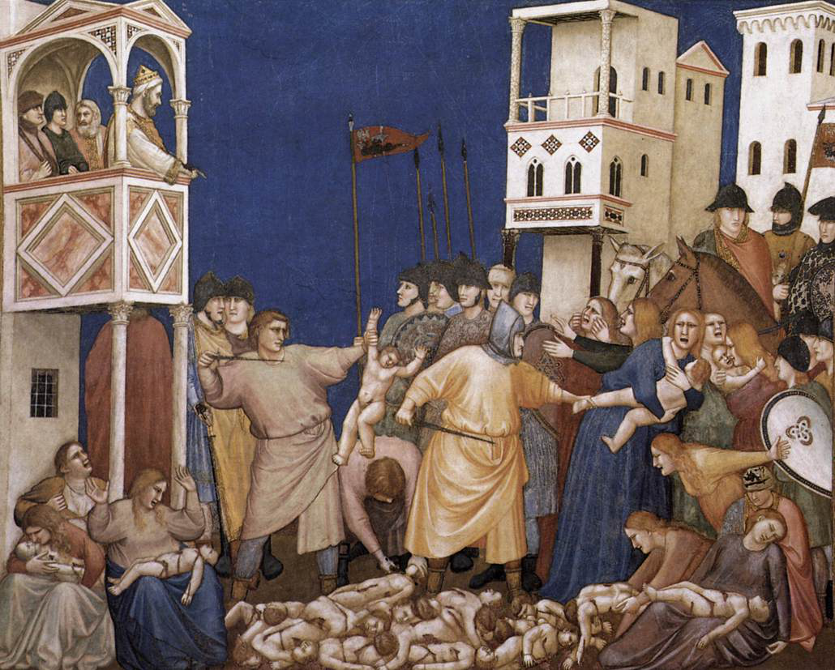
ORIGIN OF THE CELEBRATION
28th December is when people all over the world remember the babies that were killed on the orders of King Herod when he was trying to kill the baby Jesus.

Slide 3
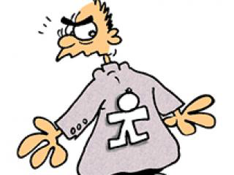
Today most Spanish children play simple pranks like putting salt in the sugar bowl or sticking paper cut-outs on people's backs.
You can find a whole range of joke articles (wigs, itching powder, false ink…) in the numerous Christmas markets (usually located in the large squares in the cities)

Slide 4
Do you want to trick anyone?

