Slide 1
My Christmas❤️

Slide 2
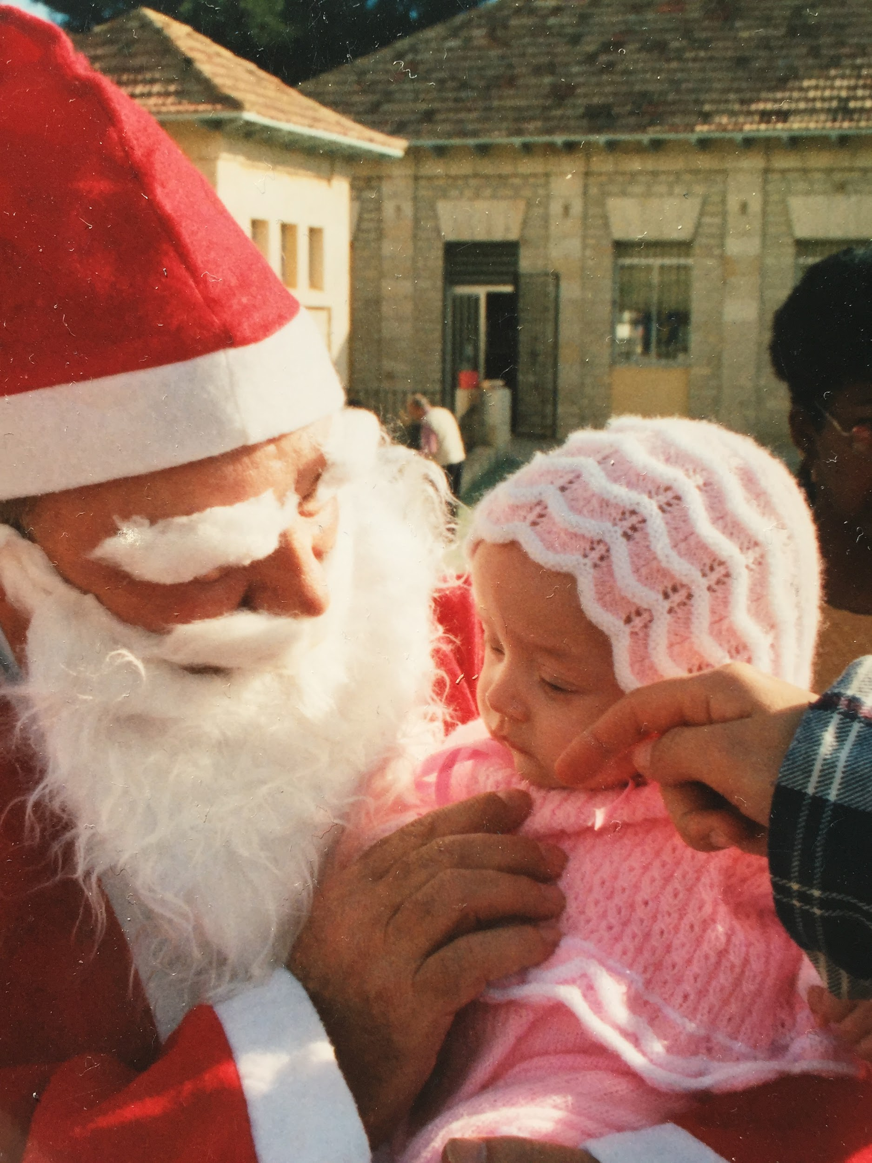
Hello, I am Sofia García Giner and I can’t choose a specific Christmas day since I have a great time every day and for this reason I am going to talk a little bit of a few days..

Slide 3
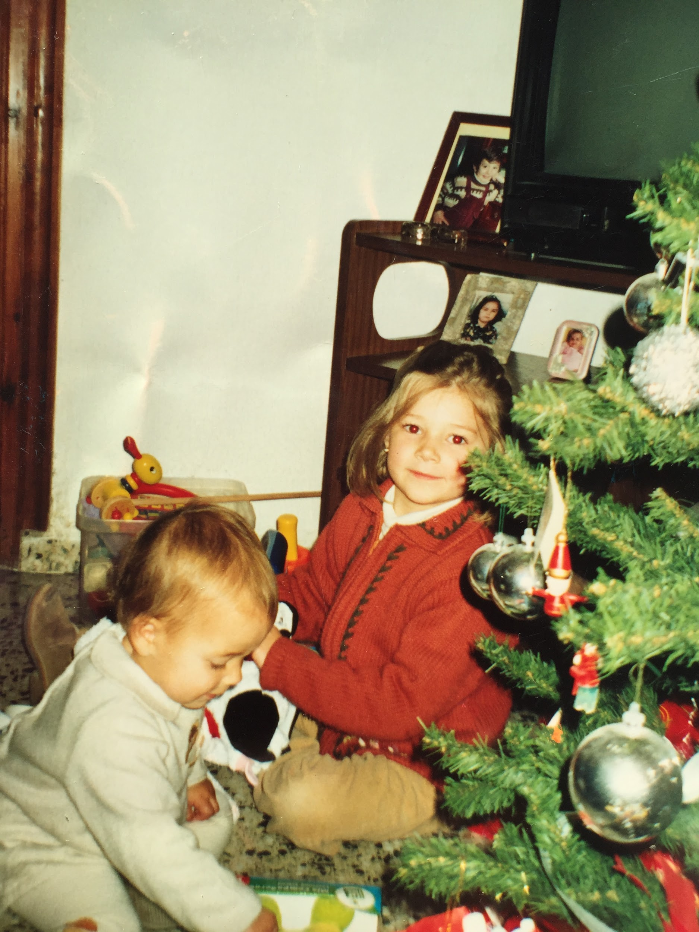
I will start on December 24th that is Christmas’Eve in Spanish “Good night”. This day we have dinner in my house with my maternal grandmother my sister, my parents and my uncle.

Slide 4
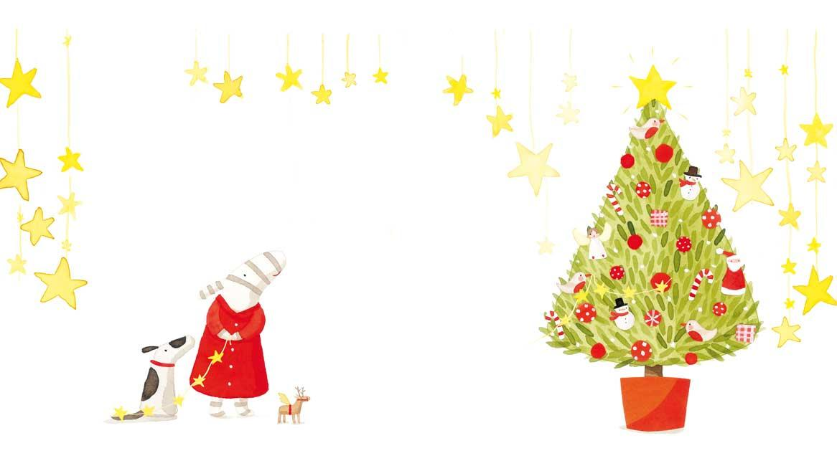
On December 25th that is to say Christmas Day, Santa Claus in the morning brings us some gifts at home after that we arrange and we are going to eat at my paternal grandmother's house, with my uncles and cousins. Before eating, an uncle or older cousin always dresses up as Santa Claus and gives us the gifts. When I was little one year my father dressed up as Santa Claus and I have the souvenir photo. In the evening we always go to my aunt Maria's house and they give us more gifts.

Slide 5
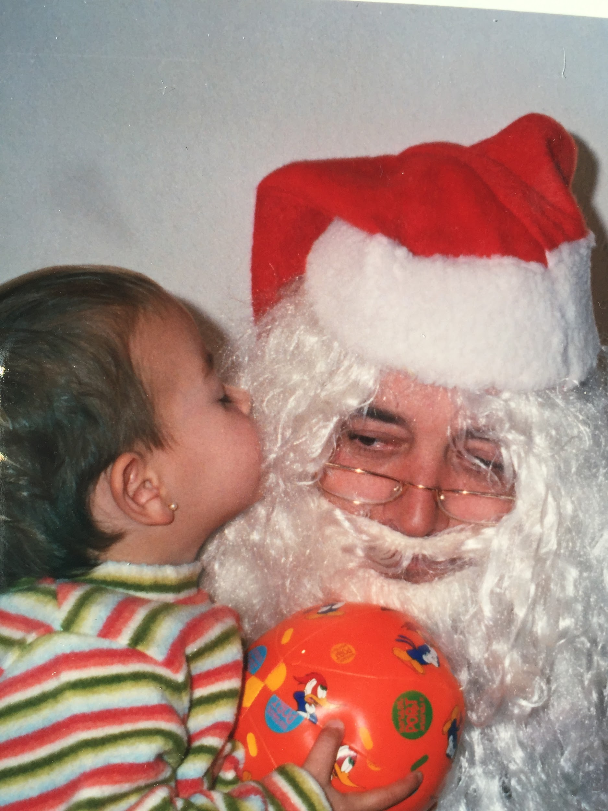
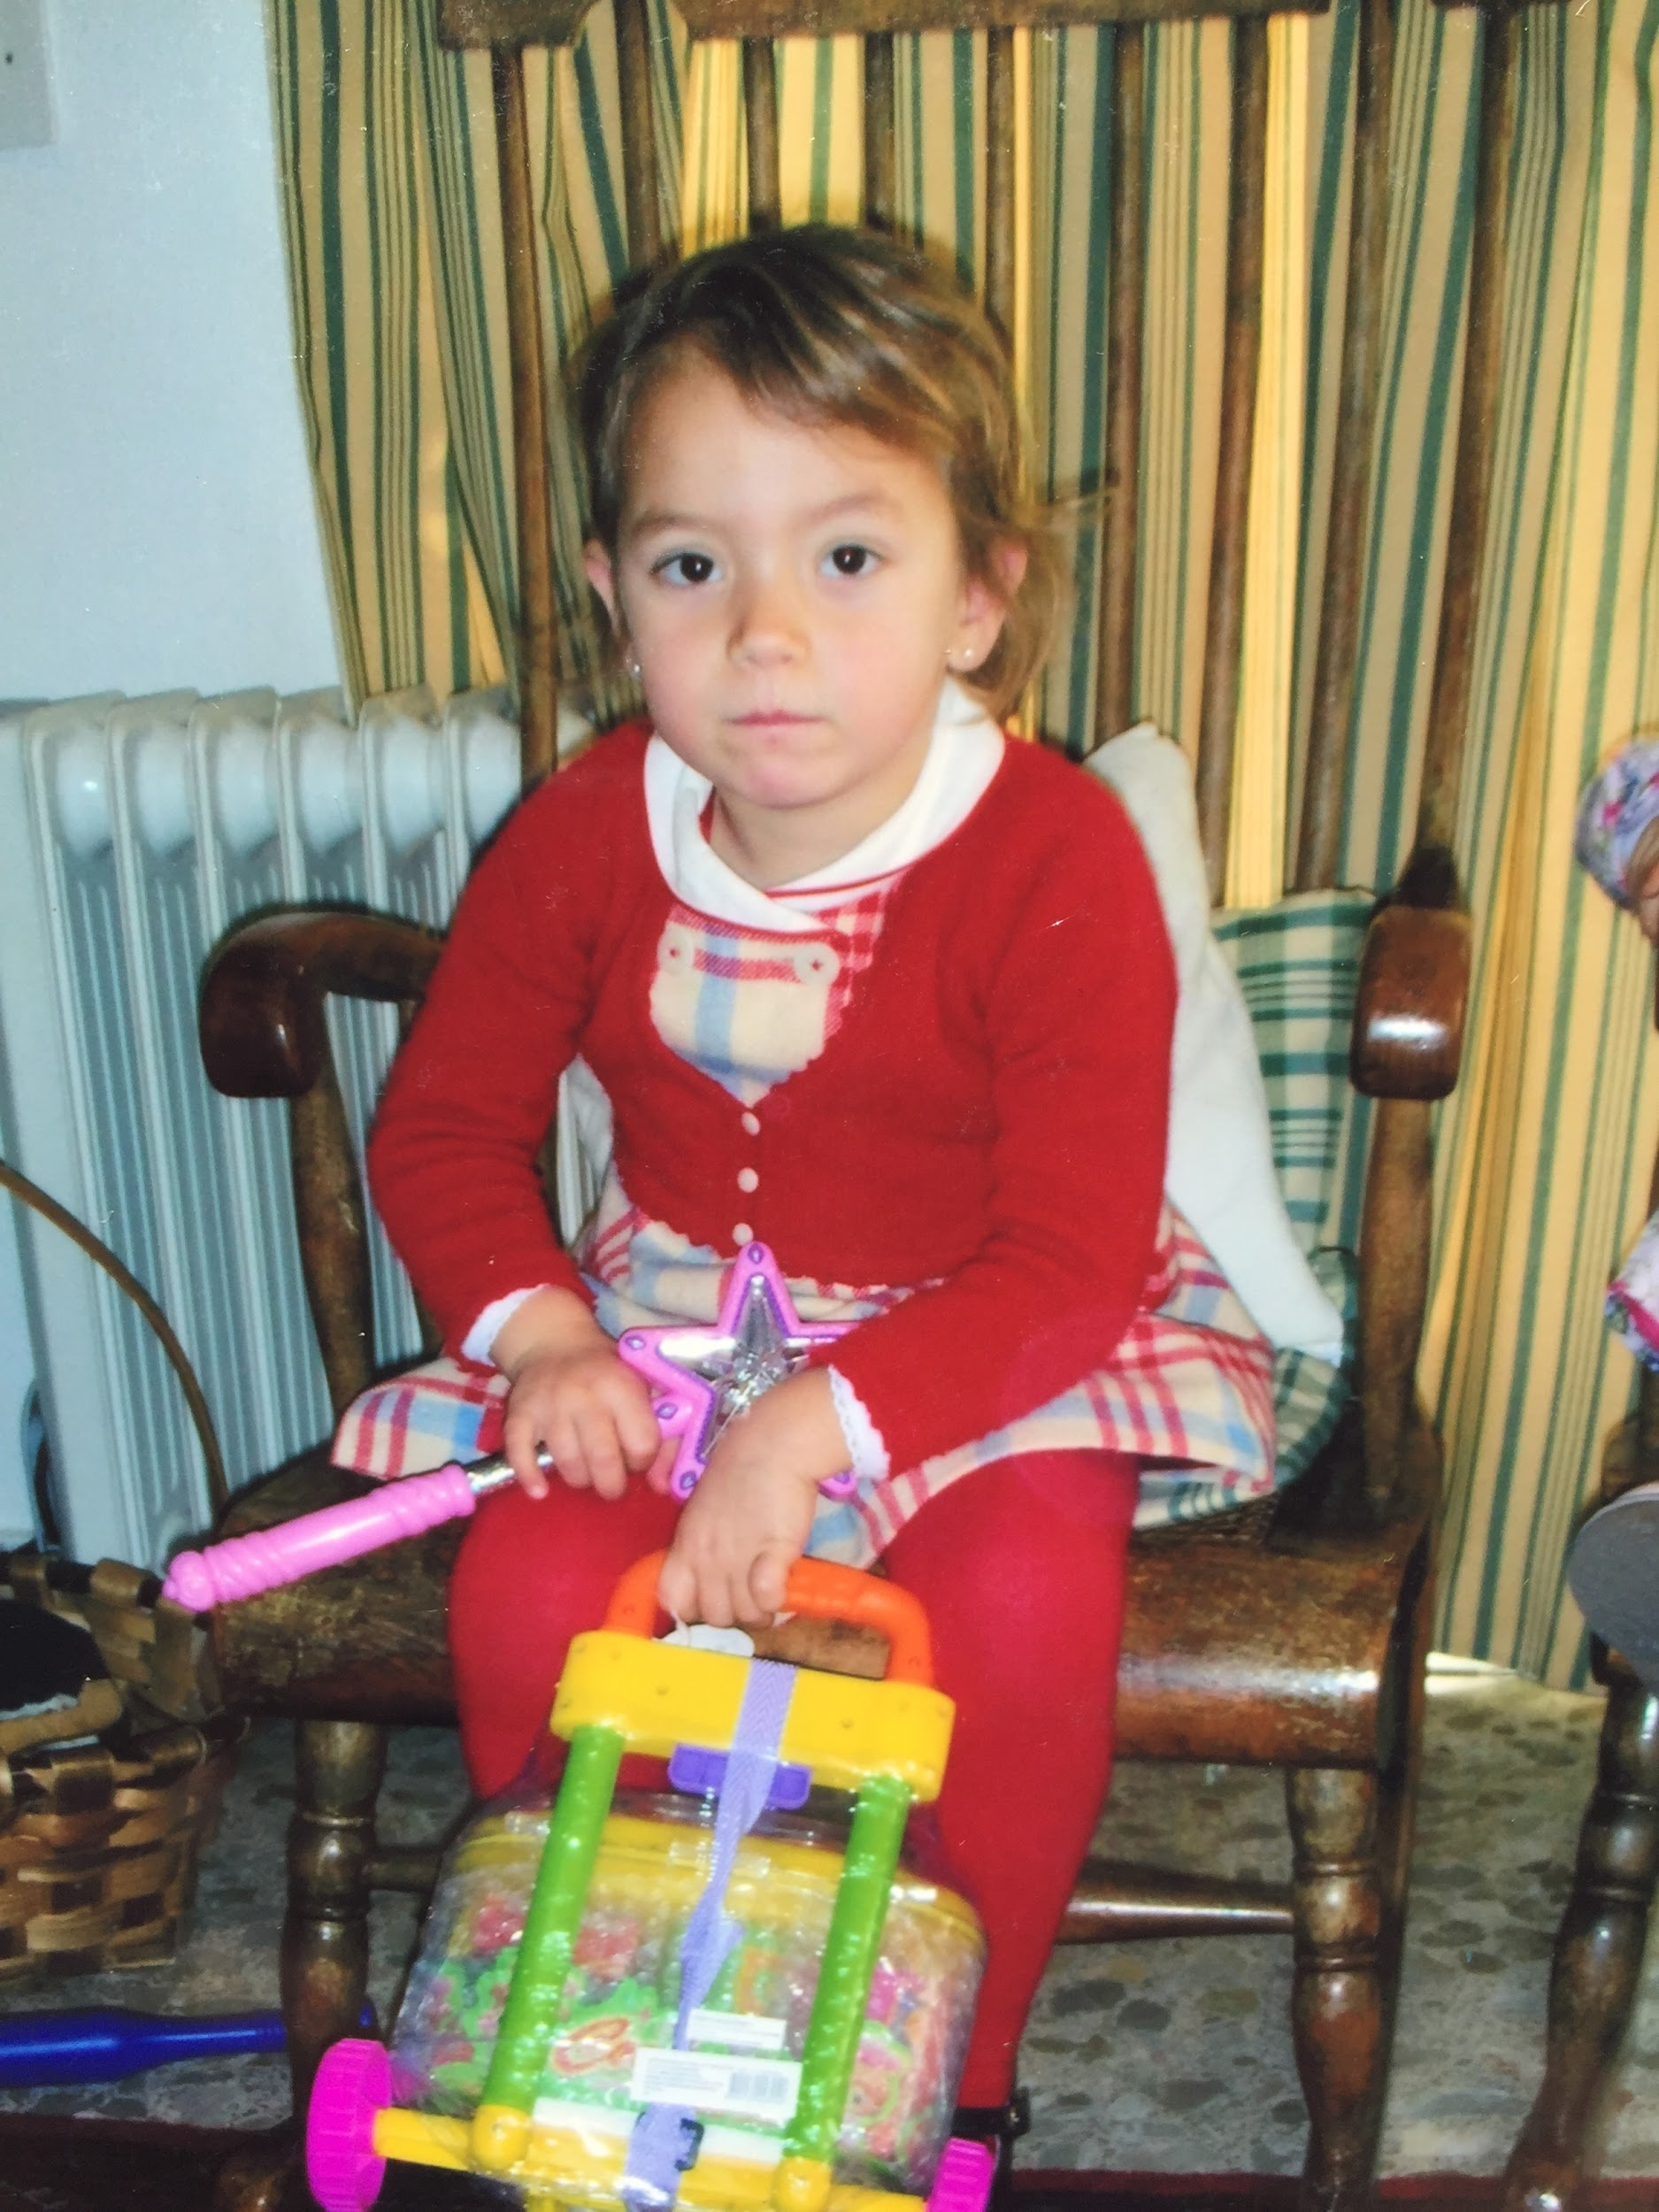
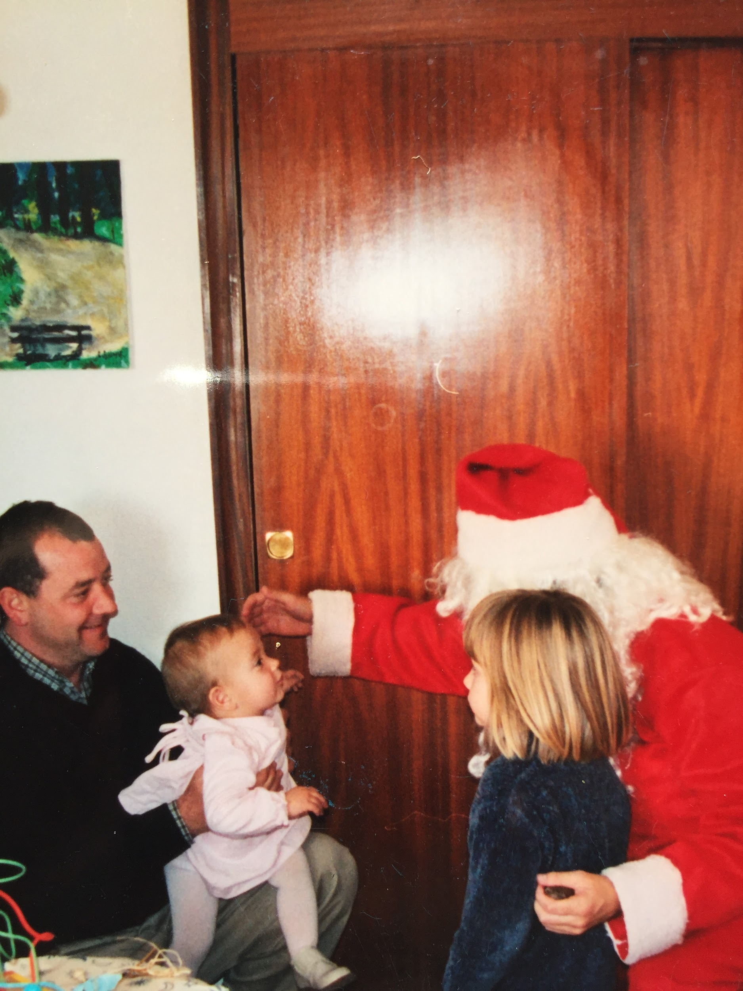
When my sister and I came back home at night,it was very difficult for us to go to bed since we wanted to play with the new toys.

Slide 6
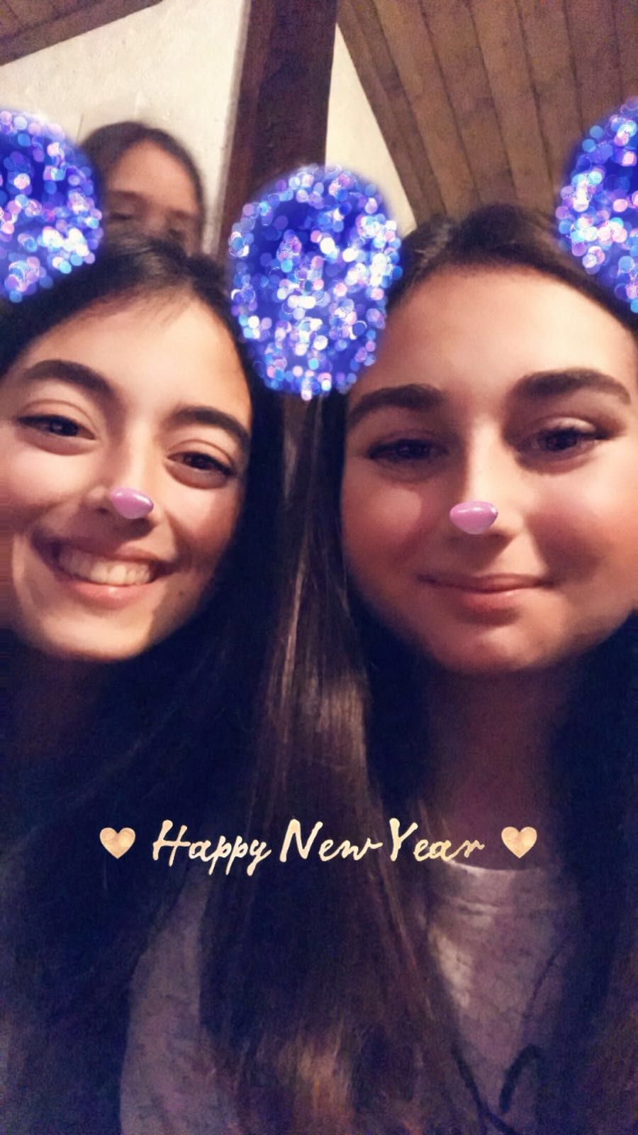
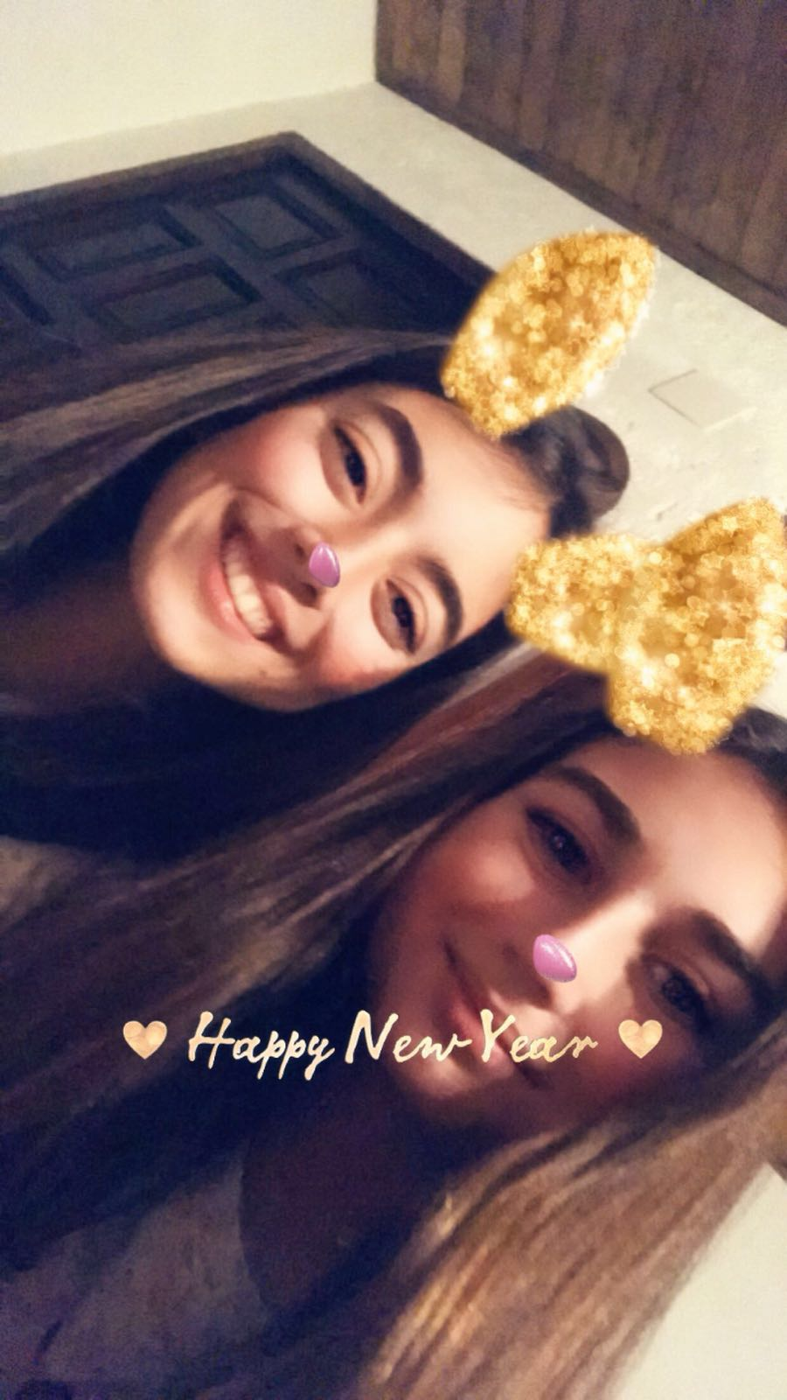
For New Year's Eve we always do some trip with my parents’ friends. Last year we were in Cazorla, in a country house and there we took the 12 grapes, which is a Spanish tradition to receive the New year.

Slide 7
On January 6th we celebrate the Kings’ Roscón. When I was little, we always went to the Three Kings’ Parade in my village (Aigües); then the kings gave us gifts in the church. Now I'm going to the parade as a musician, I play the clarinet in the band. After the parade, all my maternal uncles and aunts and also my maternal cousins ​​and we eat the Kings’roscon with hot chocolate.Inside the roscon there are gifts and a bean. Who gets the bean, the tradition says that he has to pay the roscon the following year.

Slide 8
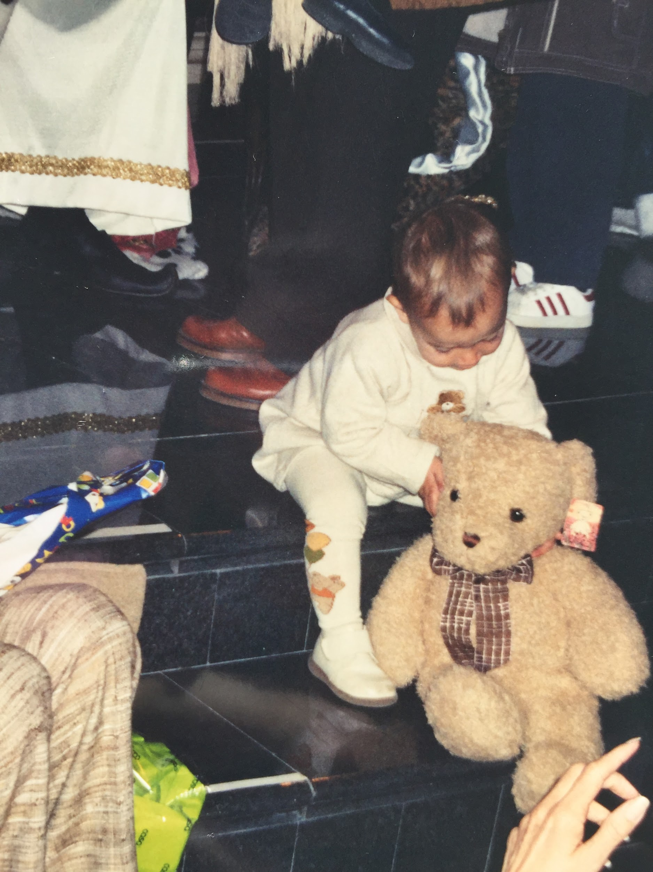
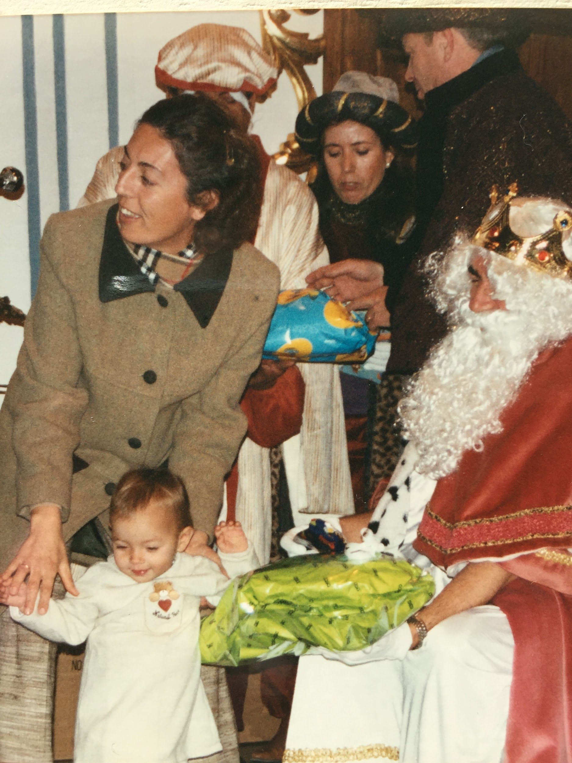
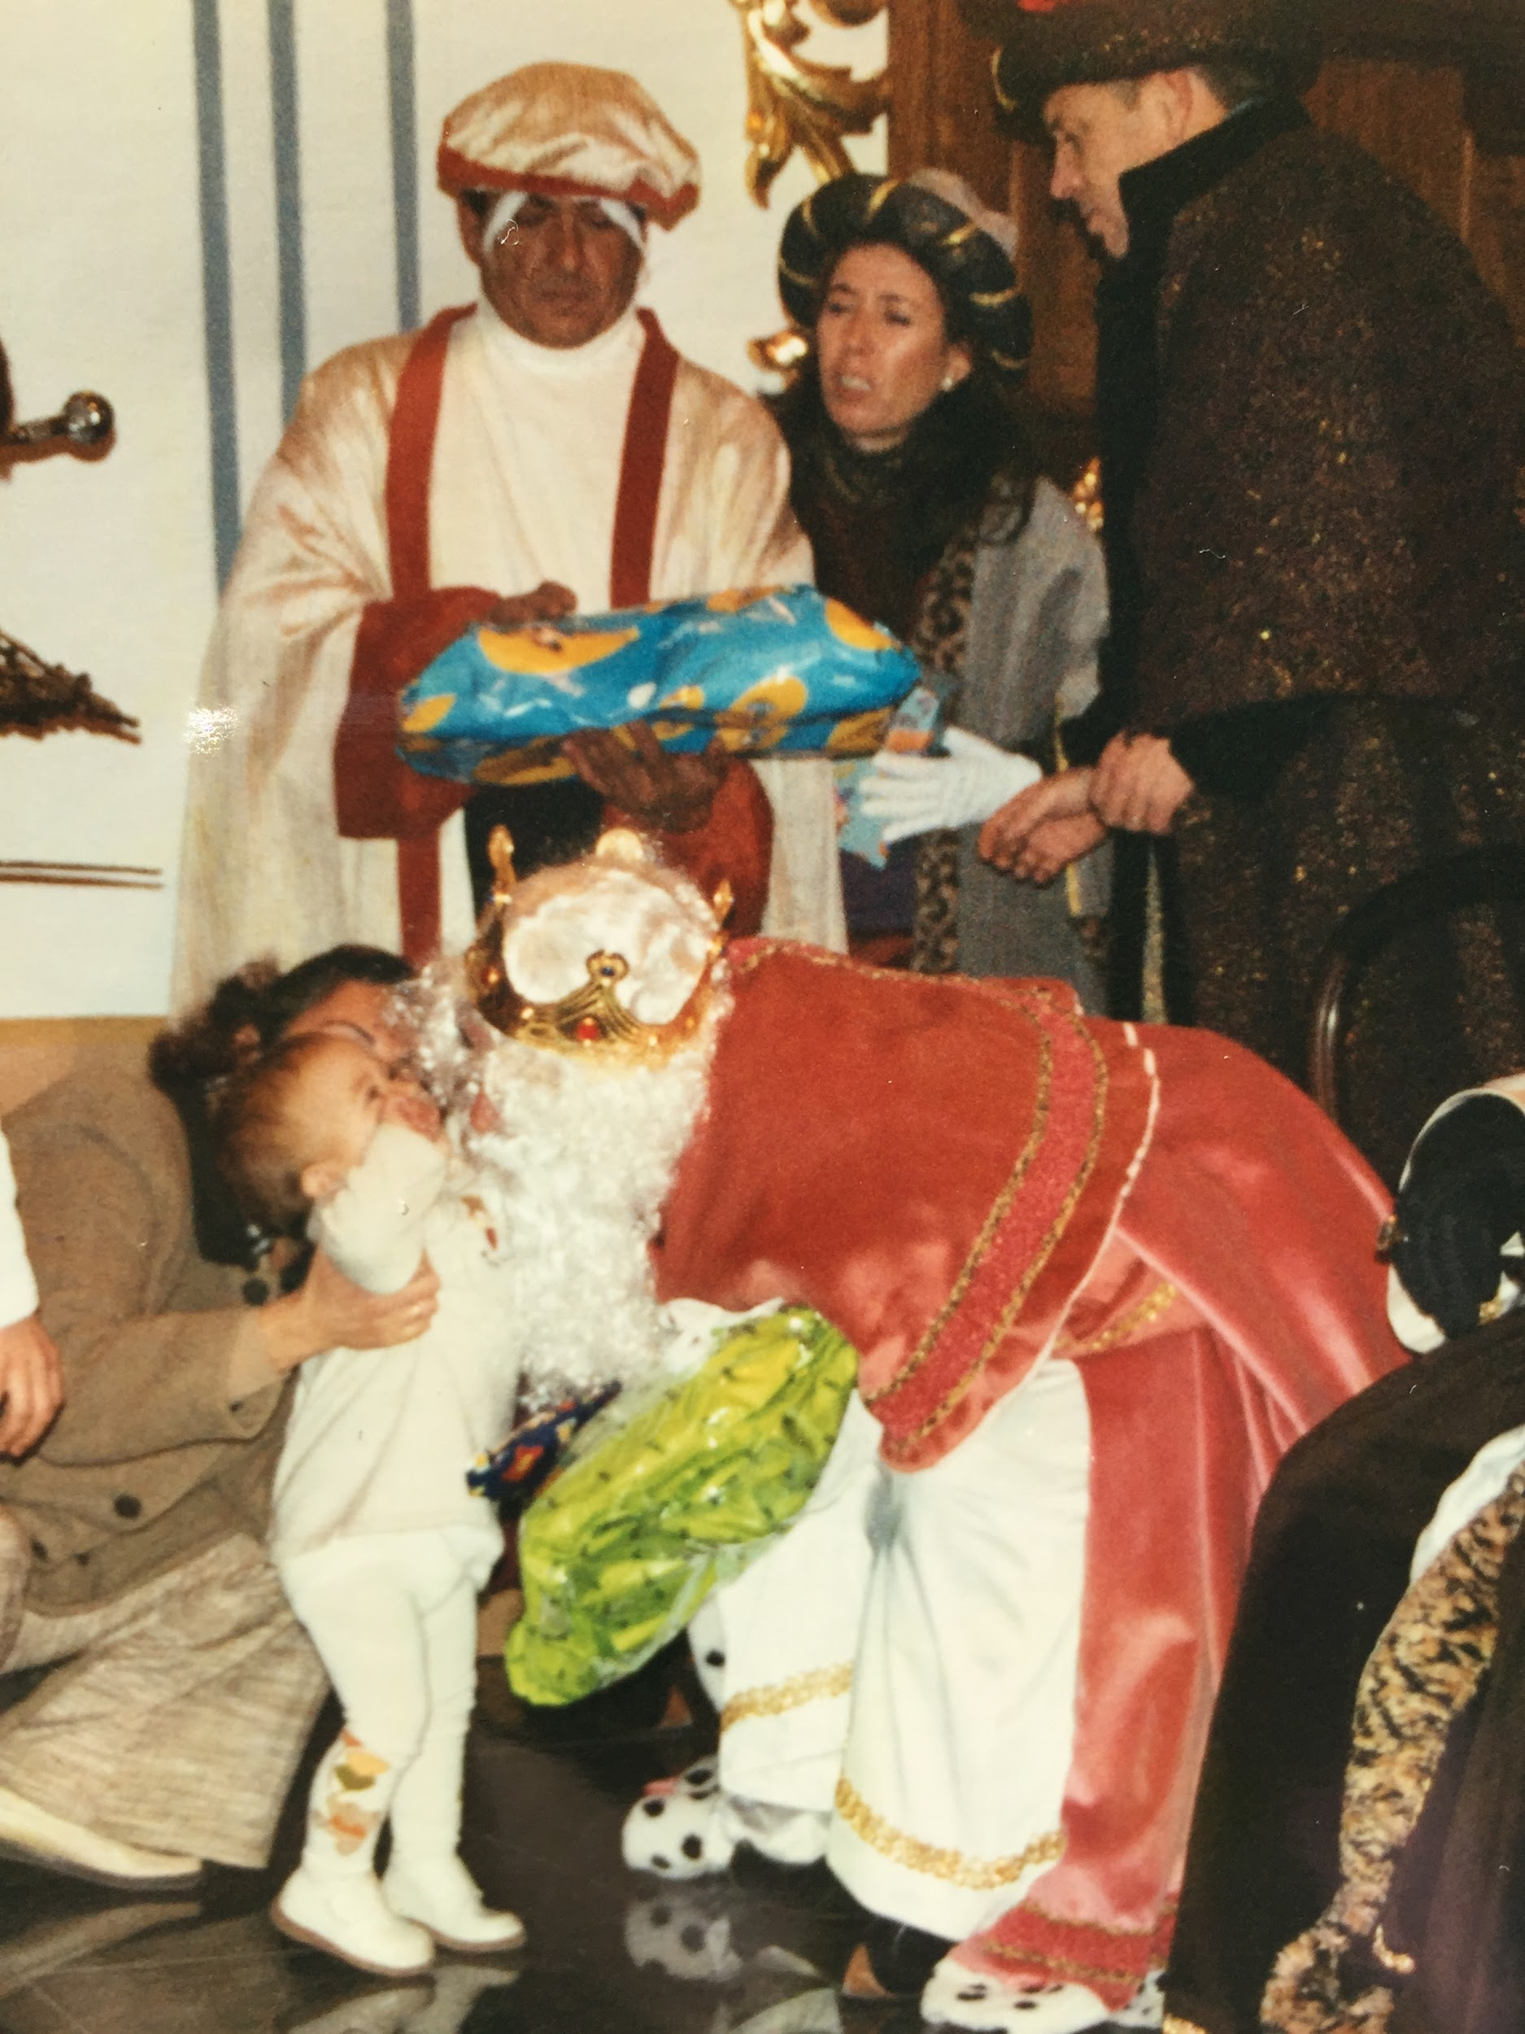
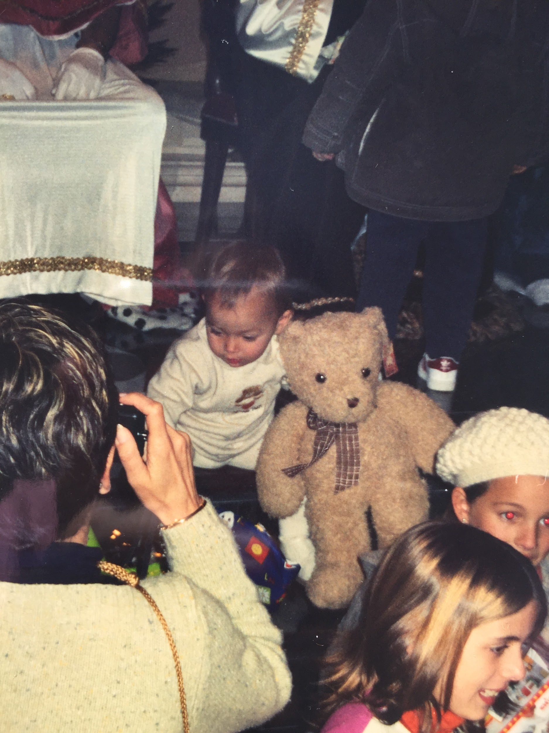

Slide 9
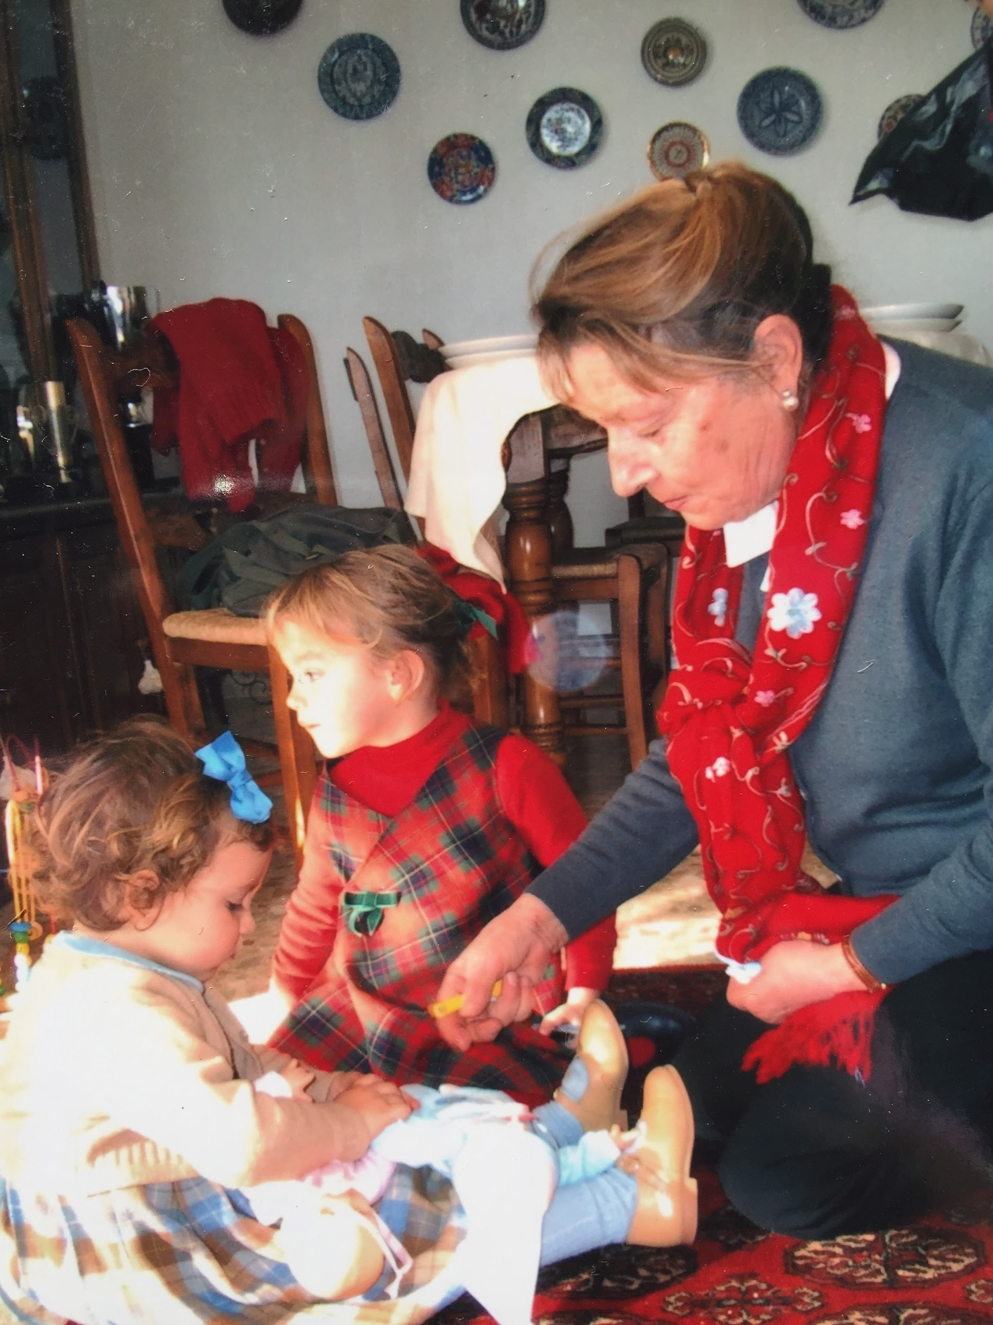
The next day we go back to eat with my uncles and cousins ​​in my paternal grandmother's house and they give us the gifts of their kings.

Slide 10
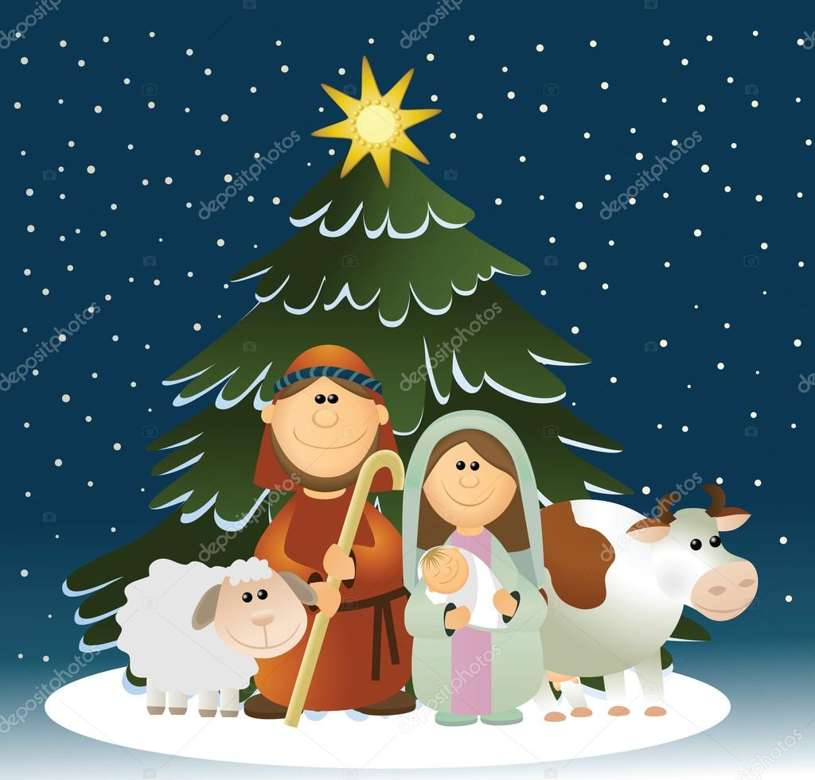
At Christmas, we usually decorate the house with the nativity scene, which are figurines representing the birth of the baby Jesus and we also put the tree, with Christmas lights and decorations.

Slide 11
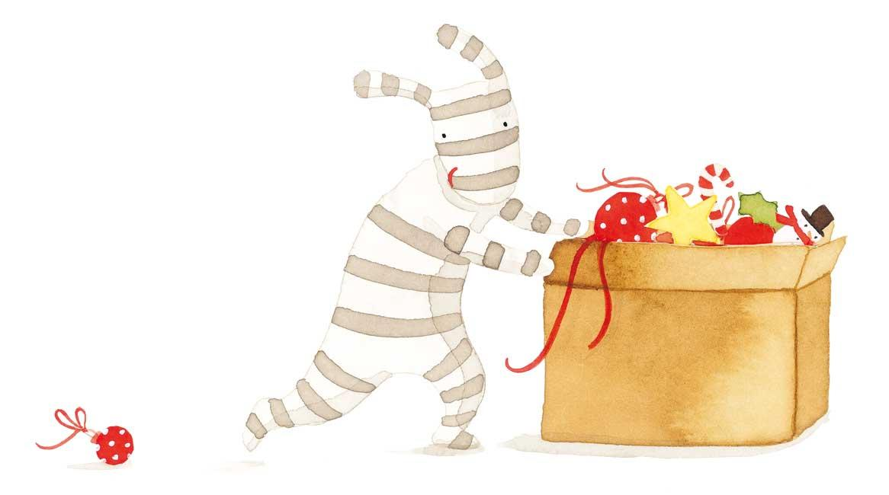
The typical sweet of my town is the almond cake, and also mantecados and almendrados. I usually help my maternal grandmother intheir elaboration. I'm going to write the recipe for the almond cake that is what my grandmother usually does. In case anyone dares to do it, it is very good: It takes 12 eggs, half a kilo of ground almond flour and half a kilo of sugar .

Slide 12
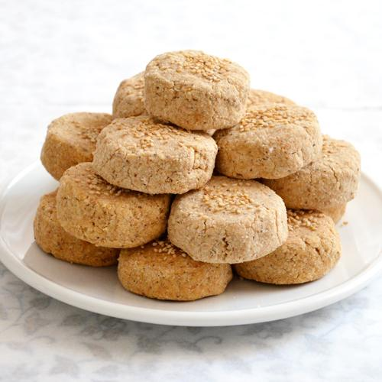
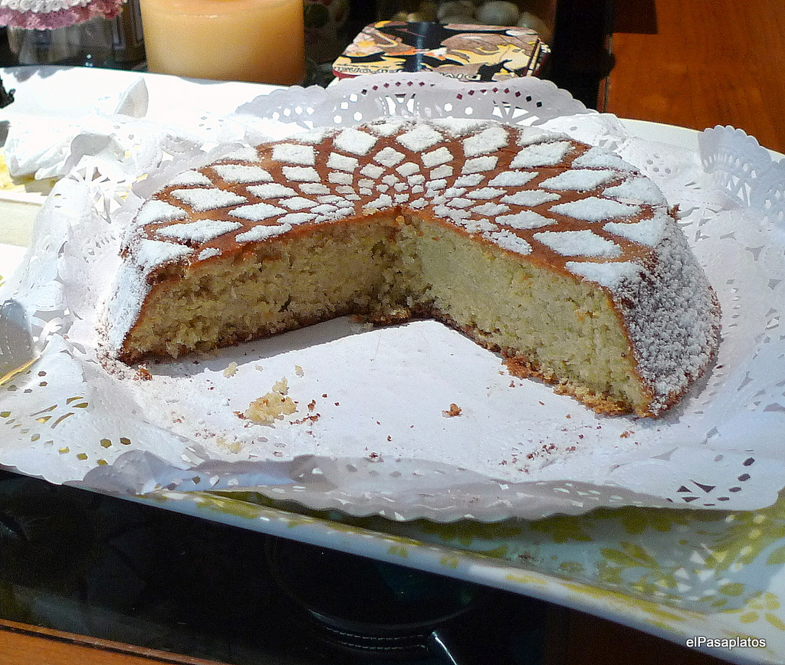
The preparation is very easy: first the white is separated from the yolk and the white one is mounted on the snowy point, the sugar is added to the white one, it is necessary to try not to lower the white one and finally the yolks and then the ground almond are added.

