Slide 1
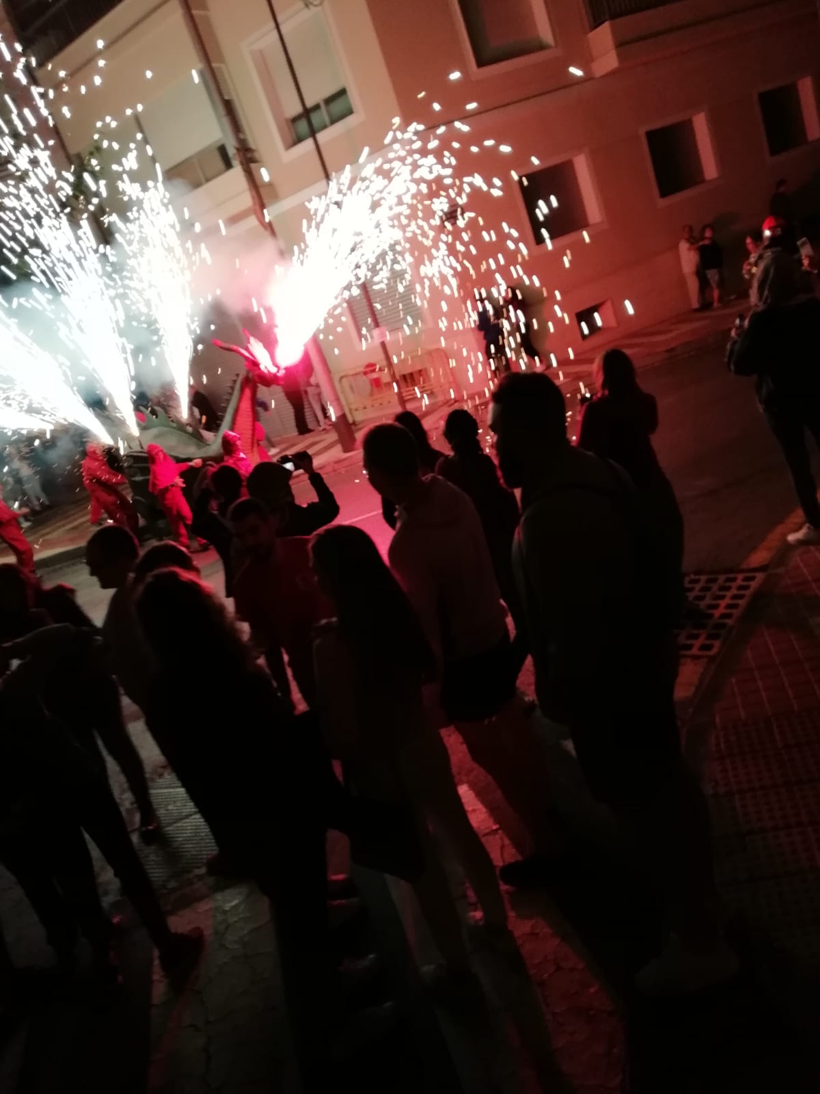
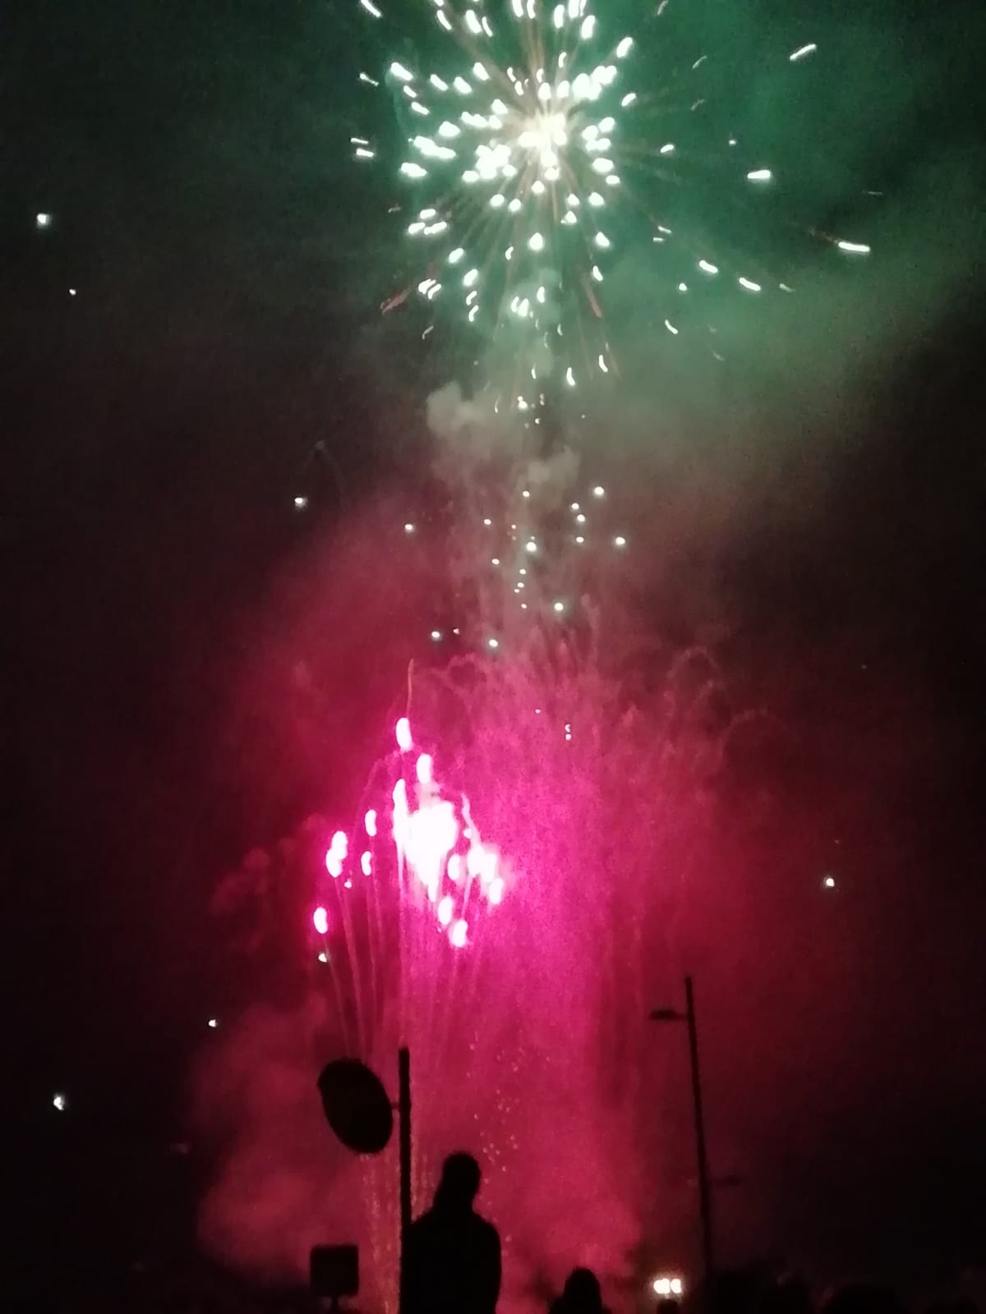
THE CORREFOCS
THE CORREFOC IS A VERY POPULAR TRADITION THAT tAKES PLACE EVERY YEAR IN`EL CAMPELLO´. IN THIS PERFORMANCE GOOD AND EVIL COME HEAD TO HEAD IN A SPECTACULAR WAY.
IN THIS PERFORMANCE SOME PEOPLE ARE DRESSED AS DEVIL AND OTHER CREATURES DANCING AND SPEARING FIREWORKS.

Slide 2
MOORS AND CHRISTIANS FESTIVAL
THIS FESTIVAL IS BASED IN THE MOORISH OCUPATION IN THE IBERIAN PENINSULA AND THE RECONQUEST BY THE CHRISTIANS.
FOR SEVERAL DAYS , THE STREETS ARE FILLED WITH CHRISTIANS WEARING FUR , METALIC HELMETS , SOME ON HORSEBACK READY TO FIGHT AGAINST THE MORS WHO ALSO WEAR MEDIEVAL ARAB COSTUMES.
THE SHOW TAKES PLACE ON THE STREET , WITH BEATIFUL COSTUMES AND AMAZING MUSIC PERFORMANCE WITH LOCAL BANDS

