Slide 1
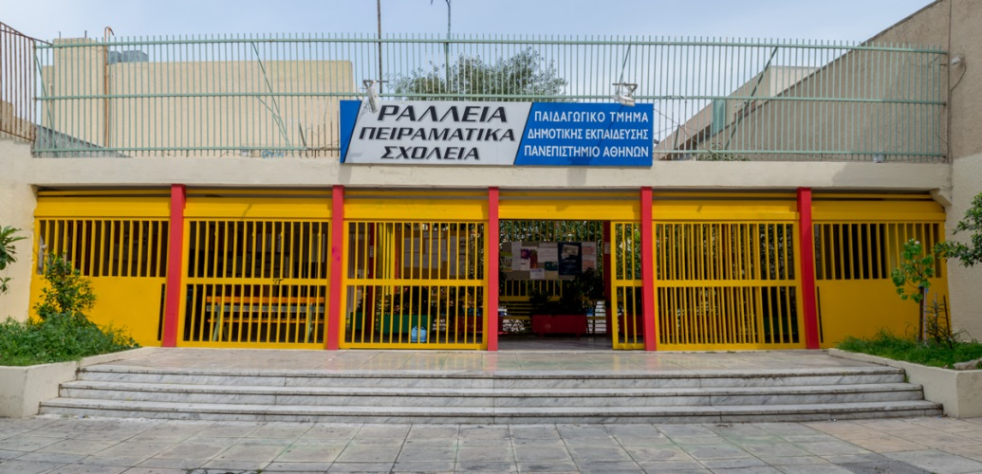
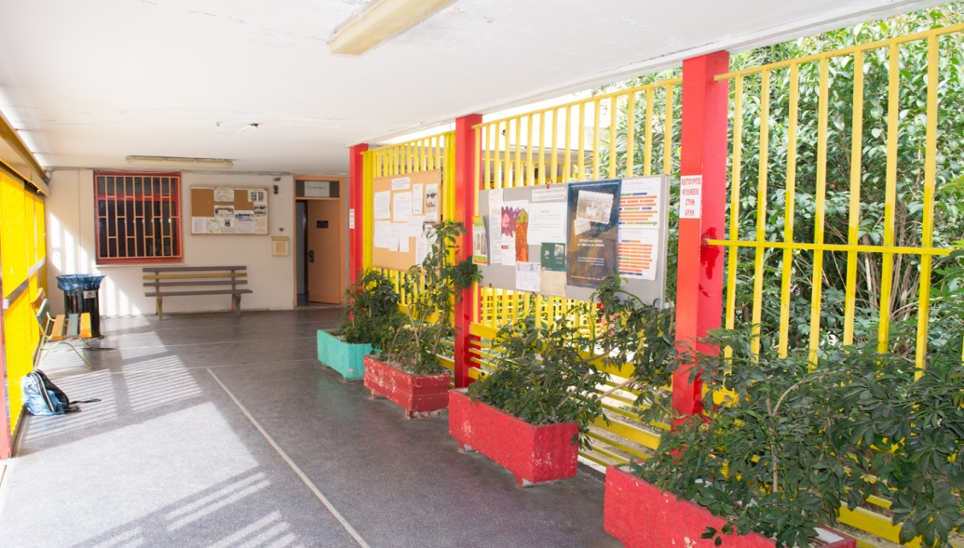
Meet the Greeks!
Ralleio Model Experimental Primary School of Piraeus
Class D

Slide 2
We are the students of Class D in Ralleio Model Experimental Primary School of Piraeus.
There are about twenty-six students in every class, both boys and girls.

Slide 3
Our Class

Slide 4
And now…let’s meet!
Introductory Letters

Slide 5
Aggelos, Boy

Slide 6
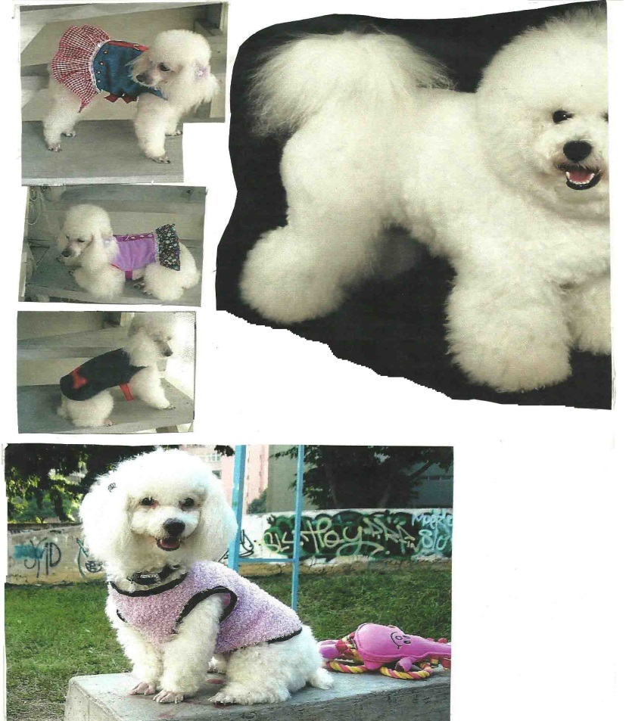
Alexandra, Girl

Slide 7
Andrew, Boy

Slide 8
Claudia, Girl

Slide 9
Haritomeni, Girl

Slide 10
Helen, Girl

Slide 11
Helen, Girl

Slide 12
Irene, Girl

Slide 13
Jason, Boy

Slide 14
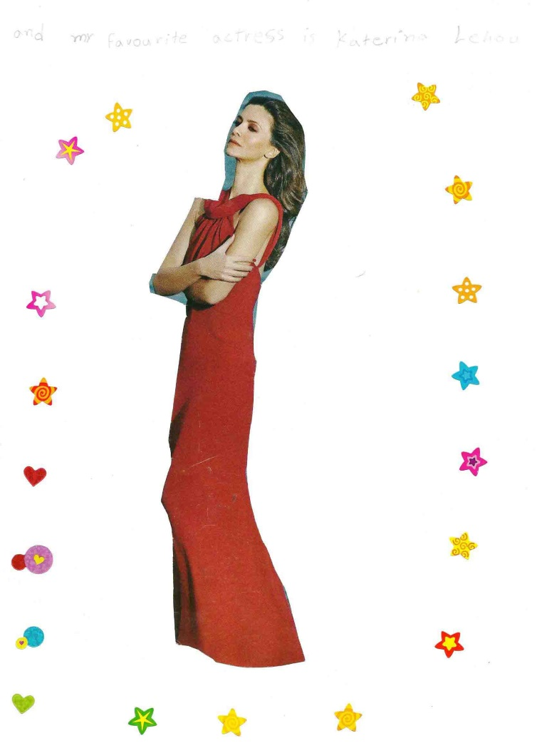
Jenny, Girl

Slide 15
Joanna, Girl

Slide 16
Kelly, Girl

Slide 17
Lucas, Boy

Slide 18
Merkouris, Boy

Slide 19
Nasia, Girl

Slide 20
Nefeli, Girl

Slide 21
Suzanna, Girl

Slide 22
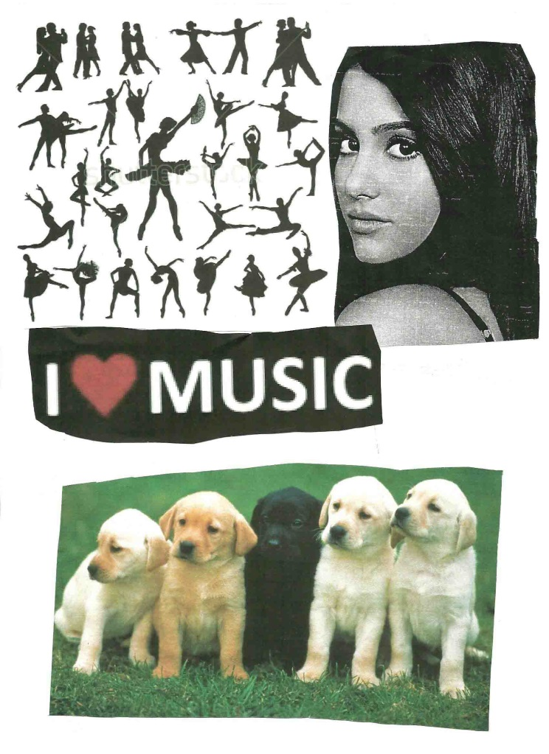
Violetina, Girl

Slide 23
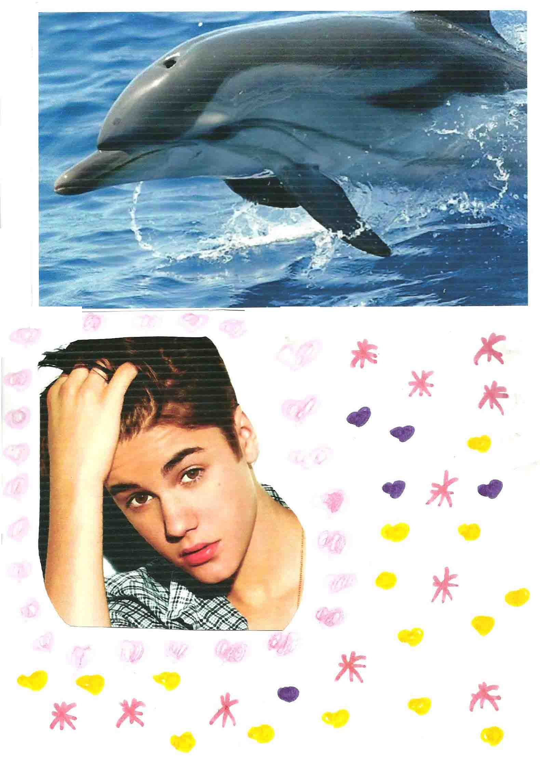
Zoe, Girl

Slide 24
What about you?
We are looking forward to meeting you!
Many happy regards from Piraeus!

