Slide 1
KARPENISSI
PAYLOS-VALADIS-DIMITRIS

Slide 2
KARPENISSI
Karpenissi is a town in central Greece . It is the capital of the regional unit of Evritania.
Mount Tymfristos(2,315 m elevation) lies directly to the north of the town.
Karpenissi has a ski resort and is a popular destination, especially during winter.

Slide 3
PHOTOS
CENTRAL KARPENISSI
MAP OF EVRYTANIA

Slide 4
KAPRENISSI SKI RESORT
Over the beautiful slopes of Mount Tymfristos (Velouchi) modern facilities welcome you offering all the amenities to enjoy your favorite sport or the breathtaking view of the whitewashed snowy landscape!
If you decide to "go" to Karpenissi, remember that it will be very easy to get up there ....!
Fans of skiing, beginners or advanced in their possession 18 tracks of high standards, which meet every difficulty or experience.
The organized snowboard track offers intense and fun moments to sport lovers, but also to ordinary viewers. As for the more daring and adventurous of you, you can look for more action in a very interesting free route (off piste) which are four in total!
The facilities of the Ski Centre Velouhi also feature modern lifts, which operate with the highest safety standards.
Visit now the Ski Center Velouhi, "climb" in mood and ... good routes in the vast white!

Slide 5
PHOTOS OF SKI RESORT

Slide 6
SPORTS CENTRE
Karpenissi is one of the finest sports centers in Europe that can accommodate a variety of sporting events. The national football and basketball teams, track champions and Olympic champions, are only a few of those who used the perfect athletic facilities, to complete their preparations, shortly before their wonderful journey in the European and global sport. There are two football pitches with grass, one of which even has grandstands and track with tartan. There is also a tennis throwing 128 m. in length, with turf. All outdoor tennis is illuminated with professional projectors.
At the same time there are nine playgrounds and a natural ring road jogging 2 km in length. On site facilities indoor training room with team sports, straight track 80 m. And three routes, two fitness rooms, changing rooms, sauna, federations offices, physiotherapy room and Ergometric Medical Center.

Slide 7
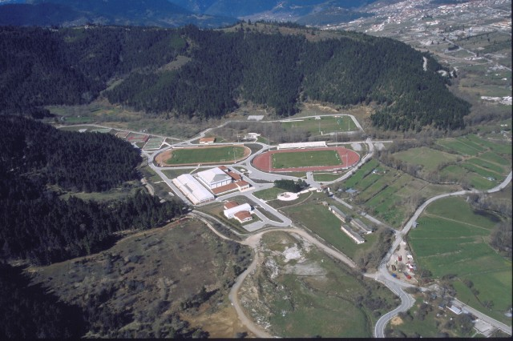
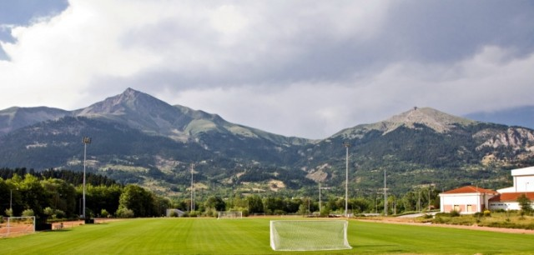
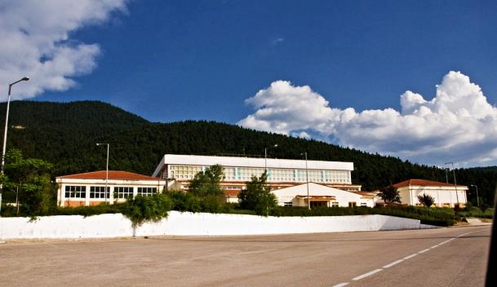
PHOTOS OF SPORTS CENTRE

Slide 8
ALWAYS RAINING GORGE
One of the most spectacular and beautiful areas of Evrytania is the Always raining gorge located between the villages Roska and Doliana or otherwise Stournara (Doliana and Stournara is the village) south of the county.
The name is because in one area of the gorge which does not exceed a length of 80m icy waters that come from the steep mountain Kaliakouda in their effort to become one with the water of the river Krikelioti find a way out from sources in the tops of the canyon creating beautiful waterfalls, due to the large amount but the flows are not continuous and compact but decays into a wide range of small and large drops creating a continuous artificial rain turning the already beautiful scenery breathtaking.

Slide 9
ALWAYS RAINING GORGE PHOTOS

Slide 10
THANKS FOR WATCHING!

