Slide 1
Our town!♥
BY:
VASSILIKI
SANDY
CHRISTINE
DIMITRA

Slide 2
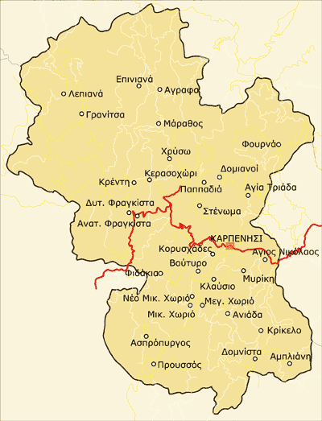
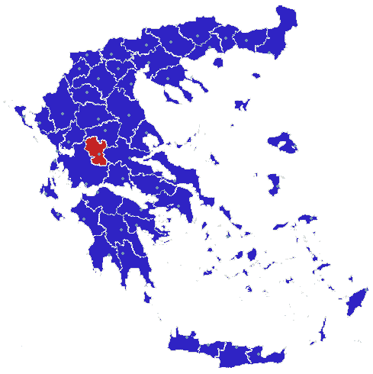
KARPENISSI:A VERY INTERESTING TOWN!!!
Karpenissi is the capital of the prefecture. Located in the center of the county, on the southwest side of Velouchi at an altitude of 960 meters. It’s a mountainous town.

Slide 3
velouchi
Located 11 km from the Karpenisi is the ski ing center Velouchi. Tymfristos or Velouchi are mountains of Central Greece. It has an altitude of 2,315 meters and occupies a large portion of Evrytania and county Fthiotida. Bounded on the north by the Blank, and on the south by Vardousia and Kaliakouda. East lies the plain Sperchios. Covered by dense forests and is covered with fir trees for the most part.

Slide 4
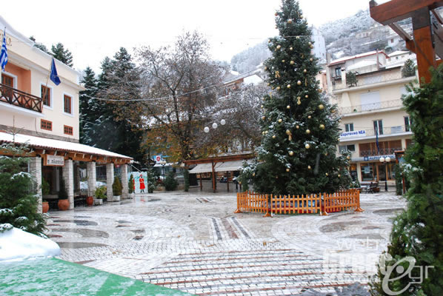
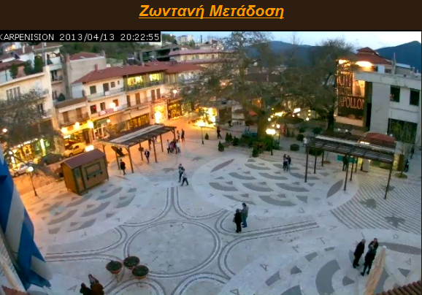
Images from our square!!!☻

Slide 5
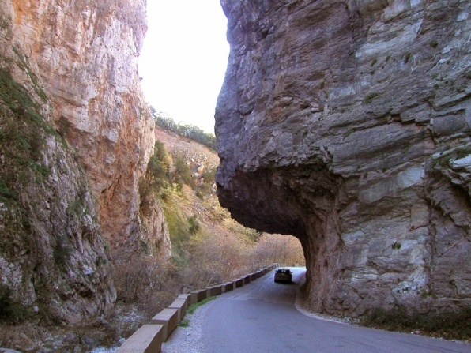
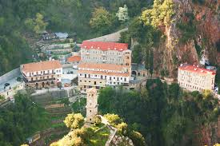
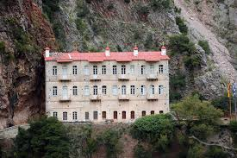
proussos
Proussos Monastery is a monastery of the prefecture. Located 31 km south of Karpenissi and 53 northwest of Agrinio, 2 km from the village, and a spiritual and pilgrimage center of the entire region. It is built in an impressive landscape, a steep, rocky area between mountains Chelidona, Kaliakouda and Mountains Panaitolikou, which is overgrown with trees.

Slide 6
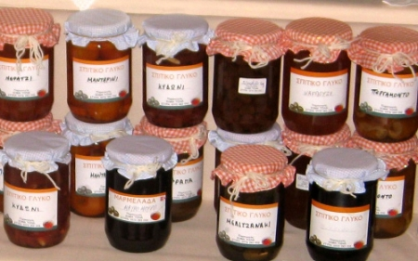
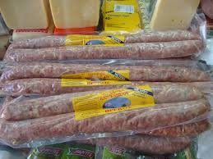
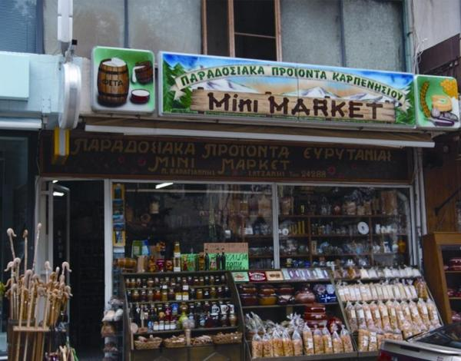
LOCal products of karpenissi
The ski center Velouchi can be the first consideration in all hearing the word "Evrytania", the county, however, owes much of its reputation in local products. Based on natural ingredients that generously provided by nature in Evrytania, locals make delicious desserts, dairy and cheese products.

Slide 7
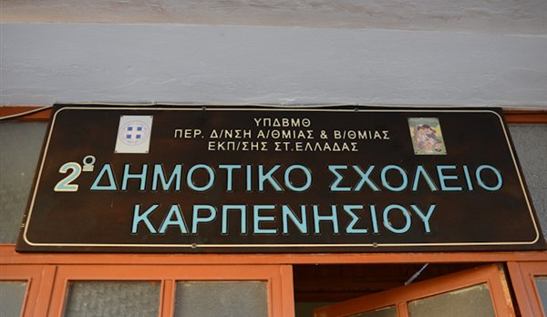
….and here is our school!♥
Isn’t it beautiful?

Slide 8
Bye for now!!!♥
Thanks for watching!
We hope you enjoyed our presentation!!!

