Slide 1
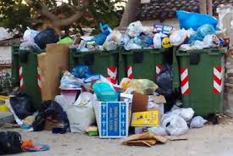
Rubbish: a problem that torments us all!!!

Slide 2
The RUBBISH!!!
In our days the problem with the rubbish is big !!! In the age we live, in our country should realize that the development and economic prosperity if not keep up with the protection of the environment and quality of life resulting in confusion. Rubbish is a live example of this finding.

Slide 3
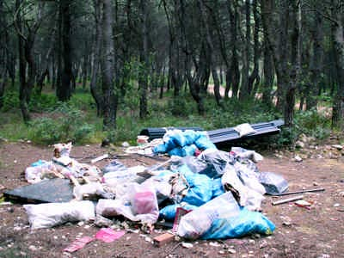

Slide 4
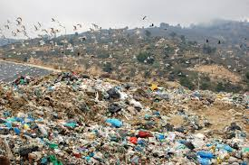
RESULTS
FROM ONE TO MANY

Slide 5
A solution!
R
E
C
Y
C
L
E

Slide 6
RESULTS
=

Slide 7
THANKS FOR WATCHING !!!

