Slide 1
HELP THE ENVIRONMENT!!!
By Vassilliki

Slide 2
The destruction and environmental pollution is a serious health, social and international problem. For this destruction is liable over all the man. The last four hundred years was a overgrowth of mankind. But man is not able to overcome the problems posed by the consequences this increase on the environment. The increased needs of the human population related to securing housing, food, labor, mode of transport, and with accumulation of unwanted substances. Much used for crops and for development of cities or develop roads.

Slide 3
FORMS OF POLLUTION
The atmospheric air.
The solar radiation.
The temperature.
Moisture.
The air movement.
The wellness area.

Slide 4
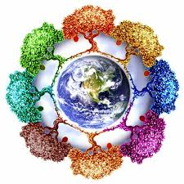
Of great importance for the human body also has the climate that distinguished:
In the marine
In the continental
In the mountain
The current climate has undergone significant effects of human intervention in the environment, mainly in big cities compared to small towns and villages.

Slide 5
For this, let's do what we can to help the environment! It's up to us!!!

