Slide 1
Nice to meet you!!!
The students of the 6th Grade,
2nd Primary School of Karpenissi.

Slide 2
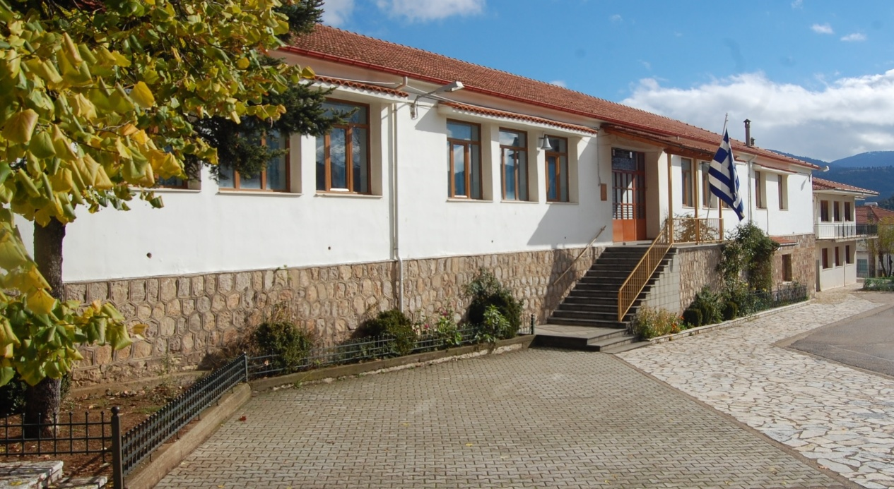
Here are a few words about us.

Slide 3
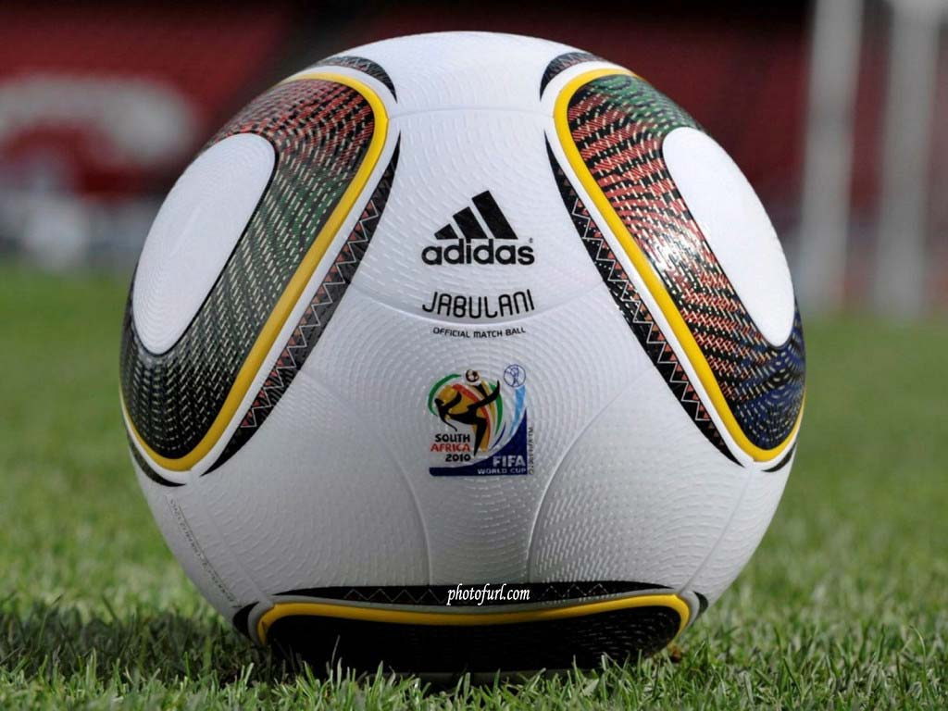
Hello! I am Andrew from Karpenissi. My hobbies are playing basketball and football. My dad’s name is Kostas and he is a ranger. My mother’s name is Maria. My sister’s name is Angie or Aggeliki and she is in college in Volos.

Slide 4
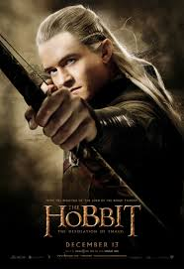
Hi my name is Christine and I’m 11-12 years old. My favourite animals are the wolves, the cats, the leopards and the dogs. My favourite colour is blue. I love reading books and my favourites are ‘the Hobbit’ and the ‘‘Trilogie of Worlds’’. My favourite films are “The LORD OF RINGS”, “The star of north”, “The Hobbit” and “Harry Potter”.

Slide 5
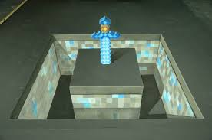
Dear friends, Hello, my name is Tolis and I am eleven years old! My favorite hobbies are playing minecraft , uploading videos in YouTube and I also like skate-boarding. My favorite foods are pastitsio and @#GYROS. My mother’s name is Litsa and my father’s name is Nikos. I live in Karpenissi, Greece. Thanks for all ☺

Slide 6
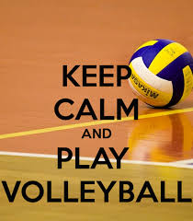
Hello guys!
My name is Penny Tassiou and I am from to Karpenissi. I am eleven years old and my favourite sports are volleyball and football. My favourite colour is purple. My best friends are Eve, Marianna, Efthimia , Nadia and Bessy. When I grow up I will become beautician.
I would like to meet you very much!!!!!!
Bye, Penny

Slide 7
Hello! My name is Konstantina Feggou. I am 12 years old. I like Volleyball and ski. Volleyball is a very good hobby. When I grow up I will become a volleyball player and a beautician. My favourite foods are pastitsio and soufflé. I like computer games. My favourite colours are blue, pink and turquoise. I live in Karpenissi. I like Karpenissi.
Konstantina

Slide 8
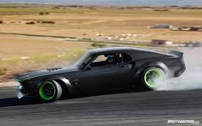
Hello! My name is Marios and I am eleven years old. I have got a sister . My sister’s name is Eri. My dad’s name is Billy. I live in Karpenissi. I love drifting.

Slide 9
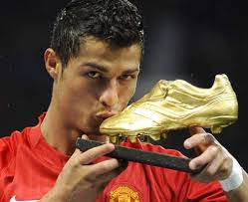
Hello. I’m Fanis and I’m eleven years old. I like football and I’m so good. On weekends I go to the sports field and
I play football with my friends. My favourite colours are red and blue. I live in Karpenissi and when I grow up
I want to become a policeman.

Slide 10
Hello, my name is John Karagounis and I am 12 years old. My favourite subject is Maths. When I grow up, I will become an actor, in which I am talented. I come from Athens and I live in Karpenissi.

Slide 11
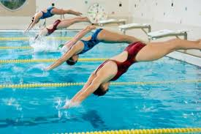
Hello!
My name is Konstantina and I am 11 years old. I am from Karpenissi and Rethimno. My favourite colour is pale green and my favourite subjects are P.E., Art and Science. I have got a brother called George. My mum is a hotel owner and my dad is a businessman. My hobbies are gymnastics and swimming. I like going skiing and reading books. My favourite food is pastitsio.♥

Slide 12
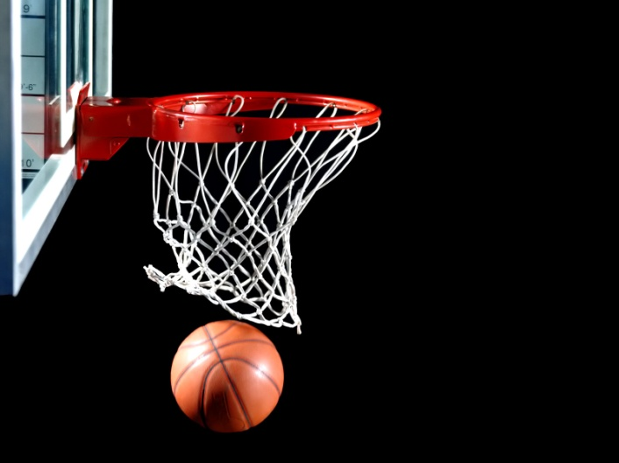
Hello! I am Jim. I live in Karpenissi. My hobby is basketball and I love drifting. I go racing in a car. I have one sister. My father is a fireman.
My mom’s name is Ioulia.
My town is beautiful.

Slide 13
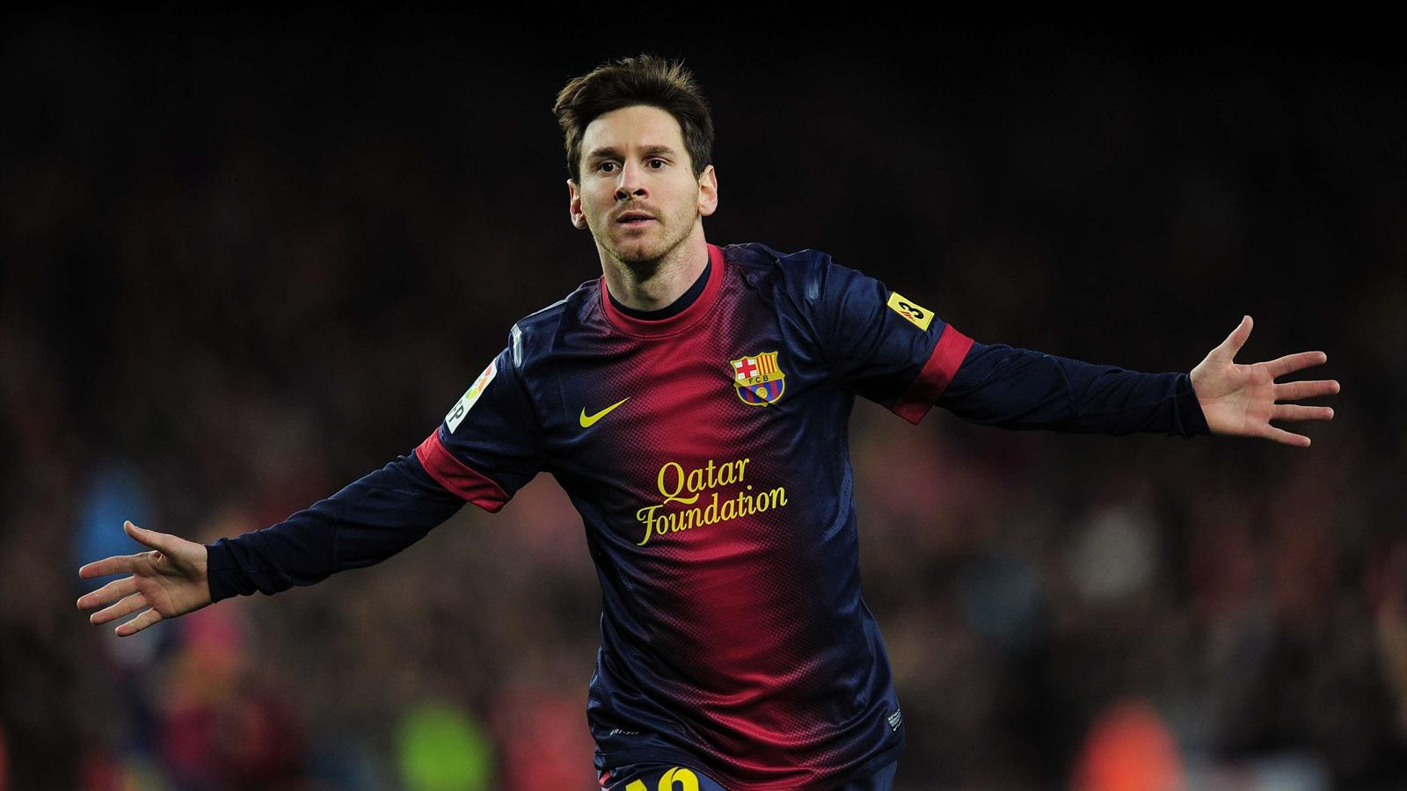
Hello, my name is Jim. I am from Karpenissi. My favourite hobby is playing the guitar and football. I am 12 years old. When I grow up I will become an archeologist.
I like spaghetti. My favourite computer game is Fifa 2014.

Slide 14
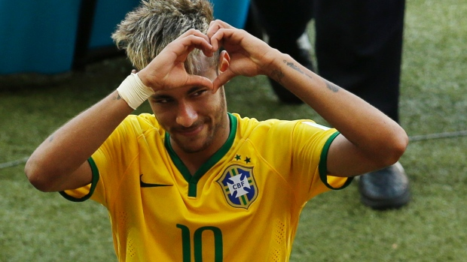
Hello, my name is Bessy and I am from Karpenissi. My age is 12 years old and my favourite sports are Volleyball, football and handball. I like listening to music and I like playing football. My best friends are Jim, Penny, John, Kostas, Marianna, Marios and Fanis. Also, I haven’t got any brothers or sisters. My favourite food is spaghetti and pasticcio and my favourite soccer player is Neymar. When I grow up I want to become a doctor.
Bye.

Slide 15
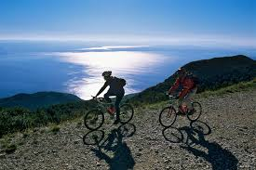
Hello! How are you? I’m Paul from Karpenissi, Greece. I’m eleven and a half years old. I have got three brothers. My brothers’ names are Gerasimos, Fotis and Spyros. My mother’s name is Chrysanthi and my father’s name is Nikos. My favourite sports are football, basketball and volleyball. My favourite colors are red and white. My favourite foods are spaghetti with minced meat, pizza, pita-gyros and club sandwich. Also my favourite hobbies are climbing , cycling and adventures!!!

Slide 16
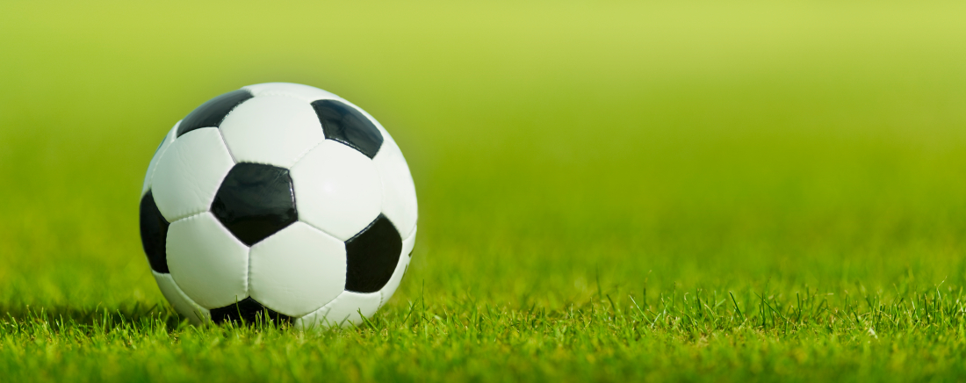
My name is Gus and my favorite sport is football and my favorite food is spaghetti.
When I grow I want to become a vet.

Slide 17
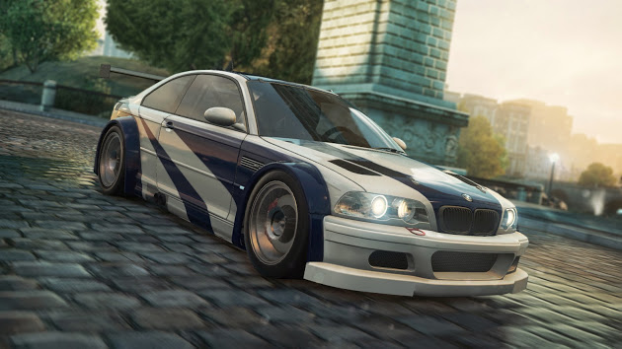
Hi ,my name is Manthos .My hobbies are car races, drifting and pursuit. I will become a racer drifter. I am 11 years old. My nicknames are Nos Tron Wanted Racer. My favourite cars are bmw m3 gtr, bucati, Toyota supra. My favorite colors are blue, white and black.

Slide 18
Hi !
My name is Sophia. I’m 11 years old.
My favourite sports are football and tennis.
My favourite foods are pizza and cheeseburger.
When I grow up I will become a dentist.

Slide 19
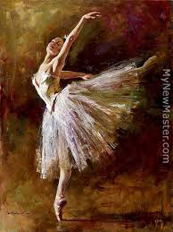
Hi,
My name is Ilia Grammatika-Pavlidou and I am eleven years old. I have a brother and a sister. My brother is thirteen years old and he is called Odysseas. My sister’s name is Nefeli and she is 18 years old. Now she is in Germany and she goes to medical school. My mom is a doctor and her name is Maria. My dad works in his marble factory. He is called Kostas. My favorite colour is electric blue. I really love ballet and I have run in three classical Marathons (5km).
That’s all about me!
Bye for now…
Ilia

Slide 20
Hi!
My name is Marianna and I’m eleven years old. I have two sisters and their names are Kostantina and Elpida. I like listening to music.
My favourite band is One Direction. I love their songs and them too!!!!
Bye ,
Marianna <3

Slide 21
Hi
My name is Irene and I’m 11 years old. My favourite sport is tae kwon do. My favourite colors are blue and white. My favourite subjects are Maths and P.E.

Slide 22
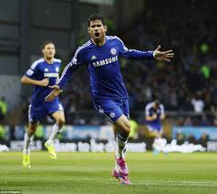
Hello,
My name is John Tsaras. My favourite sport is football. Also I like basketball.
My favourite colour is blue and my favourite team is Chelsea. I’m 11 years old. My favourite player is Diego Costa.

Slide 23
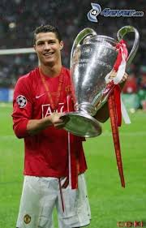
Hi,
My name is John and my favourite sport is football. When I grow up I want to become a footballer.
My family is very well. My family members’ names are Andreas, Mary, Jim and Rania. I am 11 years old.

Slide 24
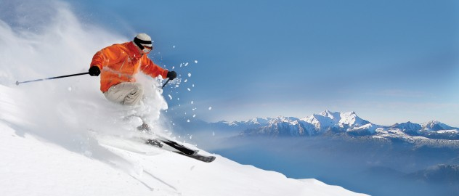
Hello. I’m Marios and I’m eleven years old. I like skiing and cycling . On weekends I go to the sports field and I play football with my friends. I live in Karpenissi and when I grow up I want to become ski instructor.

Slide 25
Thank you all for reading this!
Hello,
Dear children
My name is Valadis and I am 11 years old . My hobbies are playing Battlefield 4, Call of Duty – Black Ops 2 and Minecraft . I also play football and basketball . My favourite foods are pizza and gyros*.
I upload videos on Youtube. I live in Karpenissi, Greece!
Thank you all for reading this!

Slide 26
My name is Steve . My favourite subjects are Music, Maths, and Language.
I am 13 years old.
My favourite colours are blue, red and white. My favourite food is pastitsio.
My favourite hobby is dancing.
I love singing.

Slide 27
Hello,
My name is Zeta and I’m from Karpenissi. My town is beautiful and I love it. I have got a brother, his name is Eliot, he is very kind but he’s hot-tempered. My brother is 14 years old. My dad is a policeman and he is very good .
My mum isn’t working but whatever… I love tennis, running and volleyball. My favorite subjects are P.E. , Art and Science. Every afternoon I play with my friends. Every Friday and Saturday I go zumba in the gym , it is a kind of dance.
Goodbye!

Slide 28
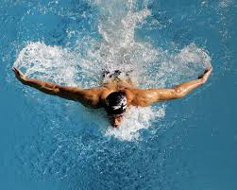
Hi my name is Alexandra and I live in Karpenissi. I’m 11 years old and my favourite hobbies are swimming, basketball and football. My favourite lessons are Maths, Language, Science and History. I have one brother. His name is George .My father’s name is Jim and my mother’s name is Ritsa. My favourite animals are the lion, the dog, the cat and the horse.

Slide 29
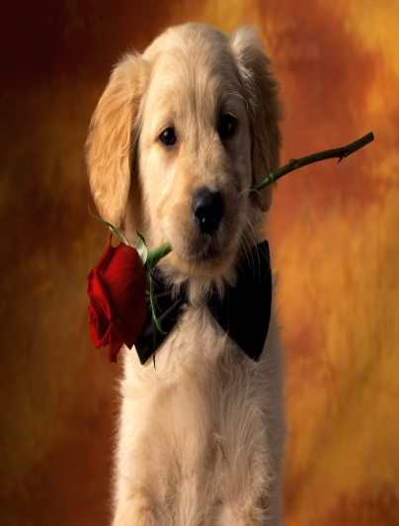
My name is Demmy . I’m 11 years old and my favourite colours are khaki, red and black and my favourite subject is Science .I like doing my homework, riding my bike and playing with my dog!

Slide 30
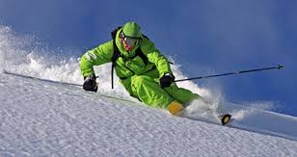
My name is Stelios. My favourite colours are blue and green. I have a sister two grandmothers and one grandfather. My hobbies are basketball, swimming but my favourite hobby is skiing. I go skiing in winter on mountain Velouhi.

Slide 31
Hello!!!
♥My name is Vassiliki. I’m eleven years old and I’m in the 6th grade of Primary School. I think I’m very sociable with my friends. I have got many of them, but my best friends are only 5. My mother is Georgia and she’s a music teacher at my school. My father is John and he’s a civil servant. My brother, Jim is 9 years old. My favourite colour is turquoise and my favourite food is pastitsio. I really love dancing, singing and playing my musical instruments (I know how to play seven of them).I have got 1 dog,10 cats,1 turtle,2 hamsters,1 rabbit and 1 fish. That’s my life!!!Reading, dancing, drawing, studying...I hope you enjoyed my presentation! Goodbye! ♥

Slide 32
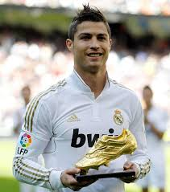
Hello, my name is Kostas. I’m 11 years old and I go to class 6B. My favourite subject is History and my favourite sports are football and basketball. My favourite football player is Cristiano Ronaldo and my favourite basketball player is Michael Jordan. I like to listen to music and playing video games. My favourite food is pizza, spaghetti, chocolate cake and ice cream. I have got 2 sisters. I’m tall. I’m not short. My sister is short and her hair is long. My second sister is baby. Is 5,5 months. I’m very good at football. My hair is black and my eyes are brown. In my class we are 15 children. I don’t like English. I like P.E. Bye!

Slide 33
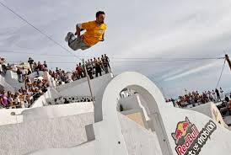
My name is Vasilis, I am eleven years old. My favourite hobby is parkour. I have got one sister and one brother.

Slide 34
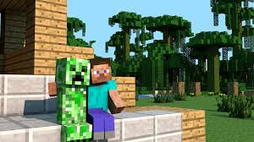
Hello! My name is Vaios. I’m eleven years old. My hobbies are football and riding my bike.
Also I play minecraft.

Slide 35
Thanks for watching!!!!!

