Slide 1
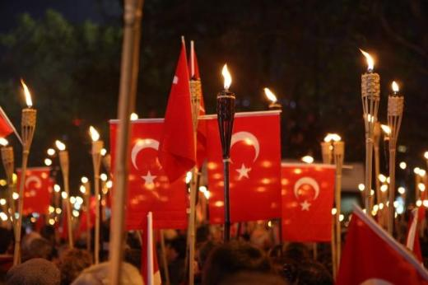
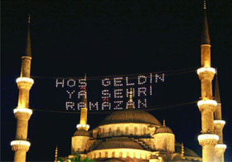
RELIGIOUS AND NATIONAL FESTIVALS IN TURKEY

Slide 2
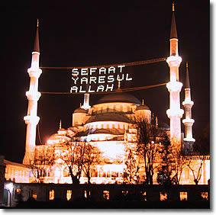
RELIGIOUS FESTIVALS

Slide 3
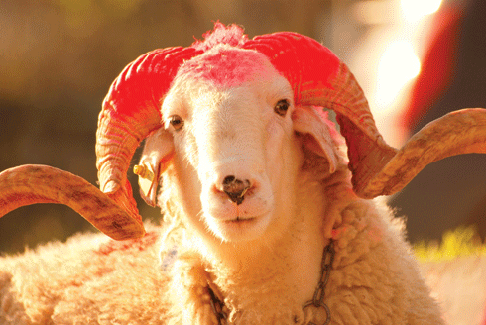
THE FEAST OF THE SACRIFICE

Slide 4
In Turkey, we have two religious festivals: Ramadan and the Feast of the Sacrifice. Both of them are celebrated ten days earlier every year. Because celebration days are calculated according to the lunar calendaring in the past. The meaning of this feast is that; the prophet Ibrahim hadn’t had a child for many years. Then he promised God. If God gave him a son he would sacrifice him for God. When he intended to sacrifice his son Ismail for God, a ram fell from the sky.

Slide 5
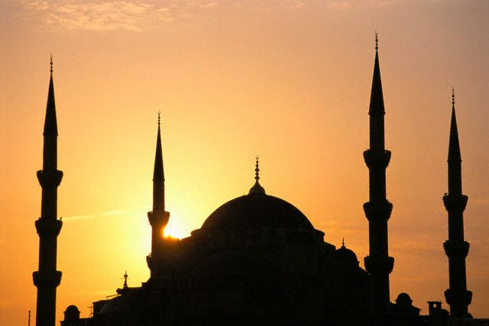
God told Ibrahim to sacrifice a ram instead of İsmail. After that day, it became a tradition. Two-third of the meat from sacrificed animals is given to relatives, neighbours and the poor people. One-third of the meat is left for the household.

Slide 6
During the Feast of the Sacrifice we usually buy new clothes and visit neighbors, relatives and friends to see each other. Young people kiss their elderlies’ hands and receive best wishes and also get a little money. The main idea of the Feast of the Sacrifice is helping the poor people and having a good relationship with everyone.

Slide 7
In the end of the pray, everybody shakes their hands together in the religious festivals.

Slide 8
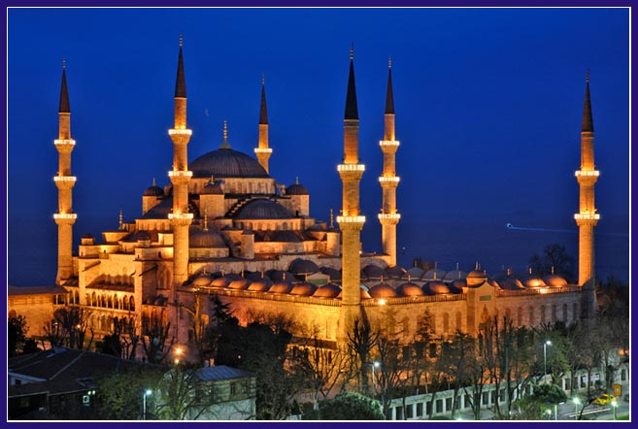
THE RAMADAN FEAST

Slide 9
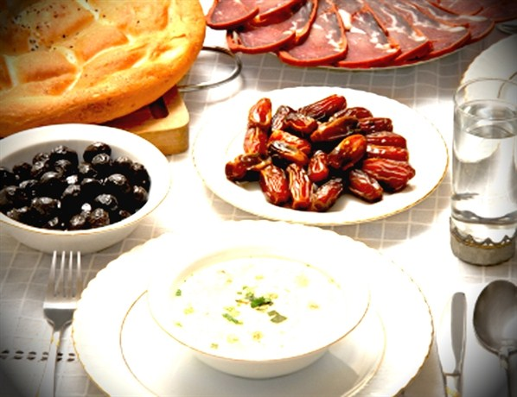
Ramadan lasts for 30 days. Every day fasting starts at sahur (A meal eaten just before down during Ramadan) And finishes at iftar (A meal eaten just before the sunset). During the day time, we mustn’t eat and drink. During the three days of the Feast of Ramadan, people visit neighbours, relatives, graveyards and friends. Young people kiss their elderlies’ hands and receive best wishes and blessings from them.

Slide 10
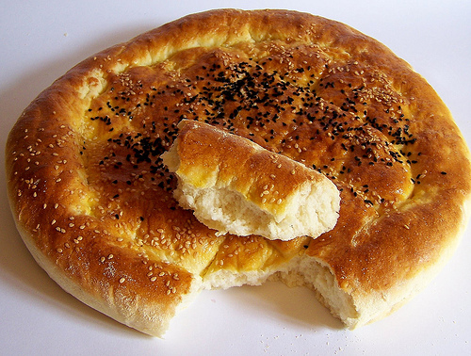
Special Ramadan Bread (Pide)

Slide 11
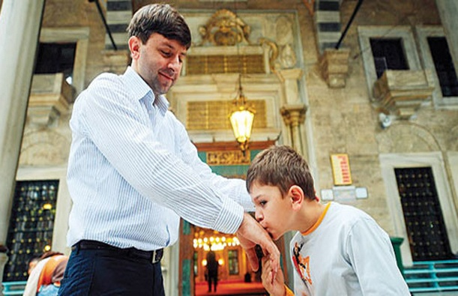
It is a tradition to give money or little gifts to those children who kiss one’s hands. Candies are served to visitors during Ramadan. In the beginning, sweet foods were only served on Nevruz, but this gradually became a general tradition which spread to all other festivals and festival days.

Slide 12
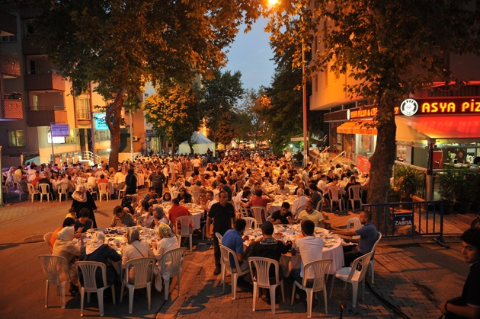
Everybody has dinner together

Slide 13
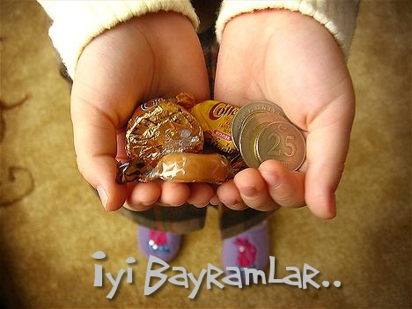
In summer when nights are shorter, people who fast don’t sleep after dinner but wait until sahur. In this period, people organize many different forms of entertainments. Karagoz and ortaoyun are examples of Ramadan shows. In rural areas, people gather in houses and in coffee houses where they talk, play instruments and sing.

Slide 14
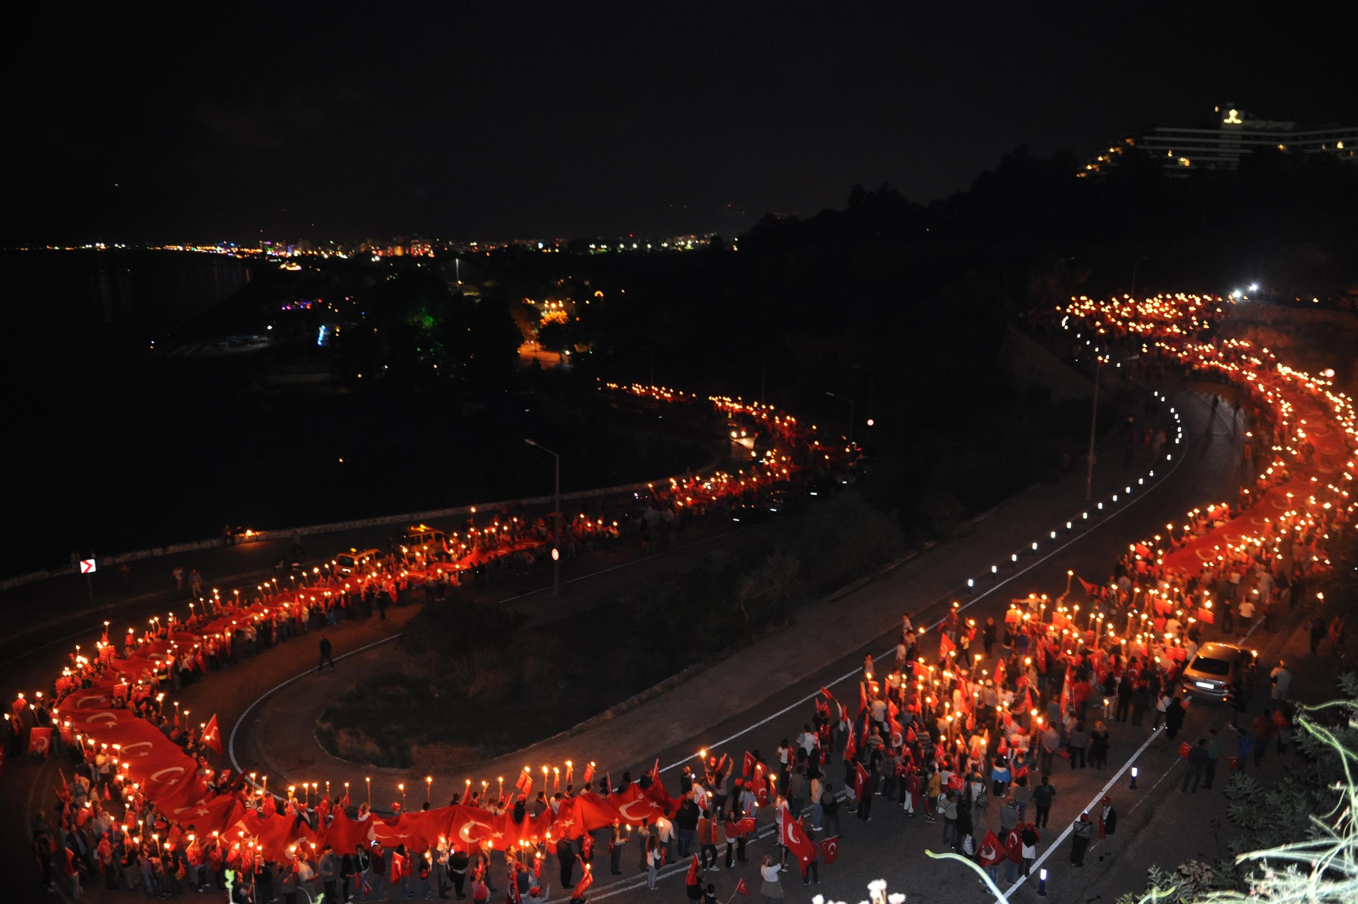
NATIONAL FESTIVALS

Slide 15
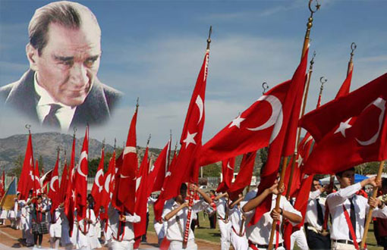
THE VICTORY DAY

Slide 16
The Victory Day is a national holiday that is recognized on 30th August and is celebrated throughout the country. It’s origins date back to a battle that began on 26th August 1922 when Greek troops invaved Turkey. The invasion was successfully repelled and the battle ended on 26th August.On 30th August all the enemies were repelled from Turkey so call this day as the Victory Day.

Slide 17
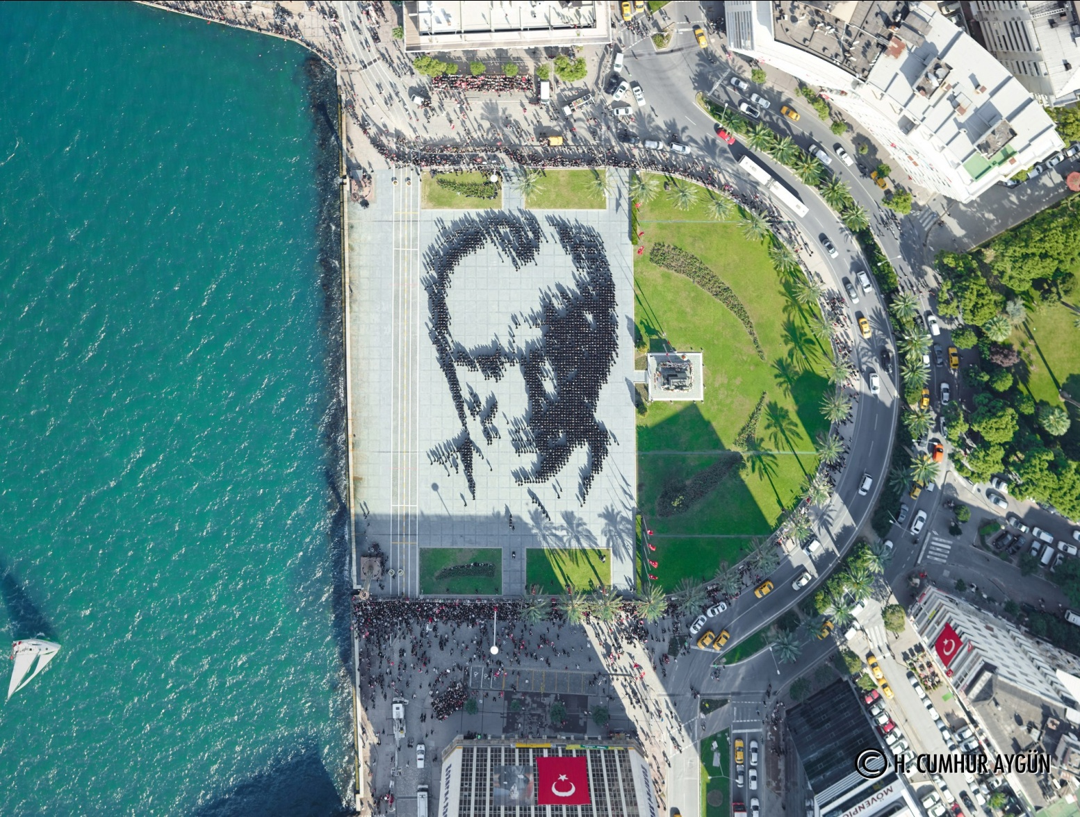
THE REPUBLIC DAY
This photo was taken in İzmir last year on The Republic Day.We see people forming the portrait of our leader ,Mustafa Kemal ATATÜRK.

Slide 18
The Republic Day of Turkey is one of the national festivals in Turkey, on 29th October 1923, Mustafa Kemal declared that Turkey would be a republic and renamed it as the Republic of Turkey. We can say, Atatürk is a hero. Because he saved our country. After that, an election occurred in the Grand National Assembly of Turkey and Atatürk was elected as the 1st president of the Republic of Turkey. That day was the beginning of democracy. Republic Day is celebrated with big feasts and lots of cheers in our country.

Slide 19
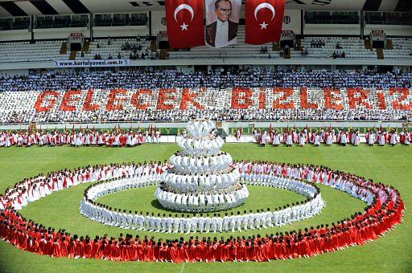
THE YOUTH AND SPORTS DAY

Slide 20
The Youth and Sports Day is an annual Turkish national holiday celebrated on May 19 to commemorate Mustafa Kemal’s lending at Samsun on May 19,1919, which is regarded as the beginning of the Turkish War of Independence, Atatürk is dedicated to young people who are the most valuable asset of this important day. This feast is celebrated as a festival of sport. ‘’Every year, all young people goes stadiums and make shows to audiences.’’

Slide 21
THE NATIONAL SOVEREIGNTY AND CHILDREN’S DAY

Slide 22
The 23rd April Children’s Festival : It’s a festival which was gifted to children by Mustafa Kemal Atatürk who was the founder of the Republic of Turkey to mark the opening of the Assembly. The festival has been celebrated internationally since 1979. The children’s festival was first celebrated in Turkey on 23rd April 1920, when the Turkish Grand National Assembly was opened. The festival intends to contribute to create a World, where children can live peacefully by developing sentiments of fratemity, love and friendship.

Slide 23
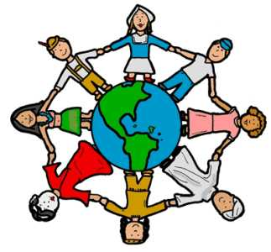
The Children’s Day is one of the first symbols of independence in Turkey .
Atatürk knew that modernization couldn’t be achieved in a rapid way; therefore, he presumed that the Turkish children should be educated at schools resting upon positive sciences could attain his goals.

Slide 24
He believed in his nation and lived for what he believed. This is the main philosophy of 23rd April. As can be seen, the educated children and youth have made great contributions to the creation of modern Turkey. Thousands of children all over the world, come to our country to celebrate this holiday every year.

Slide 25
It’s an example of Children’s Day show.

Slide 26
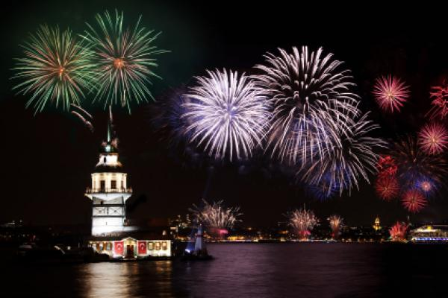
New Year's Eve in Turkey
New Year’s Eve is one of the most popular holidays in Turkey. The New Year’s Eve traditions in this country include a family dinner, a national lottery drawing and a countdown to midnight. New Year’s Eve falls on December 31 in the Gregorian calendar.

Slide 27
What Do People Do?
Many people in Turkey start celebrating New Year’s Eve with a large family dinner. The main course is traditionally a roasted turkey. Variety shows on television begin in late afternoon and continue until early morning of the next day. Many people play games while waiting for the clock to strike midnight. State TV channels announce the winning numbers of a New Year’s national lottery just before midnight. Many people in Turkey try to buy a New Year’s lottery ticket because it promises a large sum of money to the winner. Many people also congratulate each other, toast to a New Year and exchange small gifts at midnight between New Year’s Eve and New Year’s Day.

Slide 28
HISTORICAL AND RELIGIOUS PLACES IN UŞAK

Slide 29
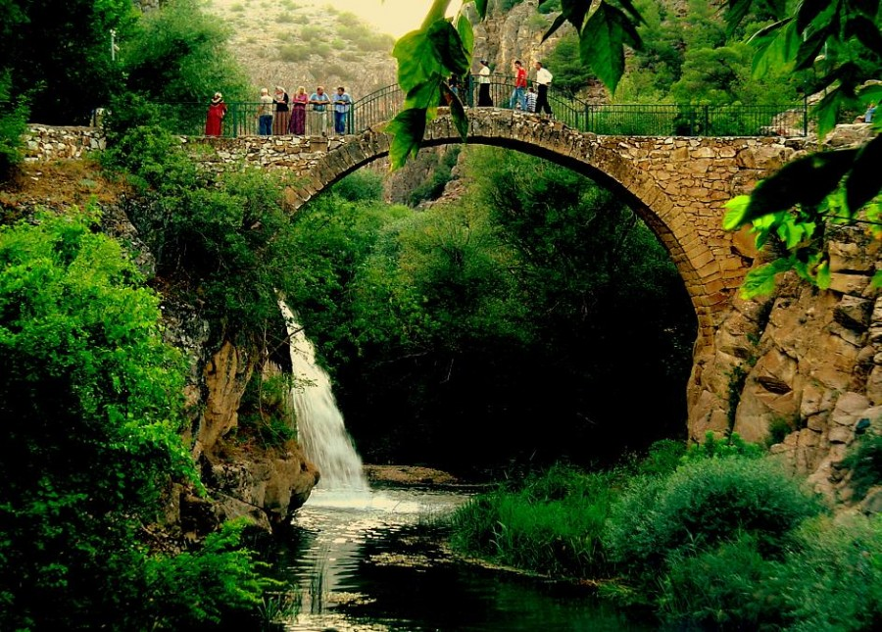
CILANDIRAS BRIDGE(KARAHALLI)
Uşak city center is 35 km. away from the Karahallı district, Banaz this bridge on river, built by some sources stated that Lydia'lı in MÖ.600 year.
Some sources are written to belong to the Roman period.
Probably part of the last king of the road from the bridge area.

Slide 30
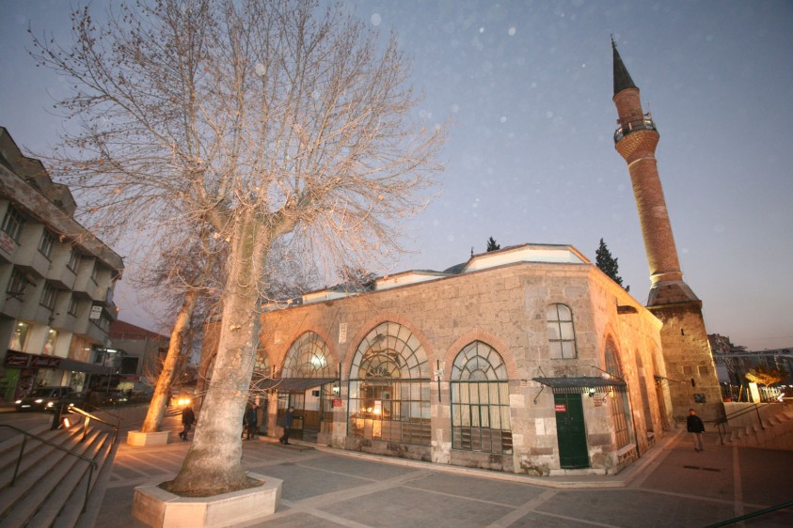
THE GRAND MOSQUE
Solid structure in the market, it is not exact date of construction of the glass attracts attention with certain interesting features. Germiyanoğlu inscription on the portal's son Jacob Süleymanşah brain belongs to a fountain, which was built in 1419. It is estimated that in the glass made in this history. They reconstructed because he saw some similarities sections has lost its originality.

Slide 31
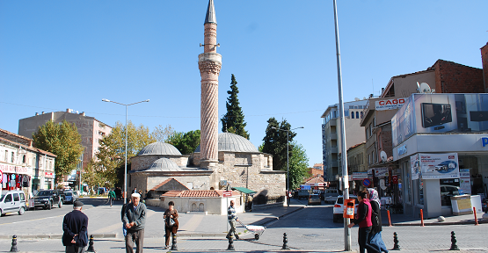
TWISTED MOSQUE
It’s one of the oldest mosques in Uşak. Its construction started in 1577 and finished in 1580.

Slide 32
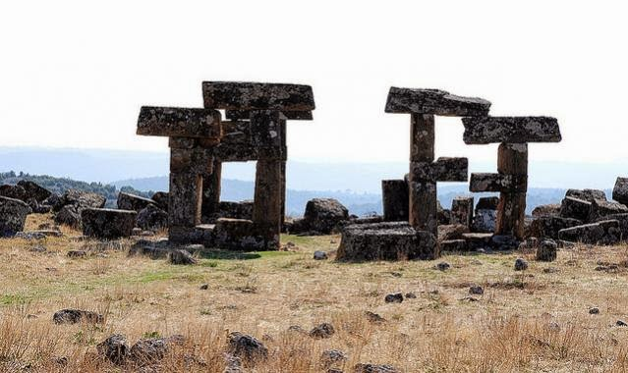
Blaundus (Sülümenli)
Usak Province, Ulubey Sülümenli district within the boundaries of the village 40 km from the city Uşak. away. After the expedition was founded by Alexander the Great from Macedonia Anatolia. Is a border city that has increased in importance during the Roman period. It is on a peninsula surrounded by deep valleys. The most important building castles, temples, theaters, stadiums and rock tombs.

Slide 33
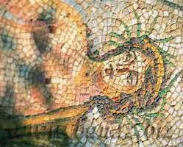
Kremon Agora (Susuzköy)

Slide 34
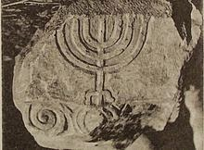
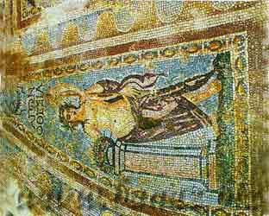
Akmonia (Ahatköy)

Slide 36
THANKS
FOR
WATCHING

