Slide 1
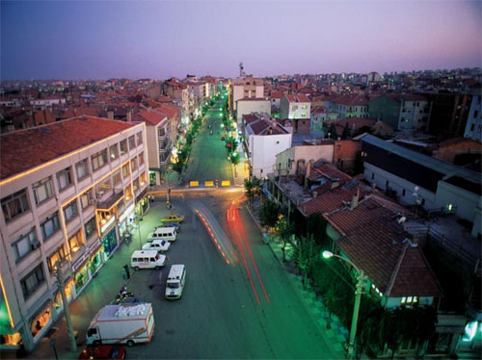
CITY OF LOVE ; UŞAK

Slide 2
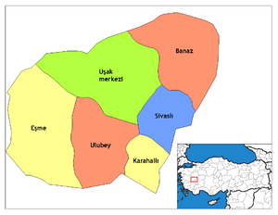
UŞAK IS LOCATED IN THE WESTERN PART OF TURKEY.
IT IS A SMALL CITY WITH 300.000 POPULATION.

Slide 3
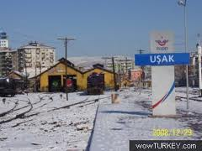
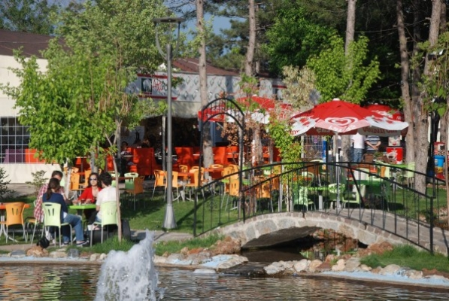
IN WINTER IT IS GENERALLY COLD (10 ° C AT MOST)
IN SUMMER IT IS HOT(25-40 ° C )

Slide 4
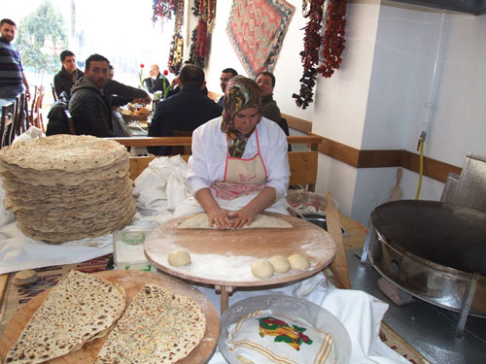
WOMEN IN UŞAK ARE GOOD AT COOKING.
YOU CAN EAT DELICIOUS MEALS AND PASTRIES IN UŞAK

Slide 5
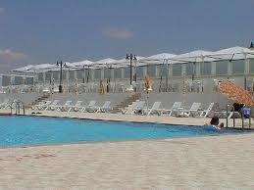
YOU CAN VISIT SPA CENTERS AND HOTELS IN UŞAK AT ANY TIME IN WINTER AND IN SUMMER.

Slide 6
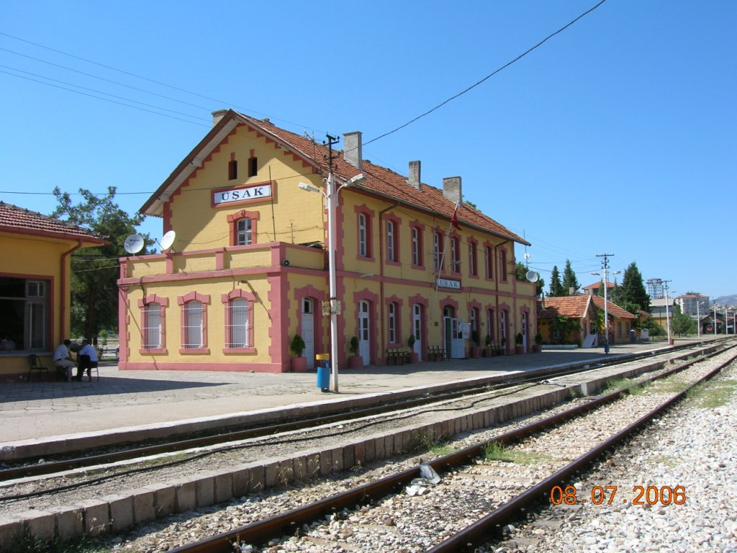
THERE ARE A LOT OF HISTORICAL PLACES IN UŞAK

Slide 7
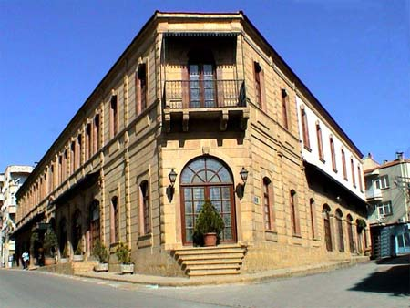

Slide 8
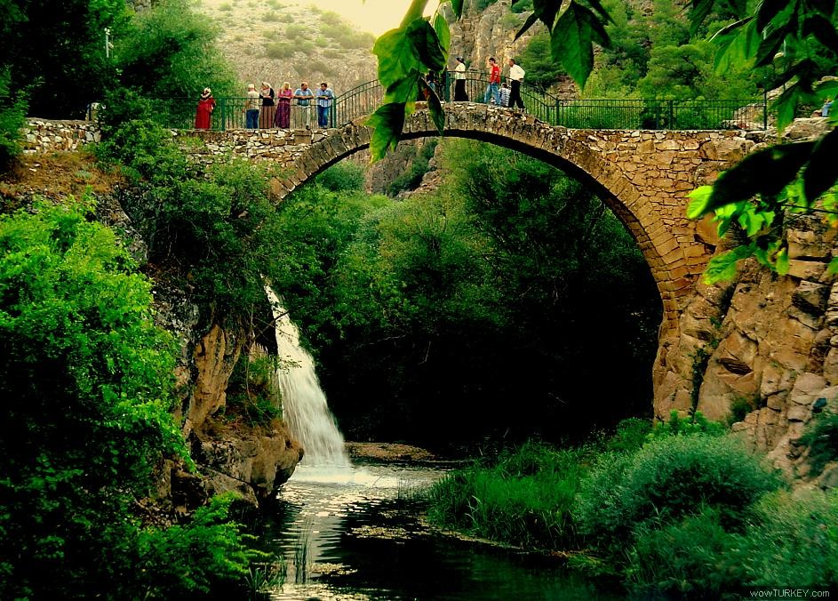

Slide 9
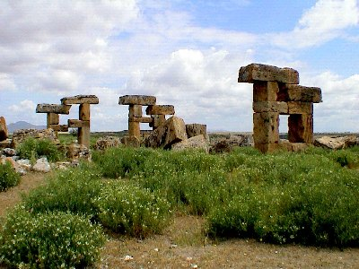

Slide 10
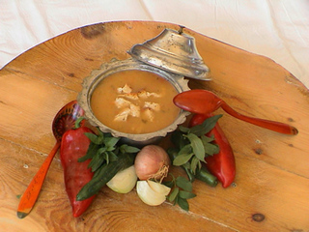
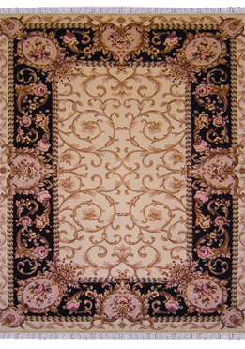
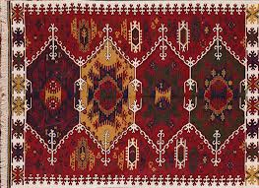
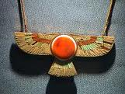
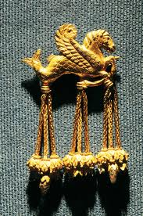
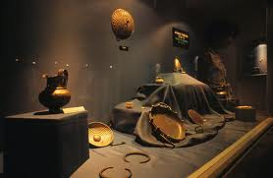
UŞAK IS FAMOUS FOR :
TRADITIONAL TARHANA SOUP
*CARPET
*RUG
*LYDIAN TREASURES
*The Second Biggest Canyon of The World (Ulubey Kanyonu)

Slide 11
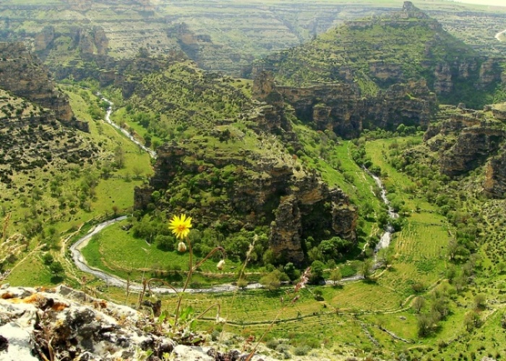

Slide 12
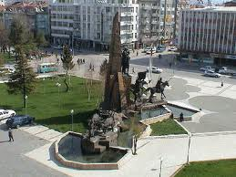
THIS IS THE CITY CENTER OF UŞAK. THIS STATUE IS ONE OF THE HIGHEST STATUES IN THE WORLD.

Slide 13
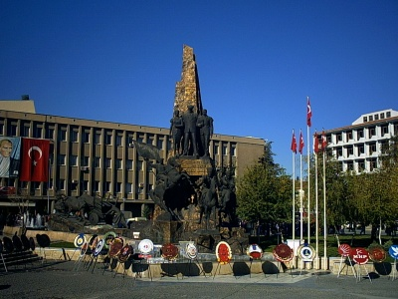
GREETINGS FROM MY LOVELY CITY ; UŞAK

