Slide 1
OUR SCHOOL
HALIT ZIYA USAKLIGIL SECONDARY SCHOOL

Slide 2
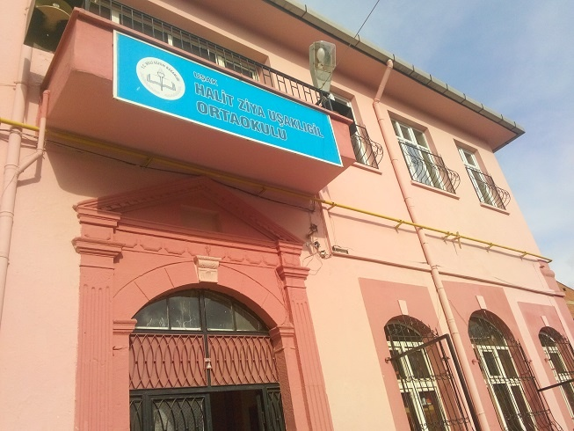

Slide 3
It was built as a church in the 19th century.
After the Turkish Independence War, it was used as a high school for girls until 1961.
Now it is a secondary school with 500 students in Uşak-Turkey.

Slide 4
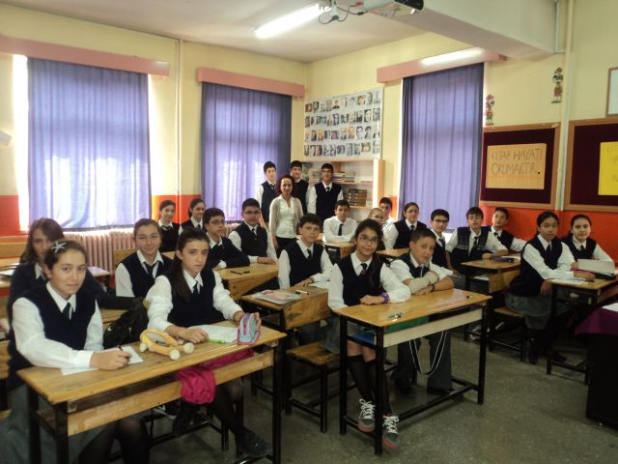
THERE ARE 20-25 STUDENTS IN EACH CLASS AND THE CLASSES ARE WELL EQUIPPED ON TECHNOLOGICAL DEVICES

Slide 5
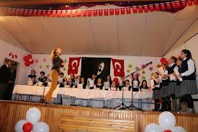
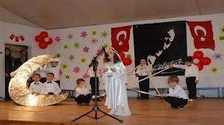
OUR STUDENTS LIKE ACTING AND PARTICIPATING IN SOCIAL,CULTURAL AND EDUCATIONAL ACTIVITIES.

Slide 6
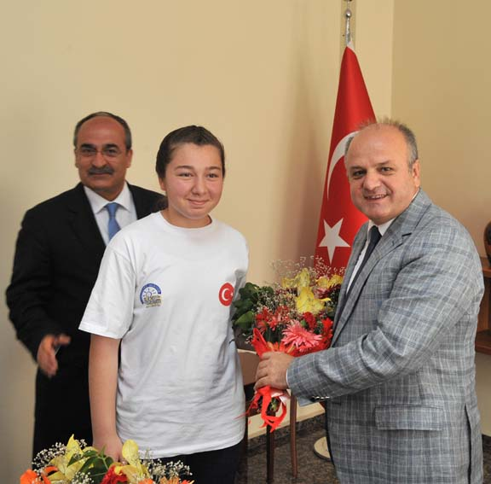
SHE IS SENA, ONE OF OUR SUCCESSFUL STUDENTS. SHE WAS AWARDED BY THE PROVINCE GOVERNOR FOR HER MATHS PROJECT IN 2012.

Slide 7
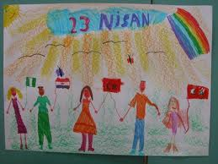
THIS IS ONE OF HE BEST DRAWINGS OF AYSE, SHE IS ONLY 9 BUT SHE CAN DRAW WELL. SHE PAINTED IT FOR THE CHILDREN’S DAY ON APRIL 23. EVERY YEAR HUNDREDS OF CHILDREN COME TO TURKEY TO CELEBRATE THE CHILDREN’S DAY IN TURKEY.

Slide 8
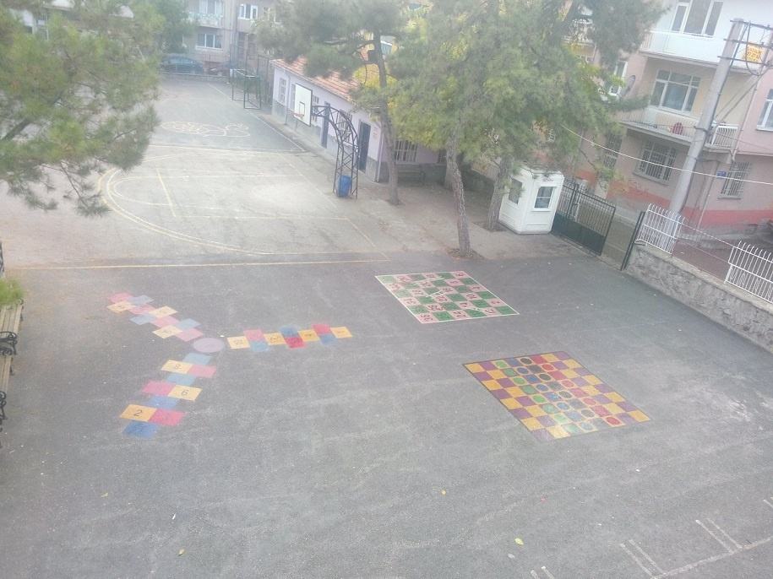

Slide 9
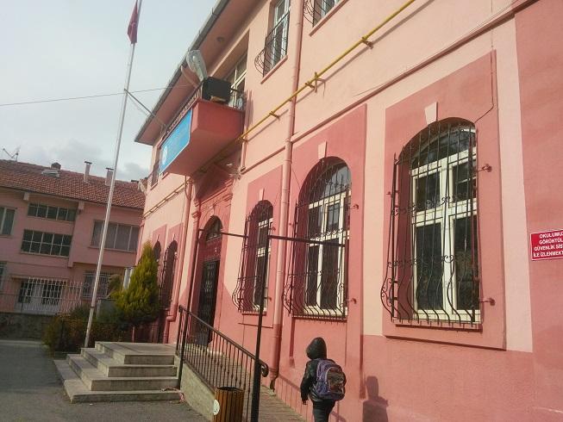

Slide 10
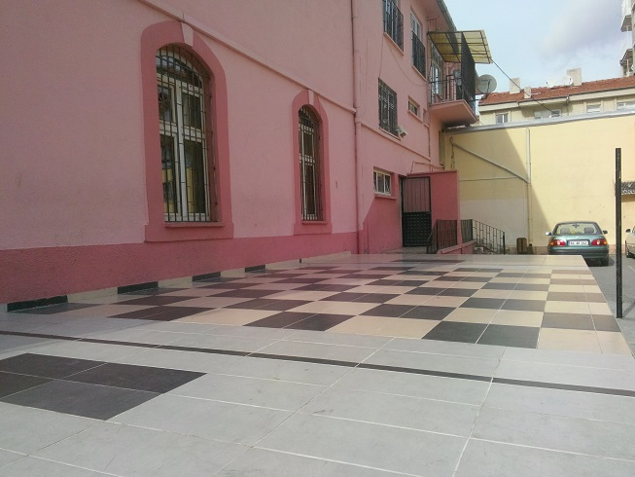

Slide 11
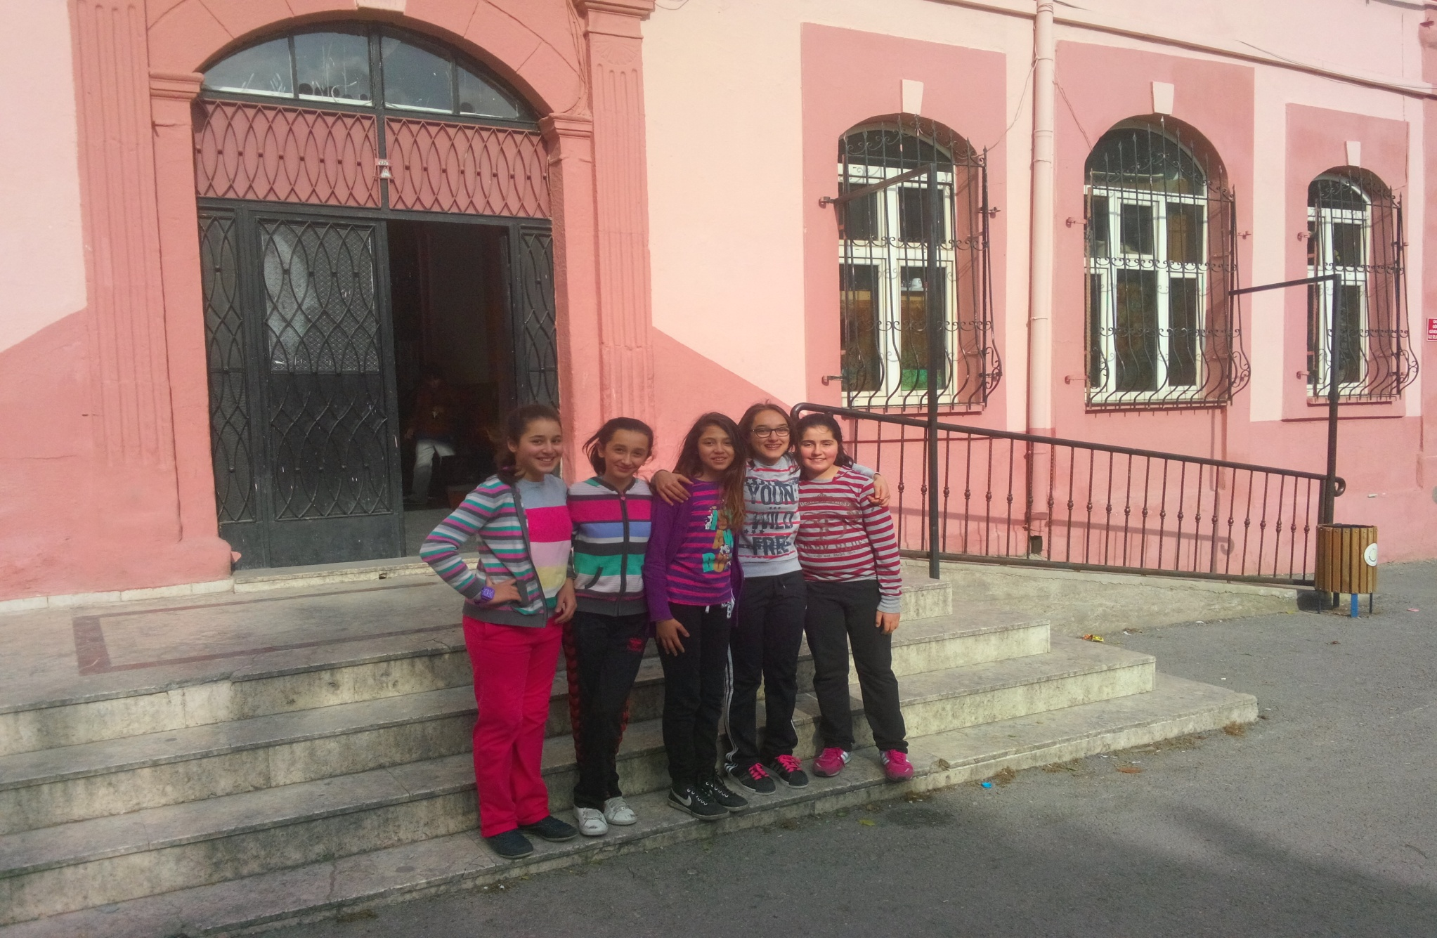

Slide 12
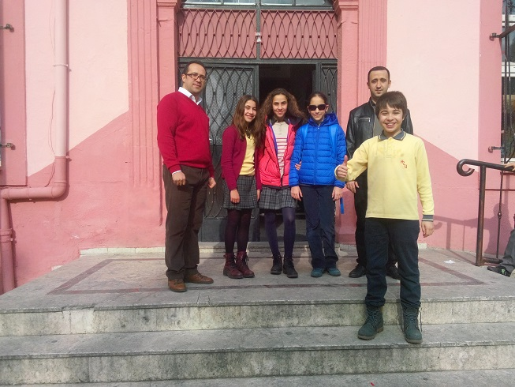

Slide 14
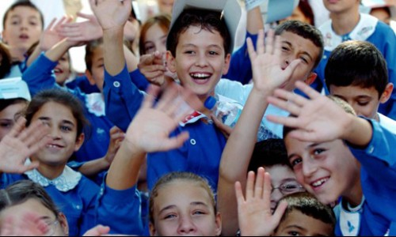
GREETINGS FROM OUR SCHOOL

