Slide 1
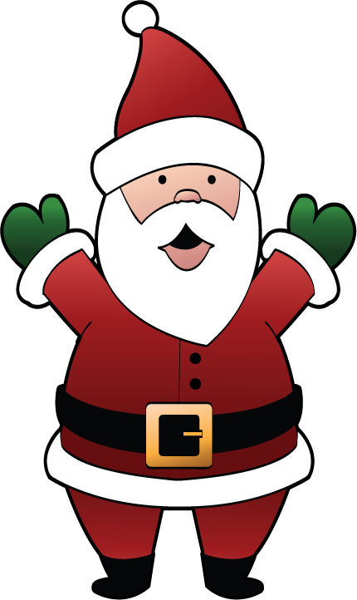
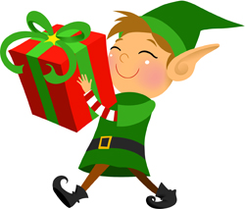
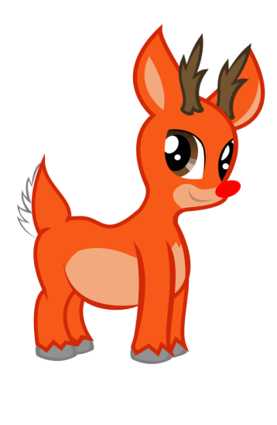
Christmas Celebrations in Ireland

Slide 2
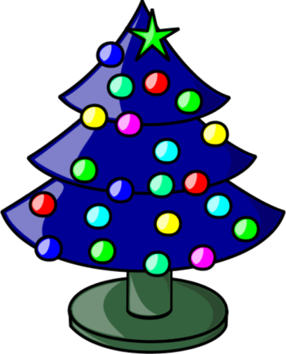
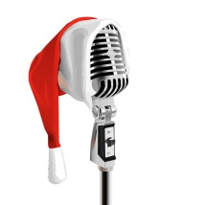
Getting Ready for Christmas…
We put up Christmas trees and decorate our homes
We collect food to give to people who don’t have much at Christmas
We get excited about Christmas ☺
We go shopping to buy presents
We learn about the Christmas story in school
We practice singing Christmas songs!

Slide 3
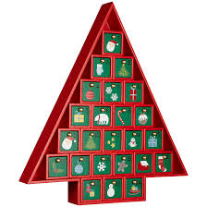
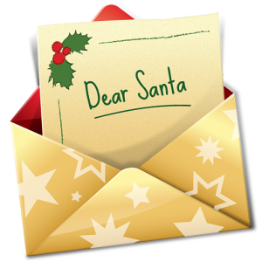
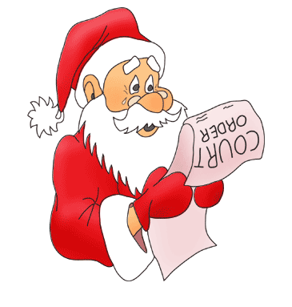
We prepare food for our Christmas dinner
We count the days to Christmas using an advent calendar
Children write letters to Santa
We visit our friends and family

Slide 4
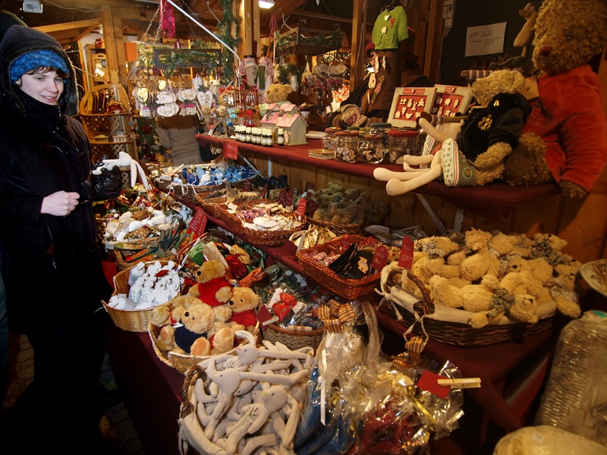
We go to Christmas light shows and markets…here is the one in Armagh!

Slide 5
This is our Christmas tree and our letters to Santa.

Slide 6
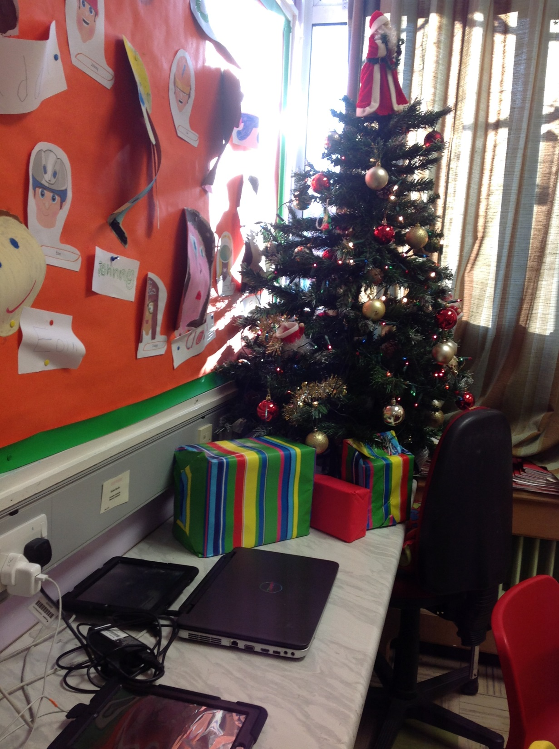

Slide 7
We wanted to try some foods from other countries….So we had a mini Christmas market in our classroom!! Here are some pictures of us trying new foods.

Slide 8
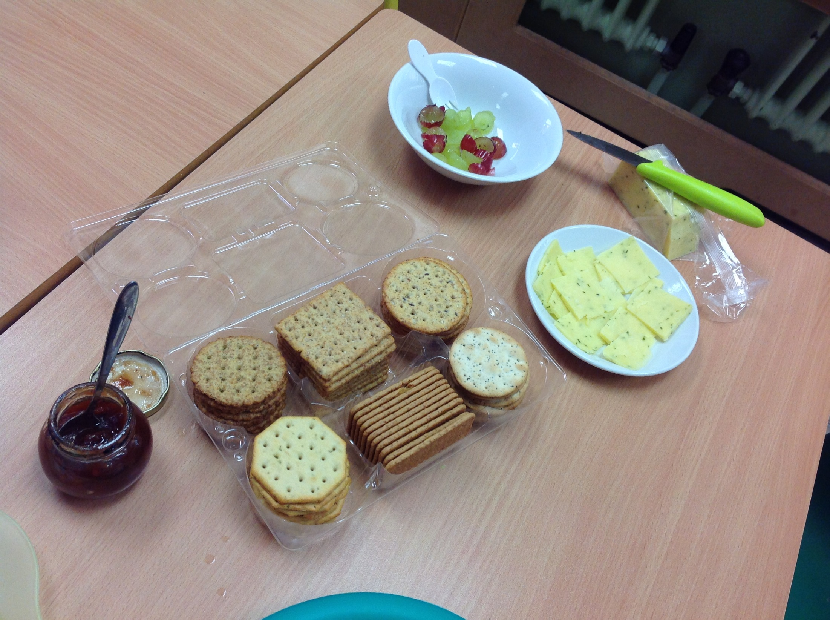

Slide 9
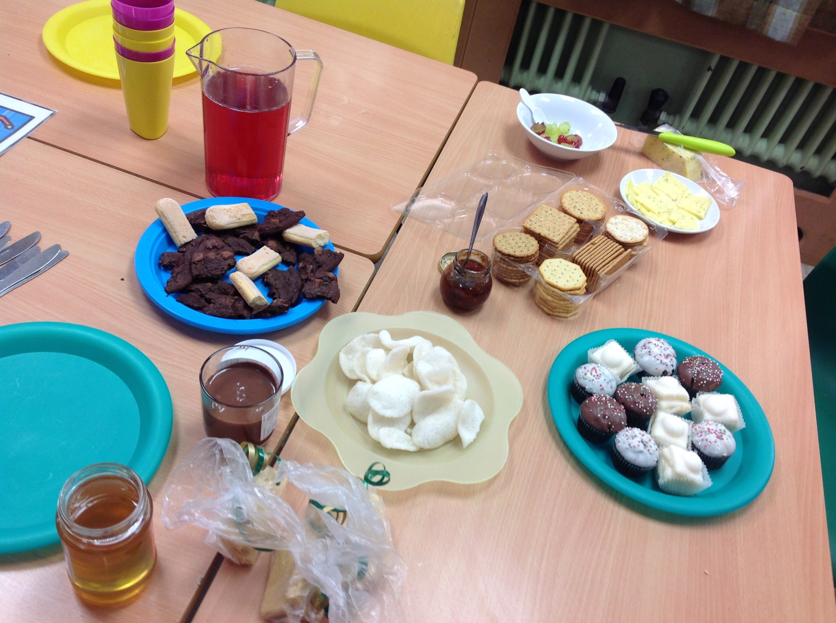

Slide 10
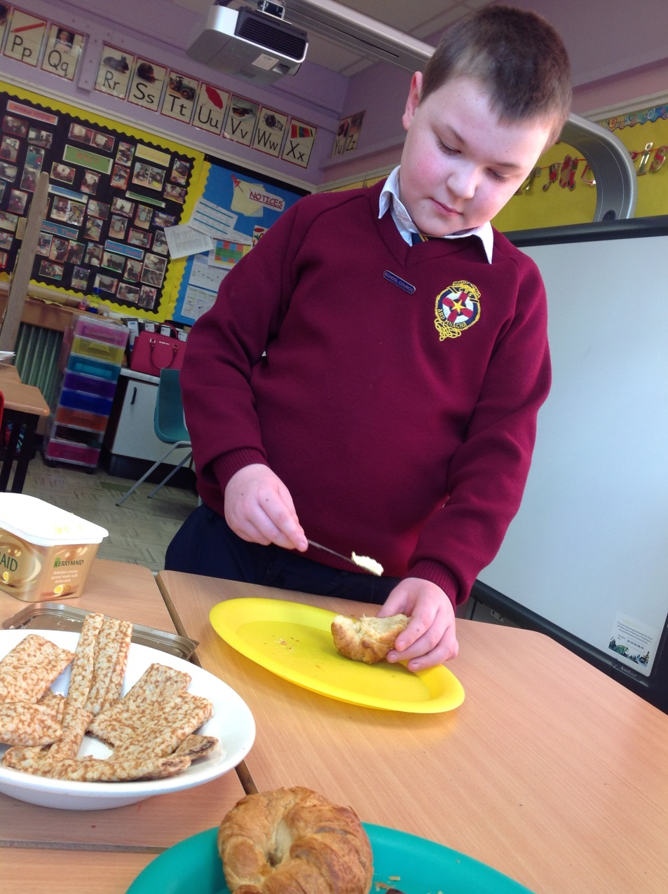
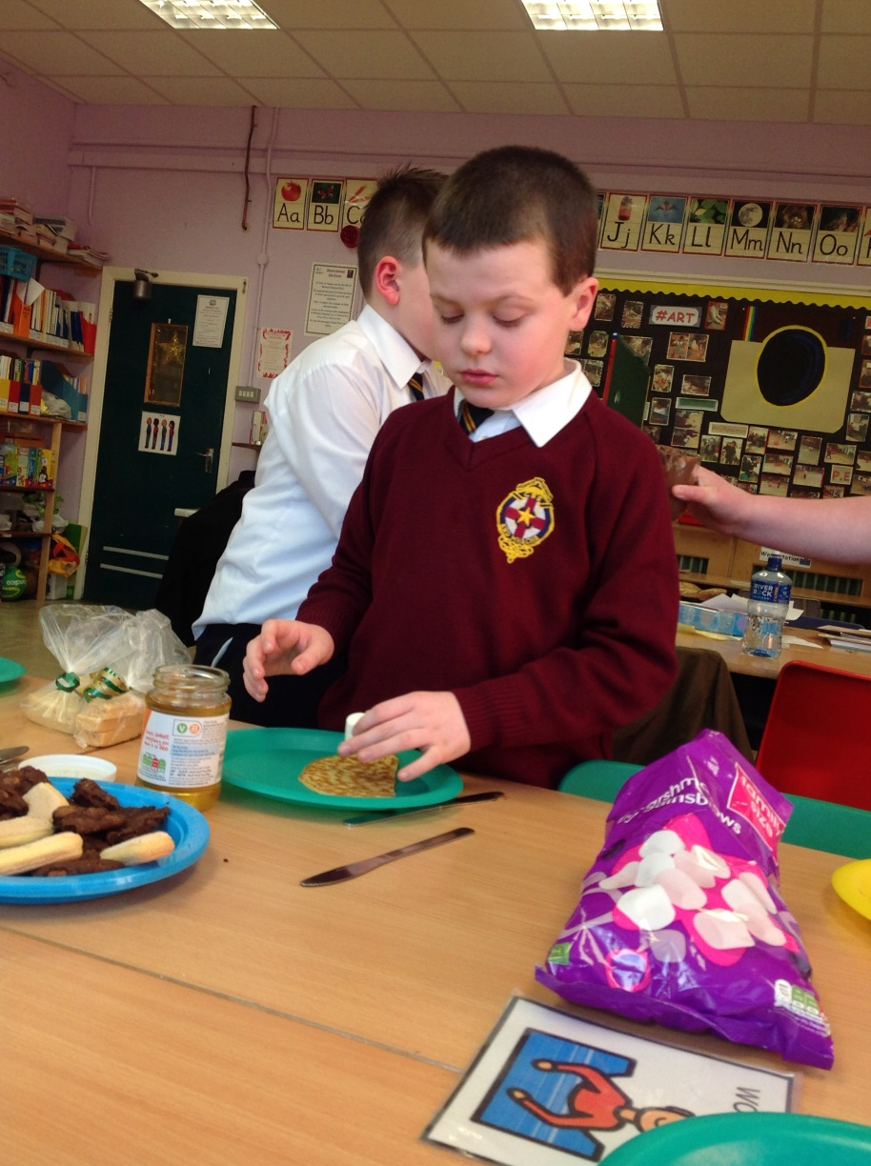

Slide 11
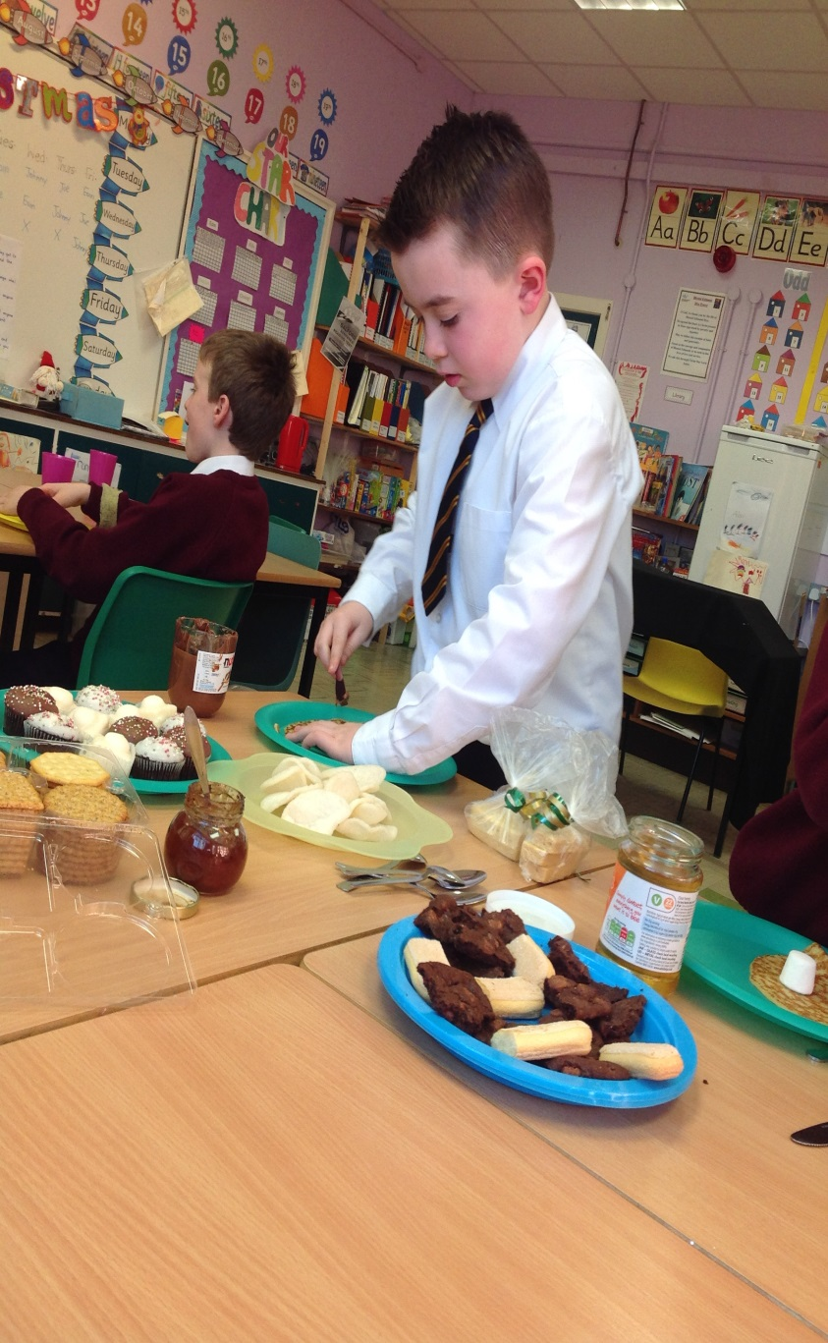
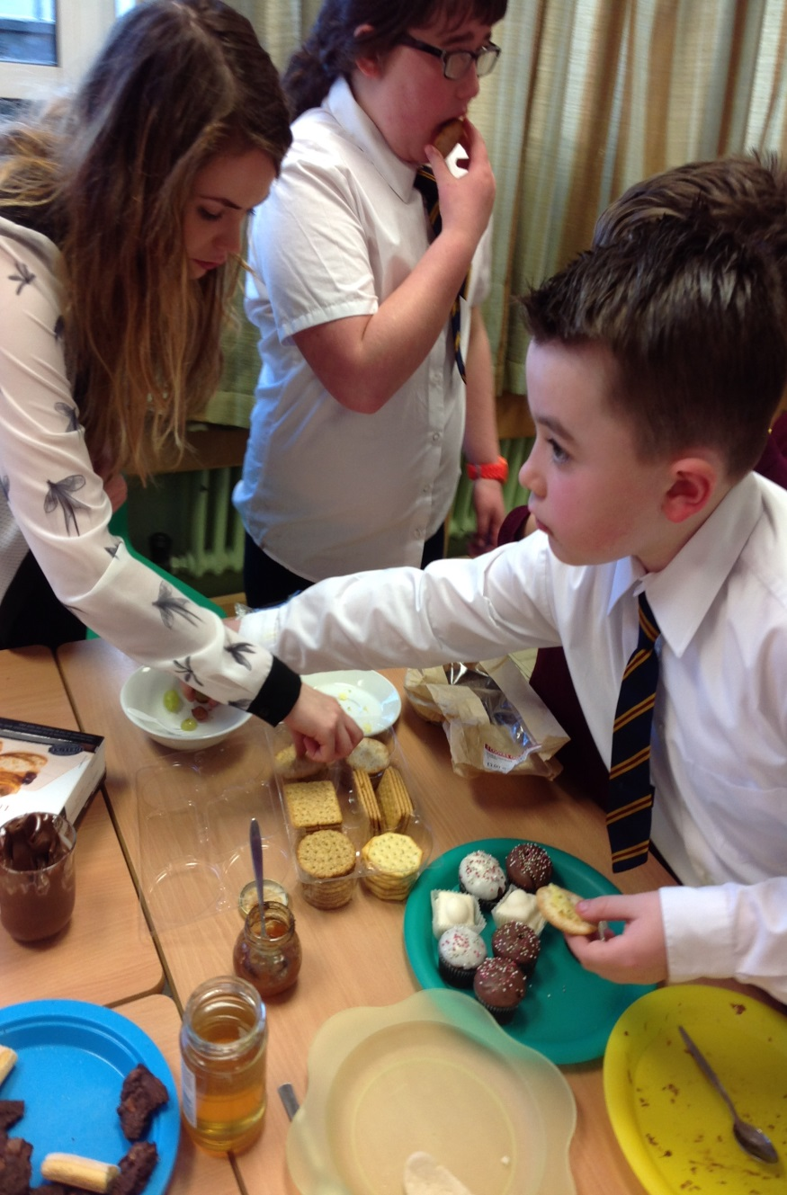

Slide 12
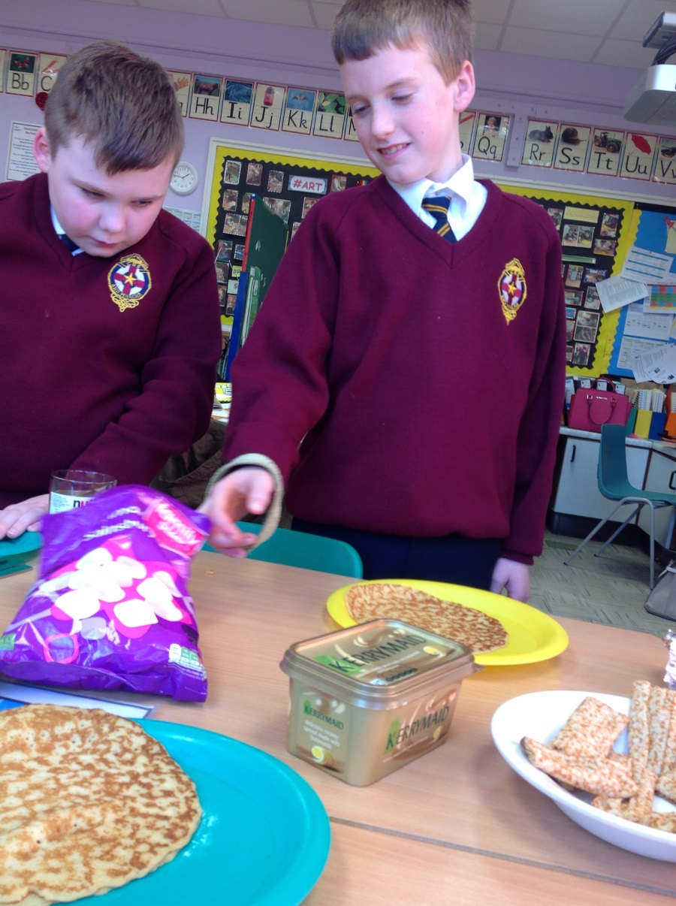
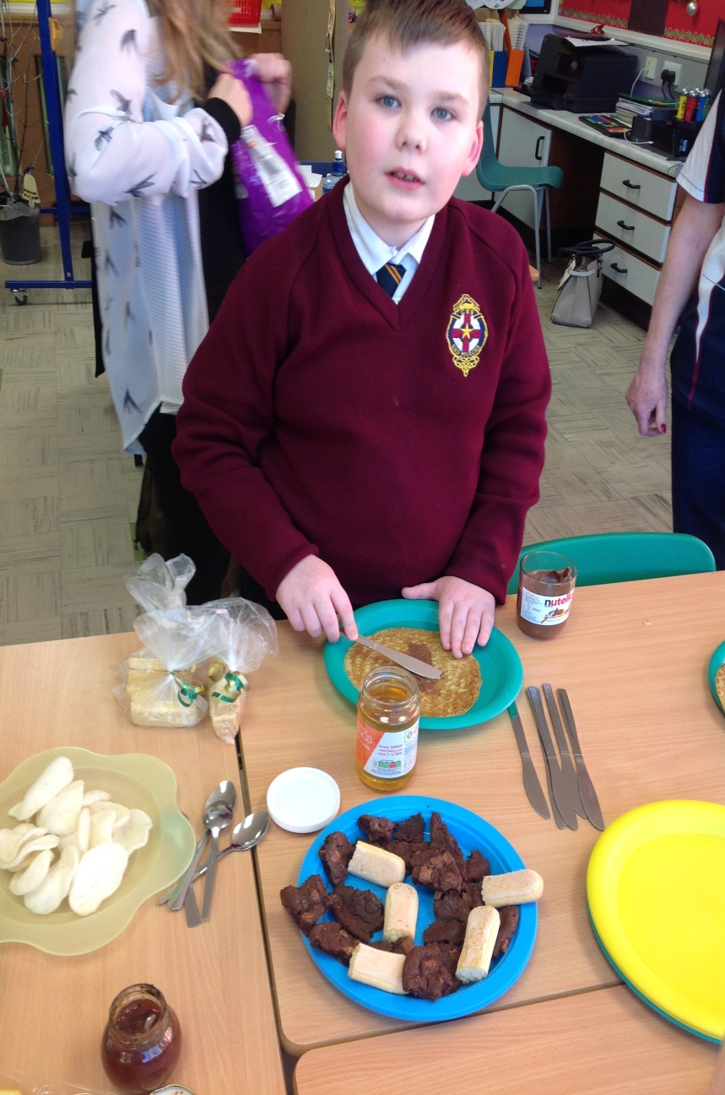

Slide 13
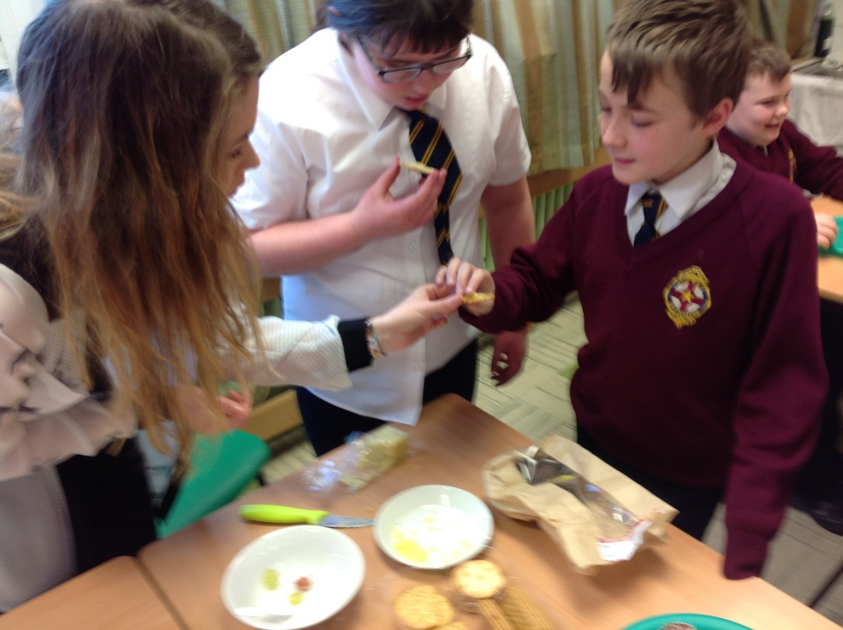
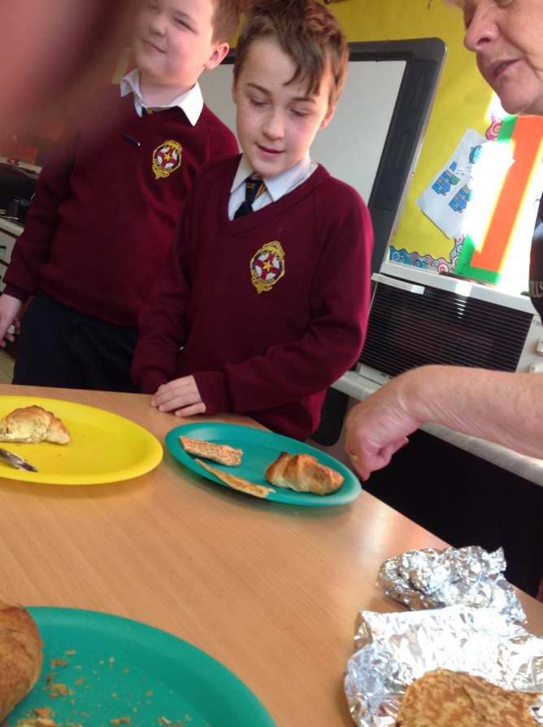
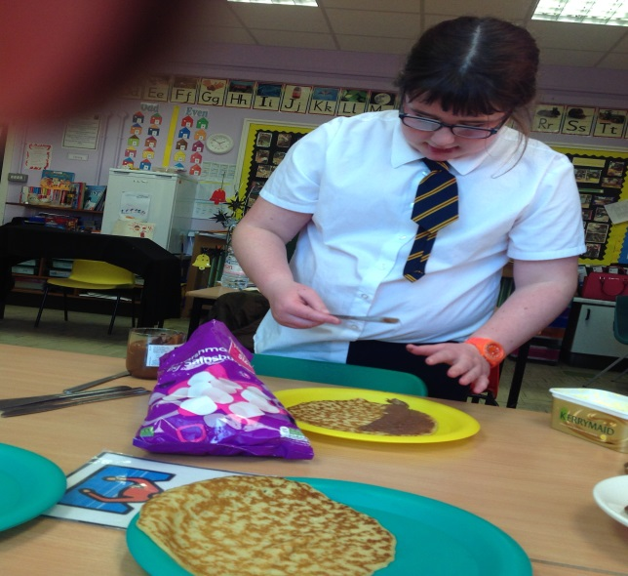

Slide 14
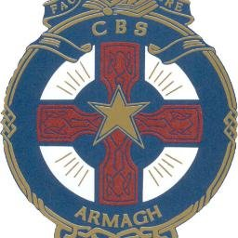
Merry Christmas from everyone in Ireland! ☺ ☺ ☺

