Slide 1

Safer internet day 2015
Hristo Smirnenski Primary School
Activities

Slide 2
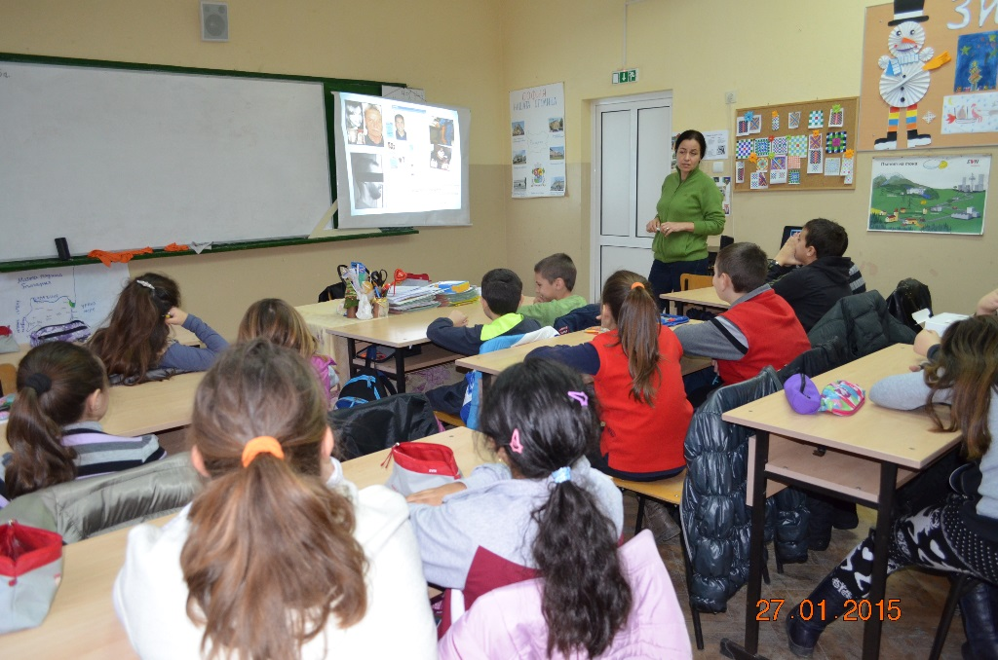
Lesson “How to make a strong password?”
Every class at school had this lesson. All the teachers prepared materials, videos, etc. and had discussions with the students about Internet safety.
Here you can find the lesson and the worksheet attached

Slide 3
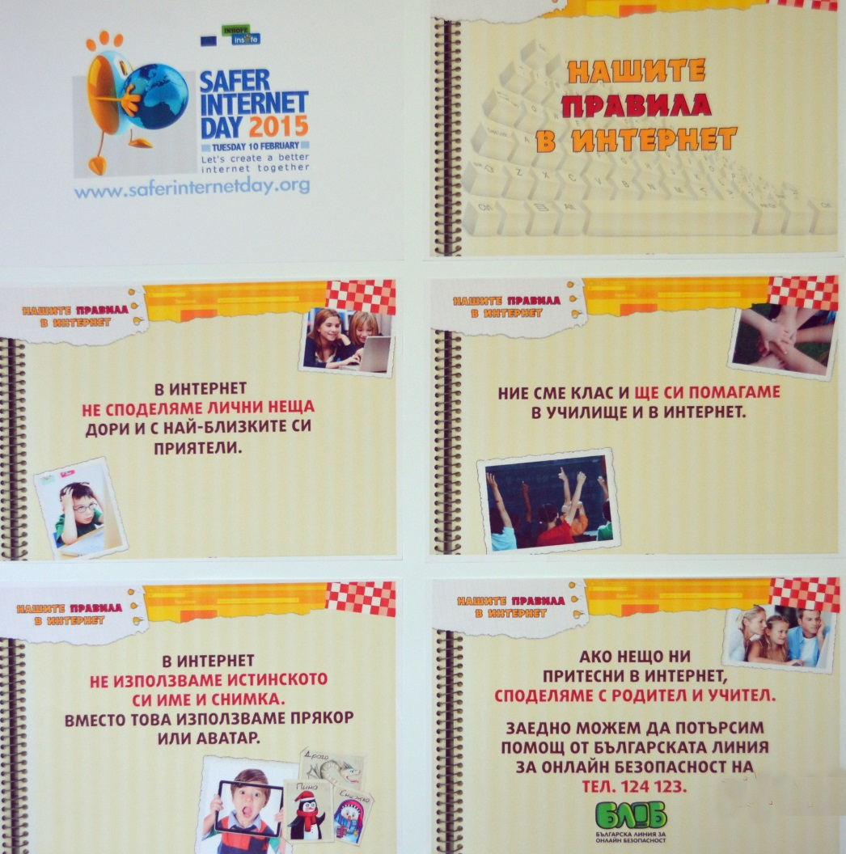
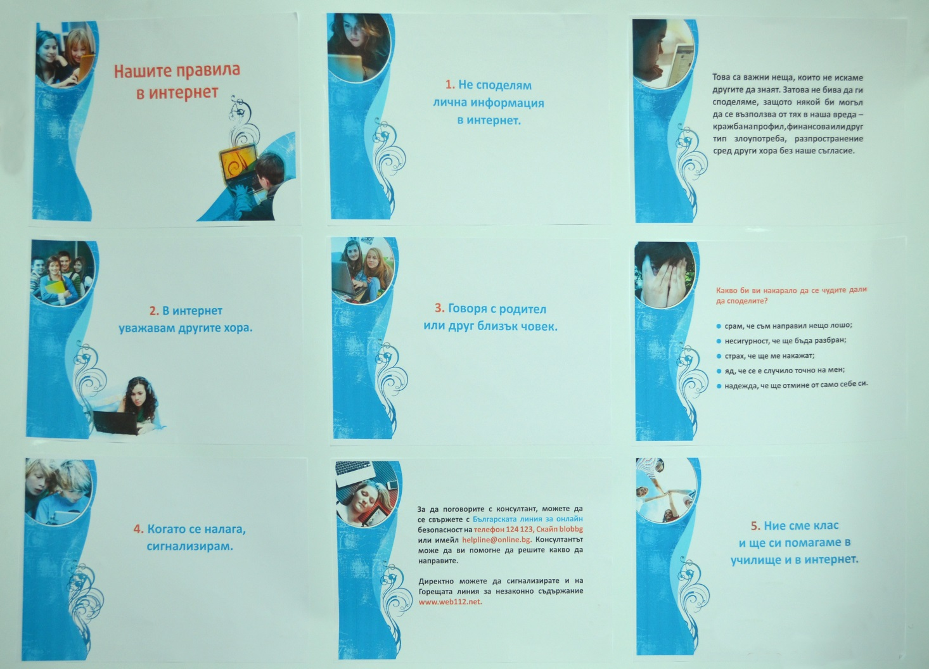
Posters “Our rules on Internet”
Two different posters for the little students (1st -4th grade) and for the older ones (5th -8th grade)

Slide 4
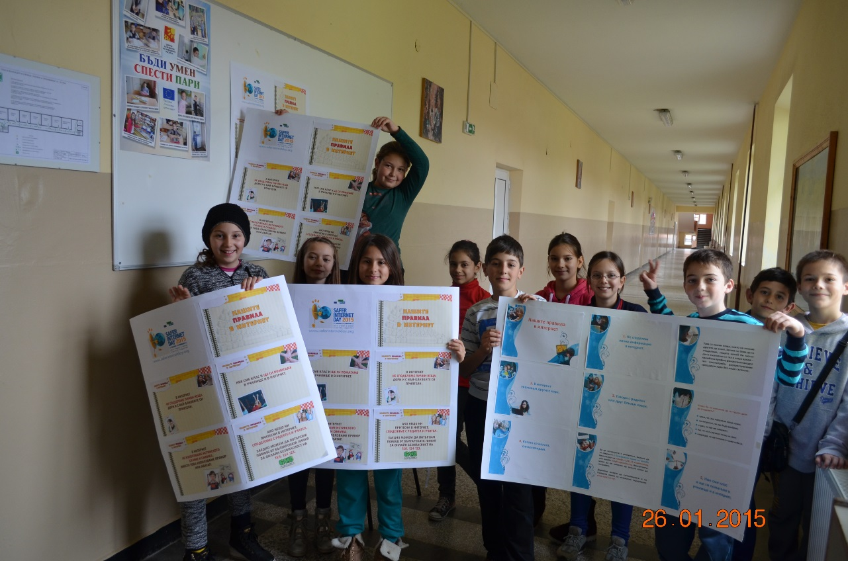
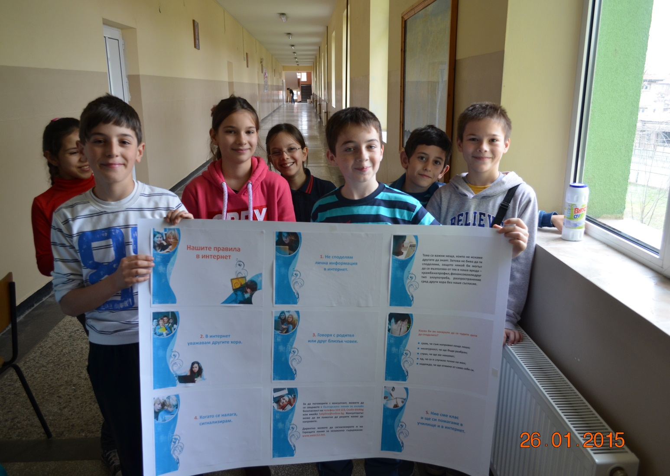
Posters “Our rules on Internet

Slide 5
Video made by students “E-safety”
CLICK HERE

Slide 6
Online poll “Check if your password is strong” (in Bulgarian)
http://3685449.polldaddy.com/s/perfectpass

Slide 7
Other activities
Online campaign on Facebook
Uploading video clips on facebook about Children’s E-safety
Brochure for students about:
- 10 rules how to use video sites
- Golden rules of the Netiquette, etc.
Poster for each classroom “7 things we have to be careful about when we use Intenet”

