Slide 1
Inspiring sports personalities

Slide 3
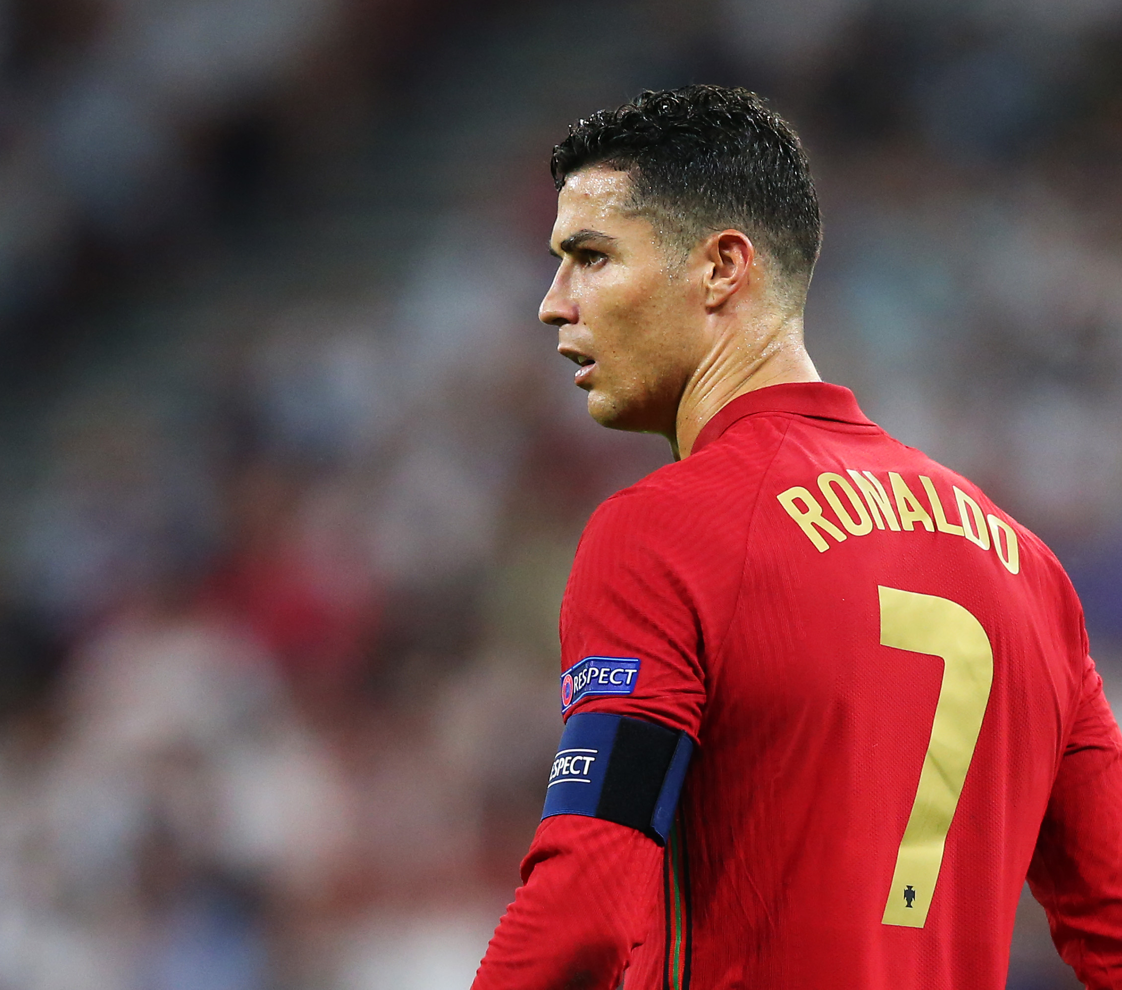
Name: Cristiano Ronaldo dos Santos Aveiro
Age: 36 years old
Birth date: 5th february 1985
Place of birth: Funchal , Madeira
Job: professional football player
Awards: over 40 awards in 38 categories

Slide 4
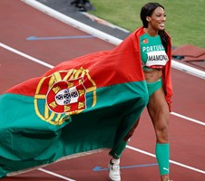
Name: Patrícia Mbengani Bravo Mamona
Age: 32 years old
Birth date: 21st november 1988
Place of birth: São Jorge de Arroios, Lisboa
Job: triple jump athlete
Awards: 11 medals (one of them being the tokyo olympic silver medal)

Slide 5
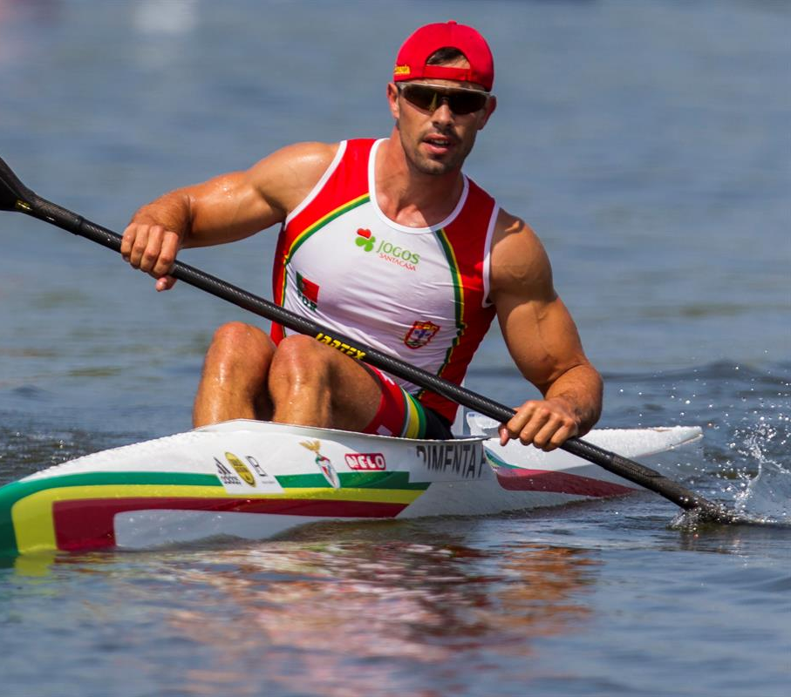
Name: Fernando Ismael Fernandes Pimenta
Age: 32 years old
Birth date: 13th august 1989
Place of birth: Ponte de Lima
Job: canoeist
Awards: over 40 awards (including the 2 medals from the olympic games)

Slide 6
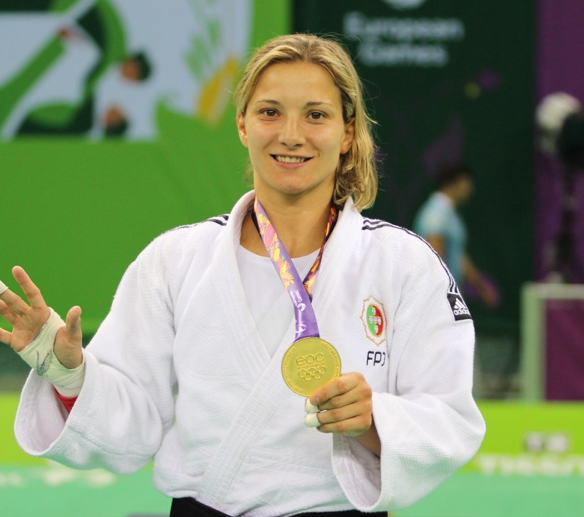
Name: Telma Alexandra Pinto Monteiro
Age: 35 years old
Birth date: 27th dezember 1985
Place of birth: Lisboa
Job: judoka
Awards: in 6 categories she won several awards including 12 gold medals and the bronze medal at the 2016 Olympic Games

Slide 7
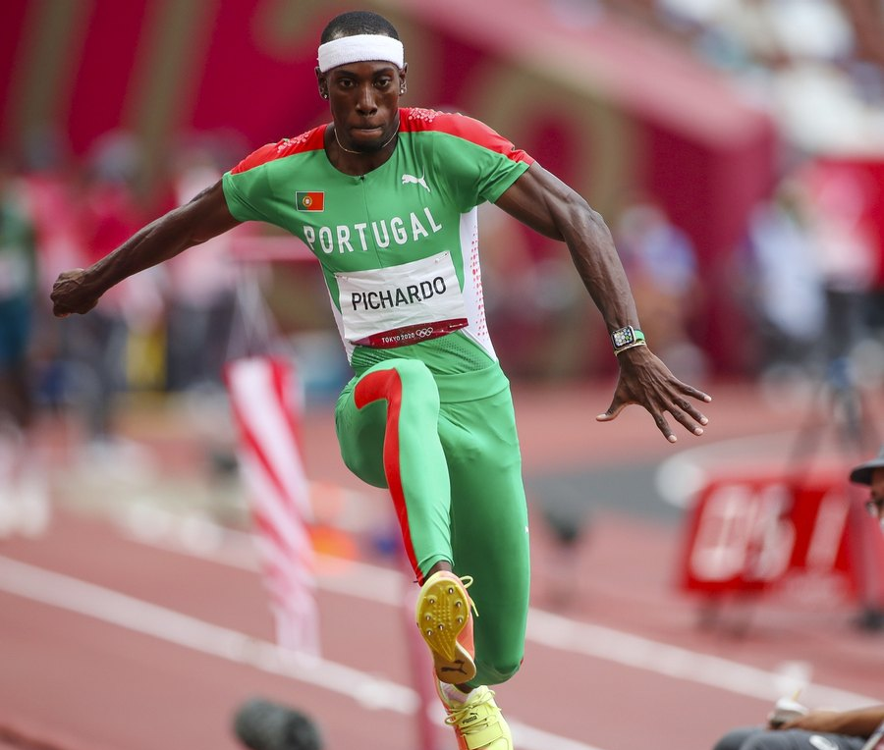
Name: Pedro Pablo Pichardo
Age: 28 years old
Birth date: 30th june 1993
Place of birth: Santiago de Cuba, Cuba
Job: athlete
Awards: gold medal at the olympic games in Tokyo

Slide 8
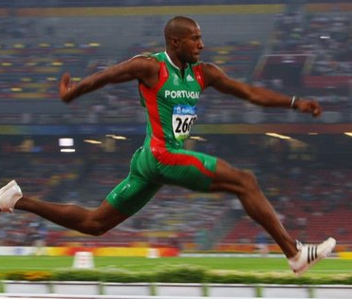
Name: Nelson Évora
Age: 37 years old
Birth date: 20th april 1984
Place of birth: Costa do Marfim
Job: athlete
Awards: 1 gold medal at the Olympic Games and more awards in different categories

Slide 9
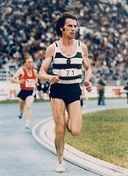
Name: Carlos Alberto de Sousa Lopes
Age: 74 years old
Birth date: 18th february 1947
Place of birth: Viseu
Job: former athlete
Awards: gold medal at the olympic games in Los Angeles

