Slide 1
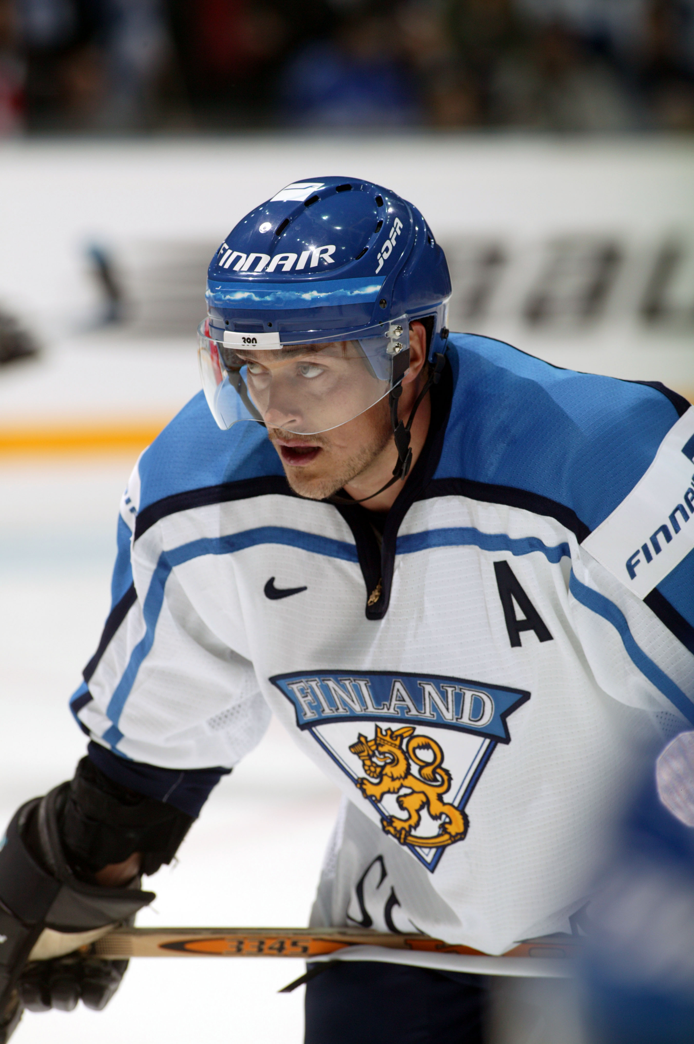
Finnish Inspiring Sports Personality
Teemu Selänne
Done by Finnish girls:
Sara Kontkanen, Sofia Ranta, Anna Laitinen & Hilma Kuittinen

Slide 2
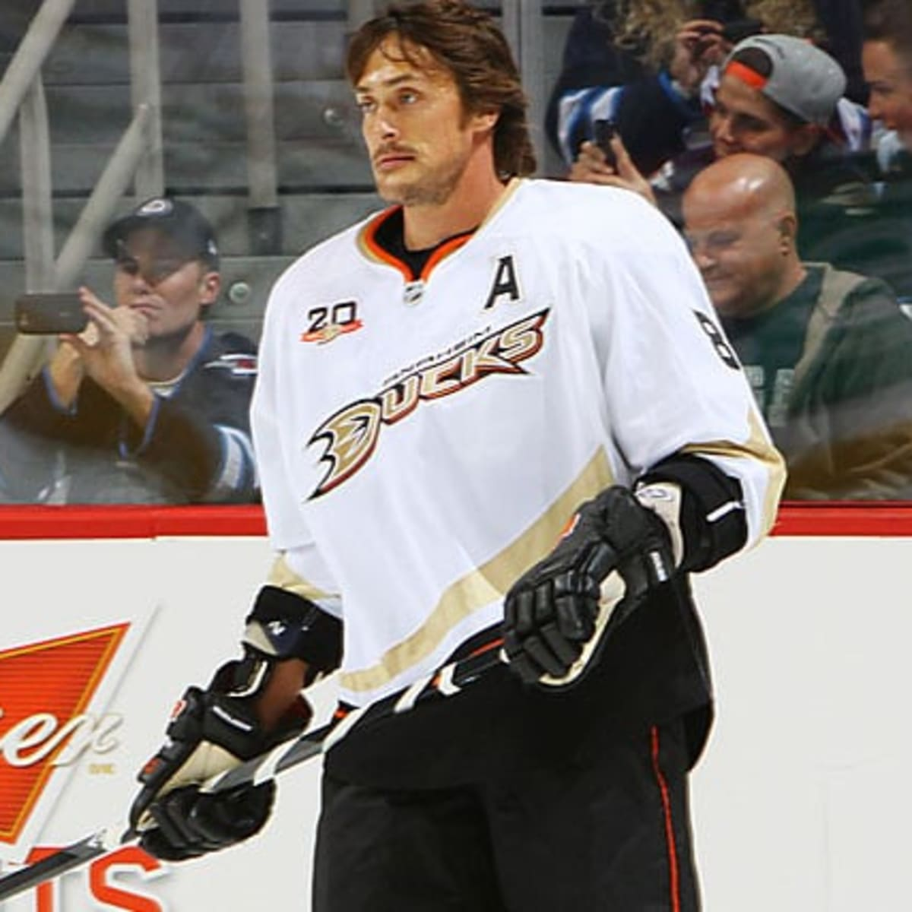
Information
Teemu Ilmari Selänne (age 51 year old and born in July 3, 1970) is a Finnish former professional ice hockey winger.
He began his professional career in 1989–1992 with Jokerit of the SM-liiga what is the Finnish Elite League, is the top professional ice hockey league in Finland.
Also he played 21 seasons in the National Hockey League (NHL) for the Winnipeg Jets (1992–1996), Mighty Ducks of Anaheim (1996–2001 and 2005–2014), San Jose Sharks (2001–2003) and Colorado Avalanche (2003–2004).
His nicknamed "the Finnish Flash", Selänne is the highest scoring Finn in NHL history, and one of the highest overall. He retired in 2014 11th all-time with 684 goals and 15th with 1,457 points.
In 2017 Selänne was named one of the '100 Greatest NHL Players' in history.

Slide 3
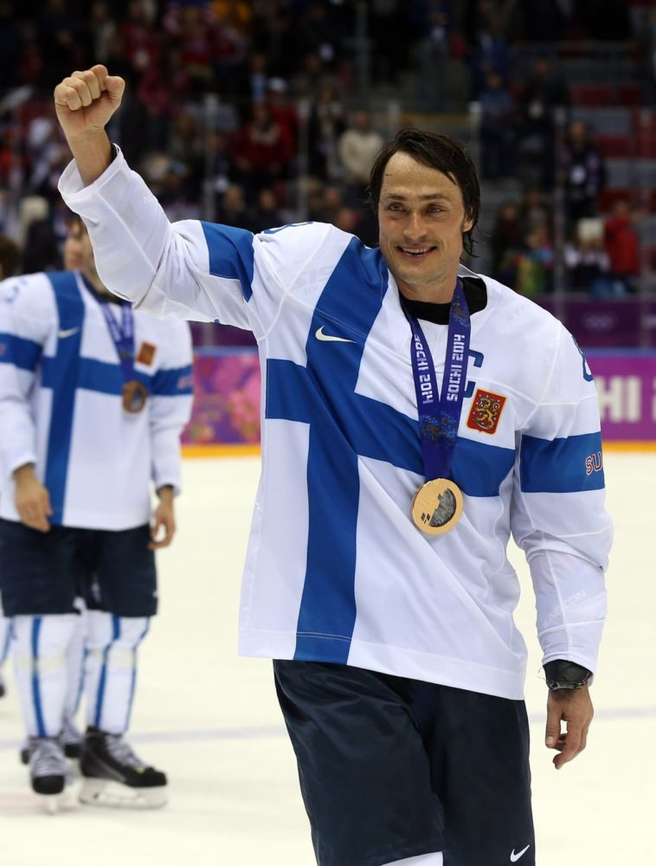
Finnish national team and olympics
Internationally, Selänne was a long-time member of the Finnish National Team. He played in five World Championships, winning a silver and bronze medal, and in three Canada Cup/World Cup of Hockey tournaments.
A six-time Olympian, Selänne helped Finland win three bronze medals and, in 2006, a silver medal. He is the all-time leader in scoring at the Olympic ice hockey tournament with 43 points.

Slide 4
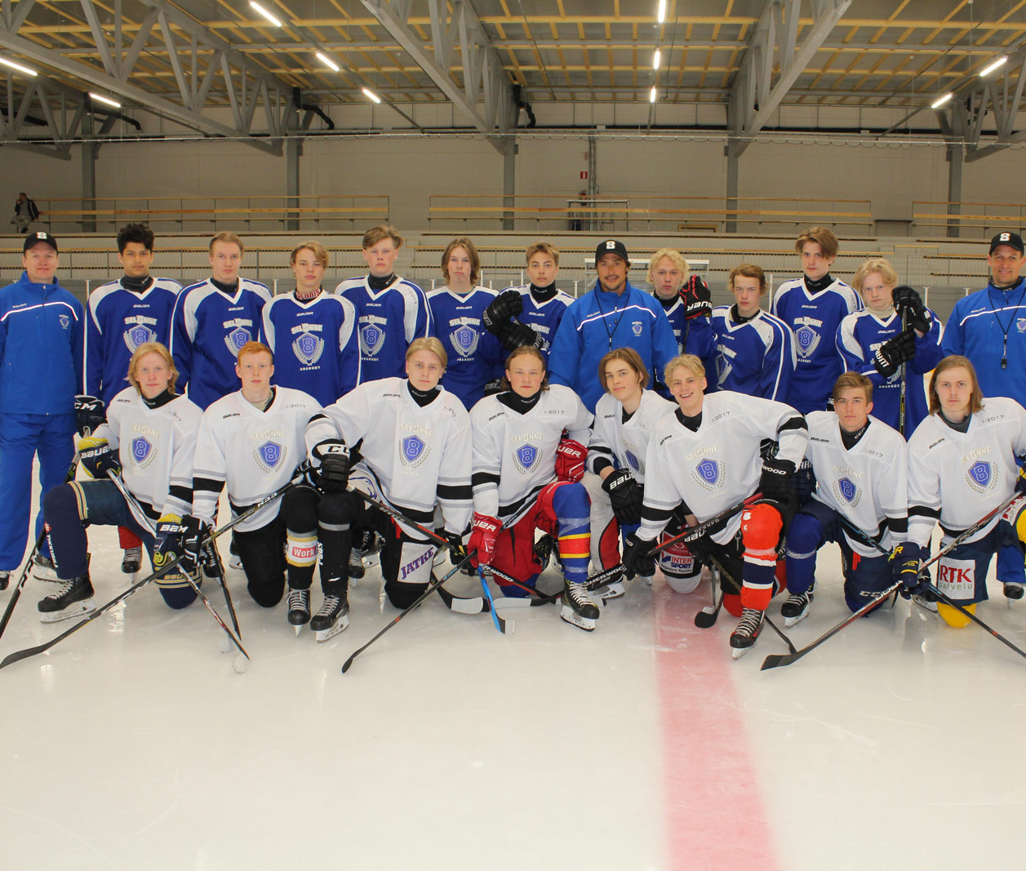
Why he inspires us?
Selänne has supported many different organizations during her career, especially childrens. Teemu´s own website supports two different charities.
Finnish Flash ry is a charitable organisation mainly supporting sports activities aimed for the young, the female, and the disabled. The name comes from the nickname given to Teemu Selänne.
Youth Sports Foundation is a non-profit organization that features programs for children in 3rd-7th grades. The goal of YSF is to provide kids the opportunity to participate in these sports, and encourage participation at the Junior and Senior High levels.

