Slide 1
Frieda Kahlo

Slide 2
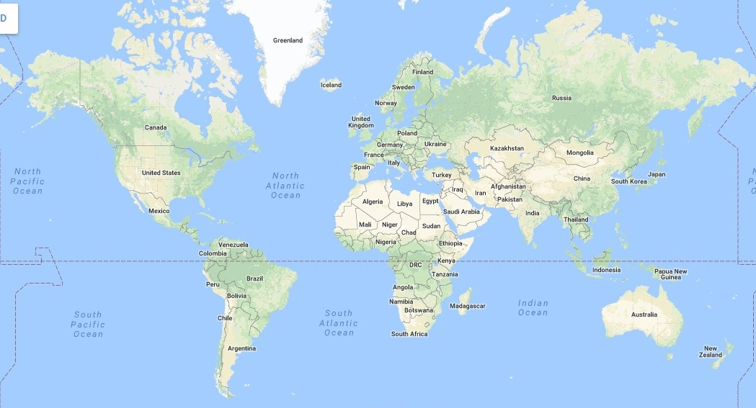
Frieda Kahlo was born in Mexico.

Slide 3
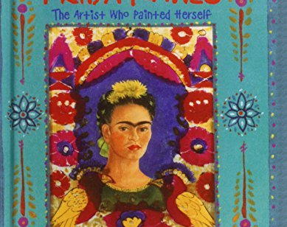
Pupils in Spain have been finding out about her work.
They used books, pictures and a children’s website

Slide 4
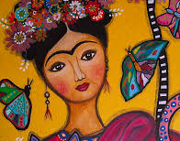
Frieda Kahlo said,
‘I paint flowers so that they will not die.’
She also said,
‘I paint self-portraits because I am so often alone, because I am the person I know best.’

Slide 5
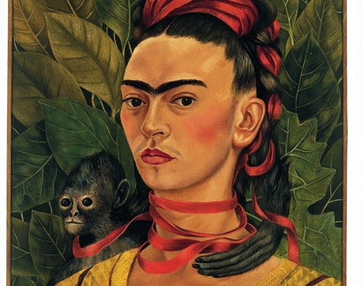
Here are some of her paintings.

Slide 6
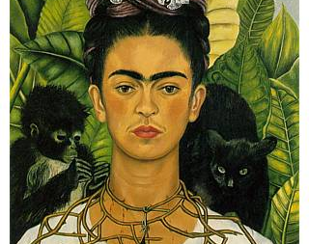

Slide 7
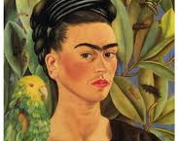

Slide 8
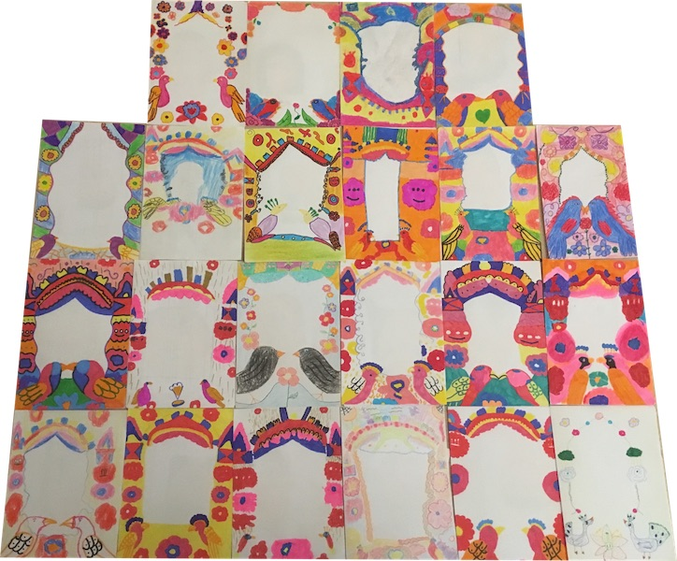
The Spanish children drew some self portraits.
Then, they made some frames for their portraits, inspired by the work of Frieda Kahlo.

Slide 9
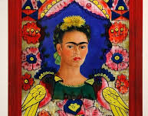
Your task:
Make a colourful border around your self- portrait, in the style of Frieda Kahlo.

