Slide 1
PRZEDSZKOLE NR 81
WARSAW
POLAND

Slide 2
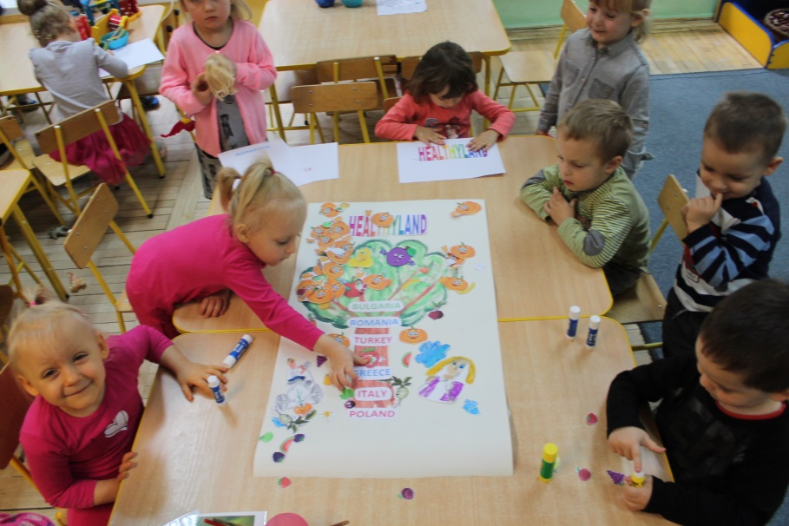
Project Activities September
Project logo

Slide 3
OCTOBER vegetables
PUMPKIN DAY – MEETING WITH PARENTS

Slide 4
Healthy pancakes

Slide 5
Teaching about vegetables

Slide 6
Teaching about vegetables

Slide 7
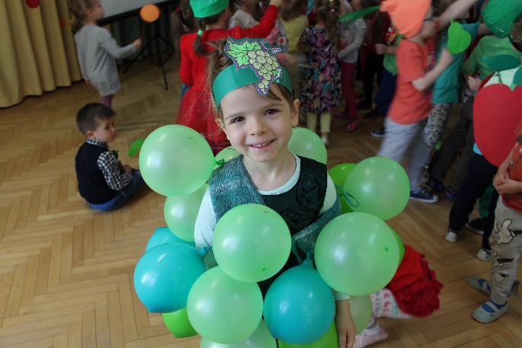
Healhty party

Slide 8
Pumpkin muffins

Slide 9
Pumpkin muffins

Slide 10
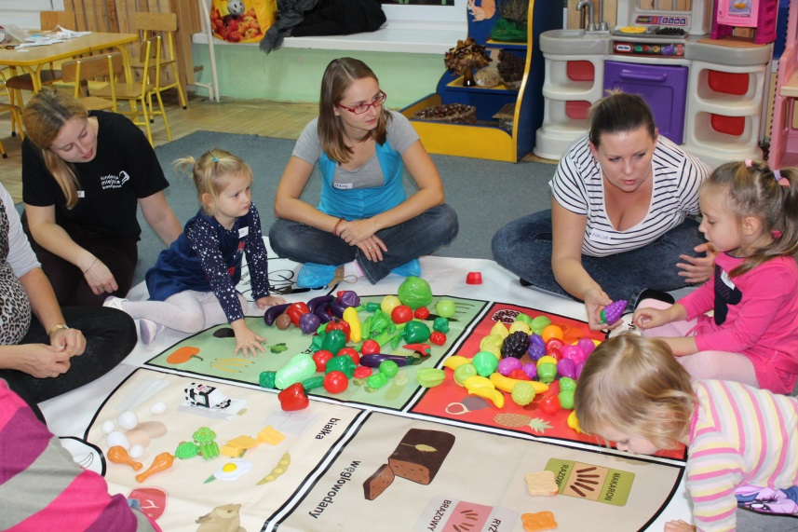
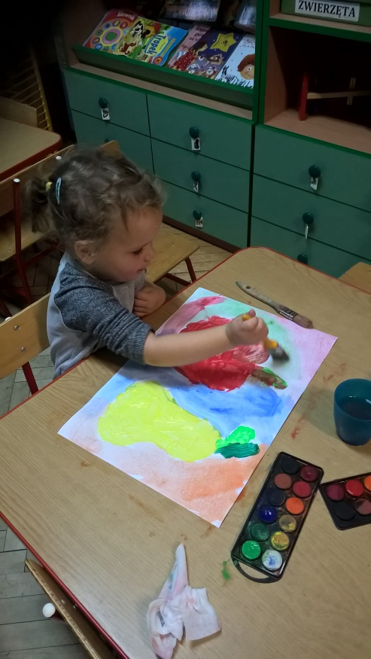
November fruits
Teaching about fruits
Workshops with parents

Slide 11
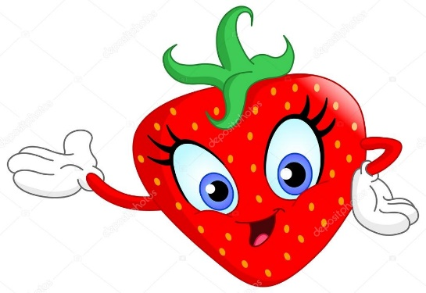
Fruit coctail

Slide 12
Fruit coctail

Slide 13
‚crazy faces’ using the shapes of fruit

Slide 15
Project meeting in Poland
Meeting with Targówek district mayor Mr. Sławomir Antonik

Slide 16
Choosing logo project
Visit in Elementary school

Slide 17
Our time

Slide 18
Activities with children

Slide 19
DECEMBER FISH AND SEA FOOD

Slide 20
Playing with fish

Slide 21
Promotion our project in Polish Radio

Slide 22
JANUARY GRAINS

Slide 23
Grains for birds

Slide 24
Grains for birds

Slide 25
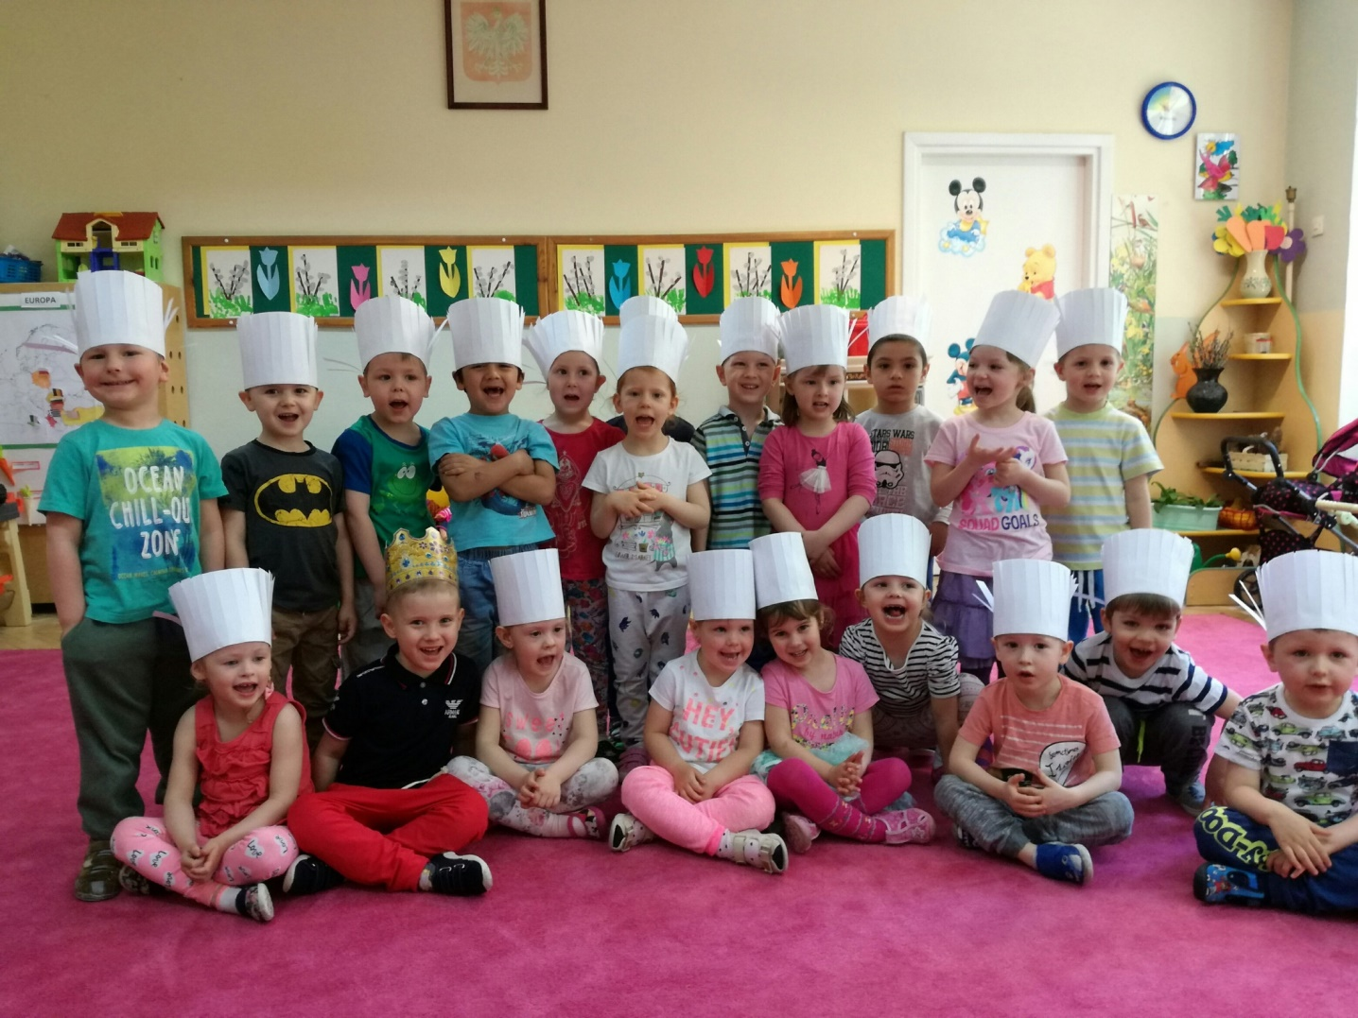
We are cooking!

Slide 26
SANDWICHES WITH CRESS

Slide 27
SANDWICHES WITH CRESS

Slide 28
Tasty sandwiches

Slide 29
FEBRUARY DAIRY PRODUCTS

Slide 30
The Day of Healthy Food – promotion of Healthyland project

Slide 31
Meeting with famous polish cook Karol Okrasa

Slide 32
MARCH HERBS AND SPRING VEGETABLES

Slide 33
Sowing seeds from our partners

Slide 34
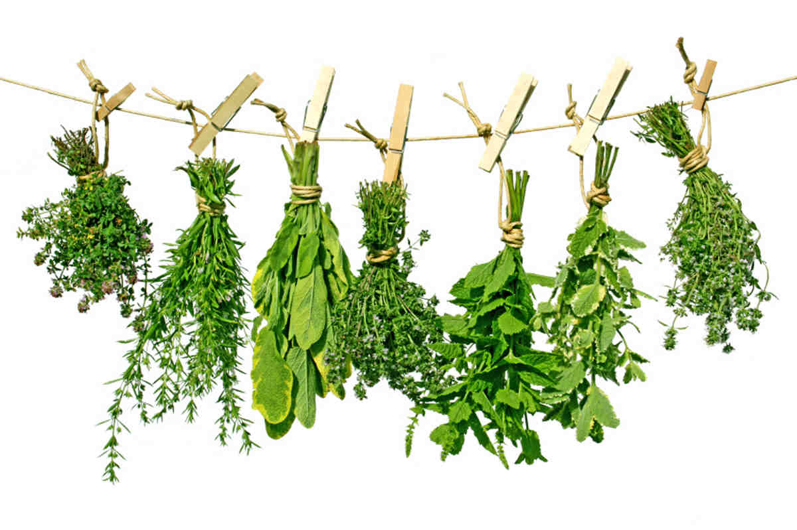

Slide 36
APRIL WATER

Slide 37
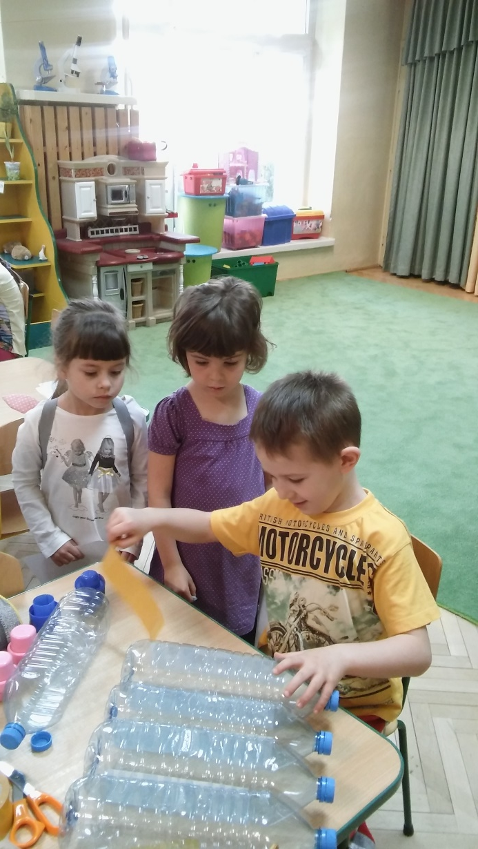

Slide 38
Thank you for your attention

