Slide 1
HEALTHYLAND
INSPECTORATUL ŞCOLAR JUDEŢEAN DOLJ
GRĂDINIŢA CU PROGRAM PRELUNGIT „FLOAREA SOARELUI” CRAIOVA
STR.NICOLAE COCULESCU,NR.20: TEL./FAX.0251/484450
E-mail: gradinita51craiova@yahoo.com
Reference number
2016-1-PL01-KA219-026474_2

Slide 2
Parteners:
Przedszkole nr 81 – Poland, project coordinator;
Gradinita cu Program Prelungit "Floarea Soarelui" – Romania;
Istituto Comprensivo Statale "Biagio Siciliano" – Italy;
Izmir Gaziemir Sabiha Gokcen Ilkokulu – Turkey;
Kalina Malina – Bulgaria;
OLOIMERO NIPIAGOGIO AVLONARIU – Greece;

Slide 3
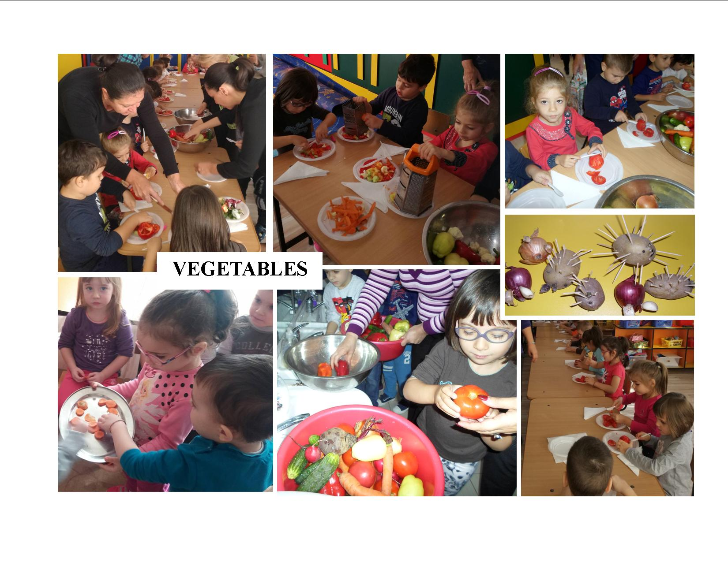
In order to reach the project objectives and to promote a healthy lifestyle, every month we proposed to approach a theme which will help us discover the secrets of a healthy nutrition.
OCTOBER
–VEGETABLES-
The activities that we carried on were: preparing vegetables salads with the help of the children’s parents, mathematics and science didactic games, various practical and art activities, funny animals made of vegetables etc.

Slide 4
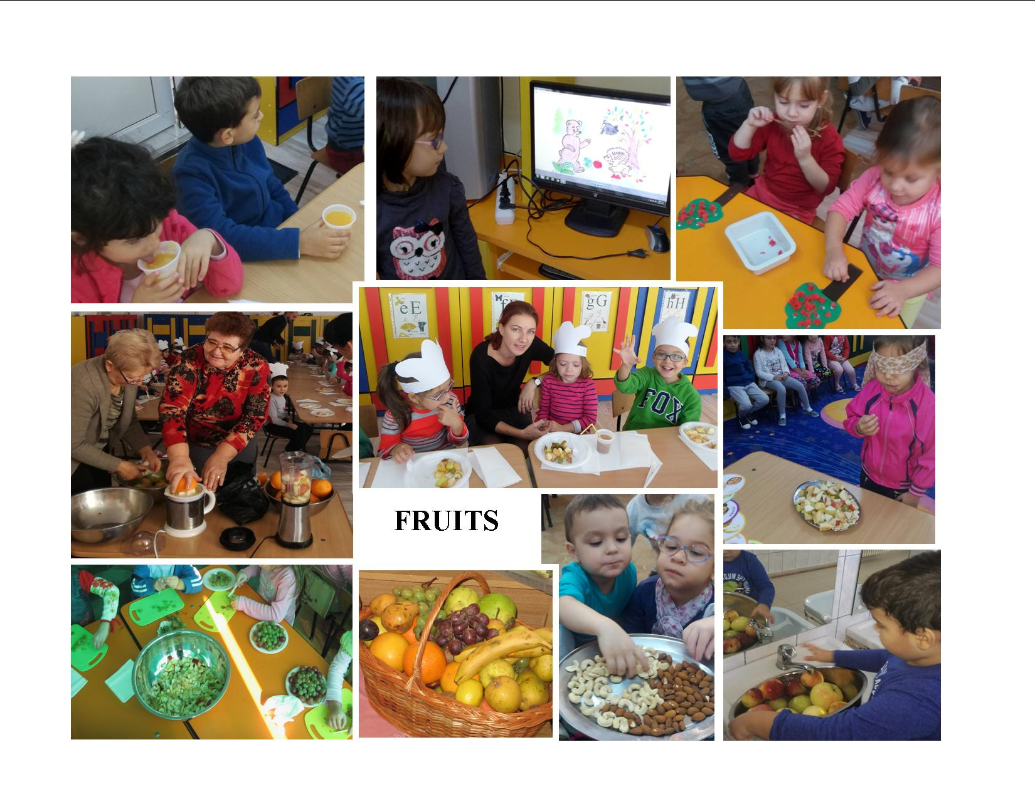
NOVEMBER
–FRUITS-
the proposed activities were: preparing fruit salads and juice, preparing fruit tarts, sensorial games : “Guess what you’ve tasted!”, “Guess what you’ve touched”, mathematics and science didactic games, various practical and art activities, stories: “The Troublesome Apple”, “The Chestnuts Story”, “The Fruits Quarrel”.

Slide 5
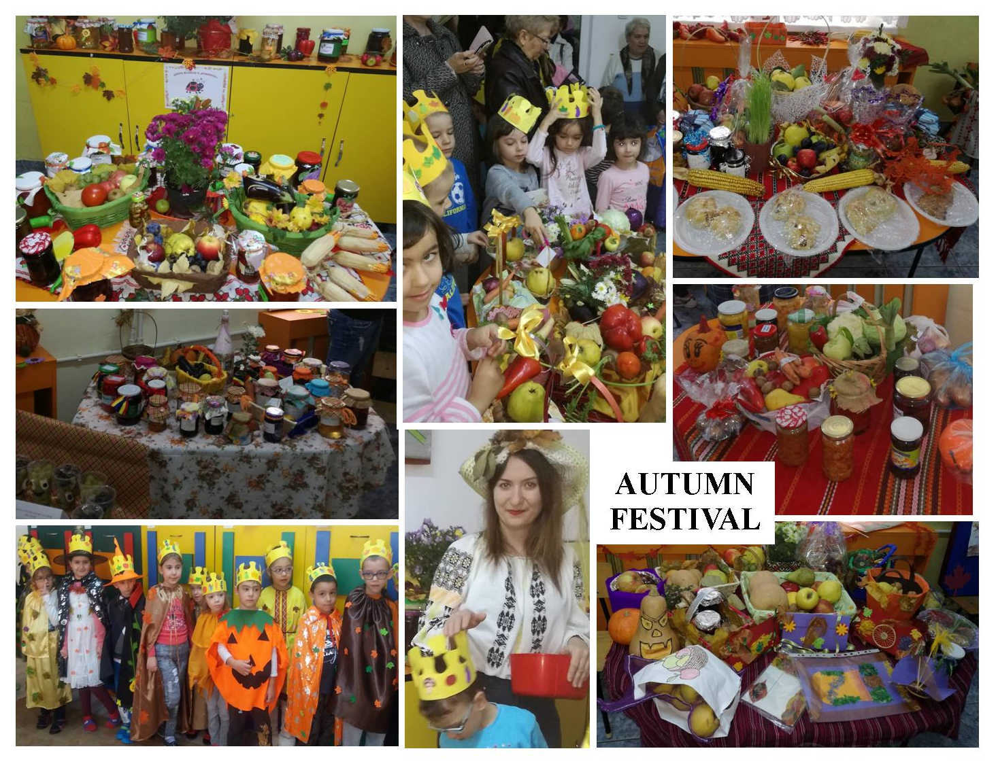

Slide 6
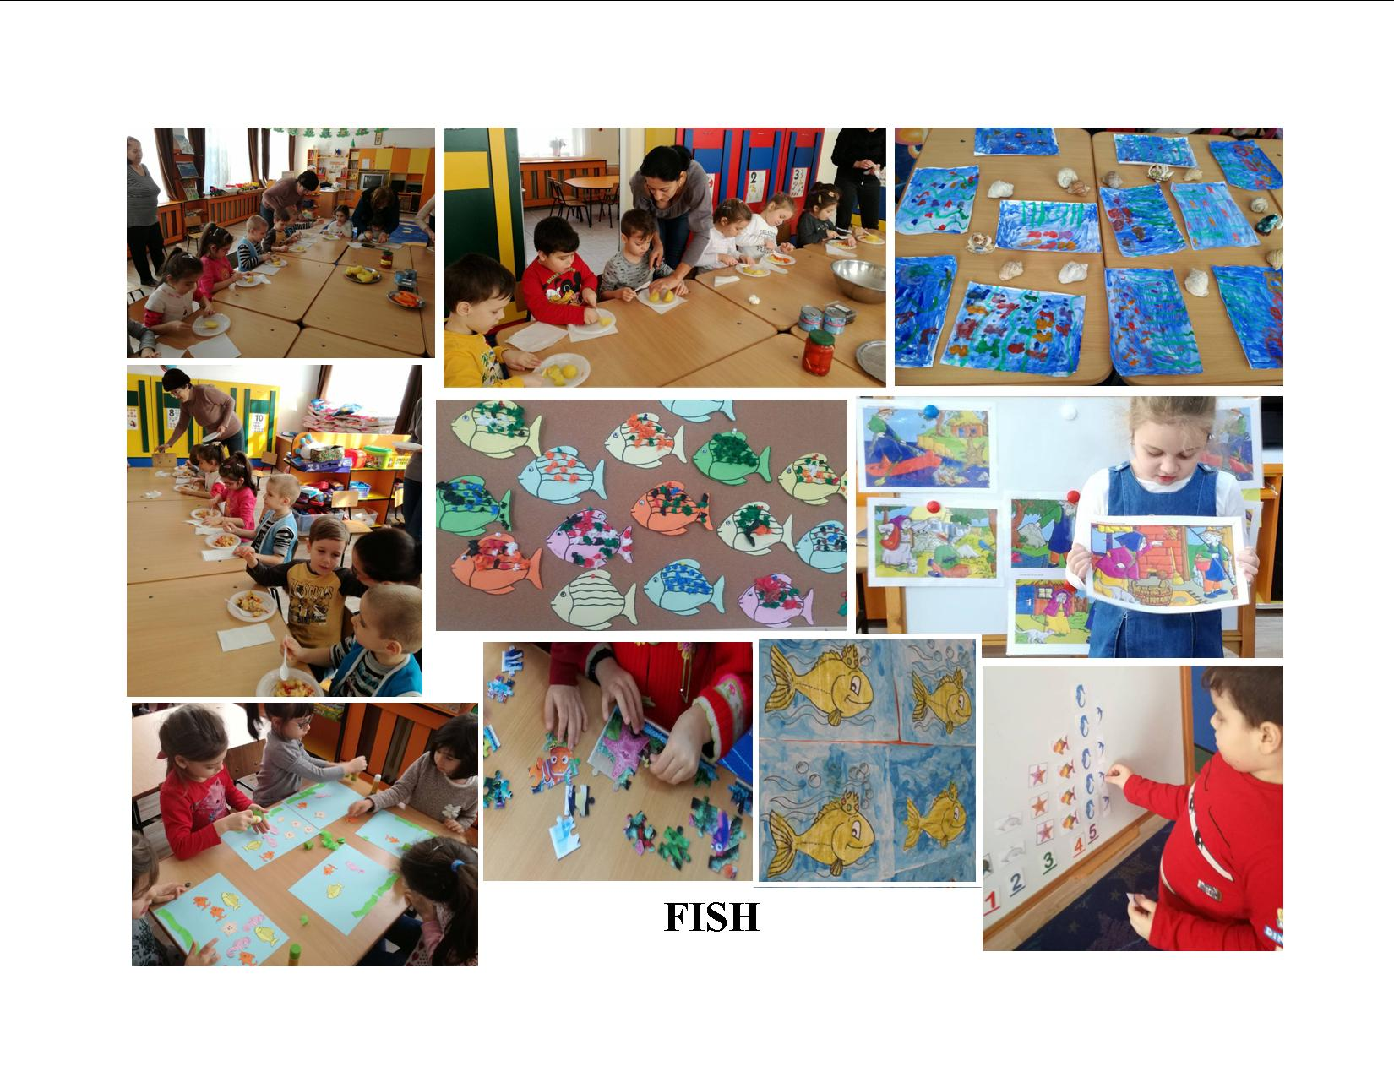
DECEMBER –FISH AND SEAFOOD-
This month came with a lot of news for the children who prepared and enjoyed “Tuna Salad”, learned about marine animals and the benefits of eating fish, carried on mathematics and language activities, had fun solving puzzles, painting, drawing or making all types of crafts.

Slide 7
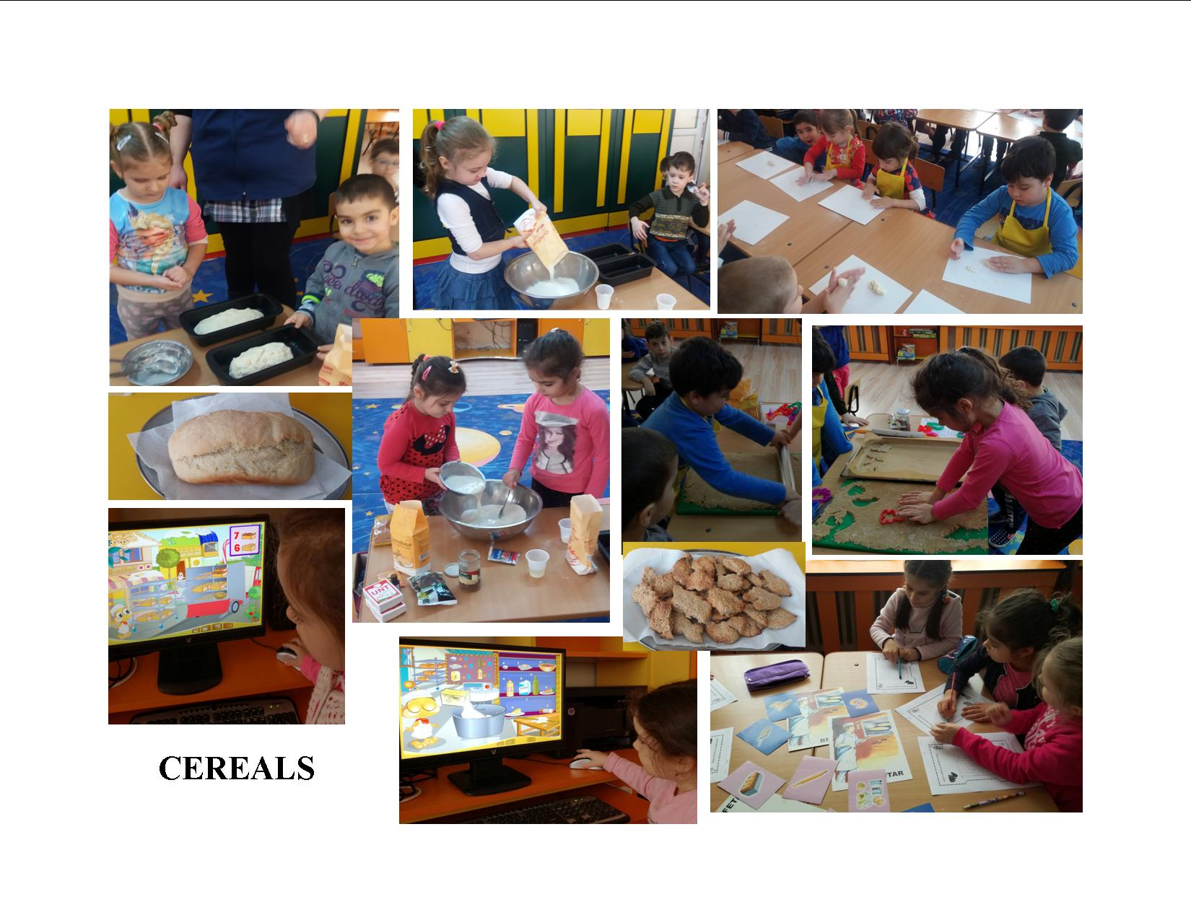
JANUARY –CEREALS-
The children acquired knowledge regarding the process through which wheat grain passes from sowing until bread arrives on our tables.
They effectuated simple experiments: dough preparation, modeling, bread baking and observing the results of these experiments
They learned songs on this theme: “The Bakers”, “Bake the Cake”, “The Miller”, learned about the types of cereals and the benefits of including them in our diet, prepared and ate digestive biscuits, carried on math activities within which they measured, weighed and counted the ingredients, the visited an important bakery in our town .

Slide 8
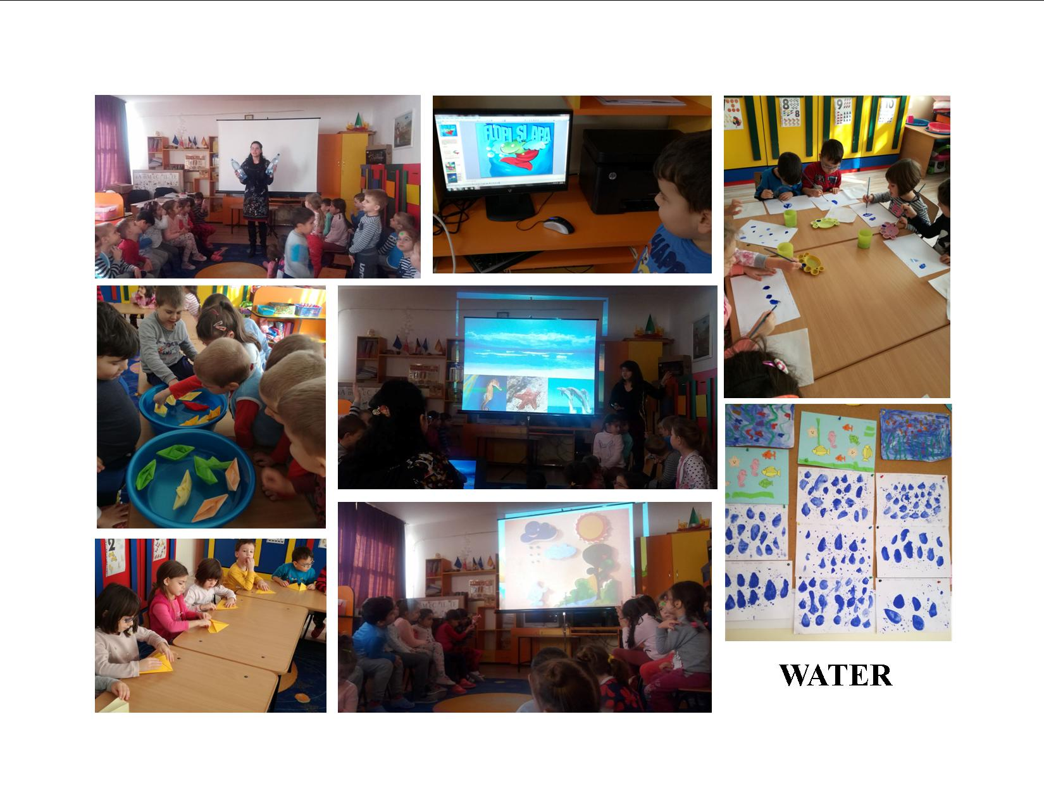
FEBRUARY –WATER-
The children learned about the types of water in the world, about the importance of drinking water for our health, and also about the importance of water for the environment, for the entire world fauna and vegetation. A specialist in hydrology from the University of Craiova came and explained the children al these things.
The children also got involved in the effectuation of various experiments: coloring the water, freezing and melting it, objects floating or diving into the water. They painted water drops, manufactured paper boats which afterwards they counted, grouped depending on their color and observed while floating,
They learned about the cycle of water in nature “The Story of the Water Drop” and about the importance of protecting the environment and keeping the water clean empathizing with Flopi in the story “Flopi and the water”.

Slide 9
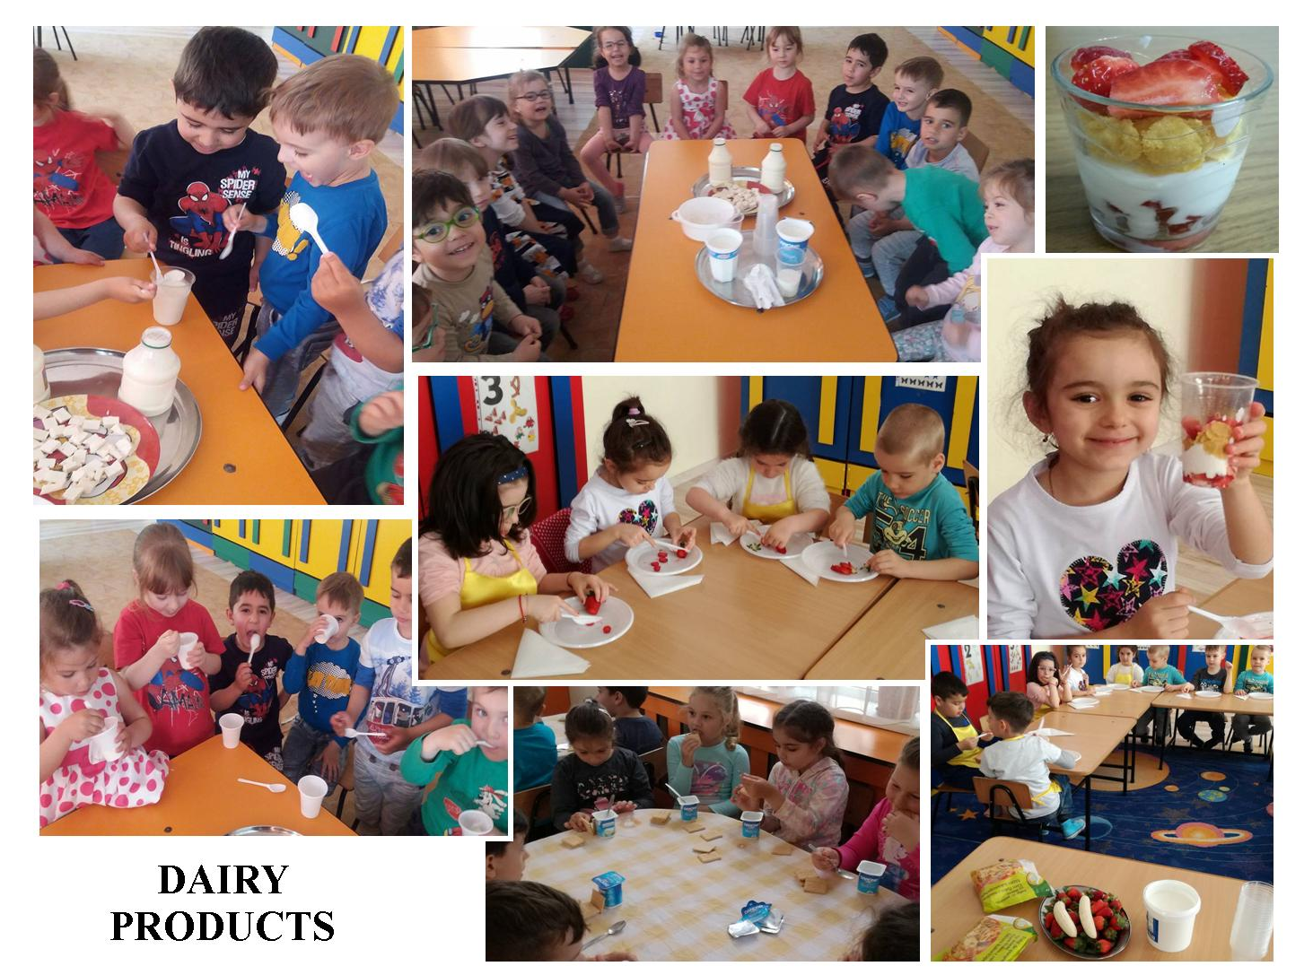
MARCH –MILK AND DAIRY PRODUCTS-
The children enjoyed this theme very much. They tasted different types of dairy products, observing similarities and differences, learned about the benefits that dairy products bring to our body and prepared delicious healthy snacks.

Slide 10
During a fieldtrip where they acquired significant knowledge about where milk comes from and how are produced dairy products. They had the chance to observe the sheep in their environment, to talk to a shepherd.
They tasted various types of cheese, saw how cheese is traditionally produced and kept, learnt about a shepherd’s life. In the end, they had the chance to eat traditional food made of polenta, cheese and cream.

Slide 11
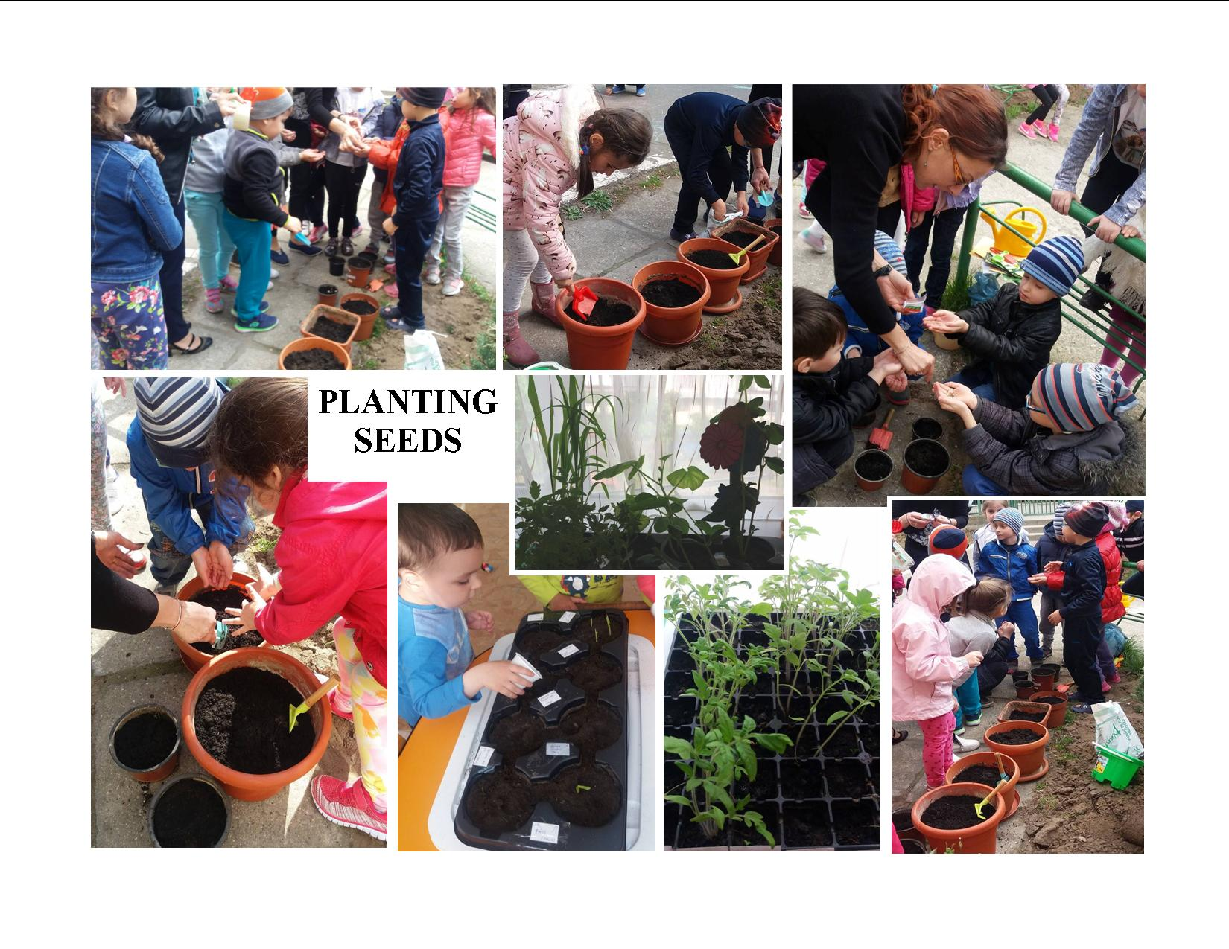
APRIL –PLANTING SEEDS-
The kids observed seeds of various plants, planted them and learned about the growth process, how to take care of them - how often to water them, that they need light and heat to grow big – and they look forward to enjoy the fruits of their work.

