Slide 1
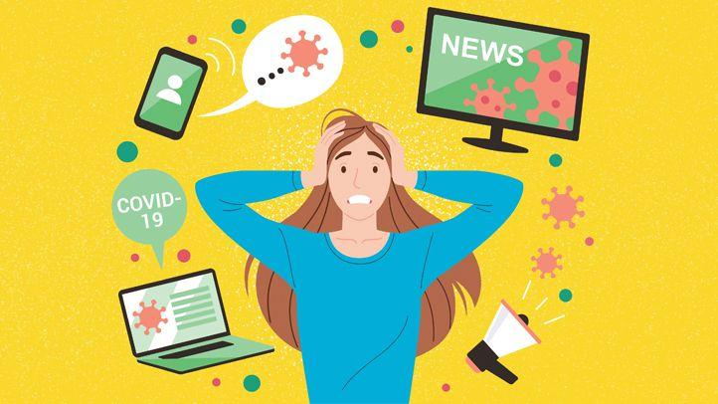
Ability to work under pressure and time management in inclusive education
-Theodor Sîrbulețu- HOW WE CAN LIMIT THE STRESS WHEN THE LIMITS ARE CREATING IT
KA229- DON'T CHANGE THE CLIMATE; CHANGE THE SYSTEM!
Notes:
Pressure is higher today because we are doing many things and everything happens fast.

Slide 2
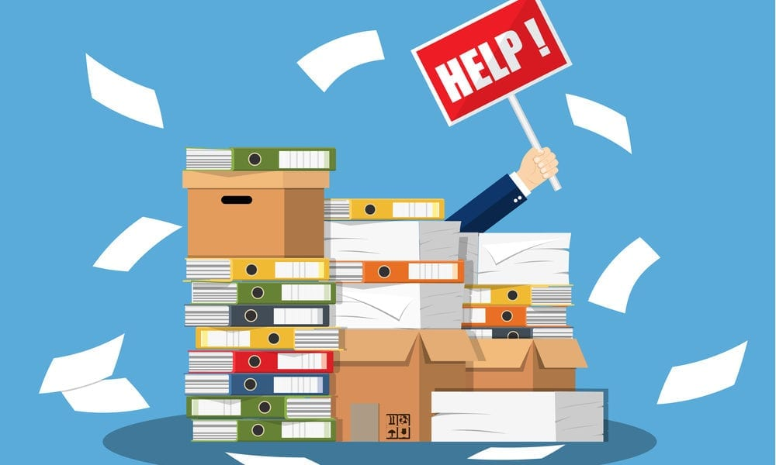
WHAT IS STRESS ?
Any type of change that causes physical, emotional, or psychological strain/pressure. Stress is our body's response to anything that requires attention or action.
Everyone experiences stress to some degree.
Notes:
Stress has a psychological component and a physical component. Twitch. Stress the most common disease of our times. More stress now then in 1990s. 45-60 years old people the most stressed people.

Slide 3
Factors/causes:
Getting out of comfort zone, an interview, too many tasks, time limits, restrictions, high expectations, sudden change… limits
Stress effects (signs):
Changes in mood, Clammy or sweaty palms, Decreased sex drive, Diarrhea, Difficulty sleeping, Digestive problems, Dizziness, Feeling anxious, Frequent sickness, Grinding teeth, Headaches, Low energy, Muscle tension, especially in the neck and shoulders, Physical pains, Stirred, Racing heartbeat, Frustrations, Twitches, all the way to deap depression and suicidal tendency.

Slide 4
Pandemic period
How a very small thing like a virus can change our lives?
Very easy, if it is highly transmissible, it will change the whole world.
What Covid19 pandemic changed?
The way we respond to stress, however, makes a big difference to our overall well-being.
Notes:
The way we live, we work, we have fun, we pray, we travel… Work related stress increased, social interactions deceased. All family at home or kids at home for too long. Much time on devices and on internet. Isolation, tiredness. Masc on face limit the expression.

Slide 5
History of inclusion

Slide 6
Inclusive education
Inclusion is the last in line after integration.
It ensures proper education for all kids including disabled ones.
But, beside its benefits, it can be problematic for the teachers who had no previous contacts with disabled kids.
A new thing creates stress: Special planning, individual intervention plan, new methods of teaching, new different materials to use with the new kid, behavior management...

Slide 7
Prevent and reduce stress
Having a daily routine, a schedule for work and for the rest of the day. Get organized and document yourself.
-breaks, move, sleep, hobbies or enjoyable activities
-If too many tasks prioritize them, if time is too short ask for help, if the task is a big one break it in smaller ones.
Physical activity (at least intense 15 minutes per day), as domestic chores, online exercise classes like ….
Relax: yoga, pilates, tai-chi, meditation and breathing techniques. Slowing down breathing (count, 4-4-4).
Stand up and walk.
Notes:
Acute stress, Chronic stress, Eustress. -As the lines between work and home life blur, the risk of burnout increases, balance is necessary. Preventing stress and decreasing stress.

Slide 8
4. Set limits on social media and around news on COVID-19
Turn off automatic news on phone, set time limits, check only the trusted sources not all the opinions that flow everywhere, concentrating on good/positive stories.
Limit the notifications from Whatsapp, Facebook, Instagram etc., unfollow or unfriend if the case.
5. Spend time in nature
Time spent in nature also contributes to our mental and physical wellbeing: walk in the garden or pak, in the forest… run on the mountain.

Slide 9
6. Reach out to others
Making time to reach out and connect with others is important for our mental health.
Socialising decreases stress and anxiety while supporting calm and happy feelings.
Call or video call if isolated at home.
Working from home can feel lonely and isolating.

Slide 10
7. Seek professional support
Peer help, counsellor, psychotherapist or medical help.

Slide 11
When something is not possible we have the power to say NO.
Focus on positive side of the things and positive thoughts;
When you leave your work leave the work related problems there.
Smile, use jokes:
Pretty wild how we used to eat cake after someone blew on it !
My mom always told me I wouldn’t accomplish anything by lying in bed all day. But look at me now, ma! I’m saving the world by doing it!
If I keep stress-eating at this level, the buttons on my shirt will start socially distancing from each other.
Nothing like relaxing on the couch after a long day of being tense on the couch.
Day 121 at home and the dog is looking at me like, “See? This is why I chew the furniture!”

Slide 12
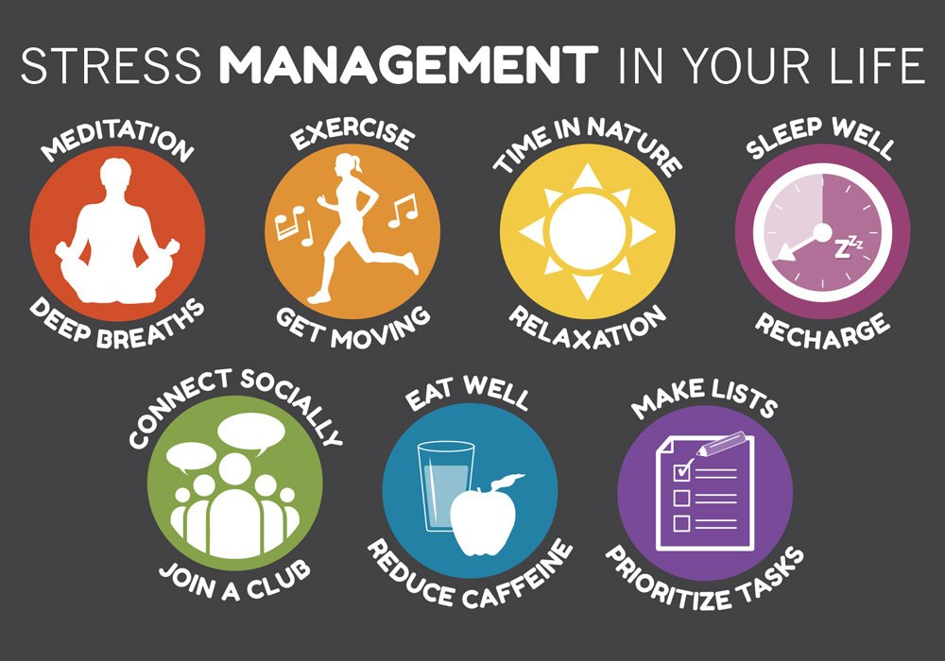

Slide 13
BIBLIOGRAPHY
https://www.healthline.com/health-news/people-more-stressed-today-than-1990s
https://www.verywellmind.com/stress-and-health-3145086
https://www.mhe-sme.org/10-ways-to-cope-with-stress-during-the-pandemic

