Slide 1
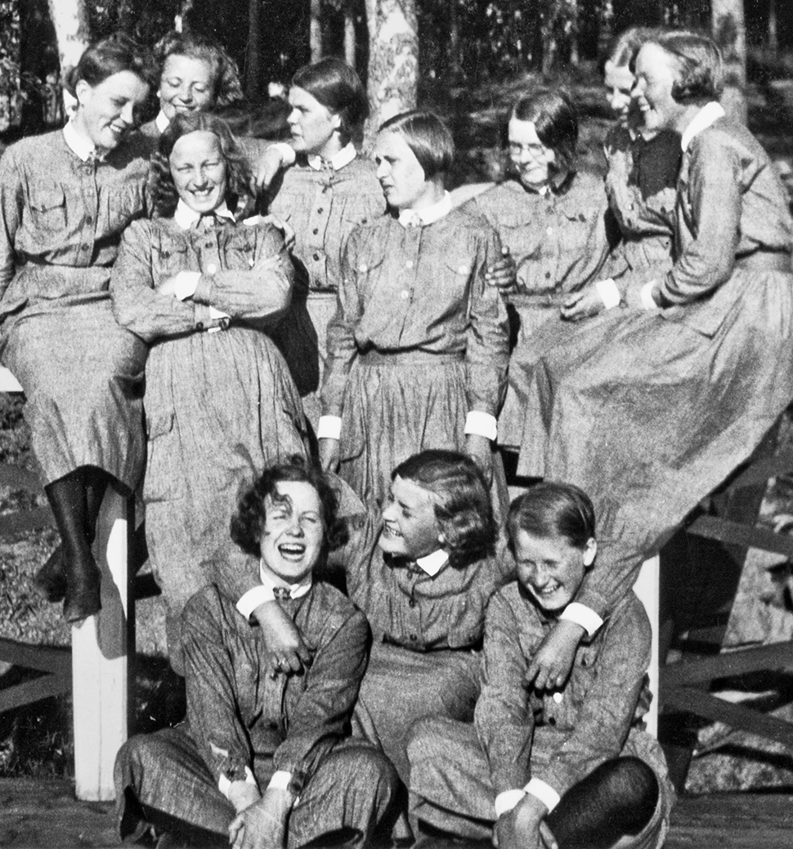

Slide 2
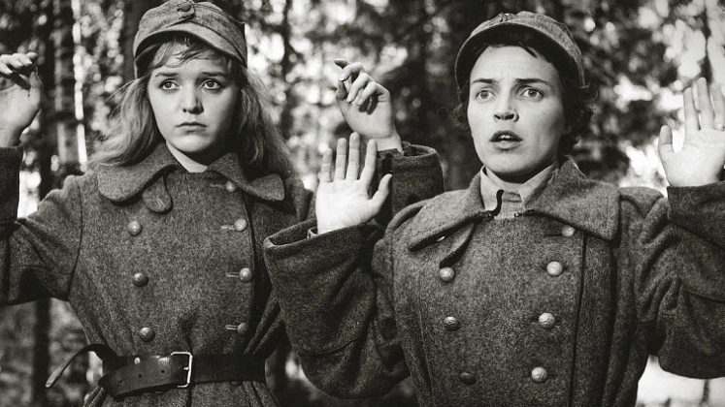
the organization was:
established in 1920
disbanded in 1944
voluntary

Slide 3
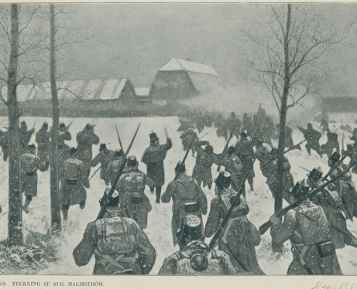
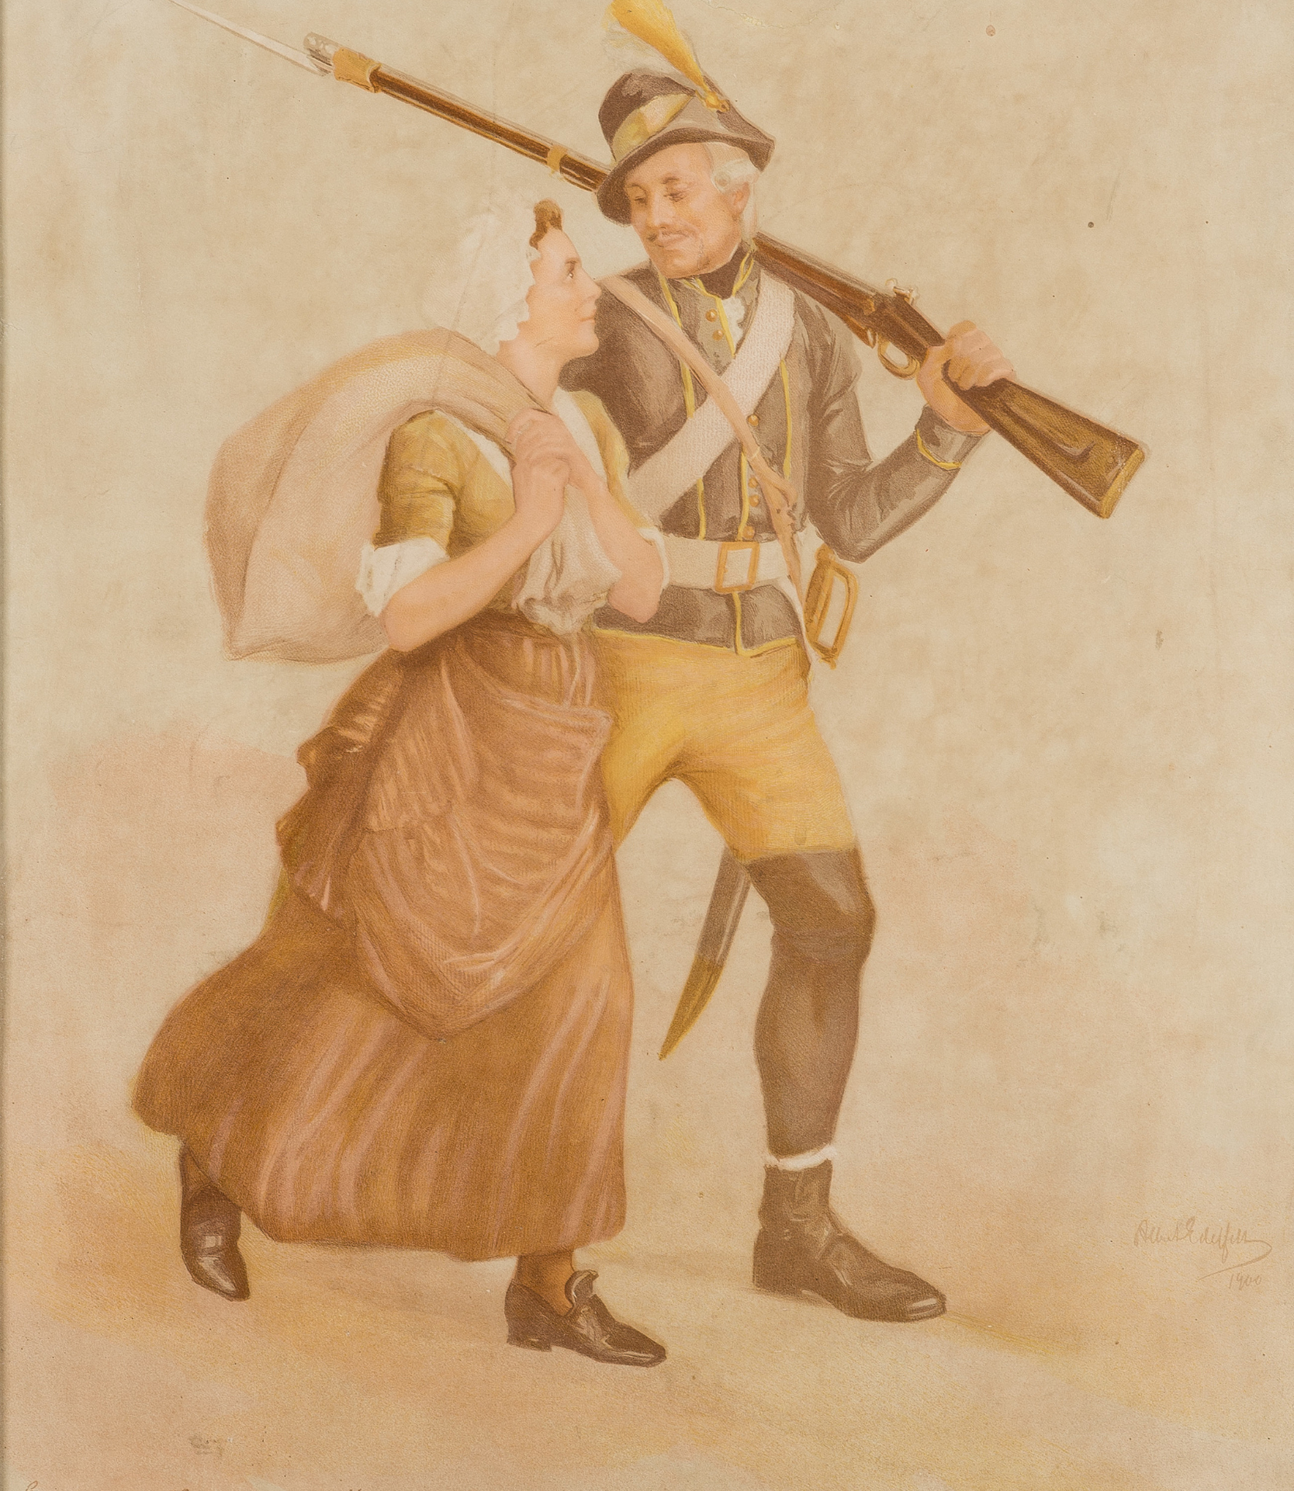
The origin of the name
tales of Ensign Ståhl
inspiration for the organisation from Runebergs story
1808-1809 war

Slide 4
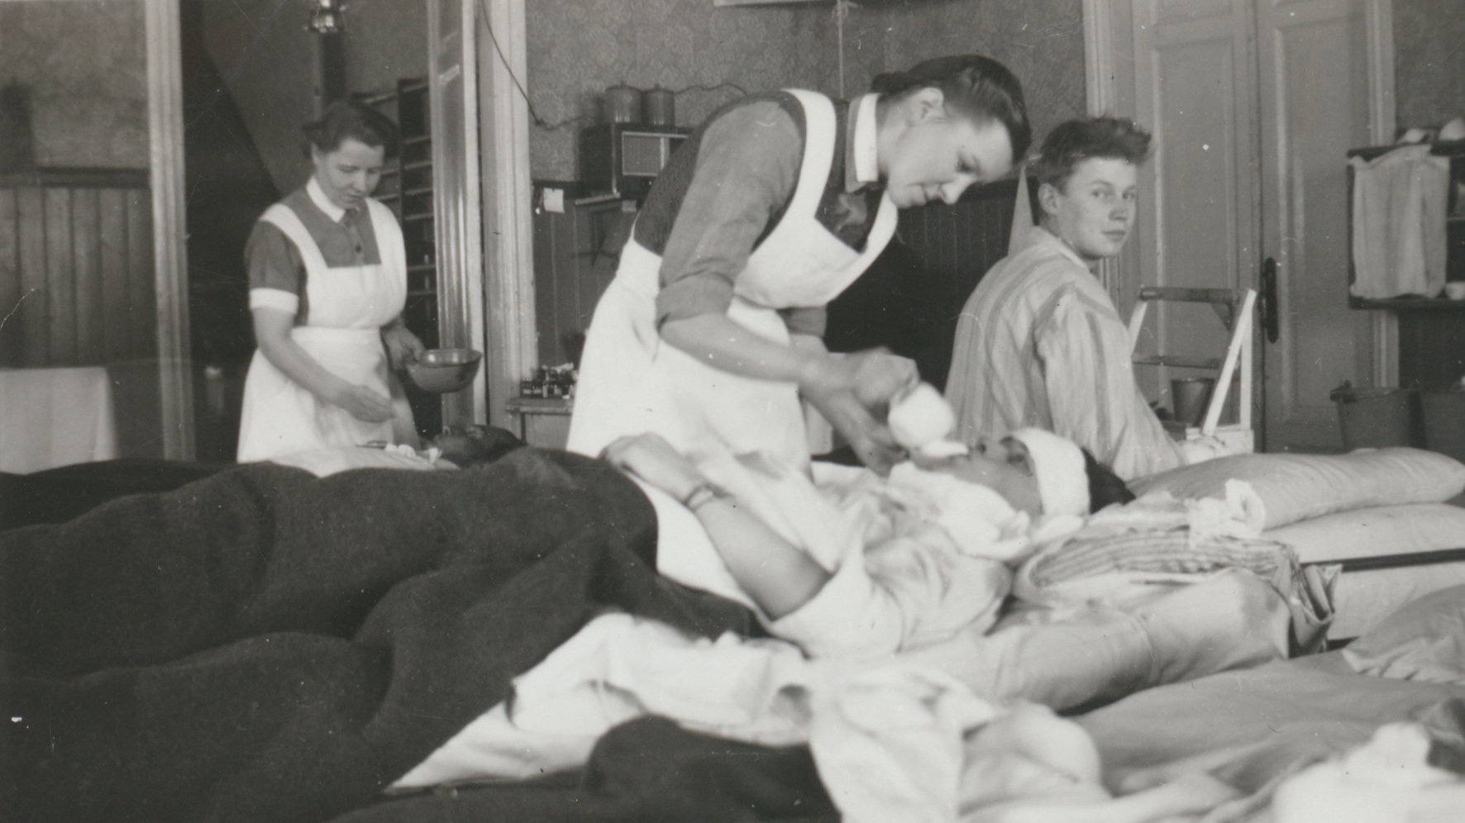
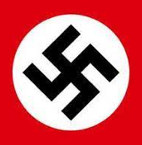
What did Lottas do and what´s the symbol?
The Lottas took care of the injured soldiers, children, household, men's work
The symbol reminds some people of the Nazi symbol

Slide 5
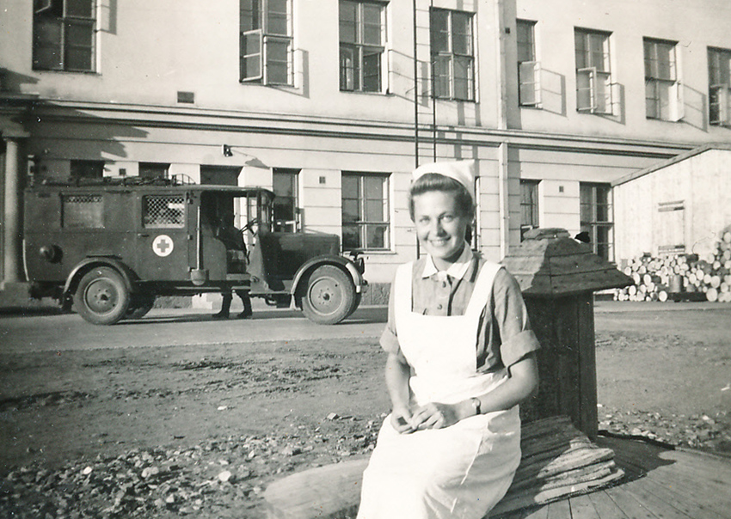
Ideology and politics
The ideology was to respect and value the previous generations.
members had set goals in terms of education, morals, behavior and appearance.
The values are centered around religion, home and country.
After the war in 1918 Finland was divided into winners and losers.
The Lotta Organization was not politically committed

Slide 6
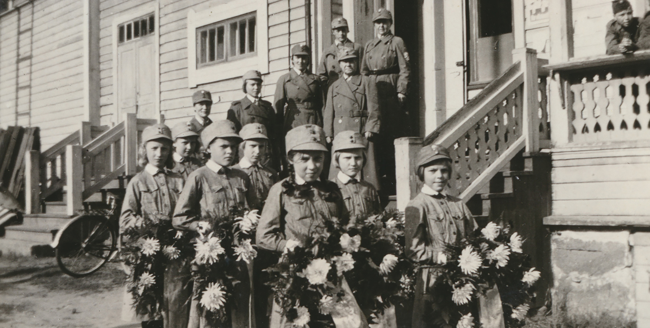
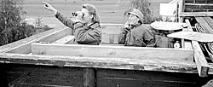
The operation of the Lottas and the junior Lottas
The Lottas were expected to keep the society going, take care of the kids and the soldiers
Bravery, smart, strong, independent, responsible
Junior Lottas were the same as Lottas but younger, 8-17-year-olds

Slide 7
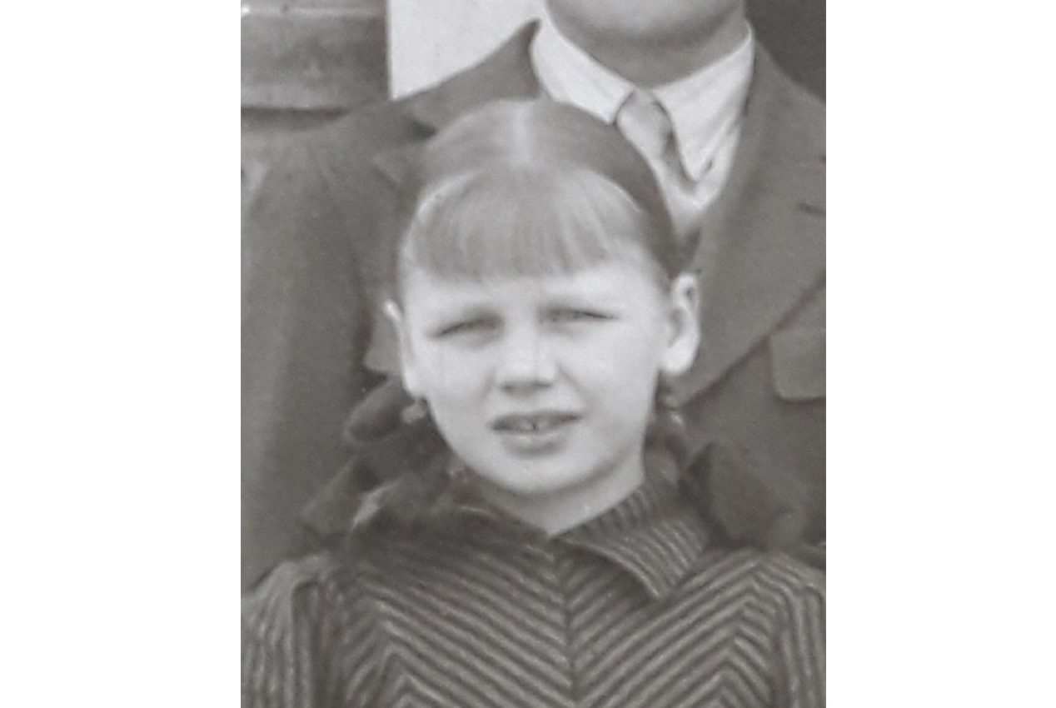
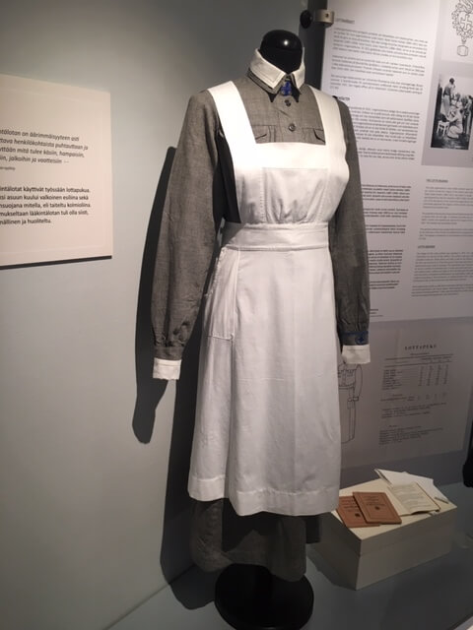
Lottagallery & clothes
Pirkko Veräjänkorva
Beda Forsström

Slide 8
Why was the Lotta organization disbanded 1944?
Stalin was the leader of Soviet-Union and he decided to stop the Lotta Svärd organization after the Continuation war.
Why?
Russia was against the swastika. Because of Hitler a new image of the swastika was formed. It was seen as a fascist symbol.
Before: the meaning of the swastika was well-being.
Today: it's banned in Germany and Belgium, but not in Finland

Slide 9
What is the role of the Lotta Svärd foundation today?
1. Support those in need of support
2. Promote caring
3. Provide a channel for good work
4. Respecting the work of the lotta Svärd
5. A memory of the war

Slide 10
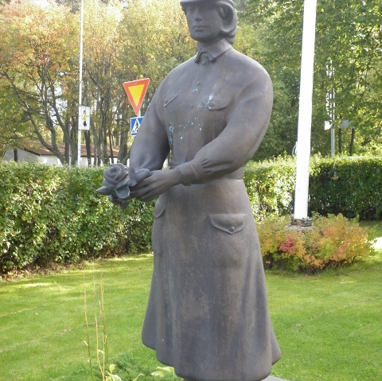
Lotta Svärd statue in Kokkola
It's in front of the Kokkola City Theatre
It was put there in 2008
Made by the sculptor Pekka Jylhä
Close to the statue is the Civil guard statue

Slide 11
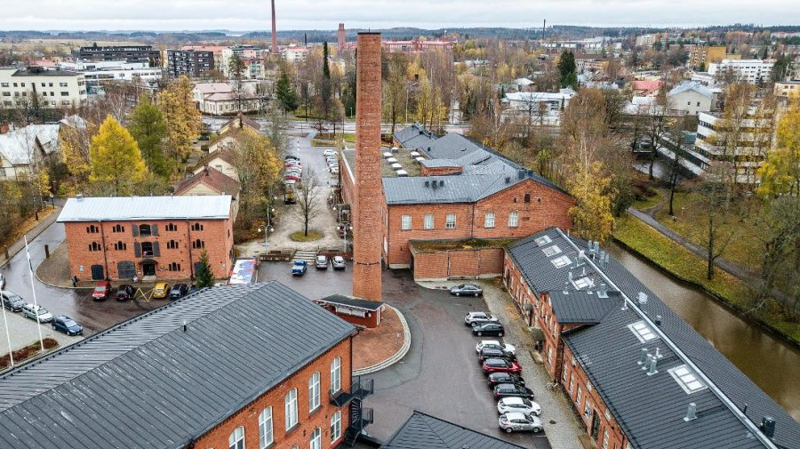
Why no statue in Forssa?
The Lotta organization is seen as on the white side in the civil war 1918
Forssa was a working class city = on the reds side in 1918
Statue would be seen as disrespectful for the towns history

Slide 12
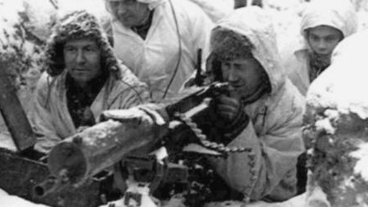
Finland in the World war II BURDEN- TREASURE

Slide 13
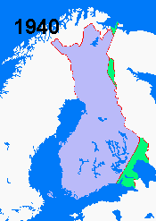
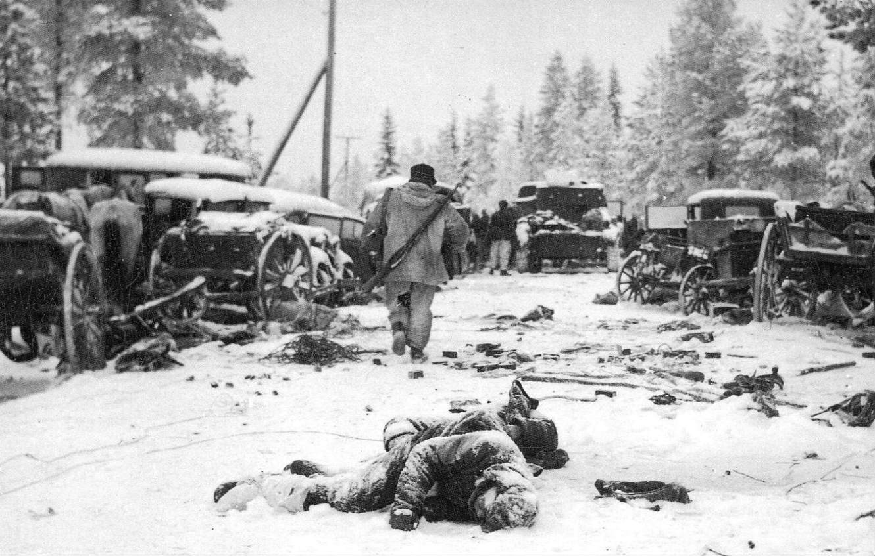
Winter war
From 1939-1940
Finland – Soviet Union
Volunteer's soldiers
Finland lost the war
Moscow treaty
Treasure

Slide 14
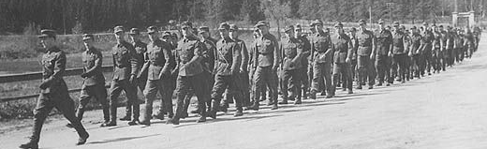
The continuation war
From 1941-1944
Finland-Soviet Union
Germany: Weapons, soldiers, Why?
Finland lost the war, (Tienhaara)
It was important for Soviet to be first in Berlin
Burden

Slide 15
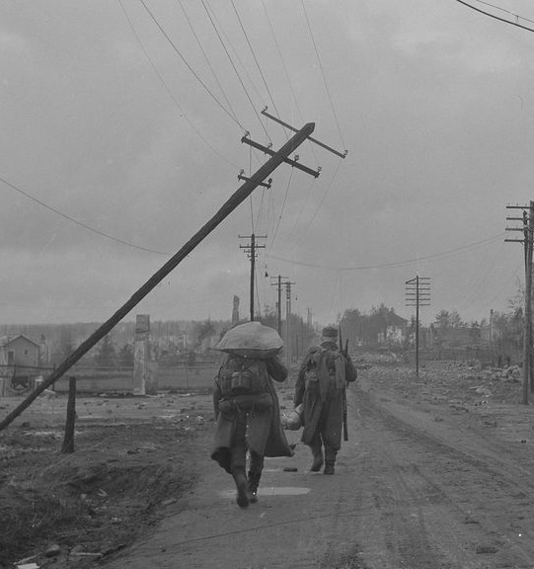
Lapland war (1944-1945)
Forcing Germans to Norway
Because of the peace terms from Soviet

