Slide 1
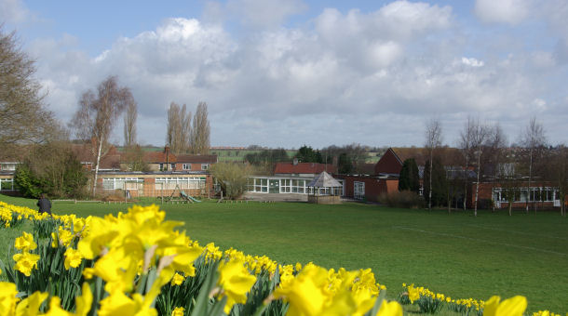

Slide 2
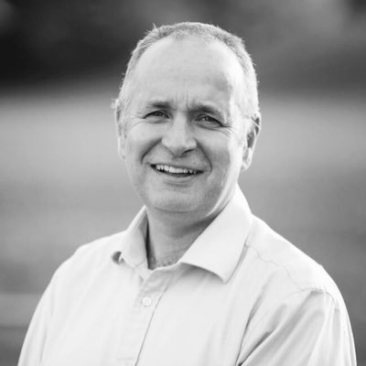
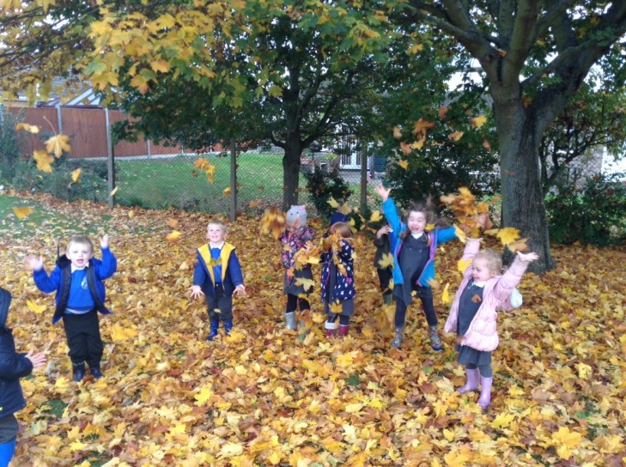
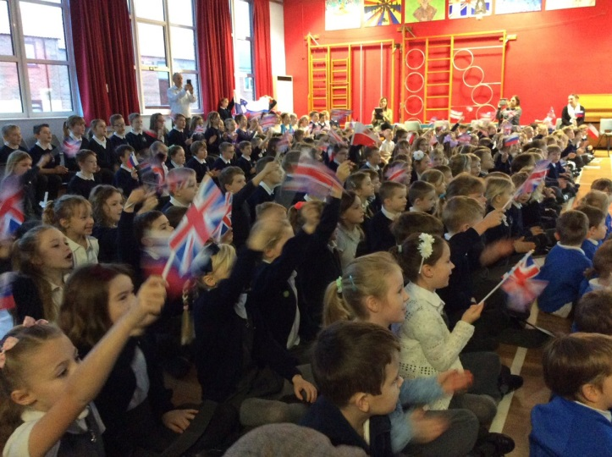
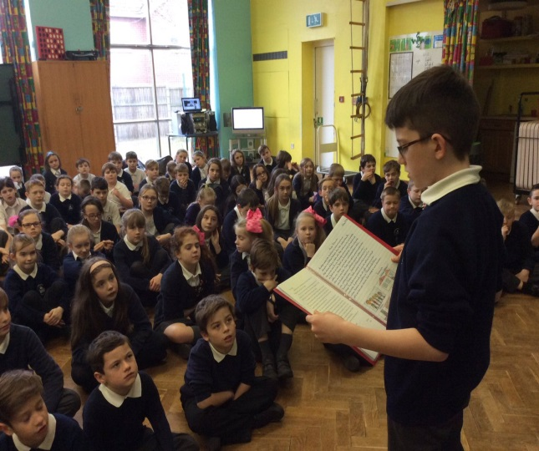
This is our Head Teacher
Mr O’Rourke.
We have around 300 pupils in our school and 9 classes. Children start school at 4 years old and leave when they are 11. We also have a nursery where children can come from 3 years old.

Slide 3
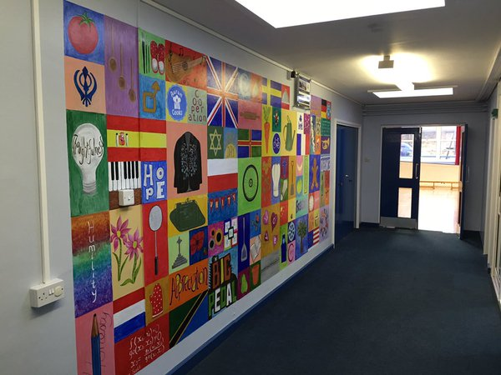
We are a values school!
Please watch this video to learn more about how we are a values school.
https://www.youtube.com/watch?v=TvXMwqVwbnw

Slide 4
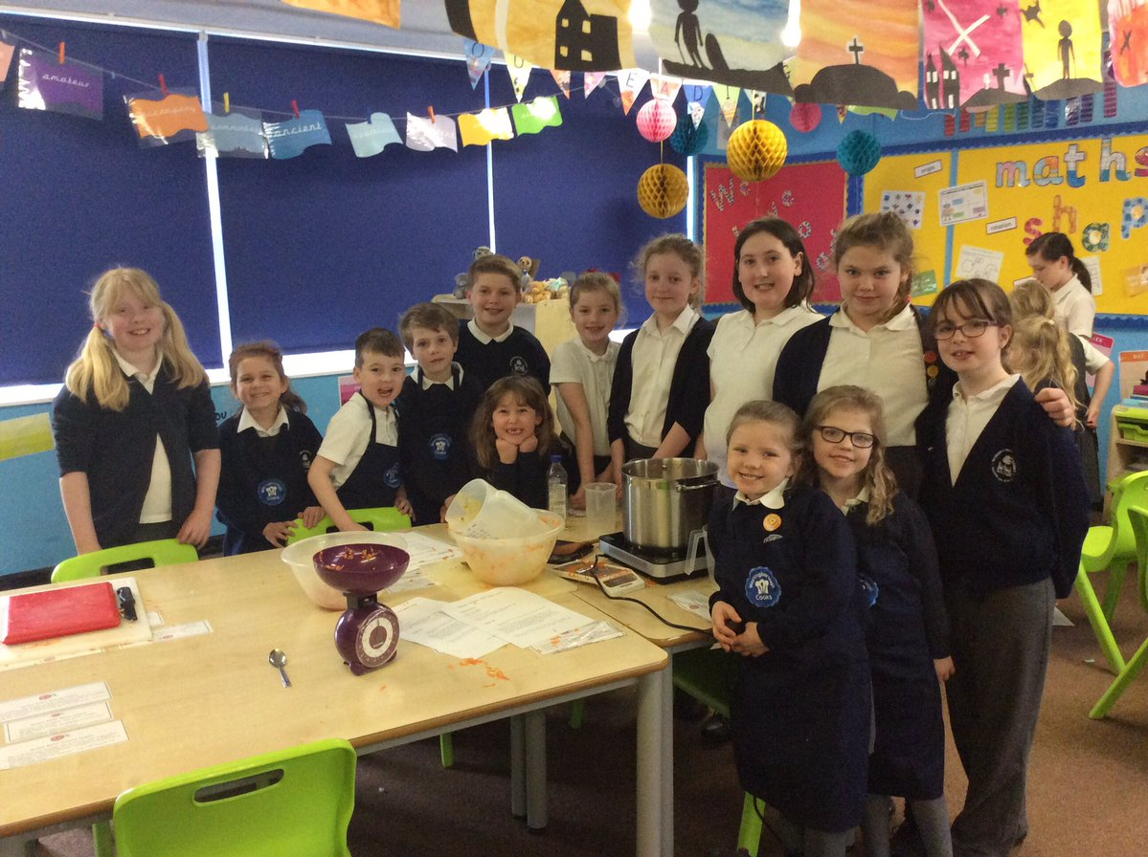
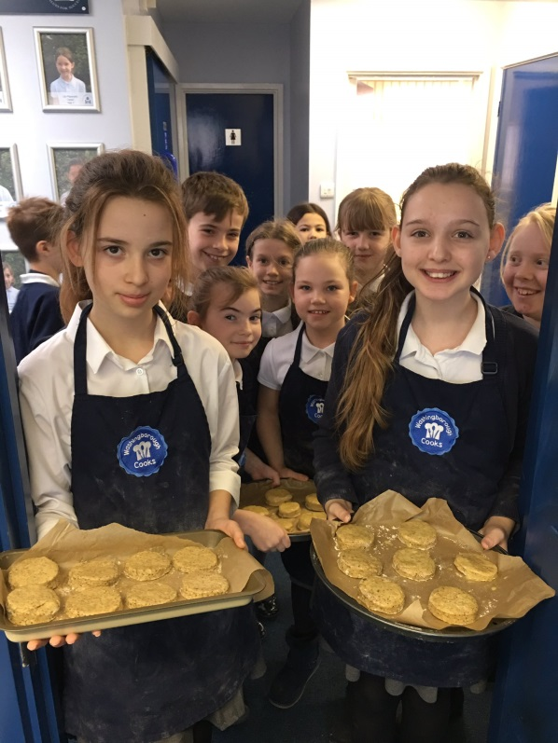
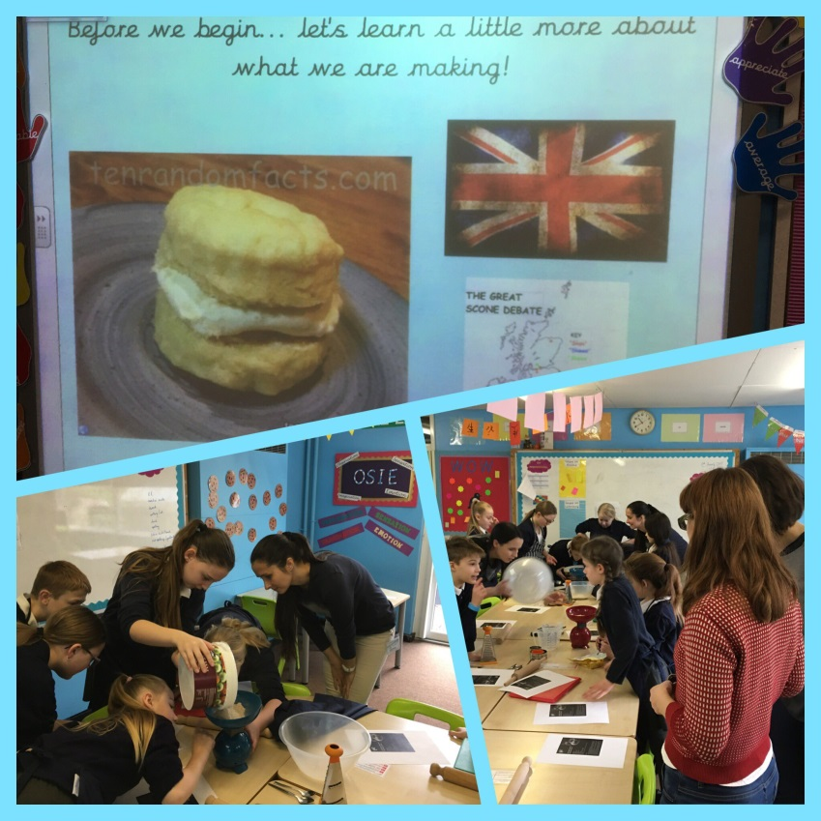
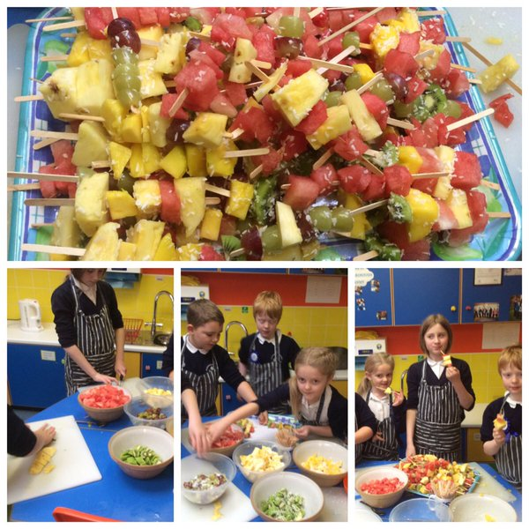
We love to cook

Slide 5
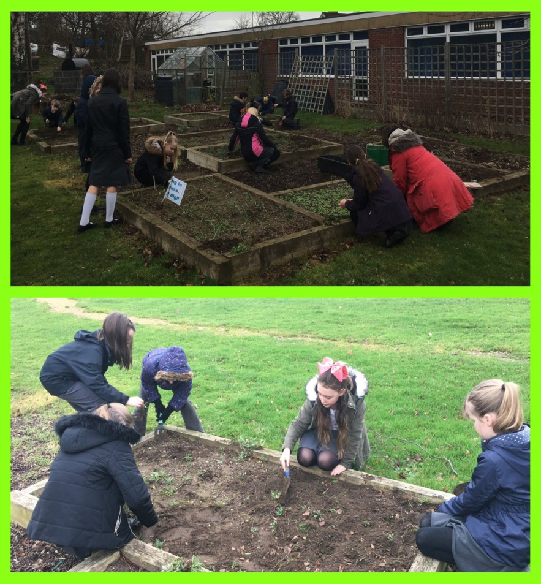
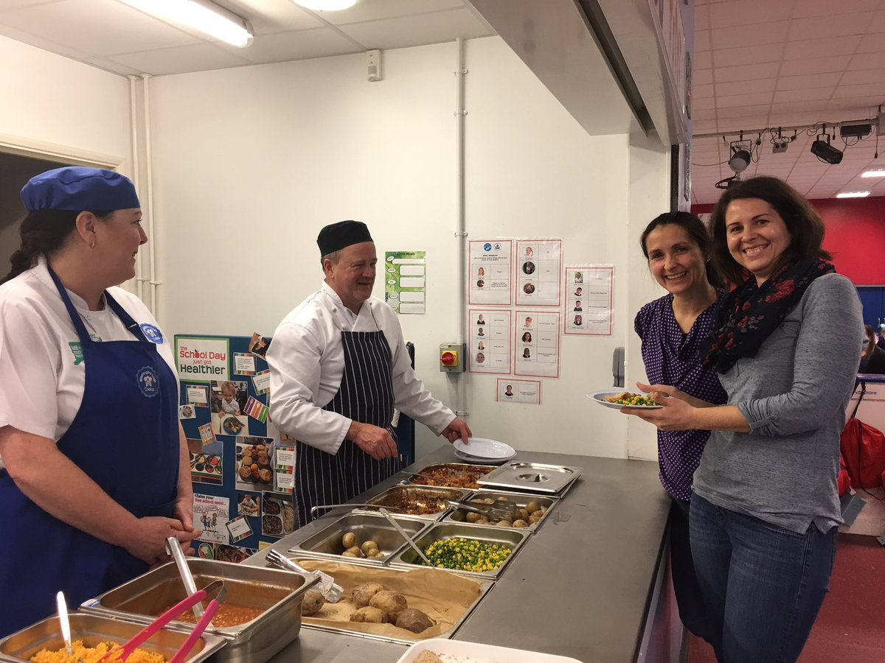
We have our own school chef and we have won many awards for our kitchen!

Slide 6
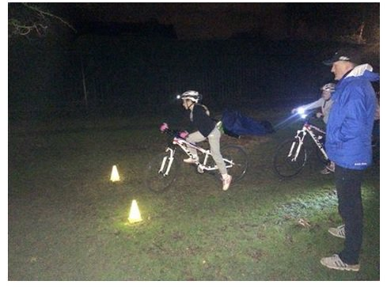
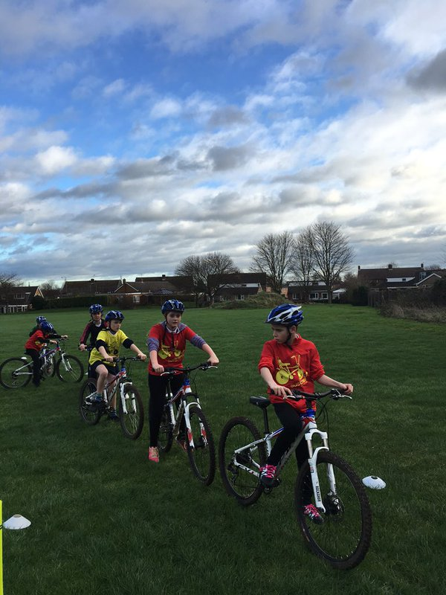
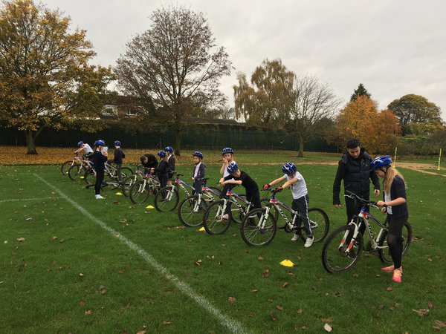
We have our own bikes and a bike track on our fields. We enter competitions and we won the Lincoln GP last year!

Slide 7
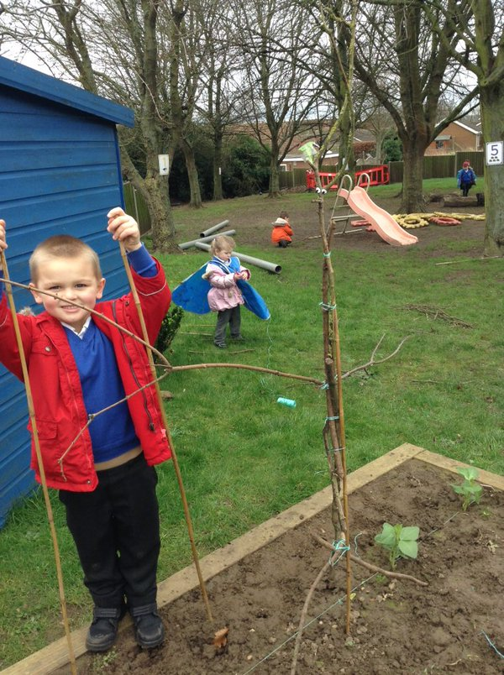
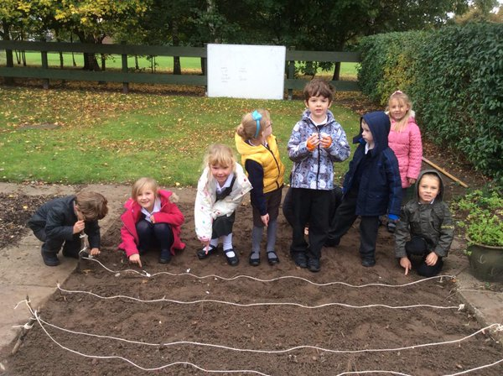
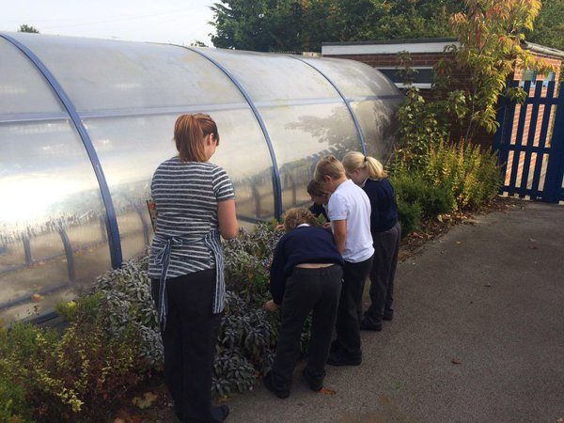
We love to garden in our lovely grounds!

Slide 8
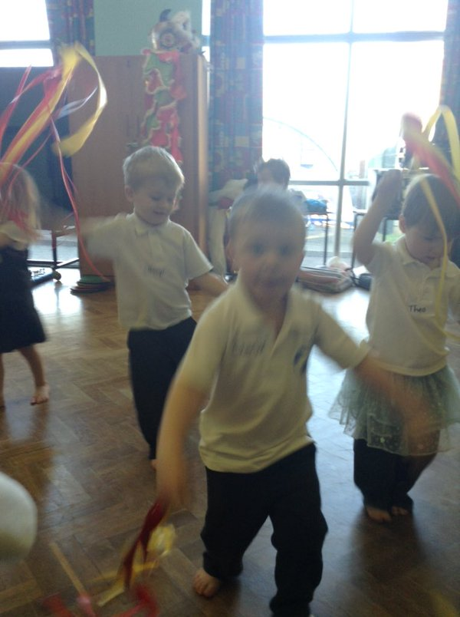
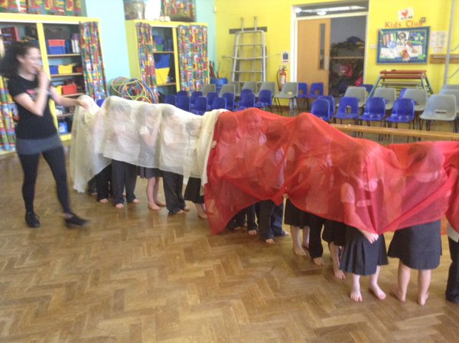
We enjoy celebrating many festivals and cultures including Chinese New Year!
This is a link to our youngest children making spring rolls.
https://www.youtube.com/watch?v=eOw120RUPfA

