Slide 1
War Poetry
The story of Belgium

Slide 2
Start World War 1 in Belgium
Belgium wanted to remain neutral
4/08/1914: German troups invade Belgium
October 1914: Belgium is under German command except for area around Ypres (Westhoek)
August - October: a lot of civilian casualties made during invasion + destruction of cities, villages, libraries…
Cities with the most civilian casualties are known as ‘martyr cities’. (Leuven)

Slide 3
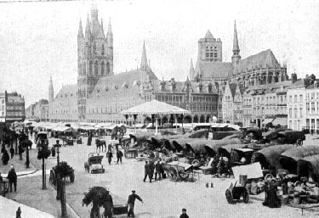
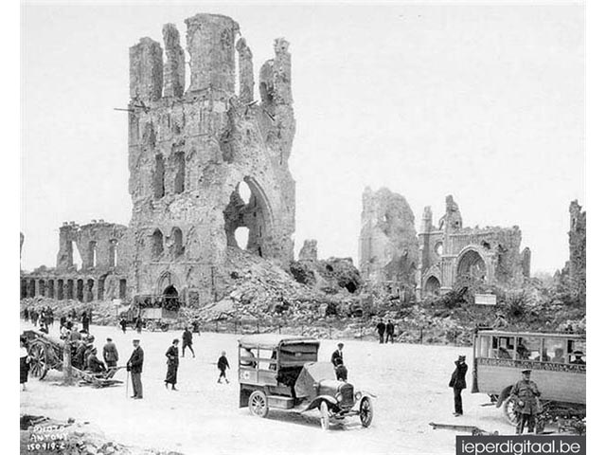
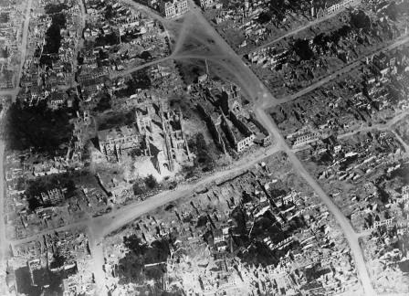
Ypres: before and after

Slide 4
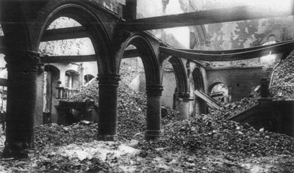
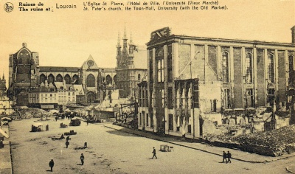

Slide 5
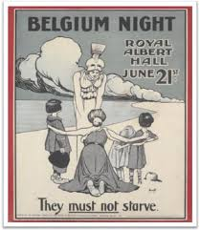
Belgium was used in propaganda
To donate money
To join the army
‘Brave little Belgium’ offered resistance - the English + Irish should follow their example

Slide 6
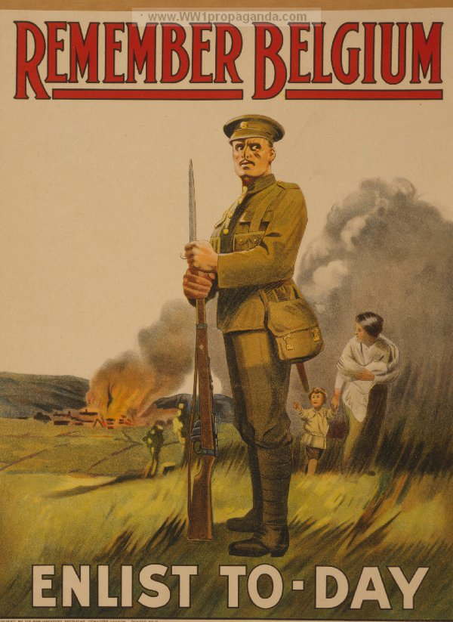
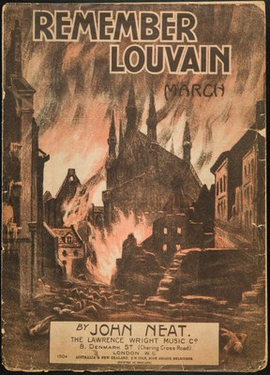

Slide 7
Flemish War Poets
Most famous: ‘Bezette stad’ (Occupied city) by Paul van Ostaijen
Expressionist - not a soldier, but a witness to war crimes
Experimenting with typography, placement of words on paper, different languages, fonts, …
https://www.youtube.com/watch?v=CBqfxtvjbkI (Boem Paukeslag)

Slide 8
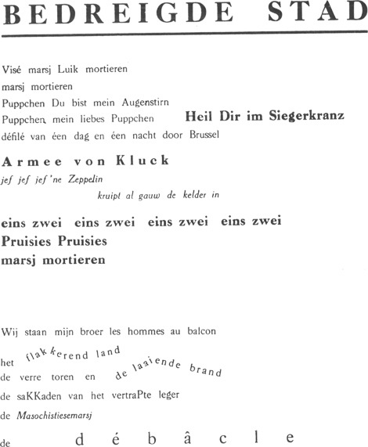
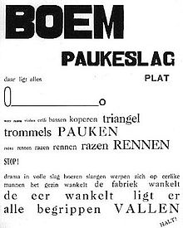

Slide 9
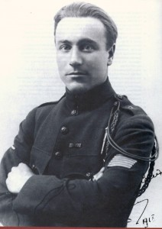
Daan Boens - soldier / poet
Book: ‘Van glorie en lijden - Sonnetten uit de loopgraven aan den Yser’ (1917)
Of glory and suffering - sonnets from the trenches at the Yser.
https://www.dbnl.org/tekst/boen003vang01_01

Slide 10
Assignment
Look at ‘The soldier’ by Rupert Brooke
Option 1: Lay-out 1 paragraph with rhythmic typography as seen in the poem ‘Bezette stad’ by van Ostaiijen
Option 2: Read expressively with your group as seen in the fragment of ‘Boem Paukeslag’.

