Slide 1
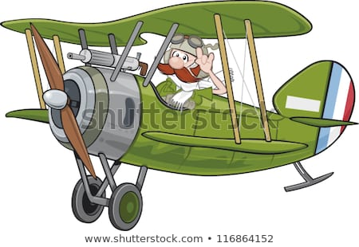
What do you already know about the conditions of World War One?
Notes:
‹#›

Slide 2
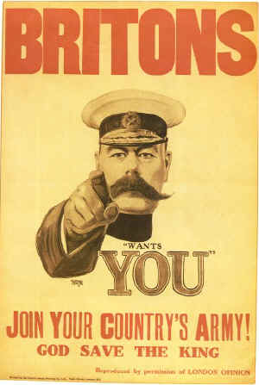
This is Britain’s most famous piece of propaganda…
Structured conversation:
What is propaganda?
What is the purpose of propaganda?
Who is this propaganda aimed towards?
What techniques does it use?

Slide 3
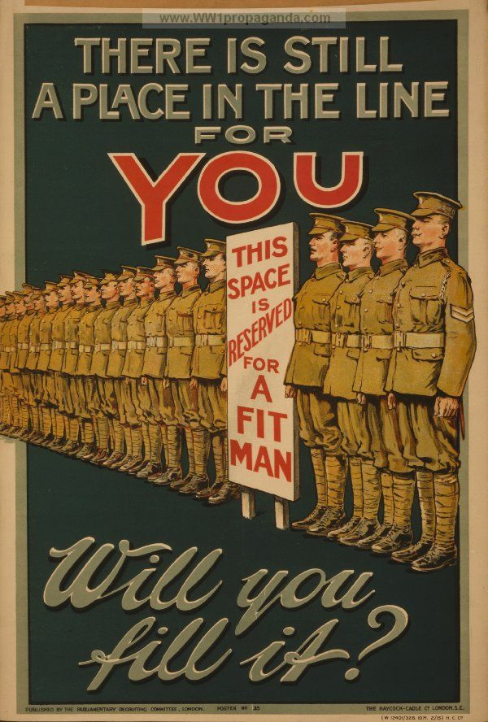
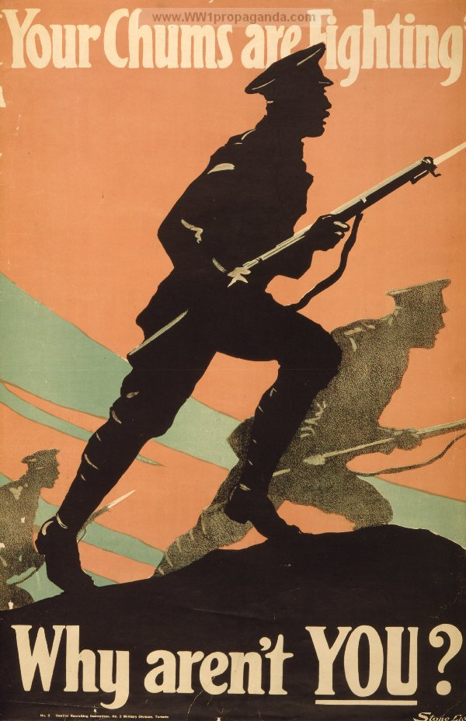
Team Task
Each group have been provided with a propaganda poster.
Consider what it tells us about the context of the time.
Notes:
Allow pupils to come to the front of the room and write the persuasive features they have found on the board to support the learning of LA pupils.
‹#›

Slide 7
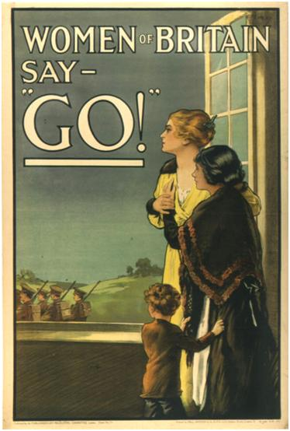

Slide 8
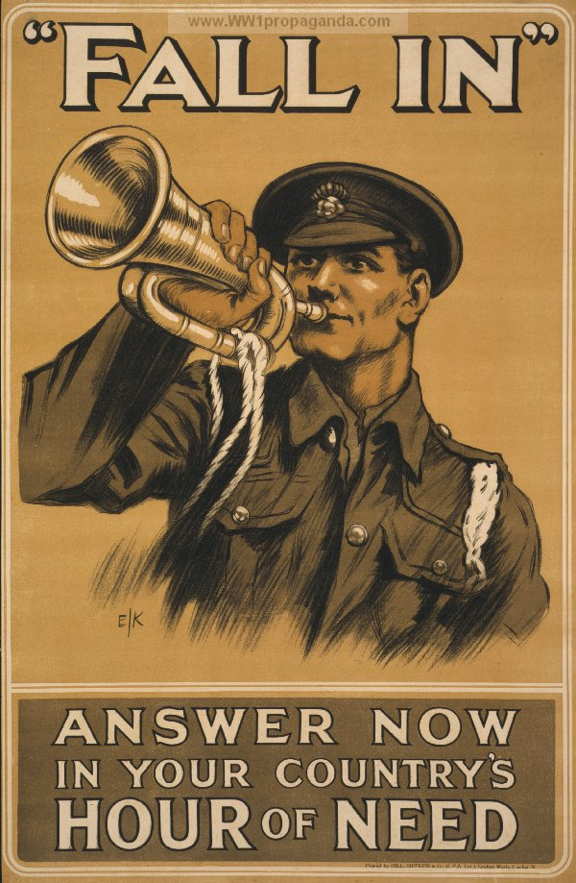

Slide 9
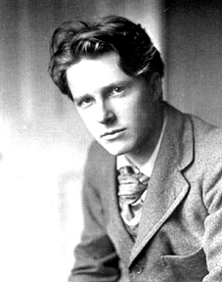
Rupert Brooke 1887-1915
Brooke was described by a fellow poet as ‘The most handsome man in England.’
He came from an upper class academic family, and was a great student and athlete.
Brooke did not see much action in the war. He contracted blood-poisoning from a small neglected injury and died in April, 1915, in the Aegean.
Brooke has been immortalised as the ‘fallen golden warrior’ through his enthusiasm as a young soldier .
You are now going to read Rupert Brooke’s poem ‘The Soldier’. Focus specifically on how he presents death.

Slide 10
‘The Soldier’
If I should die, think only this of me: That there's some corner of a foreign field That is for ever England. There shall be In that rich earth a richer dust concealed; A dust whom England bore, shaped, made aware, Gave, once, her flowers to love, her ways to roam, A body of England's, breathing English air, Washed by the rivers, blest by suns of home.
And think, this heart, all evil shed away, A pulse in the eternal mind, no less Gives somewhere back the thoughts by England given; Her sights and sounds; dreams happy as her day; And laughter, learnt of friends; and gentleness, In hearts at peace, under an English heaven.
Rupert Brooke
How does this make you feel? What message?

Slide 11
How does Brooke present death?
Highlight all the positive vocabulary in one colour
Highlight all the negative vocabulary in second colour
Then decide if you have more positive vocabulary or negative vocabulary in this poem about death

Slide 12
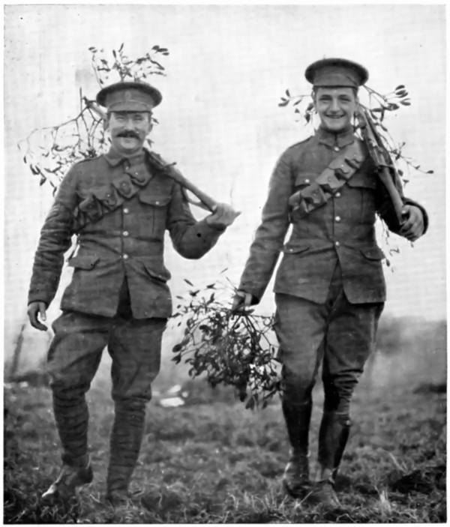
Brooke presents death as a beautiful thing. If you die in battle, you will be remembered and be forever part of England.
What do you think I would think about Rupert Brooke’s message? Do you think I would have been happy to die?
If Brooke had lived to fight in the trenches do you think he would have changed his mind about death? Or do you think he would have stuck by his original ideas?

Slide 13
Take some time to discuss War poems from England and Belgium…
Look at the examples provided.
What differences can you see?
Why do these differences exist?
What similarities are there?

Slide 14
Create a presentation on two poems of your choice
What language is used?
What message does the poet have?
What images are created?
How can you present this creatively?

