Slide 1
WELCOME
to
“Together against Dropout”
VIRTUAL ART EXHIBITION

Slide 2
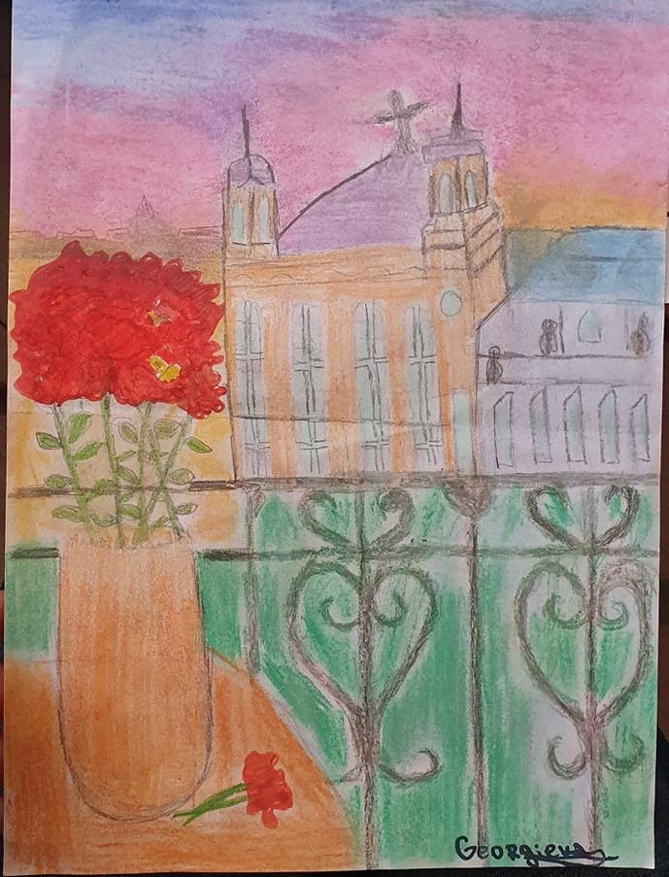
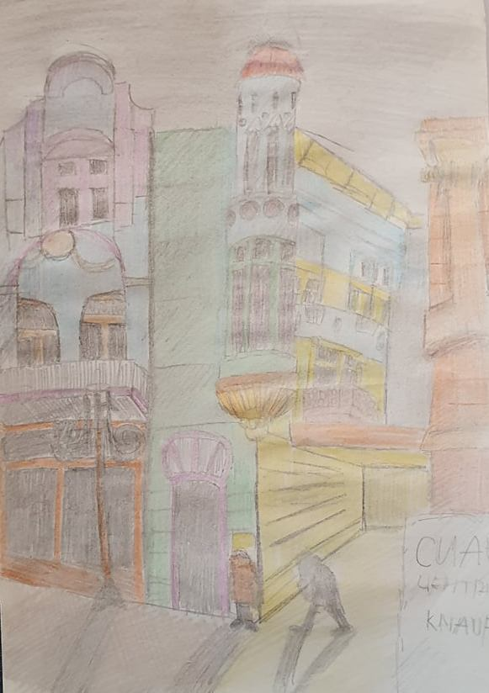
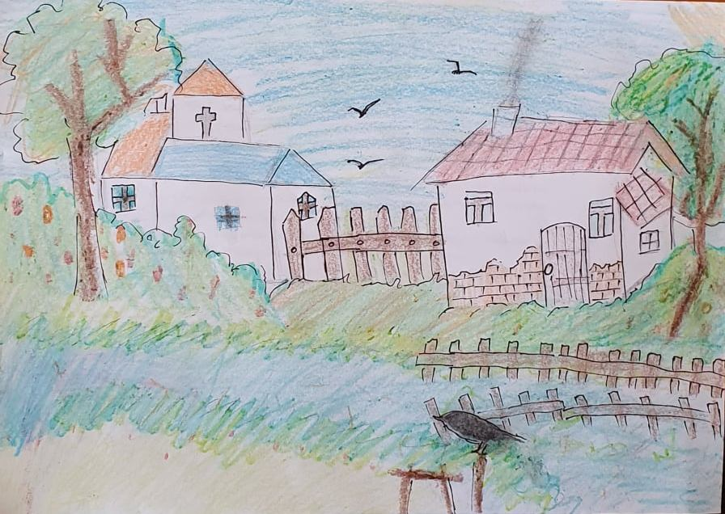
PRIMARY SCHOOL ANGEL KINCHEV , RUSE,
Bulgaria
2
3
1

Slide 3
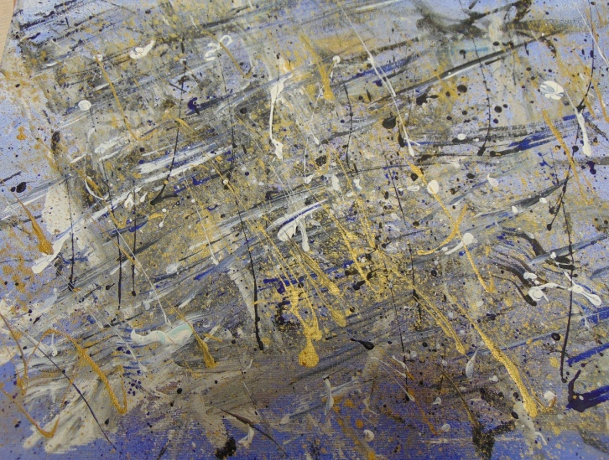
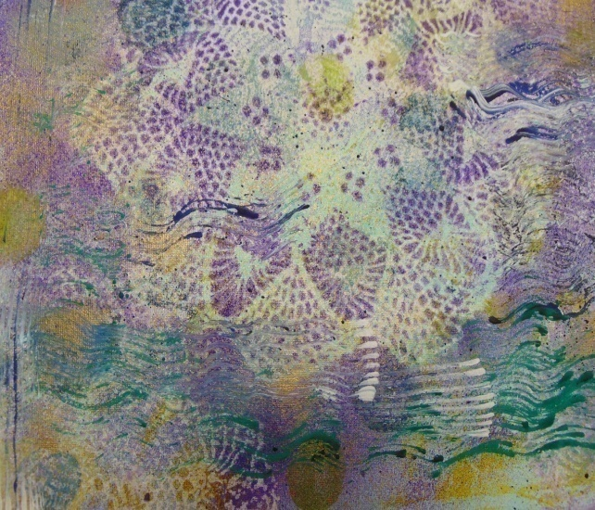
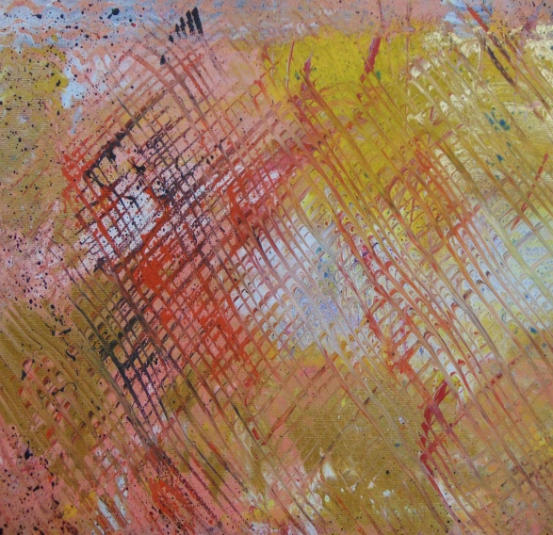
BERZUPES SPECIALA INTERNATPAMATSKOLA, DOBELE, Latvia
5
6
4

Slide 4
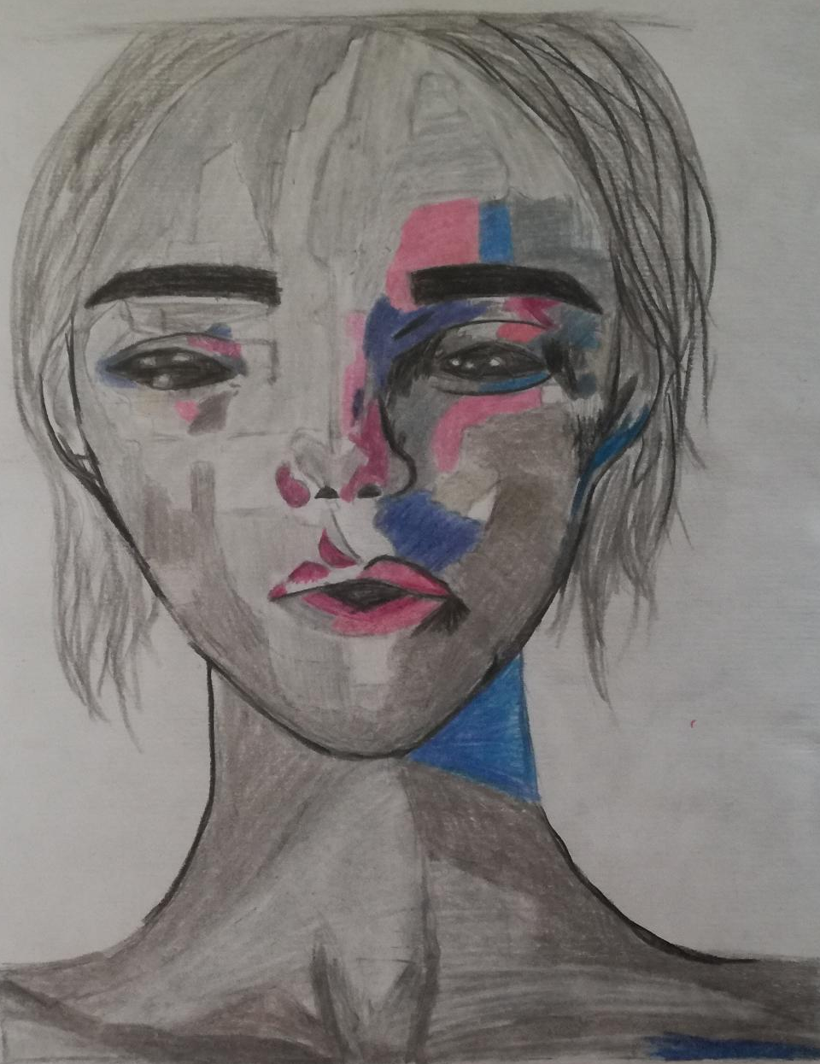
ȘCOALA GIMNAZIALĂ NR. 4 MORENI, ROMANIA
8
9
7

Slide 5
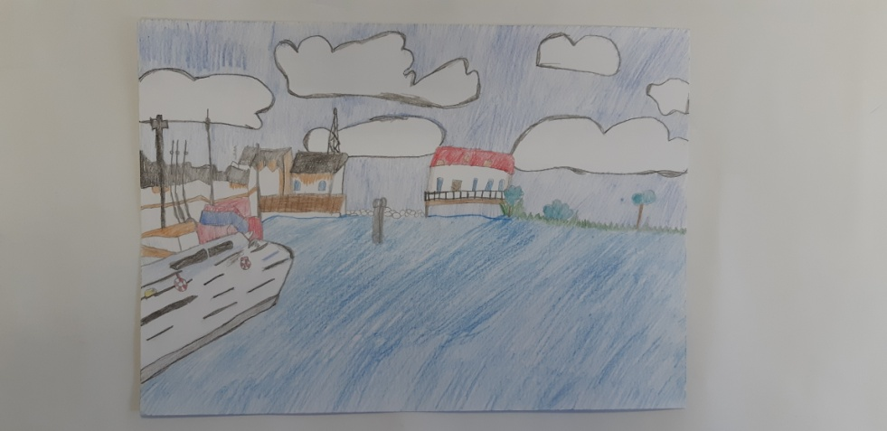
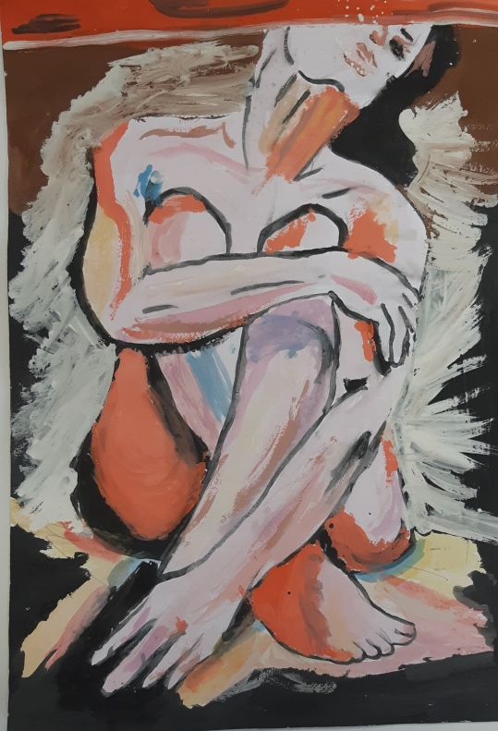
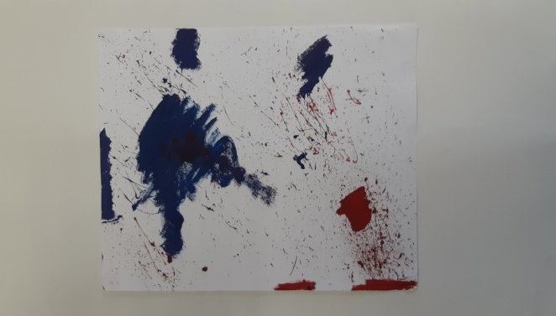
ZÁKLADNÁ ŠKOLA VEĽKÁ IDA, VEĽKÁ IDA, Slovakia
11
12
10

Slide 6
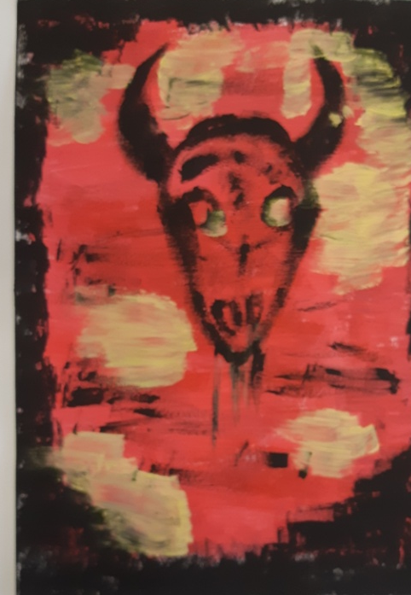
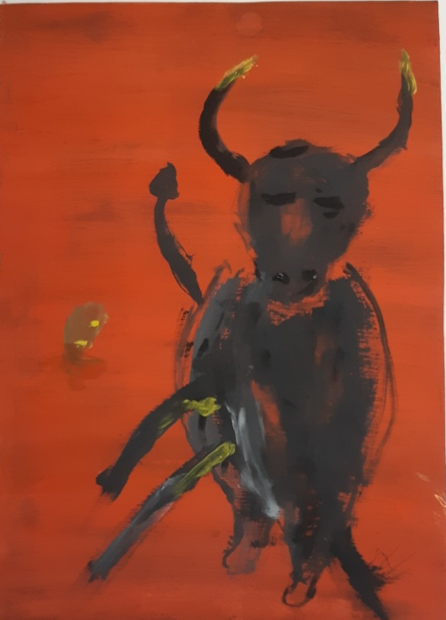
ZÁKLADNÁ ŠKOLA VEĽKÁ IDA, VEĽKÁ IDA, Slovakia
13
14

Slide 7
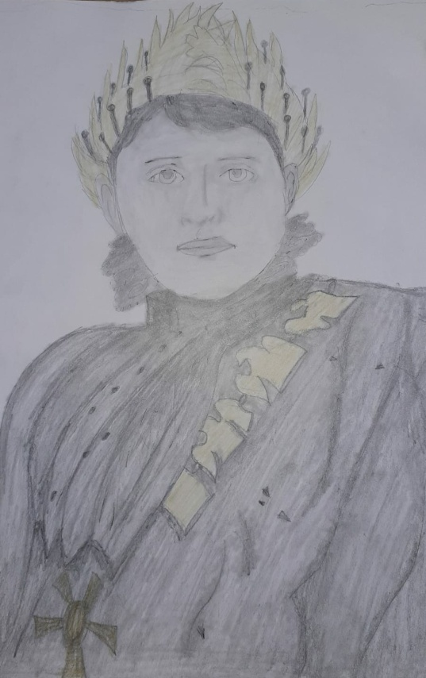
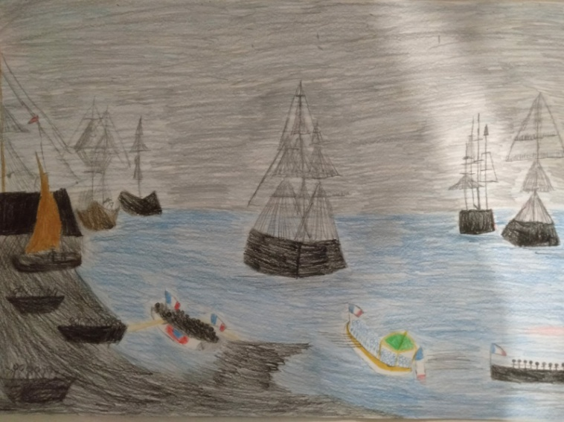
GAZI MUSTAFA KEMAL ORTAOKULU, NAZILI, Turkey
15
16

Slide 8
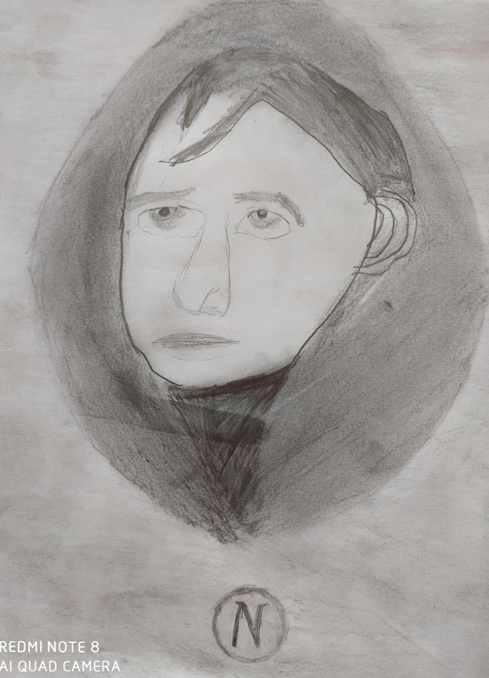
GAZI MUSTAFA KEMAL ORTAOKULU, NAZILI, Turkey
17

Slide 9
Picture 1
Autor: Viktoriya Georgieva
Title: “Romantic”
Description:
Architectural landscape
Painted by pencils.
Emblematic building in Ruse.

Slide 10
Picture 2
Autor: Dobromir Ivanov
Title: “Village church”
Description:
The painting represents church built between village houses.
Peace and tranquility

Slide 11
Picture 3
Autor: Svetoslav Dudev
Title: “Ruse`s fragments”
Description:
Architectural landscape painted
by colour penicls.
Represents part of the central street of Ruse city at night.

Slide 12
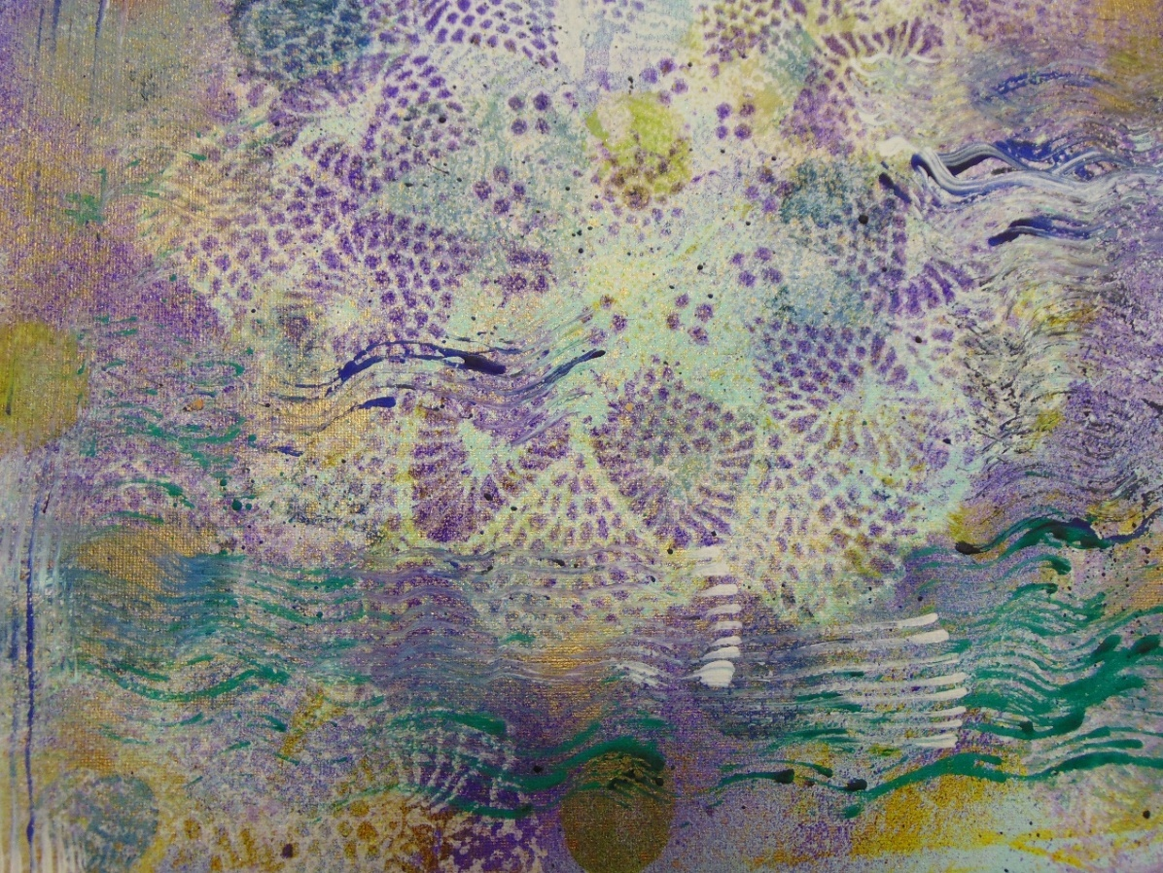
Picture 4
Autor: Monta Burkevica
Title: The miracle of the sea
Description: Reproduction of the painting by the artist Baiba Reder. Acrylic paints on canvas are used.

Slide 13
Picture 5
Autor: Danija Keita Sarguna
Title: The storm
Description: Reproduction of the painting by the artist Baiba Reder. Used acrylic paints on canvas with spray technique.

Slide 14
Picture 6
Autor: Niks Zelvis
Title: Rose's life
Description: Reproduction of the painting by the artist Baiba Reder. Used acrylic paints on canvas with spray technique. Used various tools-brushes, film.

Slide 15
Picture 7
Autor: Sofia Birliba
Title: Purgatory(Purgatoriu)-litografie
Description: Reproduction of the painting by the artist Celik Tutku. Used acrylic paints on canvas. Used various tools-brushes, film.

Slide 16
Picture 8
Autor: Andreea Dobre
Title: Pretending to be nice(Prefacându-te drăguță)-xilogravură
Description: Reproduction of the painting by the artist Dominika Marek. Used acrylic paints on canvas.

Slide 17
Picture 9
Autor: Alexandra Dobre
Title: Fereastra atelierului-linogravură
Description: Reproduction of the painting by the artist Valter Paraschivescu . Used acrylic paints on canvas.

Slide 18
Picture 10
Autor: Sara Benoova
Title: Croatia
Description:
Reproduction of the painting by the artist Gregory Goy . It´s a picture drawn by coloured pencils, combination of materials.

Slide 19
Picture 11
Autor: Vanesa Vitaniova
Title: Sad women
Description:
Reproduction of the painting by the artist Jelena Vušurovič. It´s a picture drawn by paint brush, colours, combination of materials.

Slide 20
Picture 12
Autor: Karolina Tilimonova
Title: Insanity
Description:
Reproduction of the painting by the artist Jelena Vušurovic. I like window with coloured walls.

Slide 21
Picture 13
Autor: Dominik Nalevanko
Title: Bull
Description:
Reproduction of the painting by the artist Gregory Goy. I like warm, mainly red colours and the object of the painting, the bull. It´s a picture drawn by Oil colours and white paper.

Slide 22
Picture 14
Autor: Oliver Skulka
Title: Bull
Description:
Reproduction of the painting by the artist Gregory Goy. I like warm, mainly red colours and the object of the painting, the bull. It´s a picture drawn by Oil colours and white paper.

Slide 23
Picture 15
Autor: Sudenaz Özsoy
Title: Ships
Description:Ships sailing from the island of Saint Helen to retrieve Napoleon's ashes.Death and sadness.

Slide 24
Picture 16
Autor: Cennet Çakar
Title: Portrait of Napoleon I
Description: Emperor of France the young Napoleon. Brave and strong.

Slide 25
Picture 17
Autor: Ege Ay
Title: The Last Phase
Description: Napoleon living the last phase of his life on the island St. Helen. Sad and tired.

Slide 26
TOGETHER AGAINST DROPOUT
2019-1-RO01-KA229-063155
ȘCOALA GIMNAZIALĂ NR. 4, MORENI, Romania COORDINATOR
GAZI MUSTAFA KEMAL ORTAOKULU, NAZILI, Turkey | BERZUPES SPECIALA INTERNATPAMATSKOLA, DOBELE, Latvia
ZÁKLADNÁ ŠKOLA VEĽKÁ IDA, VEĽKÁ IDA, Slovakia
PRIMARY SCHOOL ANGEL KINCHEV , RUSE,
Bulgaria
Project funded by the European Commission through the Erasmus + Program. This material reflects only the opinion of the authors and does not necessarily represent the official position of the AN or the European Commission.

