Slide 1
English lesson
Shah of Shahs

Slide 2
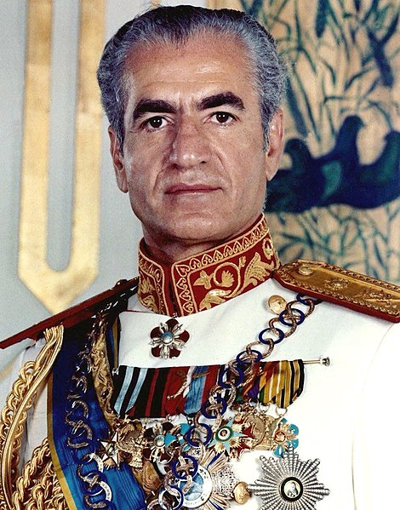
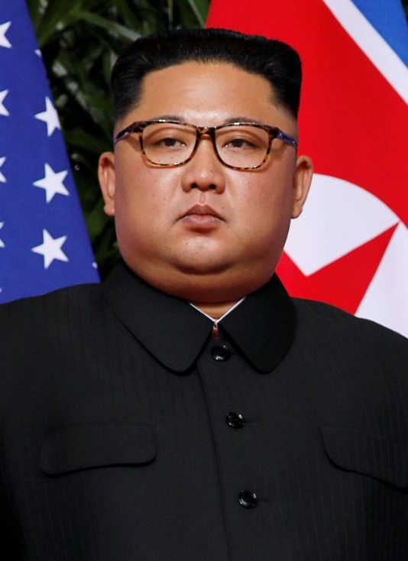

Slide 3
How to create a great civilization?
Groups of four to five people
Each group splits up in two
The rulers
The ruled ones
Present your results
Discuss what was difficult to agree on

Slide 4
Group work
The rulers
You have all the power, money and resources
You want to create a great civilization
Tasks:
Define a program, set a course for areas
Health care
Education
Defense
Industry
The ruled ones
You are ordinary citizens, you live in poverty, you have no influence
You want to have a better life
Tasks:
Discuss:
Needs
Rights
Wishes

Slide 5
What makes for a great civilization?

