Slide 1
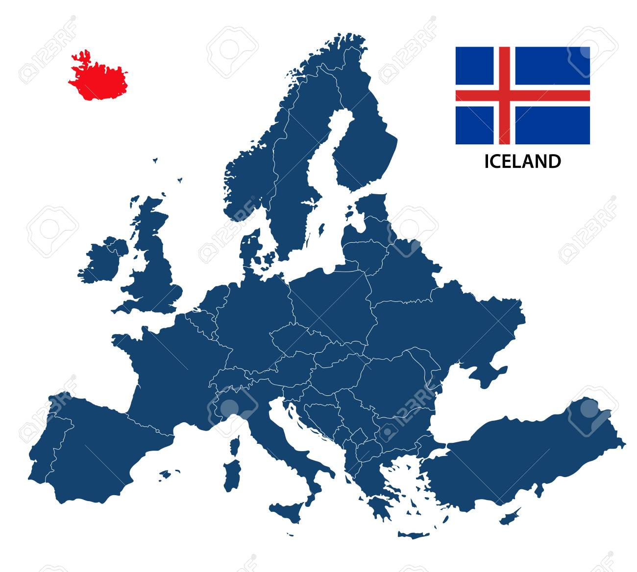
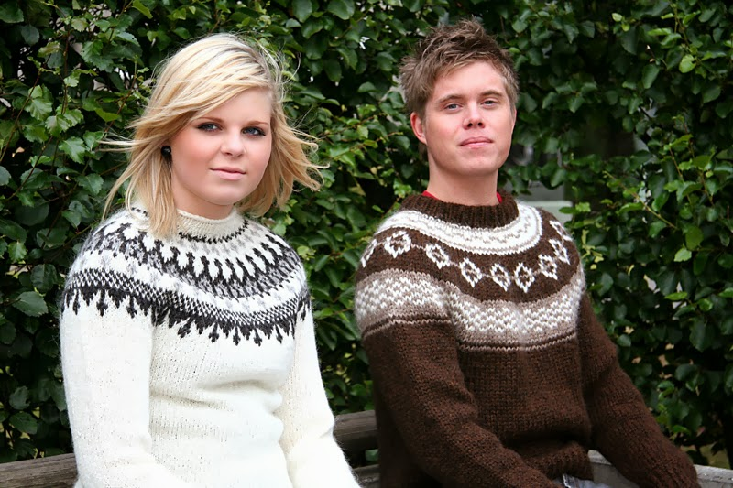
LOPAPEYSA IN ICELAND

Slide 2
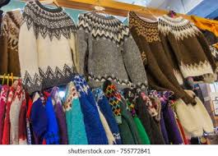
WHAT IS LOPAPEYSA?
The “Lopapeysa”, that is to say the Icelandic sweater, is loved by Icelanders and appreciated by visitors and tourists. You can see them both in the city and in the countryside since it is a garment used by all kinds of people. Without a doubt, the best way to get a sweater is by visiting the local producers that you can find around Iceland.

Slide 3
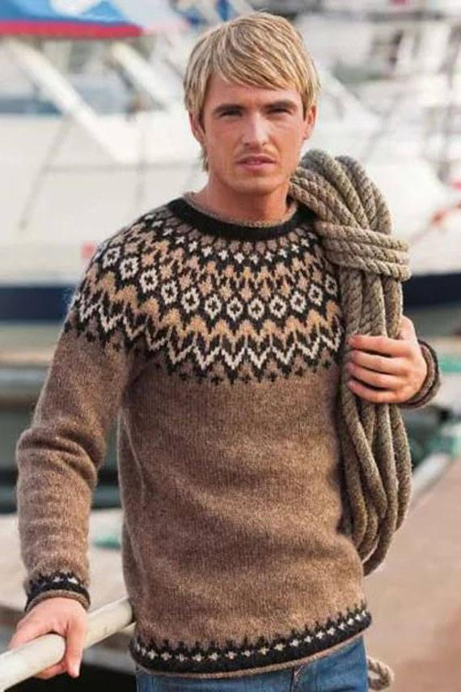
FOR WHAT IS USED ?
Lopapeysa is used for :
The lopapeysa is very hot for children used to playing at low temperatures. Teenagers who also want a “cool” look with it and for experienced fishermen who use it as a weapon to fight the cold.

Slide 4
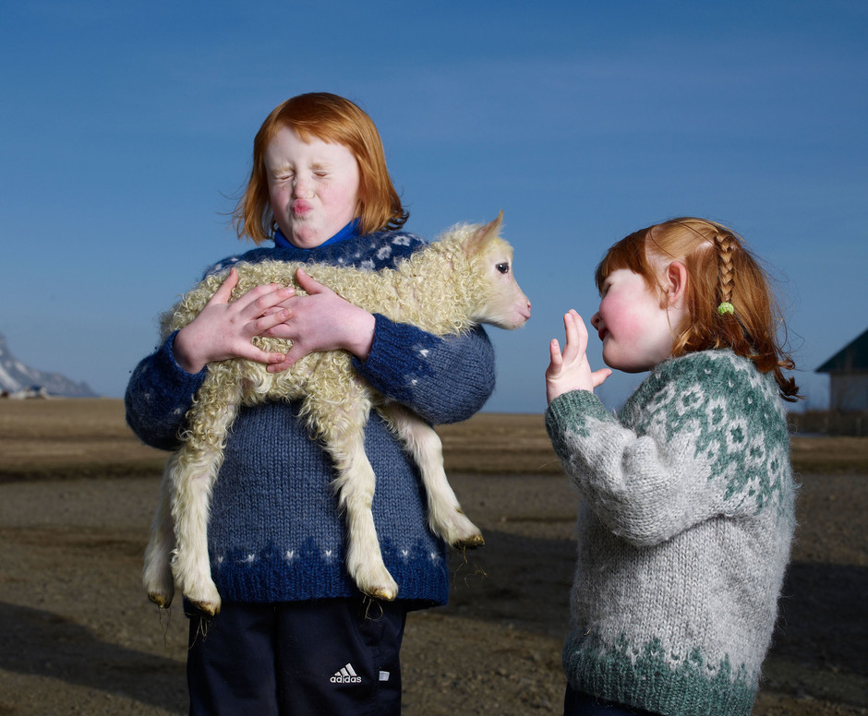
WHAT IS IT MADE OF?
The lopapeysa is both beautiful and practical, wool. The only material used to make them has the ability to insulate and repel water at the same time. The sheep from which the wool is taken have kept the people of Iceland protected from the cold since the Viking Age, although not with this type of garment exactly.

Slide 5
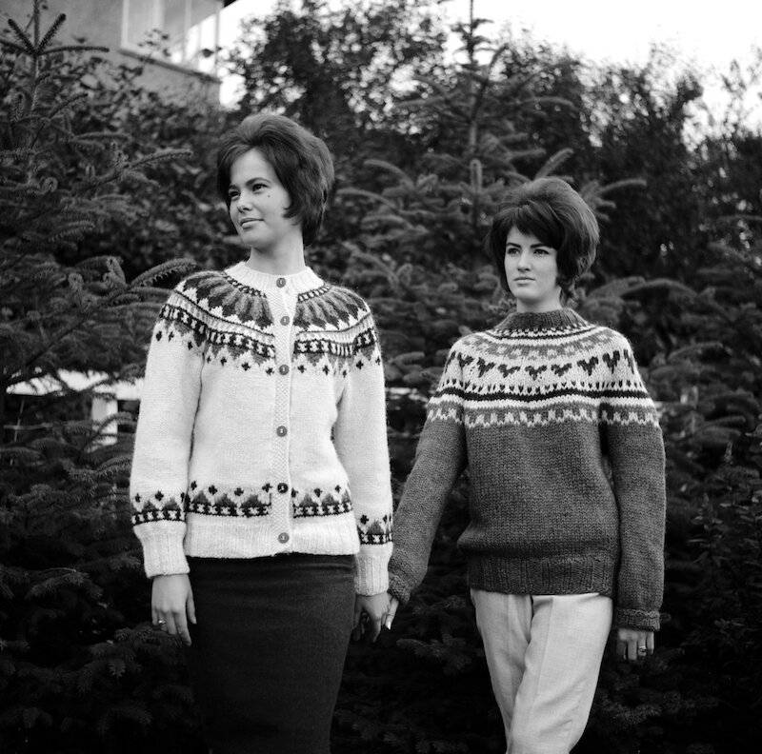
HISTORY OF LOPAPEYSA
The first lopapysa appear in the 50s. The original designer is not known, and it is generally popularly believed that it must have been a group of women who met to weave together at one of their homes. The original colors consisted mainly of earth tones such as white, brown, black, and gray. Already in the 60s is when these jerseys appeared for the first time with more daring colors and they began to be considered as a garment with more style. And it wasn't until a little later that tourists began to show interest in lopapeysa. In recent years a controversy has arisen over the legitimacy of some of these jerseys being sold. It was found that some producers outsourced their production to China, without clearly indicating their provenance but only as “produced outside of Iceland”.

Slide 6
LINK TO THE SOURCES
https://www.islandia24.com/lopapeysa-el-jersey-tipico-islandes/

