Slide 1
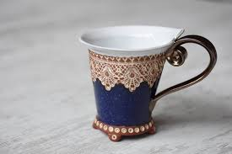
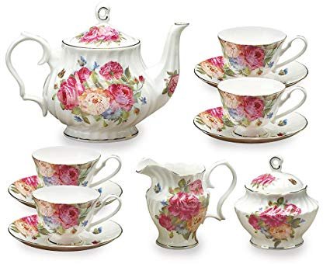
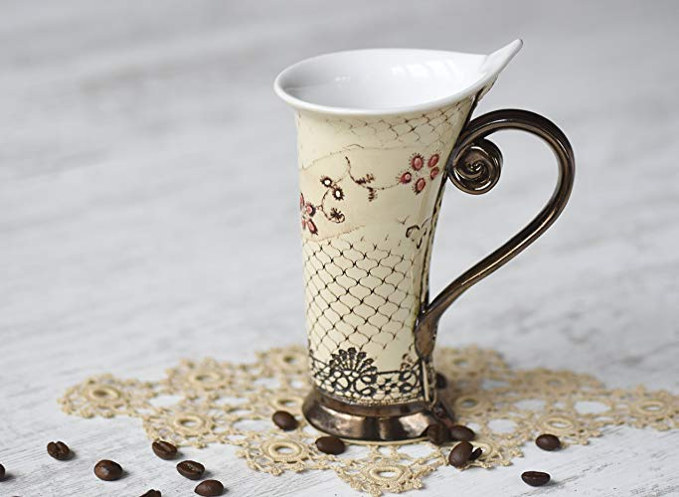
Vitrification | Ceramic teacup
Raúl Fernández Chevalier
Paula Fiorellino Casado

Slide 2
INDEX
1 Location and History “ A ceramic town in Andalucia”
2 Process and Techniques
3 Materials
4 Mass Media

Slide 3
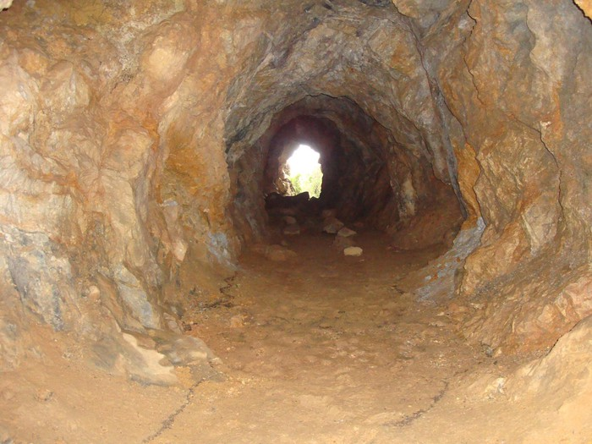
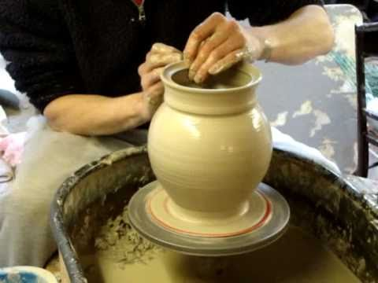
1. Location. “A ceramic town
in Andalucía”
In Málaga there is a town called Mijas. Here, ceramic tea cup are produced every day using processes and a technique. The reason why it’s produced specially in Mijas is because the amount of galleries and wells where they extract the materials. Usually people who work in this job is because their family’s job was this, and is like a “tradition” to work at the same job as your relatives.

Slide 4
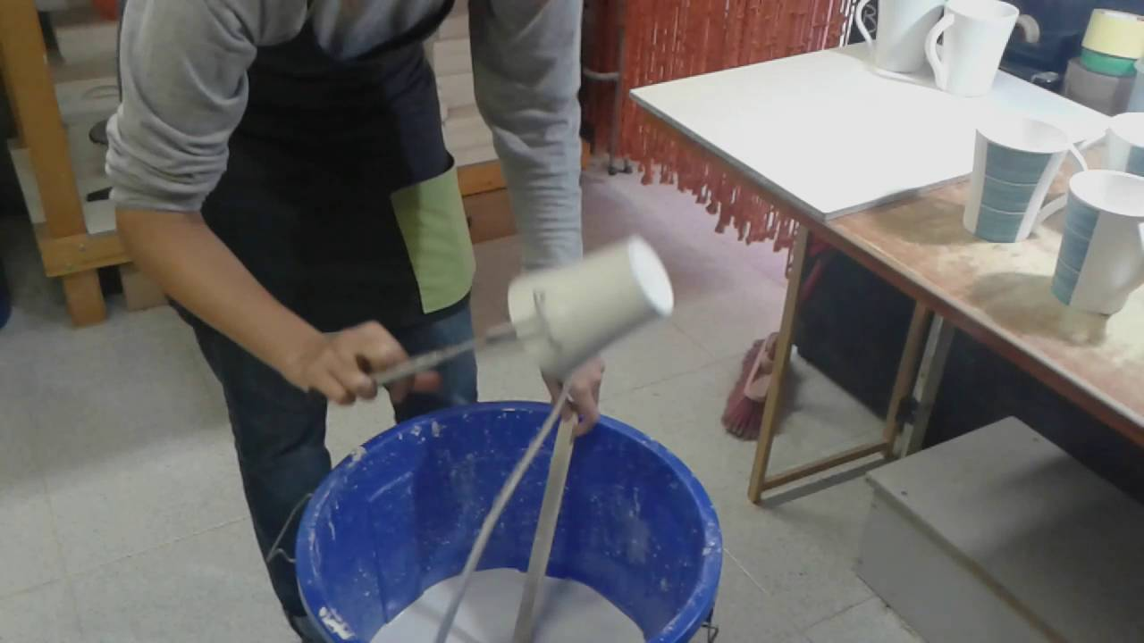
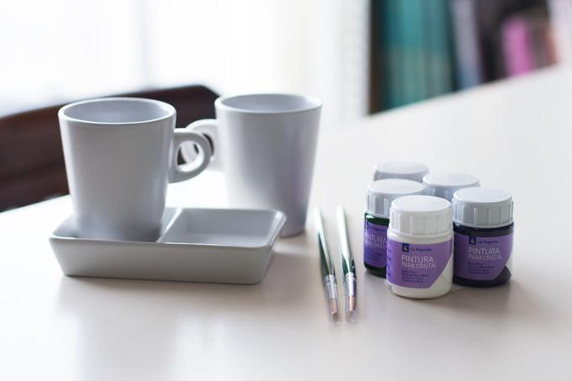
2. Process and Techniques
The main processes are: - Glazing
- Decoration
- Firing
Develop compositions and forms at an advanced level.
Sculptors and painters design an artistic drawing and give it color
Passage of the "raw" product to vitrified product and ready for sale. It is also glazed for more consistence.

Slide 5
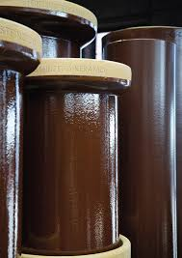
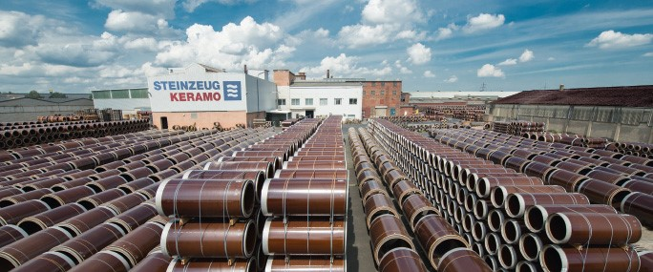
The technique used is the vitrification.
It consists of putting the material (in this case for example porcelain) and raising it to high temperatures in big tubes, to be able to treat the material better. Once this vitrification technique has been completed, it’s more easier to continue working and also to apply in the different processes.

Slide 6
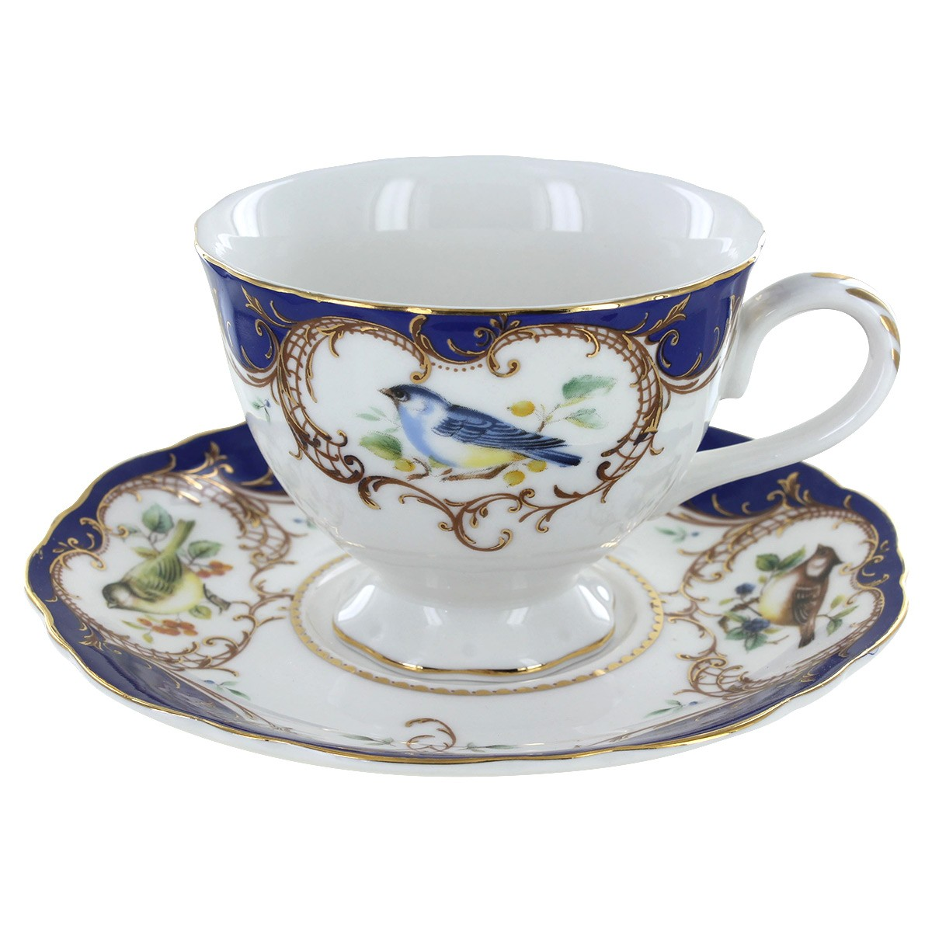
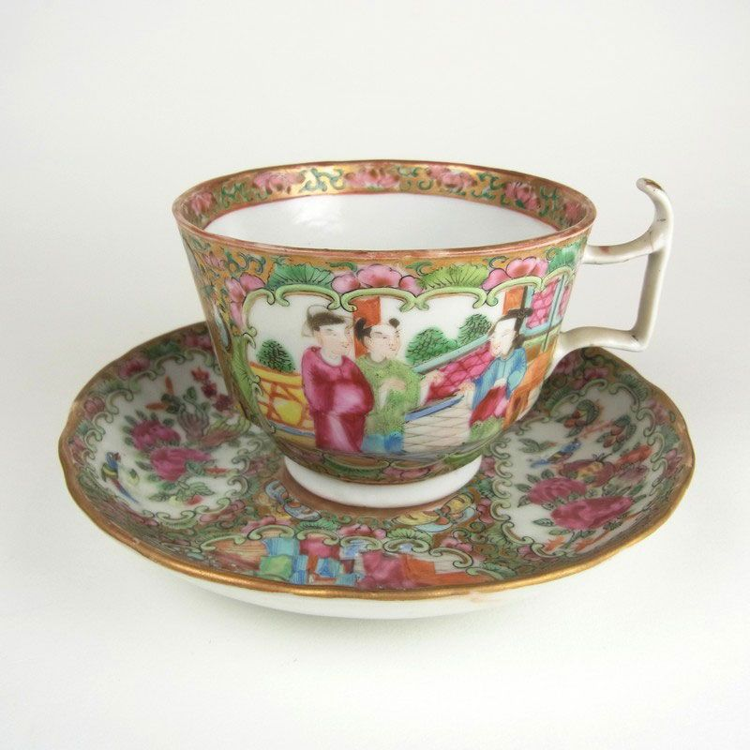
3. Materials
Ceramic tea cup is very precious because the materials, they are mainly kaolinite, feldspar, clay in granules, crystal,porcelain...
The material for do it it’s not cheap, because the extraction of materials and the technique and processes that have to been realised aren’t easy. When all the processes have been done, almost all the ceramic tea cups are decorated with different designs like mandalas, historical events ...

Slide 7
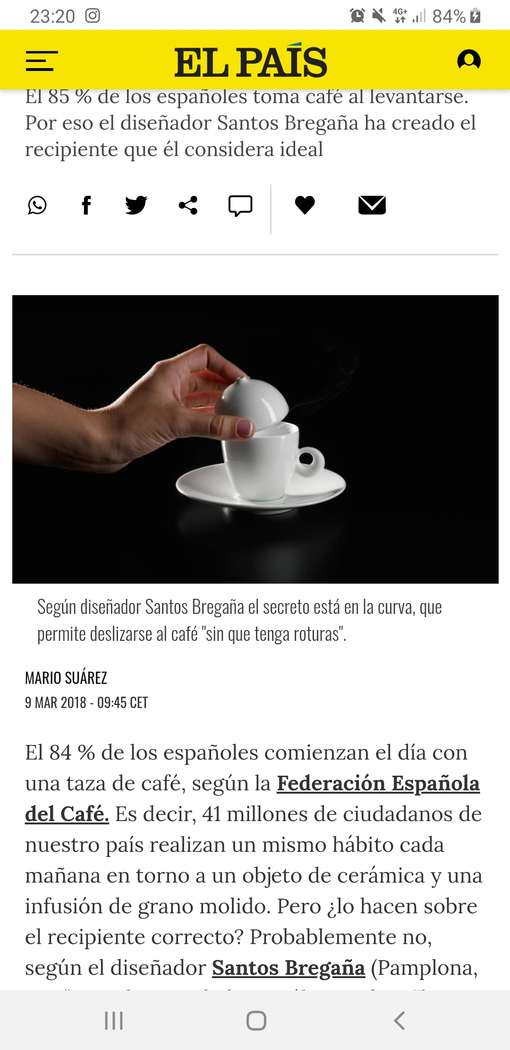
4. Mass Media
In this new we can see
that the spanish people
use the teacup everyday
and we have to choose the
perfect one for them. The
most famous is the porcelain cup
in Mijas:

Slide 8
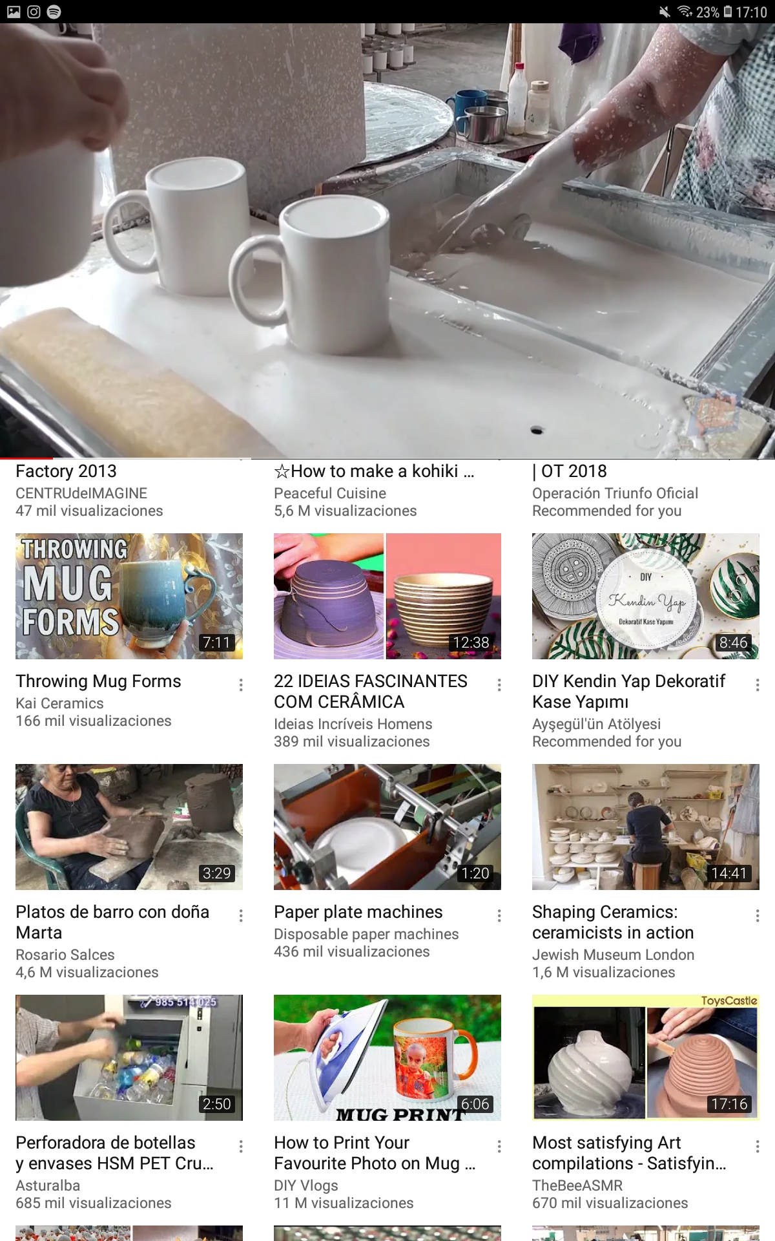
Here we can see a video about the process
of the ceramic teacup:
https://youtu.be/pYw5zUyiS7

Slide 9
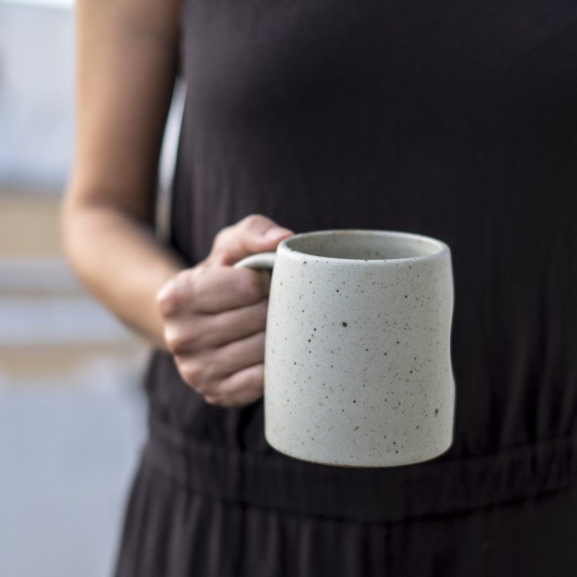
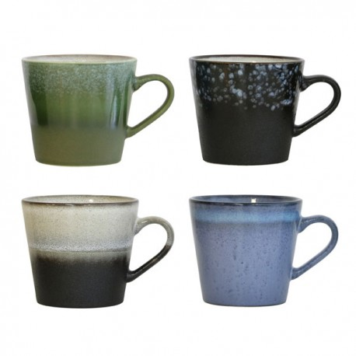
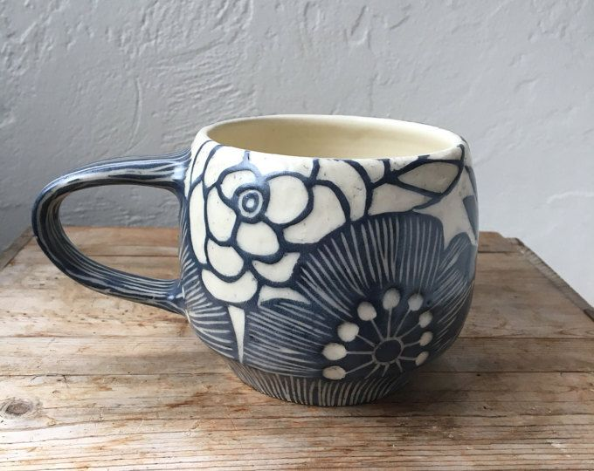
And here some photos of teacup with differents designs:

