Slide 1
Our Common European Tale Erasmus+ Partenership
SHORT TERM-EXCHANGE FOR STUDENTS
OSIJEK, CROATIA
1st – 6th OCTOBER 2018

Slide 2
Participants:
Students:
Dolha Lavinia Maria, 12 B
Trifan Andreea Damaris, 10 A
Teacher:
Suciu Andreea Daniela, English Language Teacher
“Ana Aslan” Technical College
Cluj-Napoca, Romania

Slide 3
DURING THE BLENDED MOBILITY PERIOD:
we studied the material on The Norse mythology
We rehearsed the Danish play
We learnt about the Roman mythology and Italian religious tales from the materials sent by our colleagues in Italy
85 students played on KAHOOT the quiz prepared by the Italian students&teachers (and we were pretty good :)
We also prepared and sent them a material and a Kahoot quiz about Dacian mythology

Slide 4
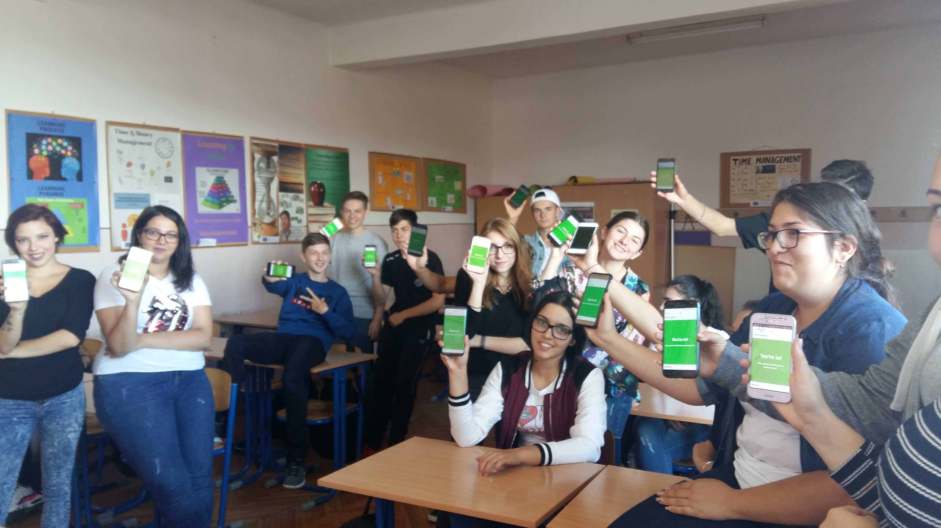

Slide 5
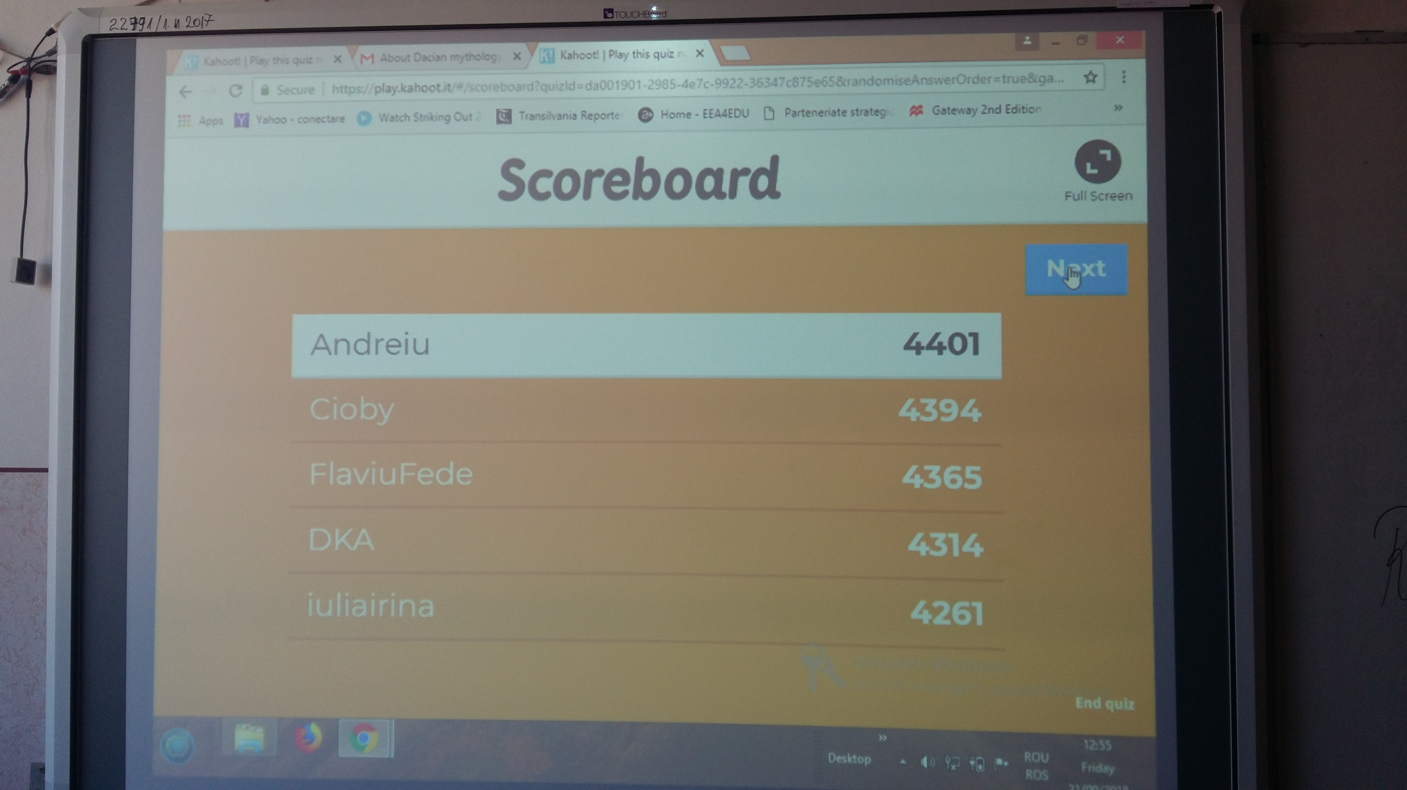

Slide 6
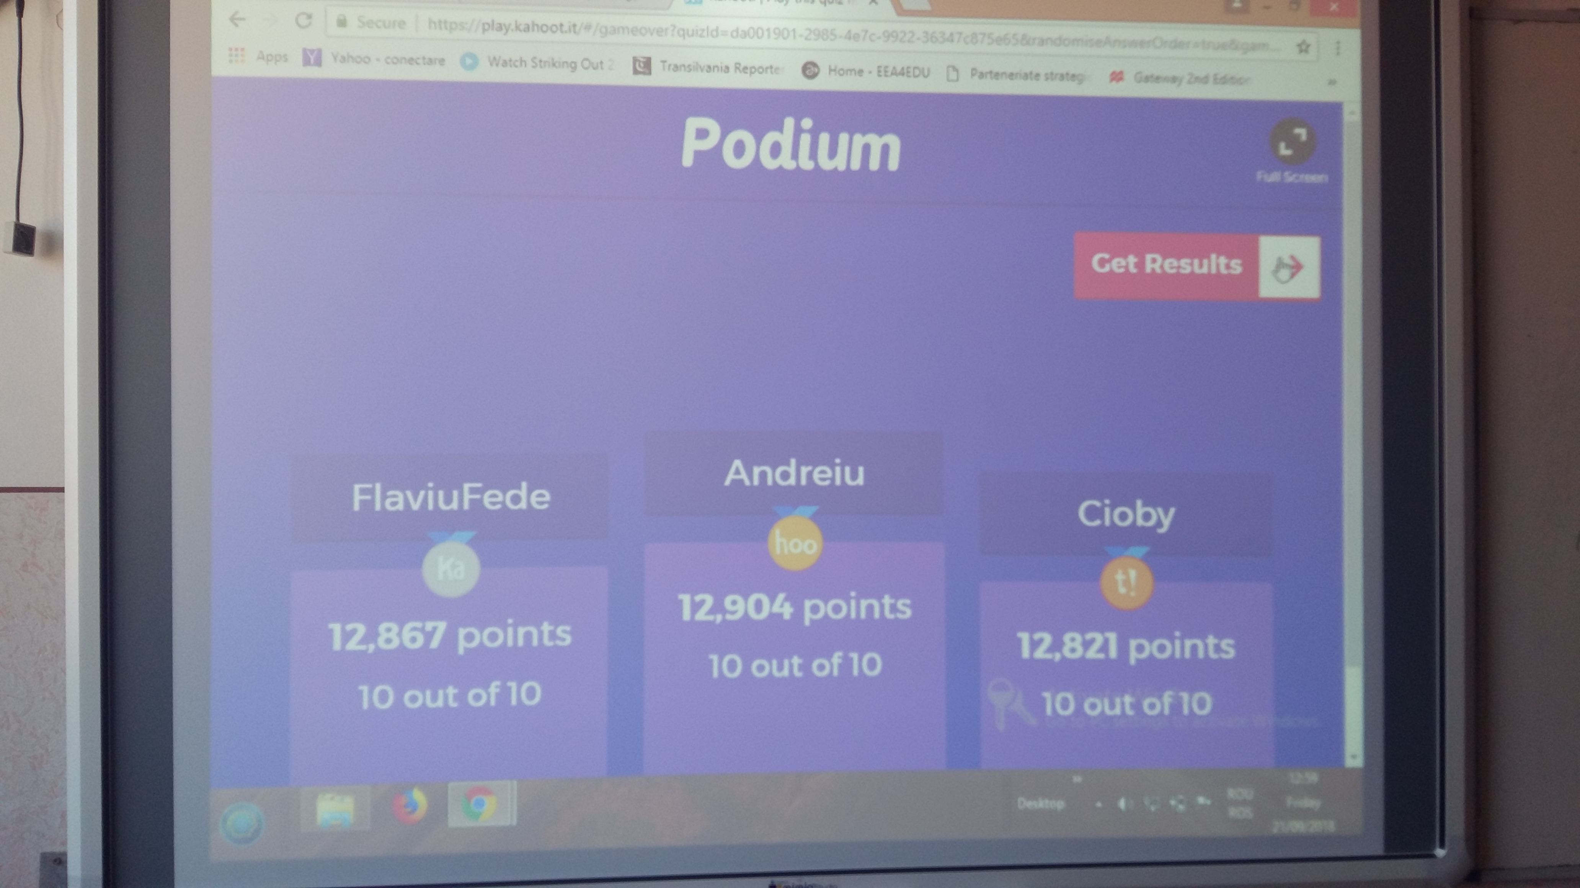

Slide 7
Similarities and Differences between Dacian Mythology and Norse Mythology
(some examples)

Slide 8
SIMILARITIES Themes:
Death-Life
Supernatural powers
Metamorphosis
Fantastic creatures
Supernatural objects
Initial situations

Slide 9
SIMILARITIES
Motives:
The immortality
The variety of Gods
The fantastic creatures (fairies, wolfes...)

Slide 10
Differences
Dacian Mythology | Norse Mythology
The greatest God was Zamolxes | The greatest God was Odin
Other Gods: Bendis(the Moon Goddess), Kotys (the Mother Goddess) | Other Gods: Thor(God of Thunder), Loki (God of deception)
Zamolxes had powers over wild animals | Odin received the wisdom from three witches from the underworld
The Legend of the Great White Wolf | The Legend of ASGARD, VALHALLA and MIDGARD
In time it became a monotheist religion | It kept the polytheistic character

Slide 12
In the previous picture is the flag of ancient Dacian civilization and it represents the wolf – the protector of the Dacian people (it might look familiar for the Game of Thrones fans ☺)

Slide 14
This picture is a representation of the nine worlds of the Norse Mythology : ASGARD, MIDGARD, MUSPELLHEIM, NIDAVELLIR, HELHEIM, NIFLHEIM, JOTUNHEIM, VANAHEIM, ALFHEIM

Slide 15
Please go to https://www.menti.com/ insert code: 77 82 77
And let’s see what you can remember from our presentation
☺

