Slide 1
ERASMUS+ KA2 OUR COMMON EUROPEAN TALE
Short term students Exchange
25-29 March 2019
Cluj Napoca

Slide 2
REALISTIC ASPECTS OF THE ROMANIAN FOLK TALES
Students:
. TRIFAN ANDREEA
KALLO BEATRIX

Slide 3
The fairytale is a fascinating literary species that opens the gate of entering into a fantastic world where everything is possible
Here the will of men knows no limits and all situations can be solved
An important aesthetic in the created world, a world of fantastic dimensions, but with the perspective of reality
It is a land of specific characters: humans, chimeric beings, animals,etc. endowed with miraculous objects, in special time and space

Slide 4
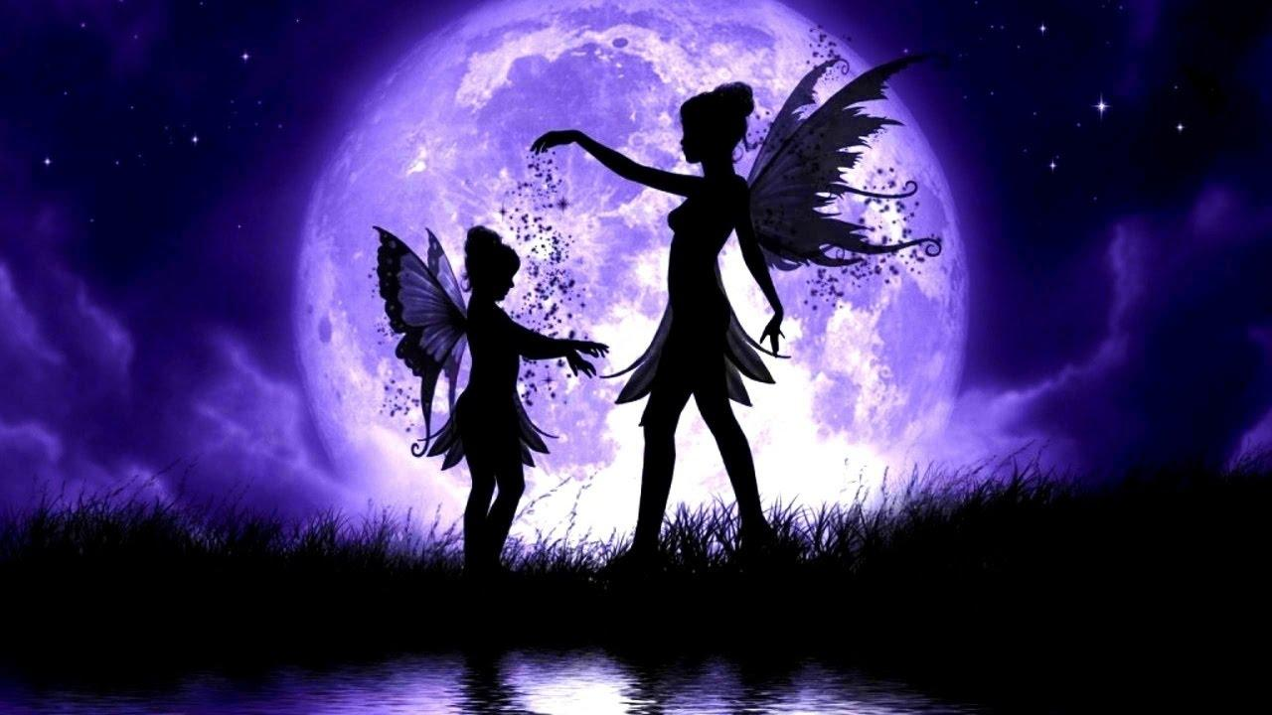

Slide 5
Romanian literary critic George Călinescu, highlights a realistic plan of the literary species, where acute problems of individual life, family and society are reflected, such as: birth, marriage, physical and moral quality of the children, and so on.
Class differences are well emphasized in folk tales. The poor man who has many children represents a typical character who serves others, from morning till evening, to earn his bread
The action of the fairytale focuses around the imperatives that the protagonist must solve and thus the fairytale aims to transmit the life experience of the collectivity and of the narrator and gives moral lessons and safe rules of conduct.

Slide 6
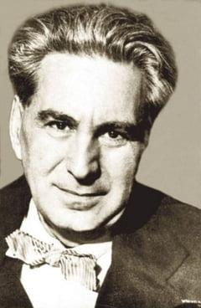
George Călinescu

Slide 7
Tales are anchored by specific formulas: initial, median and final
The initial formula: ”Once upon a time”, drives the recover into the unreal world, but also provides arguments of truth, according to an archaic conception, often used by storytellers: ”If it were not true, it would not be told”
The masculine main character in fairytales is Făt Frumos (aka Prince Charming)
The male protagonist of the realistic tale does not have extraordinary qualities or supernatural powers
He has qualities and defects, like any human being, but he is seen in evolution

Slide 8
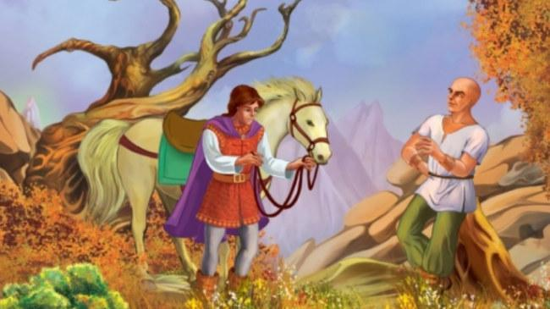
Case study: Realistic fairy tale HAPAP ALB
”Harap Alb”
Or, ”White Moor” in translation, is the chief character as well as the title of a Romanian fairytale by Ion Creangă.
Full title: “Povestea lui Harap Alb” (“The Story of Harap Alb”)

Slide 9
Ion Creangă’s hero, named Harap Alb, is a real character and not a fantastic creature
Harap-Alb is an atypical character for fairytales because it brings together both qualities (intelligence, wisdom, kindness, etc.) and defects (nativity, weakness)

Slide 10
He learns from mistakes, progresses and matures to deserve his status at the end of the fairytale
He has to travel the Earth from one edge to another, that is, from a symbolic point of view, from immaturity to maturity, from a familiar world to an unknown world
In this respect, his story is universal, it is the story of each of us

Slide 11
SIMILARITIES BETWEEN ITALIAN AND ROMANIAN REALISTIC TALES
Protagonists are searching for a better, happier life,
The tales have humble characters that develop into heroes by facing the struggles of life;
They have real life examples that are usefull to the present day
The main character encounters many obstacles on their way
In the end they find true happiness by returning home
Fairy tale formulas are present

Slide 12
DIFFERENCES BETWEEN ITALIAN AND ROMANIAN REALISTIC TALES
ROMANIAN
the protagonists are farmers/plebeian or aristocracy,
the typical Romanian village is depicted
the protagonist undergoes a major transformation
ITALIAN
the protagonists are fishermen
the subject is usually romance, engagement
they are focused on traditions/superstitions

Slide 13
Thank you for your attention!

