Slide 1
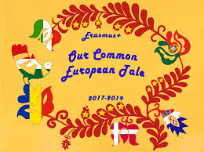
Our common European tale
Ref no.2017-1-HU01-KA219-035925
KA2 Strategic Partnership 2017-2019
Short-Term Exchange of Students:
ITALY
4th - 8th February 2019

Slide 2
Similarities and differences between magic tales of Romania and Croatia
Colegiul Tehnic Ana Aslan
Cluj-Napoca
Students:
Tepes-Onea Lucian
Maria Alexandra Campean
Teacher: Andreea Suciu

Slide 3
contents
The History of Romanian Magic Tales;
Romanian folktales writers and folklorists who gathered tales;
The Similarities between the Romanian and the Croatian Magic Tales;
The Differences between the Romanian and the Croatian Magic Tales.

Slide 4
The history of Romanian magic tales
A feature of Romanian culture is the special relationship between anonymous oral folklore and high-class written culture, determined by two factors:
1- the rural character of the Romanian communities until the 18th century resulted in an exceptionally vital and creative traditional culture, Folk Creations were the main literary genre. They were both a source of inspiration for cultivated writers and a structural model.
2- for a long time written culture developed around courts of princes and boyars, as well as in monasteries and was governed by official and social commands

Slide 5
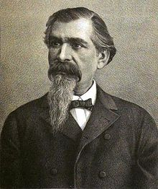
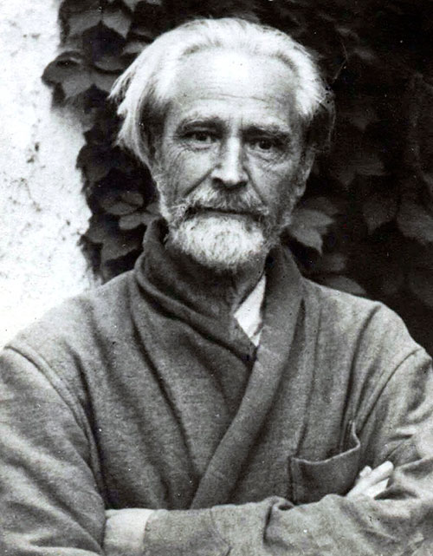
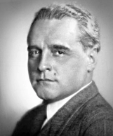
Romanian folklorists
Petre Ispirescu Vasile Voiculescu Cezar Petrescu

Slide 6
Magical creatures
Romanian tales of magic are characterized by:
the presence of a different world from the real one, thus resulting in
different creatures: people, chimeric beings, animals endowed with miraculous powers within a specific time and space
the characters of magic tales bear symbolic values, embodying good or evil in their various situations, illustrating in this way the eternal confrontation, most often ending with the victory of the good

Slide 7
Magical creatures
POSITIVE characters: Prince Charming, Ileana Cosânzeana (the Beauty), good-fairies (like the Pentecostal fairies), the fairy godmothers, the personifications of the bright phenomena (the Sun, the Morning Star, the Dawn)
NEGATIVE characters: giants, ogres, dragons and dwarves (Wood-Bending Dwarf, Stone-Breaking Dwarf, One Hand-Tall Dwarf, evil-fairies (e.g. Iele), Vâlva, Ştima (Evil Water-Fairy) , The Hag of the Forest, the personification of phenomena related to the darkness (the North, the Sunset) or abstractions (Luck, Faith, Death)

Slide 8
Example of a romanian magic tale
Inspired by folklore, Vasile Voiculescu wrote the fantastic story "Lostriţa" The narrator talks about the evil spirit of a lake that takes different faces, like the face of a young girl. Sometimes it comes out of the water and, from afar, she seems a young lady lying in the sun. It entices the young fisherman, who remains lovestruck, his mouth open in awe and his soul trapped.
Like Prince Charming, Aliman the fisherman is handsome, courageous and brave, vowing to catch the evil water-fairy.
Ambiguity increases when real and fantastic plans intersect. One night, the waters that come out of the course bring a raft on which there is a beautiful girl with a strange appearance: beautiful, with a chubby face and a long, voluptuous body. Her eyes, green-golden amber with blue flashes, were large, round, but cold like glass. The hair is disheveled on the shoulders like spikes and her teeth are white, but sharpened like those of beasts. People were astonished to see how the clothes quickly dried on her, as if they had never been wet.
The two fall in love and form a couple until the girl's mother, comes one day out of nowhere, quick tempered and angry like water after the rain and breaks them apart. The young man loses his desire to live, he is convinced to marry another girl, but he disappears into the turbulent waters, trying to catch the water-fairy again.

Slide 9
Similarities between Romanian and Croatian magic Tales
Both in Romanian and in Croatian magic tales, folklorists combine the real world with the fictional one, bringing forth characters like fairies, witches, giants, magic imbued in animals but also humans and human-like creatures, embodying good or evil in their various situations in permanent struggle, illustrating in this way the eternal confrontation, most often ending with the victory of the good side.
As Croats have Malik as the mythical creature to blame when things go bad, we have our infamous evil-fairies that are to blame for everything going wrong in one’s life.
Another similarity we found is between the tales “Lostrița” and “Stribor’s Forest” , where a young man blindly falls in love with a demon appearing as a beautiful, young woman seducing him (although our story has a darker ending).

Slide 10
Differences between Romanian and Croatian magic Tales
In Croatian magic tales, fairies are very well defined characters, always good and enchanting, with a young appearance and pleasant voices, but that is not the case in Romanian stories, we have both good fairies (fairy godmothers) and evil fairies (Ielele/Water-fairies); the latter being vicious, vindictive and cruel, embodying forces of nature, lesser deities or even the spirits of the dead.
Romanian stories more usually follow a pattern for the protagonist (usually a handsome and kind man) that is helped by secondary characters and very often at the end they marry into royalty, receiving the hand of a princess and half the kingdom.

Slide 11
SEE YOU SOON IN ROMANIA!
THANK YOU FOR WATCHING! ☺

