Slide 1
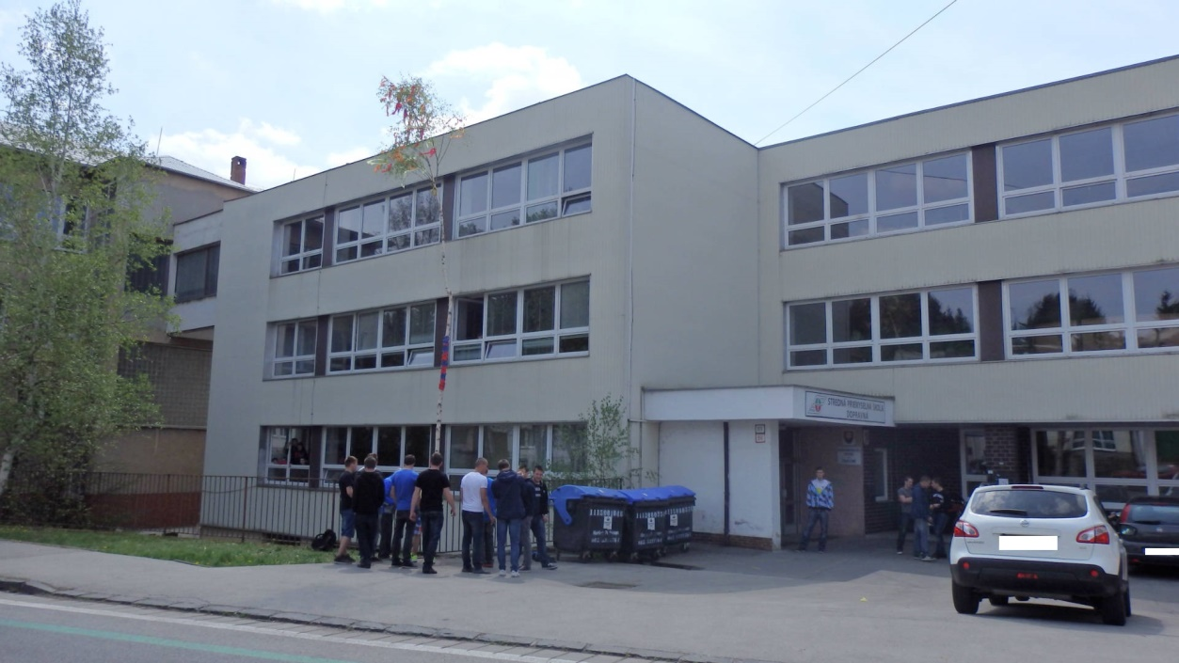
SPŠ dopravná vo Zvolene
Secondary technical school
Of transport

Slide 2
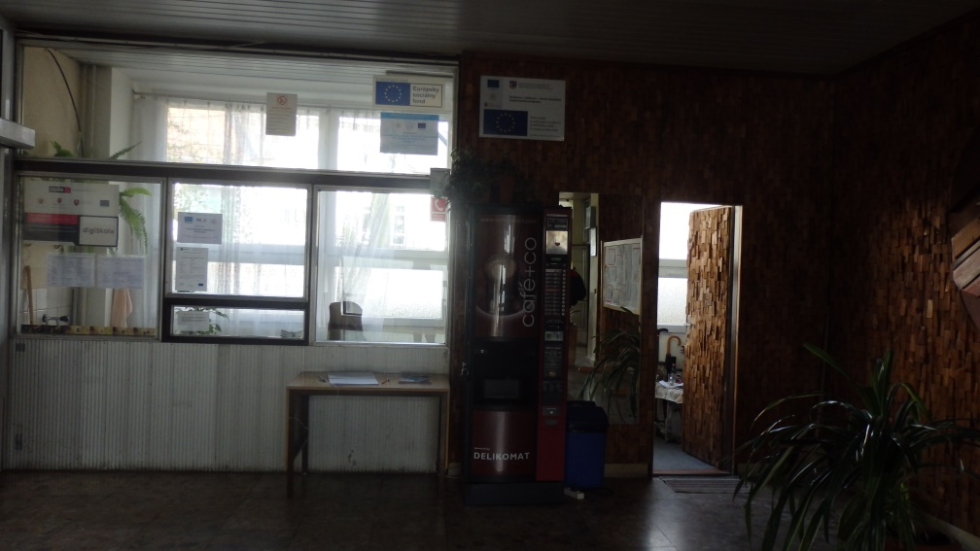
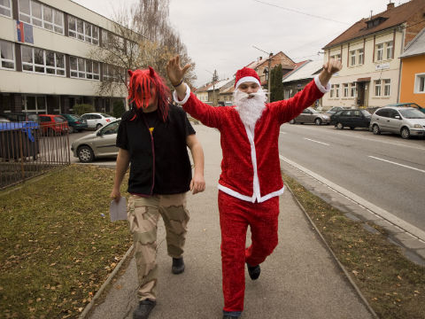
Let‘s look inside - Vstúpte

Slide 3
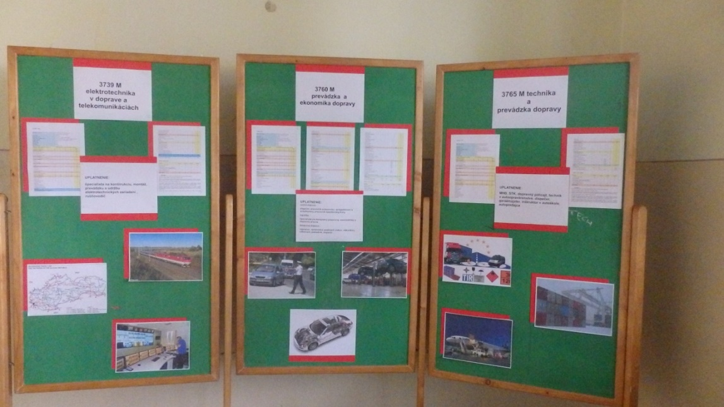
Studying programmes - Odbory na našej škole
Operation and Economics of Transport
Logistics
Road Transport
Rail Transport
Technics and Operation of Transport
Electrical Engineering in Transport
Our school is focused mainly on automobile transport, transportation, logistics, economy in transport.
Naša škola je zameraná hlavne na automobilovú dopravu, prepravu, logistiku, ekonomiku v doprave.

Slide 4
Enforcement of students – Uplatnenie študentov
Our students learn the principles of economics, accounting, transport business, international agreements and transport contracts. They can be employed in road traffic or in rail transport, auto servis, car manufacture and business.
Naši študenti poznajú zásady ekonomiky, účtovníctva, podnikania v doprave, medzinárodné dohody a zmluvy v doprave. Môžu nájsť uplatnenie v cestnej, alebo železničnej doprave, autoopravárenstve, výrobe automobilov a obchodnej sieti.

Slide 5
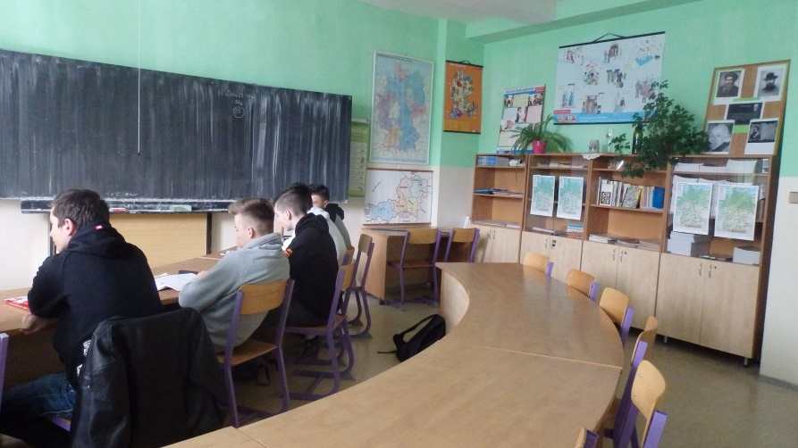
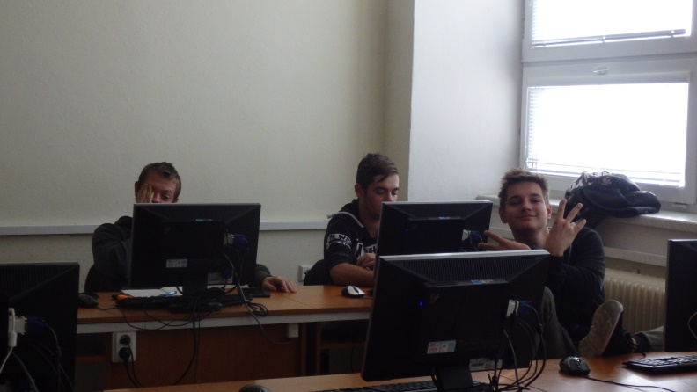
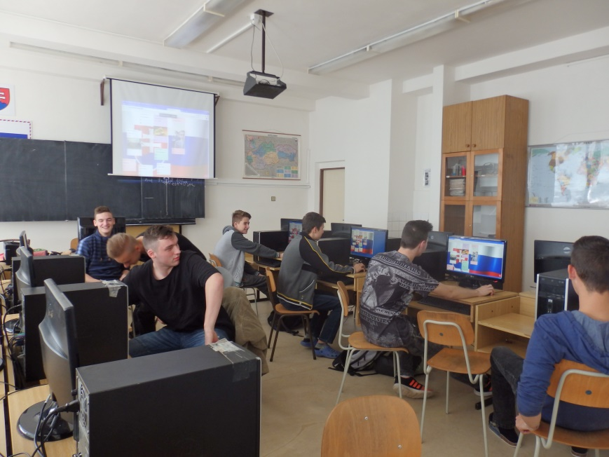
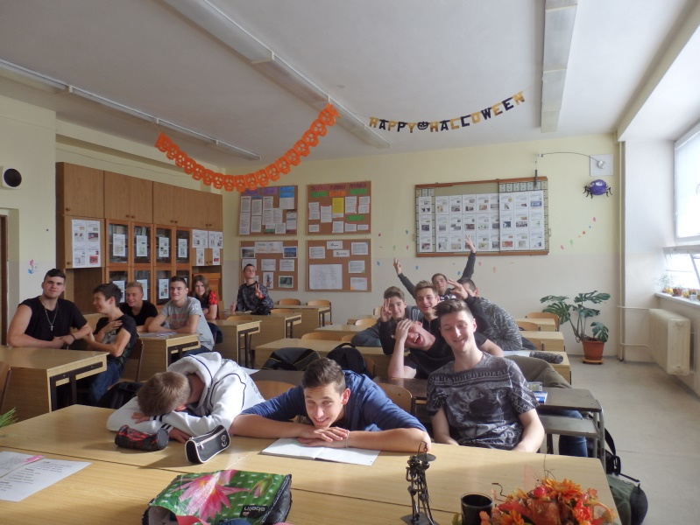
Classrooms - Učebne
English language classroom
A German language classroom
Computer science classroom
Ordinary classroom

Slide 6
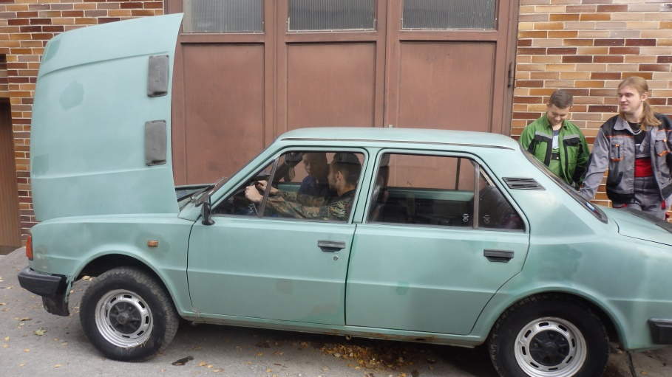
From a ordinary classroom to a technical classroom
Students practise their theoretical knowledge in technical professional classrooms.
Čo sa študenti naučia teoreticky
v odborných učebniach, to si vyskúšajú prakticky v dielňach.

Slide 7
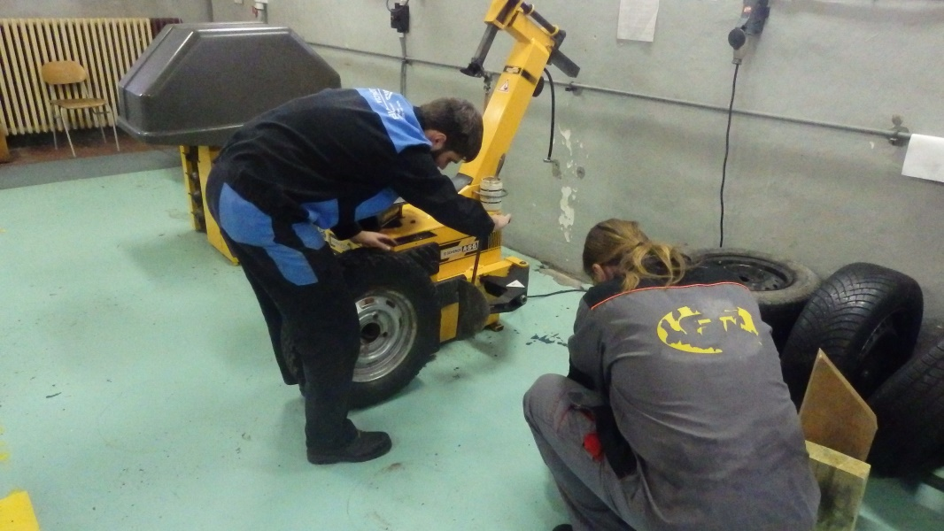
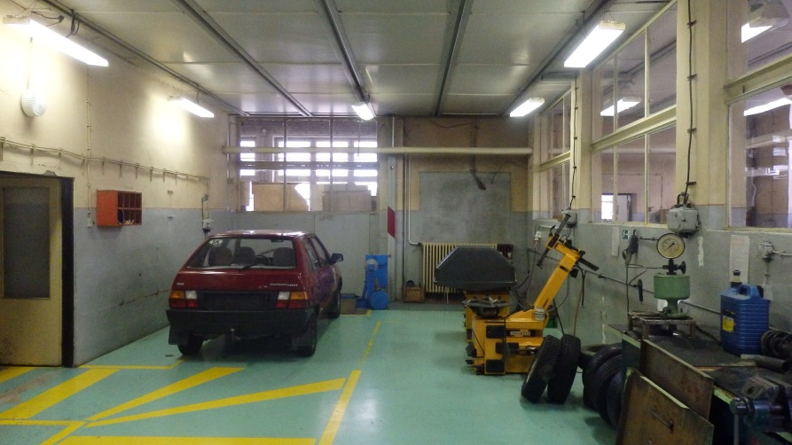
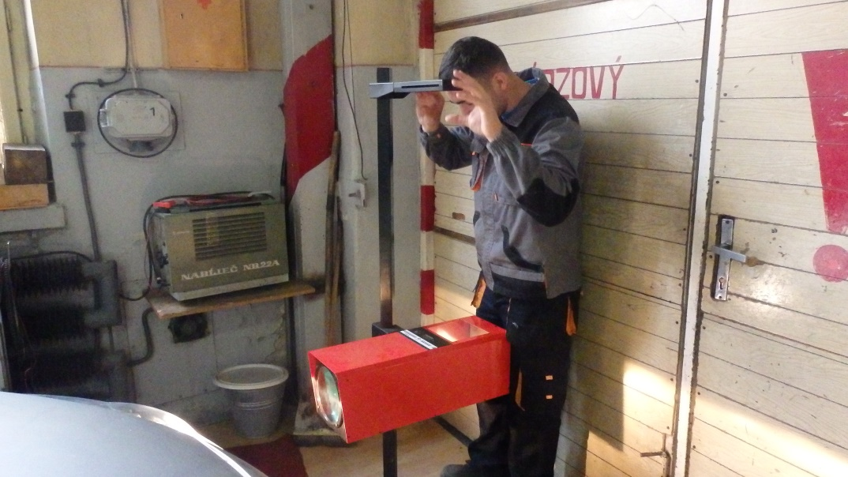
Technical classrooms – Dielenské učebne

Slide 8
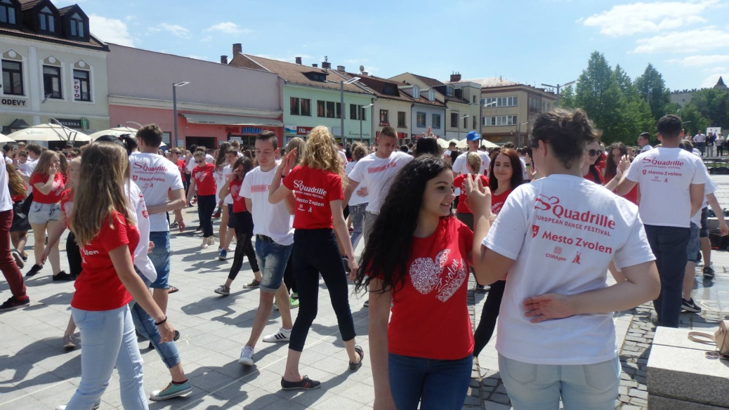
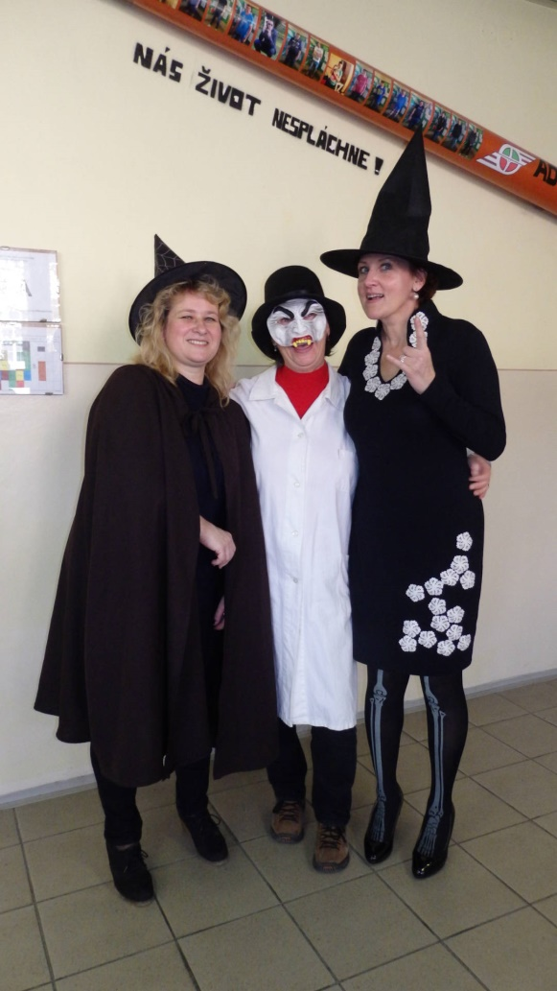
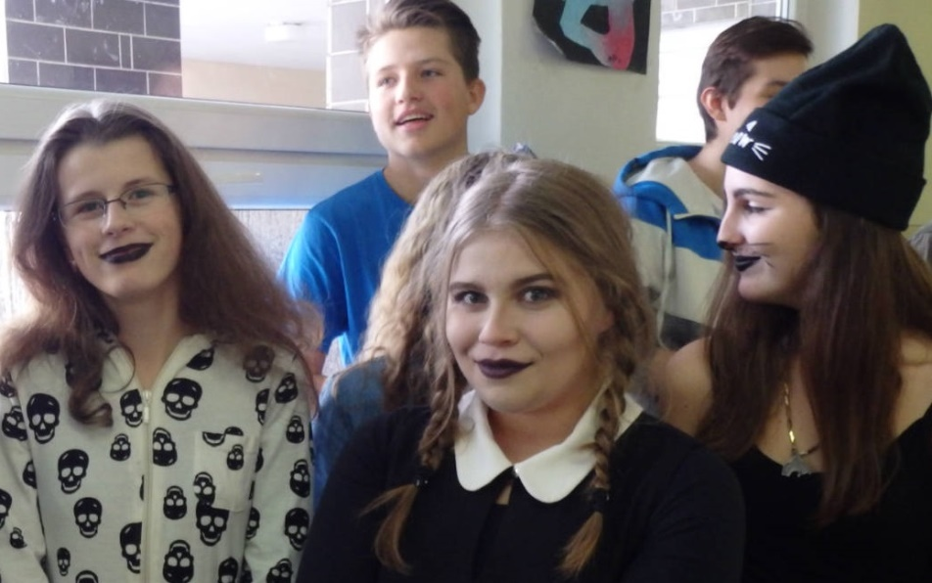
Events at school - Akcie na škole
Mikuláš - st. Nicolaus day
Štvorylka- Quadrille
Halloween contests

Slide 9
Activities at school – Akcie na škole
There are many different activities for our students at our school. Halloween contests, st. Nicolaus day, decorating classrooms and awarding the best decorated classroom. School ball. There are many excursions and competitions.
Na našej škole prebieha veľa rôznych aktivít pre študentov. Súťaže na Halloween, Mikuláša, zdobenie tried a ocenenie najlepšie ozdobenej triedy. Školský ples. Uskutočňuje sa množstvo exkurzií a súťaží.

Slide 10
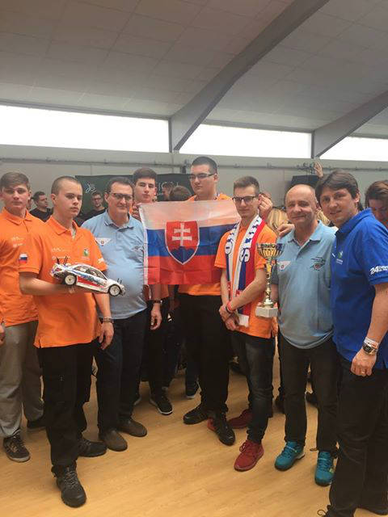
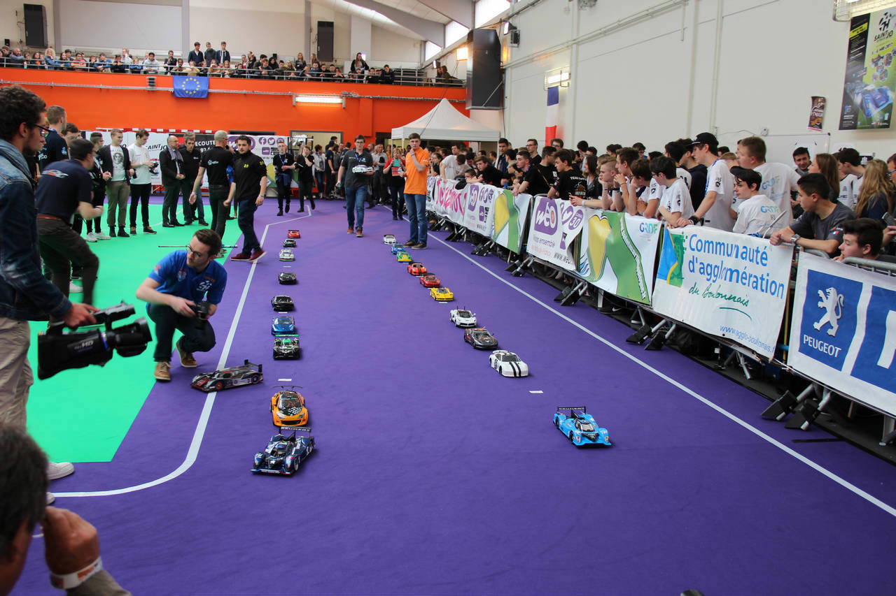
Competitions - Súťaže
One of the contests that our students took part in was a competition in France.
Our students set up Porsche and Hybrid models with which they competed in France and in their category they won the first price.

Slide 11
And this is only our school in a nutshell. We look forward to your school.
A toto je len v skratke naša škola. Tešíme sa na vašu školu.

