Slide 1
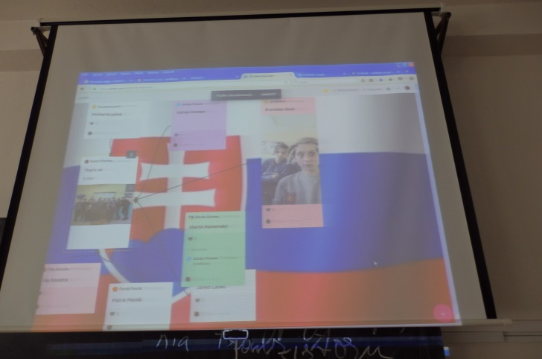
Work on our common padlete - Práca na spoločnom padlete

Slide 2
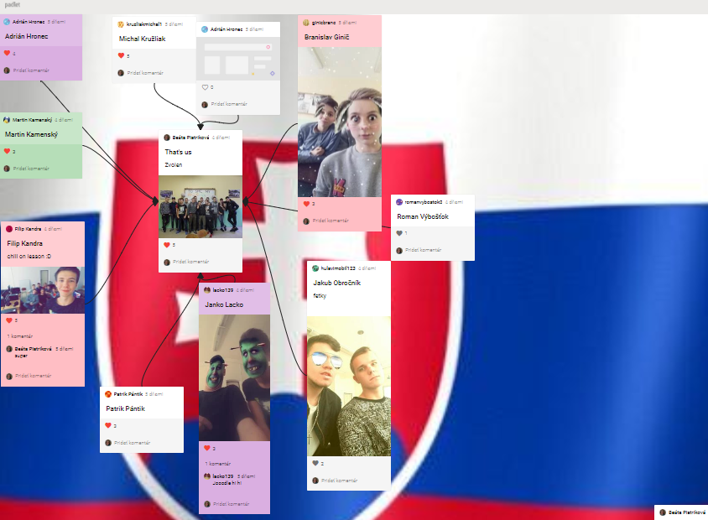

Slide 3
The first group is involved- Zapája sa prvá skupina

Slide 4
And the second group is added – A pridáva sa druhá skupina

Slide 5
I'm happy yet - Zatiaľ som spokojný

Slide 6
And leave place for a partner school from Turkey – A necháme priestor pre partnerskú školu z Turecka

