Slide 1
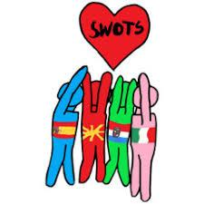
Erasmus+ project Swot Scouts
Activity C3
Developing Social Inteligence; the key of Enhanced life
Osnovna škola Otona Ivekovića
Zagreb
2nd – 6th December 2019

Slide 2
The aims of activity:
developing of team work skills
creativity
tolerance
care of cultural heritage
Activities during mobility:
animation workshop
- art workshops (ceramics, Christmas balls)
cultural heritage (sightseeing of Zagreb, Plitvice, Smiljan)
class of History/Geography
game Labirynth
messages of tolerance
diary

Slide 3
Monday 10 00 -14 00
Tuesday 9 00 – 13 00
Wednesday 9 00 – 13 00
Friday 18 00
Presentation of work
animation workshop
development of media literacy
including vizual thinking, digital skills, comunication skills
team work skills
creativity
comunication nowdays depends on media
product of workshop:
animated film

Slide 4
Cultural heritage
Monday 19 30
Croatian National Theatre / ballet Nutcracker
Wednesday 14 00 – 18 00
Old town
Museum of Broken Relationships
Ice skating
Thursday
Smiljan / birthplace of Nikola Tesla
Plitvice / National park
Friday 11 00 – 13 00
Down town, Zagreb
Museum of illusions

Slide 5
Messages of tolerance for column in the hall in all languages
/ during Monday and Tuesday
Class of History and Geography
Tuesday 14 00 – 15 00
Learning a little about Croatia / Croatian students as assistants
Diary
Free space / be creative !

Slide 6
Labyrinth
Monday 15 30 – 17 00
Game is based on draft of our Treasure Hunt game
Accent is on OPPORTUNITIES
Labyrinth = the school
All activities in game are created for development of social skills
Game is contribution to The Guide / product of the project
Both teachers and students play
Instructions are in the bags / read later

