Slide 1
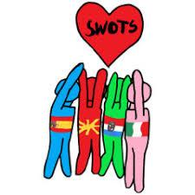
Erasmus+ project Swot Scouts
Activity C3
Developing Social Inteligence; the key of Enhanced life
Osnovna škola Otona Ivekovića
Zagreb
2nd – 6th December 2019

Slide 2
The aims of activity:
developing of team work skills
creativity
tolerance
care of cultural heritage
Activities during mobility:
animation workshop
- art workshop (ceramics, painting)
- decorating classroom
cultural heritage (sightseeing of Zagreb, Plitvice, Smiljan)
class of History/Geography
game Labirynth
messages of tolerance
diary

Slide 3
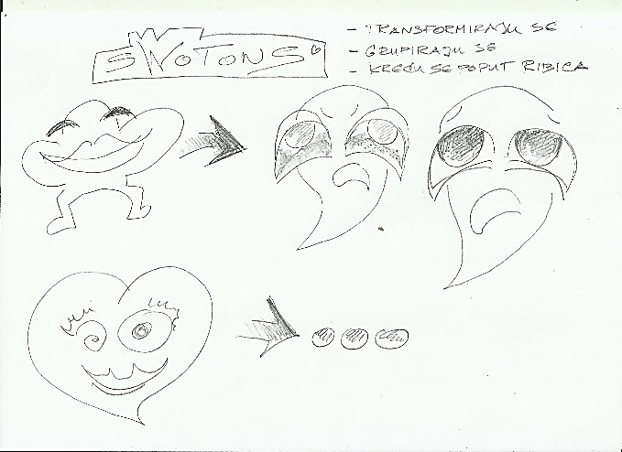
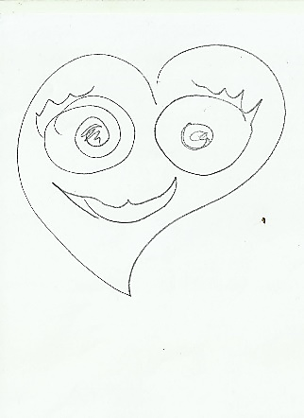
Monday 10 00 -14 00
Tuesday 9 00 – 13 00
Wednesday 9 00 – 13 00
Friday 18 00
Presentation of work
animation workshop
development of media literacy
including vizual thinking, digital skills, comunication skills
team work skills
creativity

Slide 4
product of the workshop:
animated film
Just because...

Slide 5
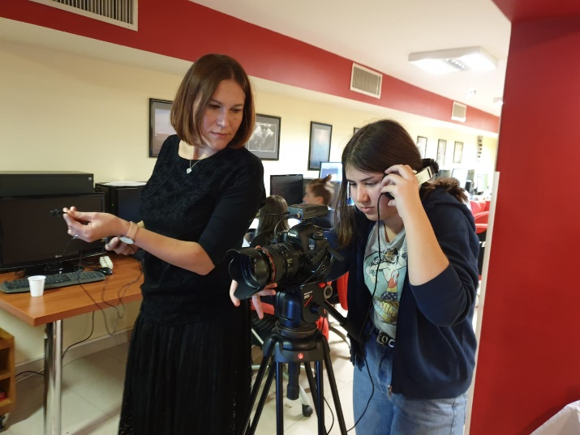
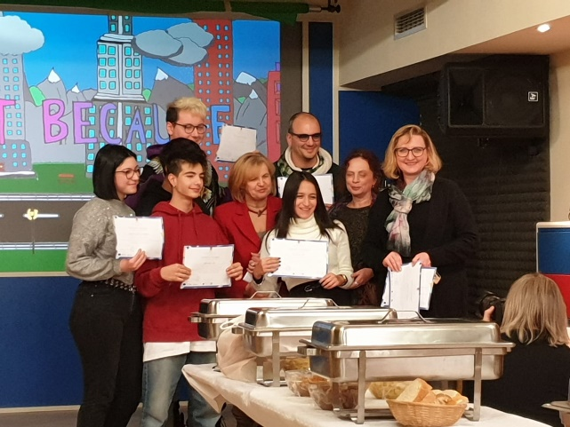
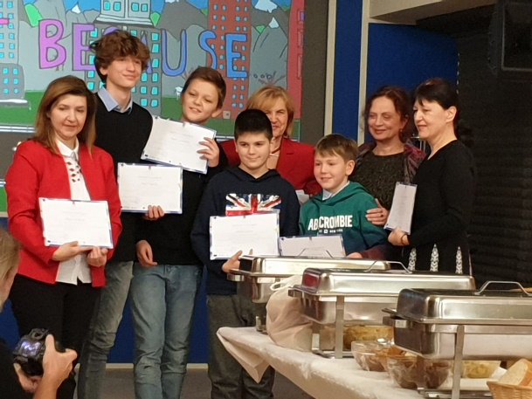
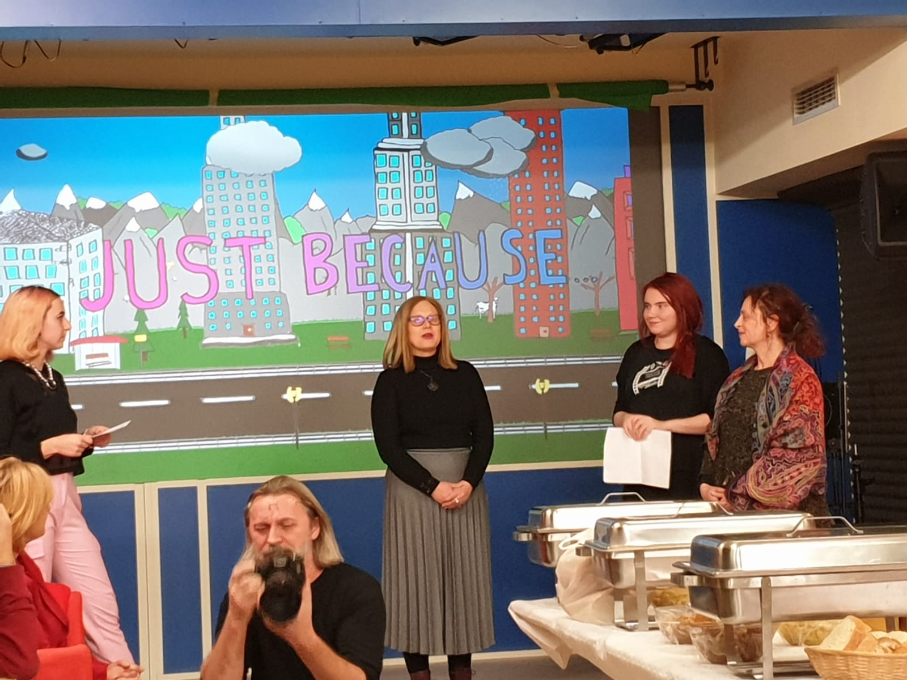
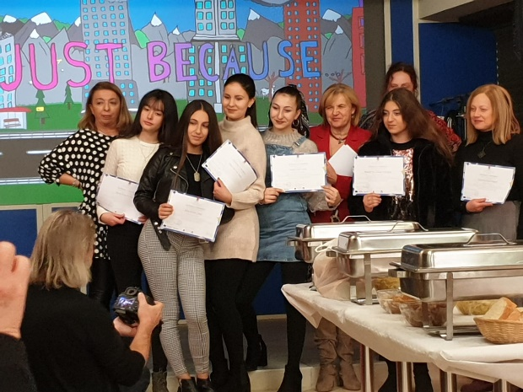
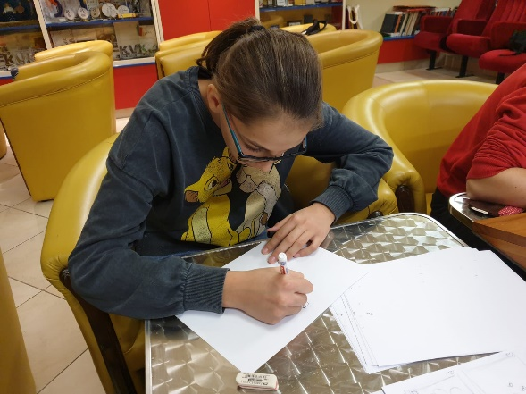

Slide 6
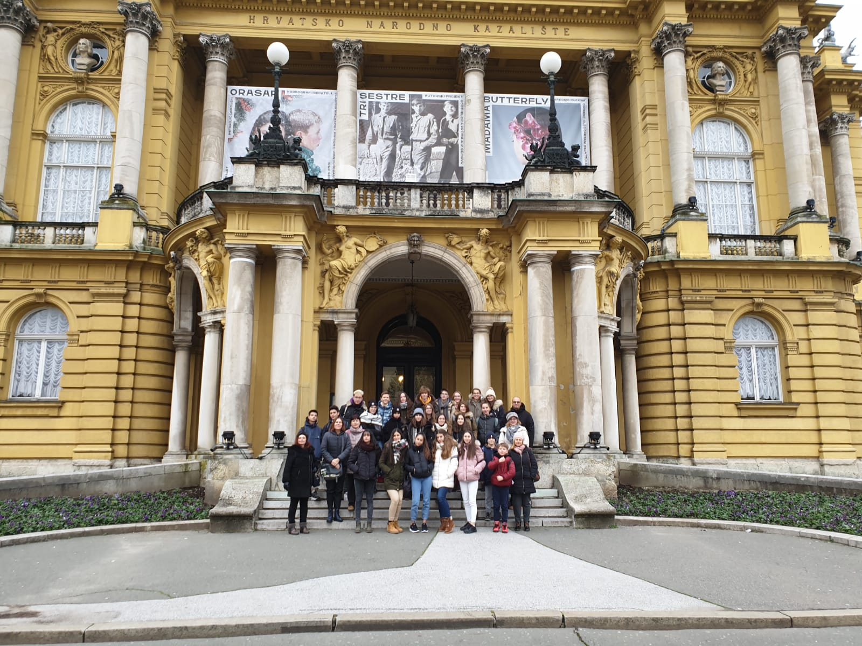
Cultural heritage
Monday 19 30
Croatian National Theatre / ballet Nutcracker

Slide 7
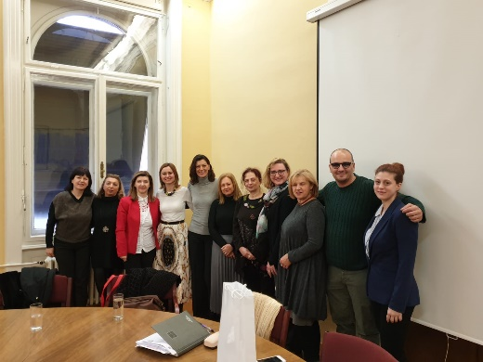
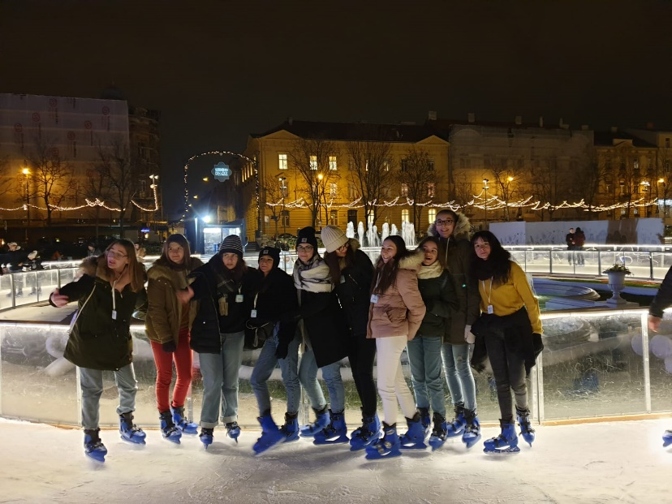
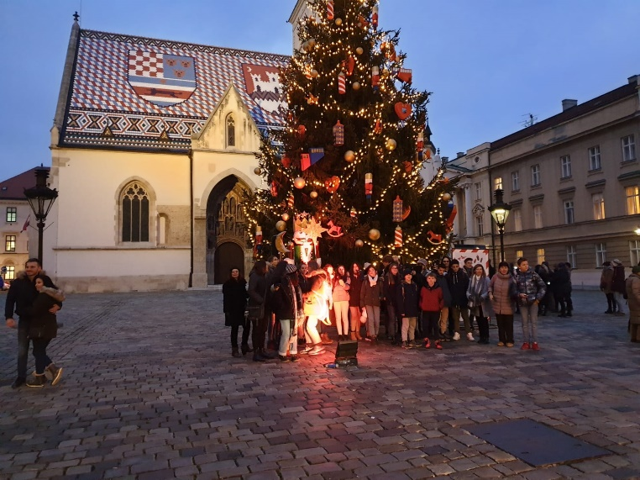
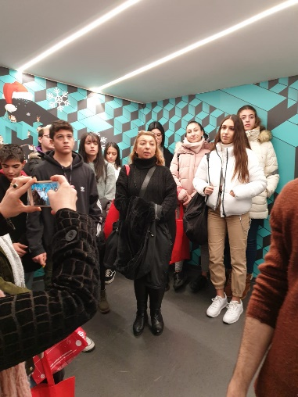
Cultural heritage
Wednesday 14 00 – 18 00
Old town
Museum of Broken Relationships
Ice skating
Friday 11 00 – 13 00
Down town, Zagreb
Museum of illusions
The city Hall

Slide 8
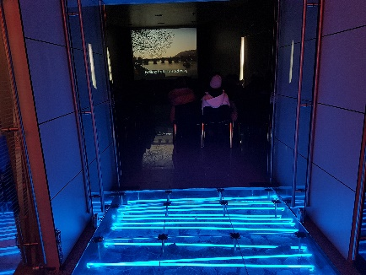
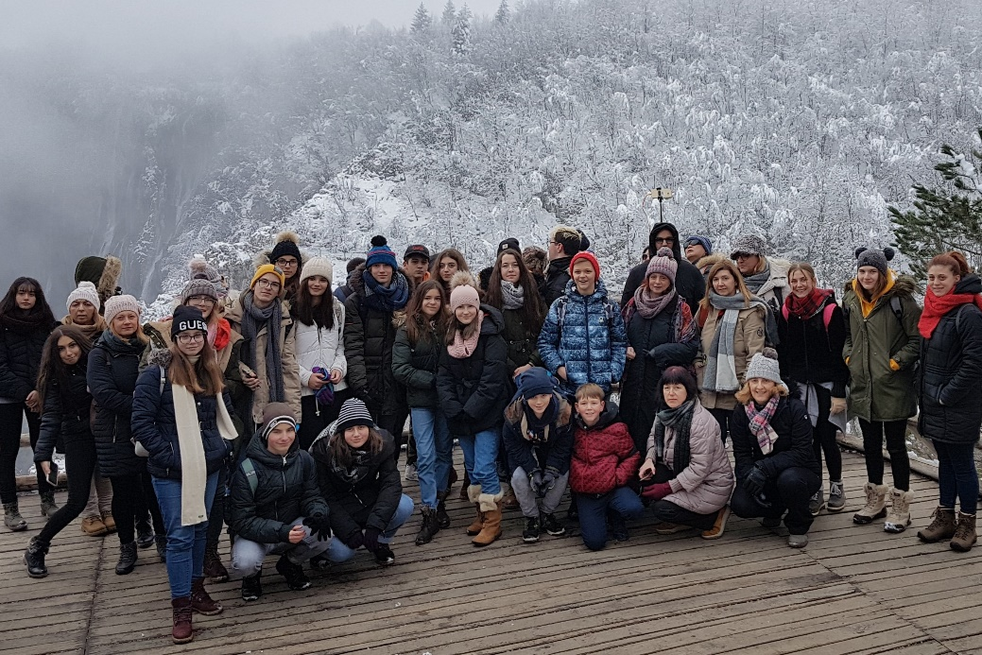
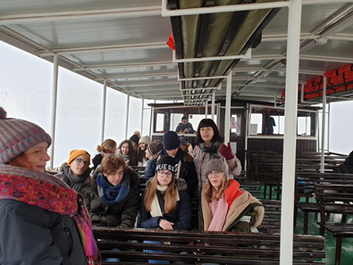
Cultural heritage
Thursday
Smiljan / birthplace of Nikola Tesla
Plitvice / National park

Slide 9
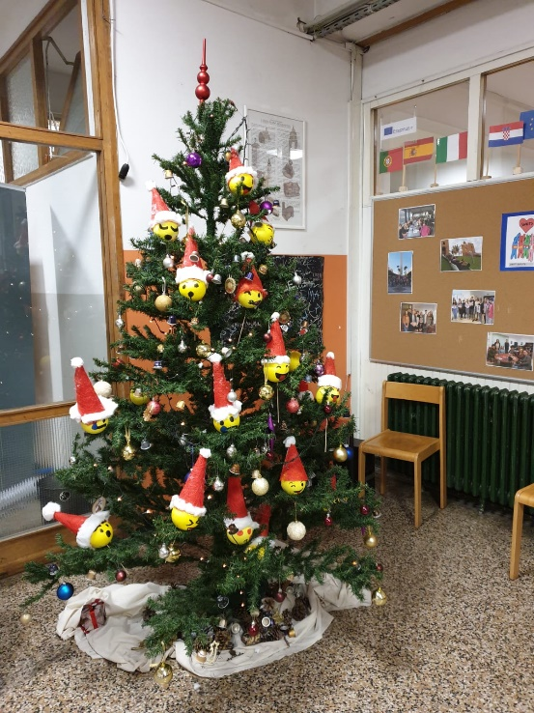
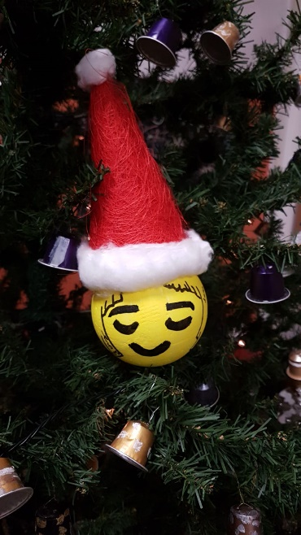
Messages of tolerance for column in the hall in all languages
/ during Monday and Tuesday
Class of History and Geography
Tuesday 14 00 – 15 00
Learning a little about Croatia / Croatian students as assistants
Guests present their countries and schools
Ceramics and art workshop
Diary

Slide 10
Labyrinth
Monday 15 30 – 17 00
Game is based on draft of our Treasure Hunt game
Accent is on OPPORTUNITIES
Labyrinth = the school
All activities in game are created for development of social skills
Game is contribution to The Guide / product of the project
Both teachers and students play

Slide 11
Saying goodbye
Saturday

