Slide 1
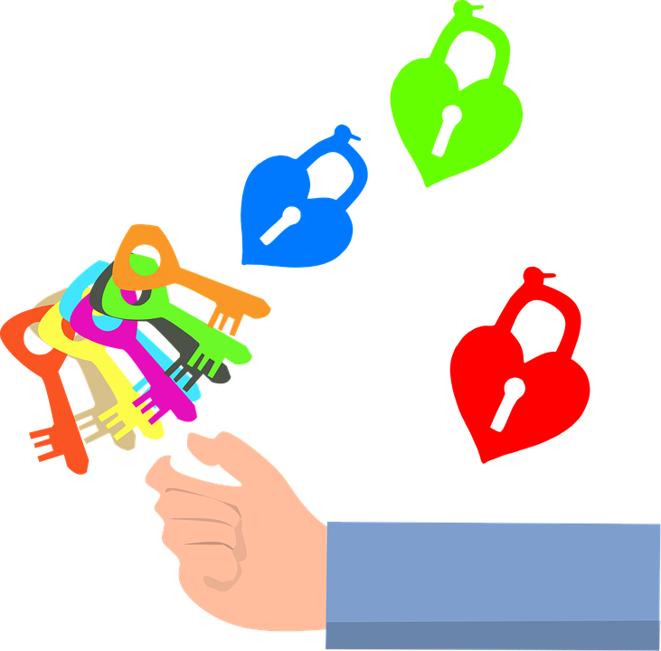
Emotional intelligence
BY IRENE ESTÉVEZ, LAURA DE AMO, LUCÍA MATEOS, MARÍA SÁNCHEZ,
NATALIA MARTÍN, PABLO VELAR and RODRiGO LIROLA
“SWOT Scouts” Project
2018-1-ES01-KA229-049952

Slide 2
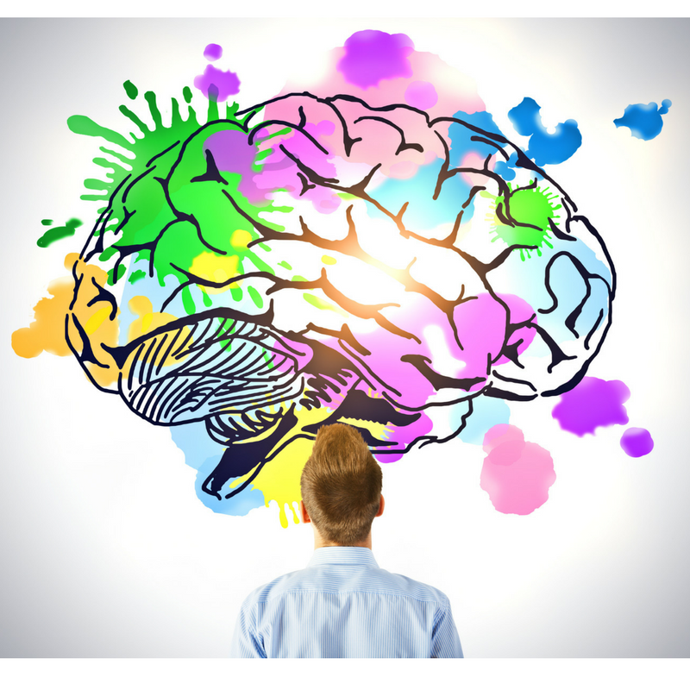
introduction
Everything the humans do has an emotional meaning. Our actions, our decisions and all the opinions are based in an emotion, or in an opinion-mix.
Those who are emotionally intelligent are able to analize the thoughts and identify the origin of the emotions to avoid the problems they can produce.

Slide 3
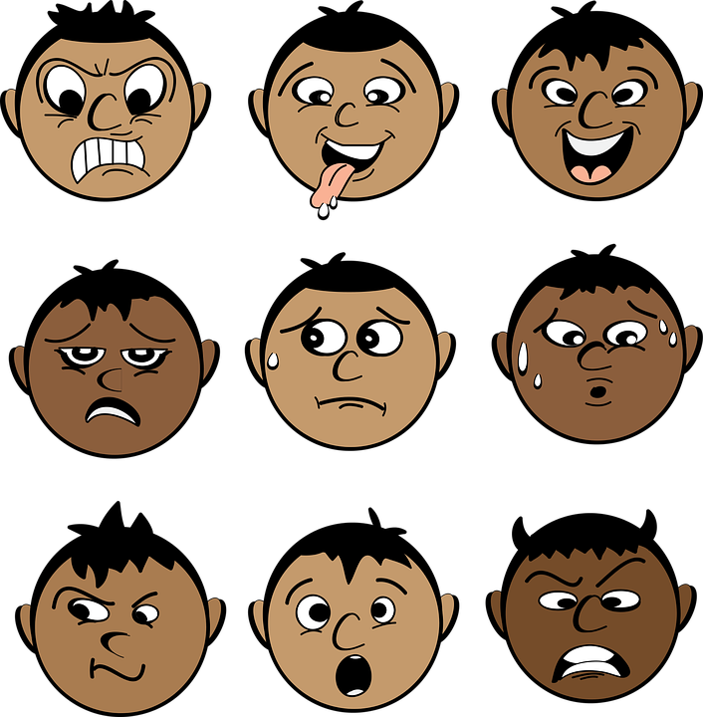
BUT… WHAT IS AN EMOTION?
An emotion is a complex psychological state that involves three components:
A subjective experience,
A physiological response, and
A behavioral or expressive response.
In 1972, psychologist Paul Eckman suggested that there are six basic emotions that are universal in all human cultures: fear, disgust, anger, surprise, happiness, and sadness. In 1999, he expanded this list to include a number of other basic emotions, including embarrassment, excitement, contempt, shame, pride, satisfaction, and amusement.
I have an experience ➔ my body has a physiological response ➔ I behave in a certain way

Slide 4
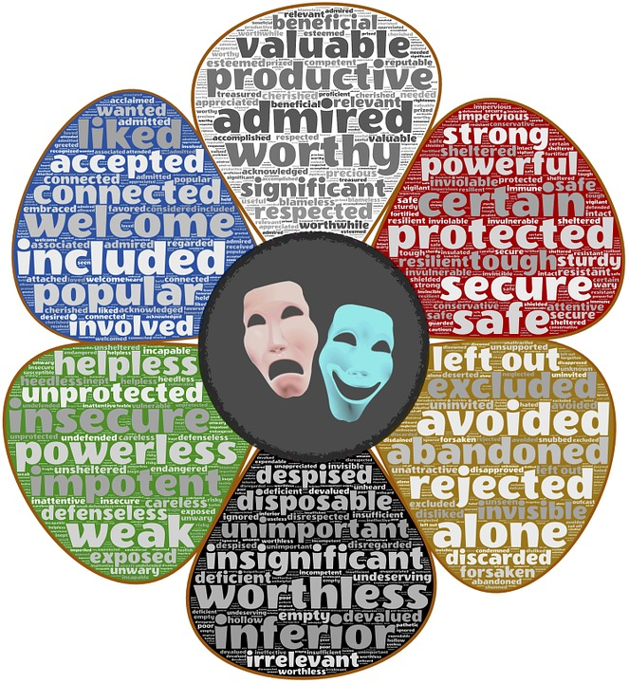
And what is a feeling?
A feeling, on the other hand, is usually much milder than an emotion, but longer-lasting. In many cases, it can be difficult to identify the specific cause of a feeling. For example, you might find yourself feeling gloomy for several days without any clear, identifiable reason.

Slide 5
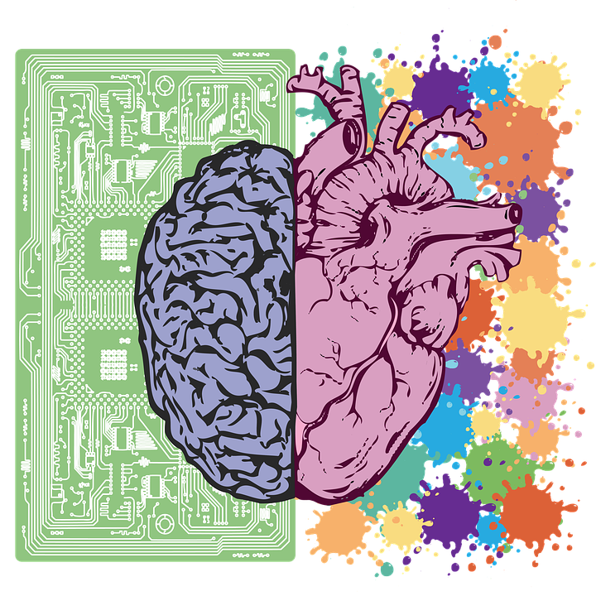
What is emotional intelligence?
Emotional intelligence is a tool which helps you to use our emotions in a right way, being able to take decisions thinking about the meaning of the emotions.
Emotional intelligence is the ability to identify, understand and handle emotions correctly, in a way that it facilitates relationship with others.
It's how we identify and manage our emotions and the emotions of others.

Slide 6
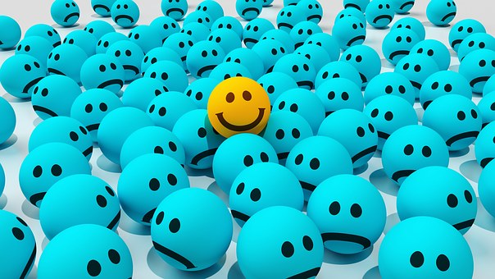
the IMPORTANCE of emotional intelligence
 EI helps us maintain better health by being able to better manage negative emotions.
 EI reduces stress levels and anxiety.
 EI helps us to succeed in all those areas of life that involve interacting with others.
 EI helps to relate more with others. People with high emotional intelligence are better able to express what they feel to others and to understand what others feel.
 EI improves your personal relations and your communication capacity with other people.
 EI develops your integrity and the respect to the others.
EI helps you get assertiveness and better self-confidence.
EI increases the academic capacity.
EI increases creativity.
EI increases team-working.
EI increases leadership ability.
EI improves decisions making.

Slide 7
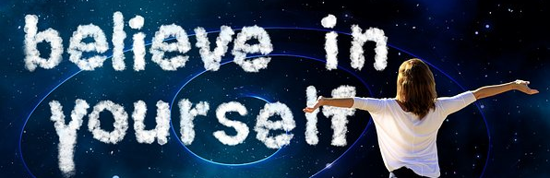
AREAS of emotional intelligence
Personal competence
Social competence
Self awareness: I know myself
Self-esteem: I love myself
Self regulation: I can manage
my emotions
Motivation
Decision making
Commitment
Empathy
Interpersonal
awareness
Social skills
Relationship
management
I can listen to you
I know how you feel
I know what you need
I know how to be friendly
I know my reasons
I know what I want
I’m going to achieve it

Slide 8
Characteristic of people with high EI
SELF-AWARENESS
THEY IDENTIFY THEIR OWN EMOTIONS
They are able to identify their emotions and know what they are feeling every moment.
EMOTIONAL AWARENESS
THEY IDENTIFY THE EMOTIONS
OF OTHERS
They have a high capacity to understand the emotions of others. They know how to put themselves in the place of others and understand points of view different from their own.
EMOTION MANAGEMENT
They are able to control their impulses
They are not easily carried away by emotional outbursts. They know how to calm themselves.

Slide 9
Good news !! Emotional intelligence can be developed
This is what our Project SWOT Scouts is about

Slide 10
What can YOU do to improve YOUR Emotional Intelligence?
#1) Practice objectively observing how you feel and pay attention to how you behave.
#2) Examine how you react to stressful situations and learn your emotional triggers if you want to change how you react to things.
#3) Pay attention to body language: it tells how you and other people feel.
#4) Take time to celebrate the positive, but don’t ignore the negative.
#5) Keep an emotional diary. Write at the end of each day to reflect on your day.
#6) Understand your personal goals, the things that motivate you.
#7) Keep an agenda: write your objectives with dates and don’t procrastinate.
#8) Observe how you react to people. Examine how your actions will affect others – before you take those actions.
#9) Take responsibility for your actions, because your feelings and behaviour come from you.
#10) Avoid complaining, negativity, criticism and drama. Always think constructively.
BE MINDFUL

Slide 11
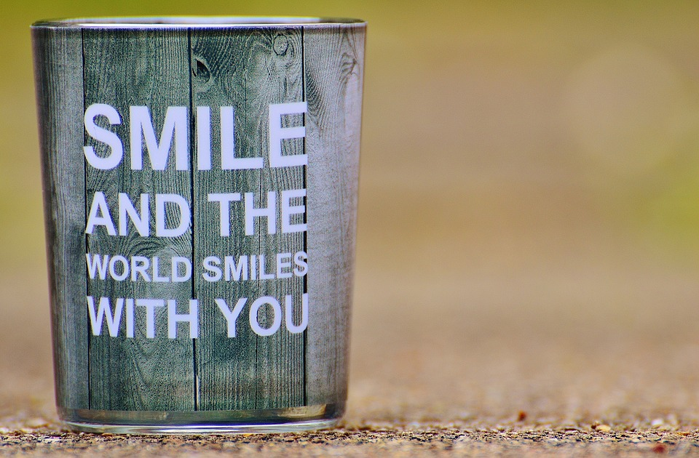
Thanks for your attention!

