Slide 1
NAME’S ORIGIN

Slide 2
Introduction
The two main subjects of our classical school are Latin and ancient Greek; these have given rise respectively one to Italian and the other to modern greek. Although greek and italian are two languages totally different, in ancient times were sisters languages, so much so that one person could speak both.
Thanks to this proximity with the greek, then, many terms of our everyday spoken derive from this. Between the various words with a Greek origin, many are proper names.

Slide 3
Alessandro: derives from the Greek name Άλέξανδρος, formed by αλέξω “to help” and ἁνήρ “man”. And means “defender of man”.
Irene: derives from the Greek noun είρηνη, “peace” and means “one who brings peace”.
Alessia: derives from the Greek term Aλεξις, that means “defender”.
Andrea: derives from the Greek ἁνήρ, genitive ανδρός that means “brave man”.

Slide 4
These names are all united by the ideal of peace, very strong in ancient Greece: in fact, for example, during the period of Olympics games all war activities in proress were interrupted, at least in appearance.

Slide 5
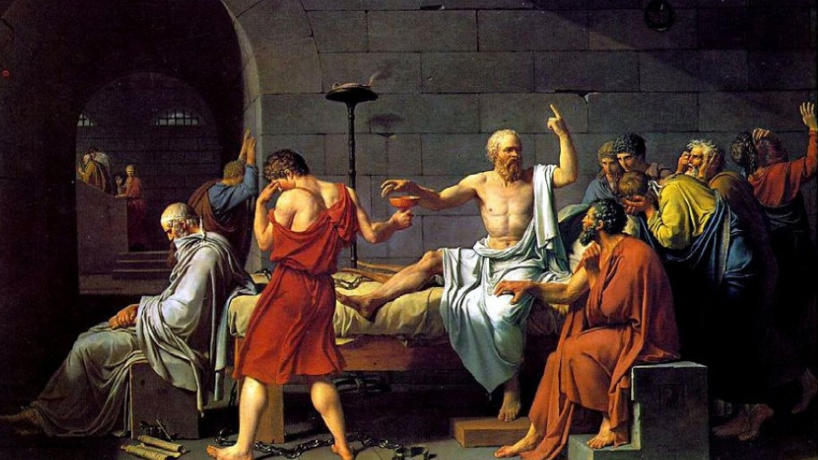
Sofia: derives from the Greek term σοφία that means “wisdom”.

Slide 6
Also this name reflects another founding value of Greek culture: the wisdom.
In fact, just this country is the birthplace of philosophy and the oldest and most revolutionary thinkers, just think to Plato or Aristotle.
In the religious sphere the term “wisdom” was associated to Minerva, Zeus and Apollo.

Slide 7
Over the austerity of the philosophers, Greeks were festive and happy: in fact, there were a lot of banquets.
As the god of happiness was identified Dionysus, main terrestrial gods of Greek mythology.

Slide 8
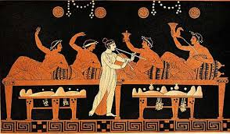
Connected right to joy and happiness is the name:
Ilaria: derives from the Greek term ίλαρος that means “hilarious”.

Slide 9
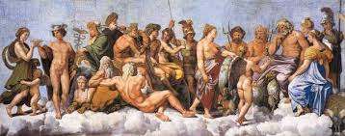
Greek mithology has had an enormous influence on the culture, the arts, literature and western culture and her heritage is still alive in its languages and its cultures. The gods are also the most important figures in the mithology.

Slide 10
The names of our theacher and some of our classmates refer precisely to this:
Selena: derives from the Greek Σελήνη that literally means “moon”.
Gaia: derives from the Greek noun Γῆ “earth”.
Elena: derives from the Greek έλένη, “torch” and means “shining light”, “the bright one”.
Ettore: derives from the Greek έκτωρ which is based in turn from the verb έχω: “to have” and means “that stands firm”.

Slide 11
Angelo: derives from the Greek term άγγελος: “angel or messanger”.
Agnese: it’s a female given name, which derives from the Greek term ἁγνός meaning “pure” or “holy”. The name passed to Italian as Agnese.
Barbara: derives from the Greek noun βάρβαρος meaning “foreign”.

Slide 12
Caterina: derives from the Greek κάθαρος meaning “pure”.
Filippo: derives from the Greek noun φιλός “friend” and ίππος “horse” so means “lovers of horses”.
Gregoria: derives from the Greek γρηγορείν meaning “to watch”. The name means “watchfull, alert”.

