Slide 1
Introducing myself!
Ilaria Panarelli

Slide 2
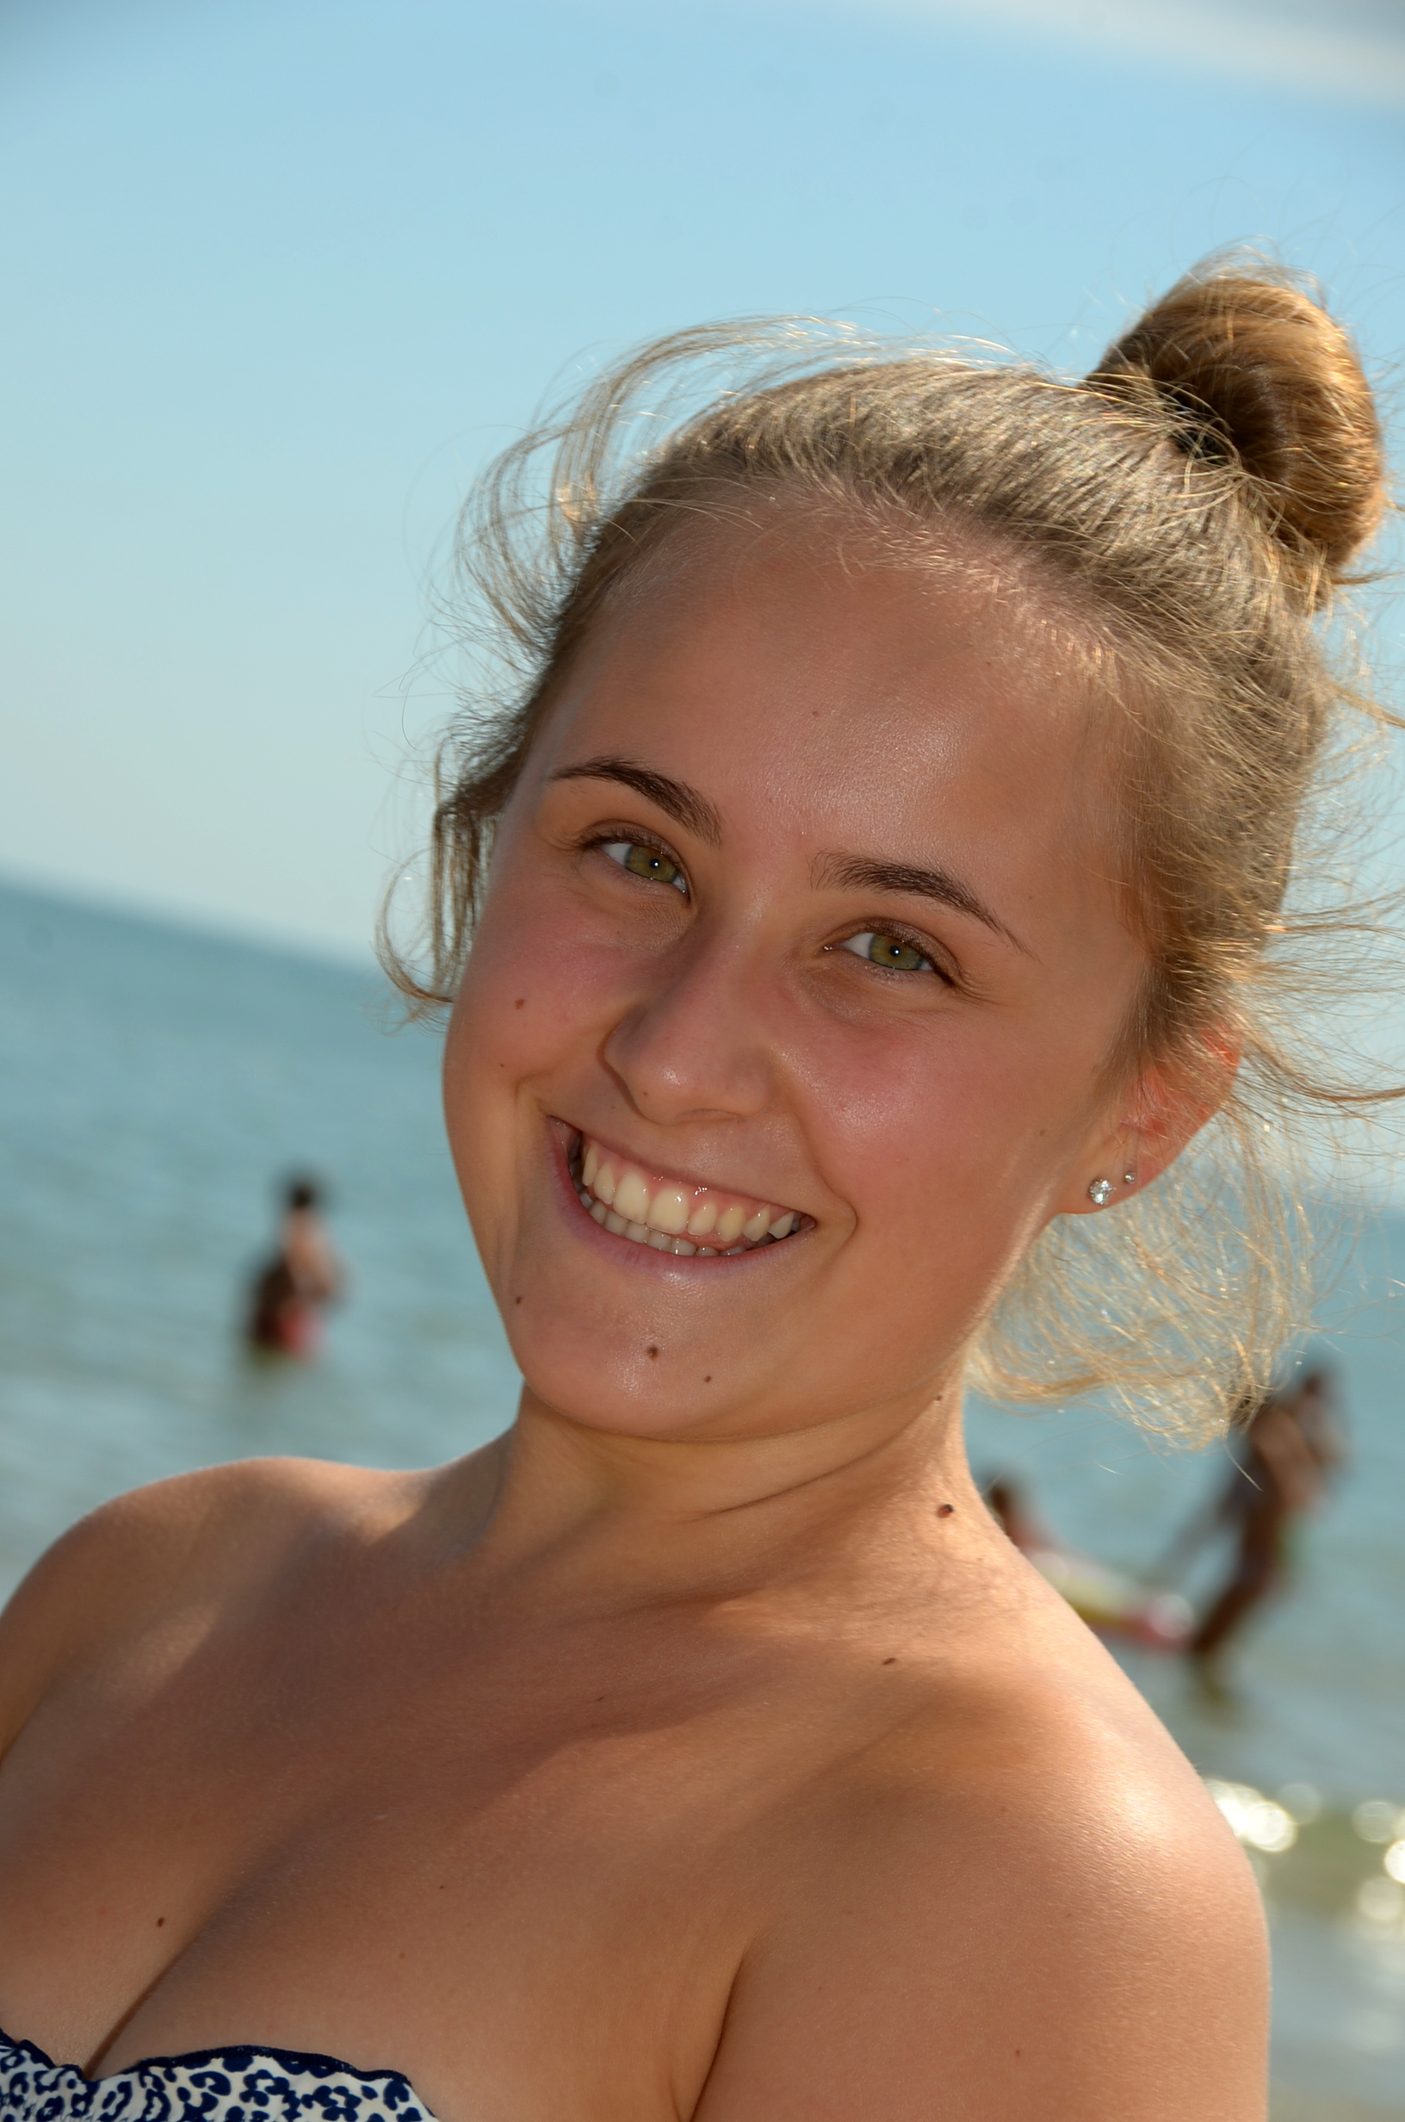
Hi!
My name is Ilaria, I’m 16 years old and I come from Gubbio, a town in the centre of Italy. I attend the third year at “Liceo Classico G. Mazzatinti”. I’m blond with green eyes, but I’m not very tall!

Slide 3
My school!
I live near my school so every day I go there on foot with my schoolmate Elisa. My favorite subjects are Maths, Latin and English. Our school is very big and there are five fields of study: Artistic, Classical, Scientific, Human Sciences and Sports.

Slide 4
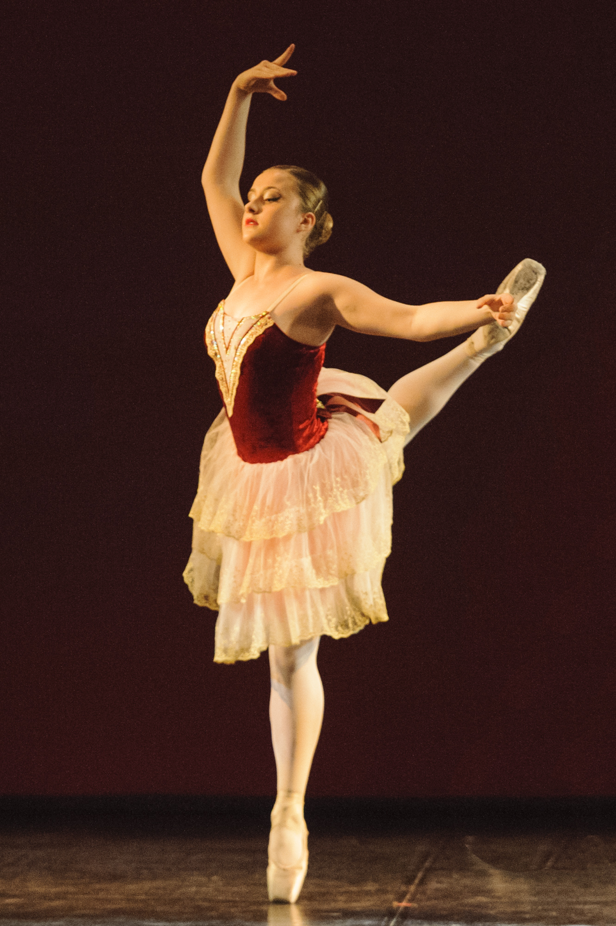
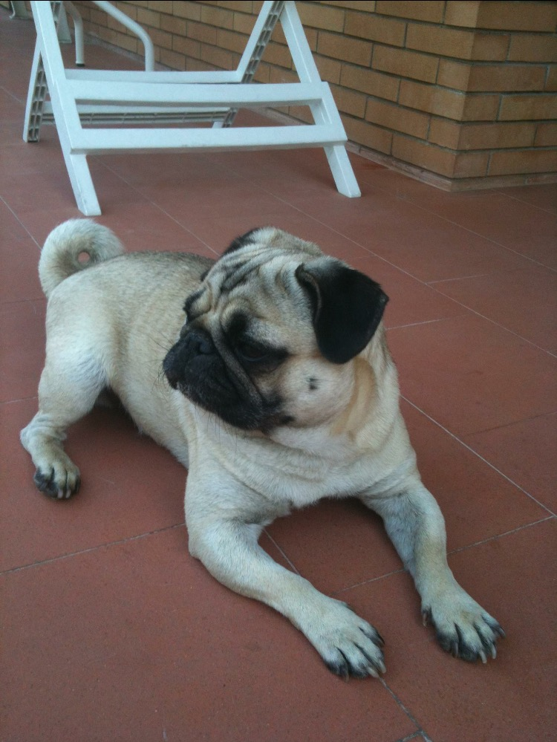
My free time!
I love cooking especially bakery! Every week I do a cake or biscuits or other types of sweets!
I did ballet for 10 years and now I swim.
I have a dog, a pug: his name is Leo, also known as Puzzi or Puzzetto.

Slide 5
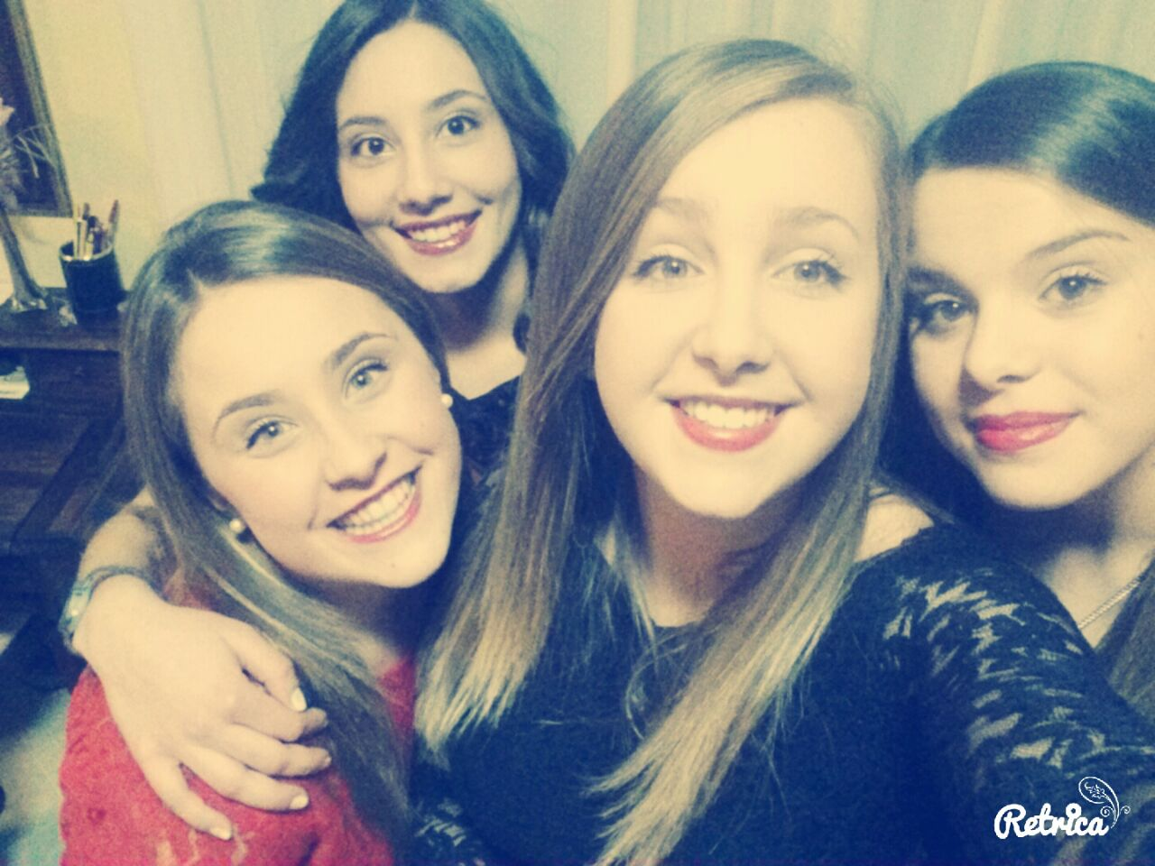
My passions!
I love going shopping and going out with my friends! I also enjoy parties! I just adore taking selfies everywhere!

