Slide 1
INTRODUCING MYSELF

Slide 2
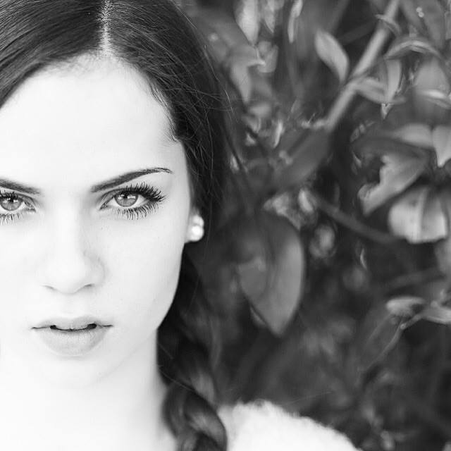
THIS IS ME!
Hi! My name is Laura and I live in Gubbio,Italy. I’m 16 years old. I have been practicising dance since 2003 and in my free time I love going out with my friends and with my boyfriend. I attend the Liceo Classico Giuseppe Mazzatinti; my favourite subjects are Art, English and Philosophy and I hate Science and Maths.

Slide 3
In my family there are four people: my brother Leonardo, my mother Cinzia, my father Franco and me. I have one dog, one cat and five horses…i love animals! My favourite type of music is pop and in my opinion the best Italian singer is Alessandra Amoroso. I love food, especially pizza, pasta, potatoes and fish.

Slide 4
I love reading books and my favourite is ‘‘The Notebook’’. I really like going to the cinema and the best film for me is ‘‘La vita è bella’’. When I stay at home I’m very relaxed. I’m tall and slim, I’ve got green eyes and long brown and curly hair like my mother. I am shy, sensitive, generous and very very romantic. I don’t like moody people!

